Slide 1
What is Pollution Prevention
Spring 2023
Laura Henne

Slide 2
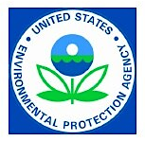
US Pollution Prevention Act 1990
Pollution prevention or source reduction is any practice which reduces the amount of any hazardous substance, pollutant, or contaminant entering any waste stream or otherwise released into the environment (including fugitive emissions) prior to recycling, treatment, or disposal

Slide 3
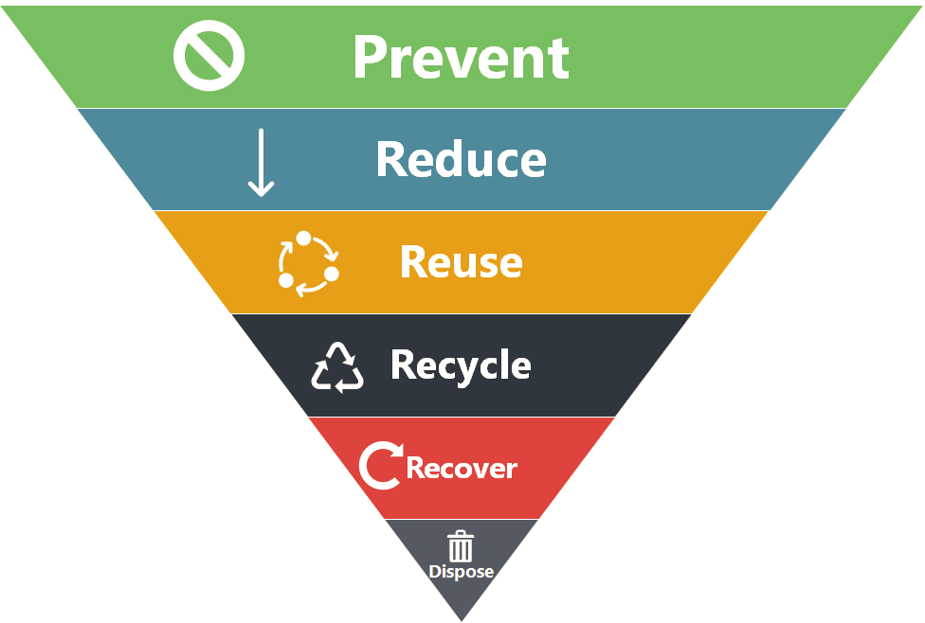
Waste Management Hierarchy

Slide 4

P2 is 2 of the Three Rs
Reduce
Reuse
Recycle (except in-process recycling!)

Slide 5
Polling Question #1
Read the activity below and select the part of the environmental management hierarchy that corresponds to it.
A company uses a scrubber to treat an acid waste stream that is released as part of the production process.
  Pollution Prevention
  Out-of-process Recycling
  Treatment/Control
  Disposal
  None of the Above

Slide 6
Three Pillars of Sustainability
Social
Economic
Environmental

Slide 7
APPLICABLE ACTS
New Jersey Worker and Community Right to Know Act (1983)
  N.J.S.A. 34:5A-1.1 et seq.
New Jersey Pollution Prevention Act (1991)
  N.J.S.A. 13:1D-35 et seq.

Slide 8
REQUIRED REPORTS/DOCUMENTS
Pollution Prevention Plan
  confidential plan that stays at the facility
  available for inspection by DEP
Pollution Prevention Plan Summary (DEP-113)
  submitted electronically every 5 years
Release and Pollution Prevention Report (DEQ-114 or RPPR)
  contains annual pollution prevention progress report

Slide 9
Industrial Sectors Covered
Industrial Sector | Notes
Manufacturing | Facilities engaged in the mechanical or chemical transformation of materials or substances into new products
Metal mining | Not including metal mining services, and uranium, radium, and vanadium ores
Coal mining | Not including coal mining services
Electrical Utilities | Limited to facilities that combust coal and/or oil for the purpose of generating electricity for distribution in commerce
Treatment, Storage, and Disposal facilities | Limited to facilities regulated under the Resource Conservation and Recovery Act, Subtitle C, 42 U.S.C. Section 6921 et seq.
Solvent recovery services | Limited to facilities primarily engaged in solvent recovery services on a contract or free basis
Chemical distributors | Facilities engaged in the wholesale distribution of chemicals and allied products
Petroleum bulk terminals | Facilities engaged in the wholesale distribution of crude petroleum and petroleum products from bulk liquid storage facilities

Slide 10



Section 313 Chemicals (Non-PBT) & Thresholds
A facility meeting the first two applicability criteria for reporting must file a TRI Report for a non-PBT Section 313 chemical if the facility:
Manufactured (including imported) more than 25,000 lbs of the chemical in the reporting year, or
Processed more than 25,000 lbs of the chemical in the reporting year, or
Otherwise used more than 10,000 lbs of the chemical in the reporting year

Slide 11
PBT Chemicals & Thresholds
PBT chemicals are subject to separate and lower thresholds (see 40 CFR 372.28)
100 lbs/yr (manufactured, processed, or otherwise used)
  Aldrin
  Lead*
  Lead compds.
  Methoxychlor
  Pendimethalin
  Polycyclic Aromatic compds.
  Tetrabromobisphenol A
  Trifluralin
10 lbs/yr (manufactured, processed, or otherwise used)
  Chlordane
  Heptachlor
  Mercury
  Toxaphene
  Isodrin
  PCBs
  Benzo(g, h, i)perylene
  Hexachlorobenzene
  Mercury cmpds.
  Octachlorostyrene
  Pentachlorobenzene
0.1 g/yr (manufactured, processed, or otherwise used)
  Dioxin & Dioxin-like compounds
* Excluding lead in stainless steel, brass, or bronze alloys

Slide 12
Per and Polyfluoroalkyl Substances (PFAS) Chemicals and Thresholds
The National Defense Authorization Act (NDAA) for fiscal year 2020 added 172 PFAS to the list of chemicals covered by TRI.
Reporting Year 2021 and 2022 each had 4 additional PFAS added to the TRI List.
Reporting Year 2023 will add 9 more PFAS substances.
The de minimis level for Perfluorooctanoic acid (PFOA) (CASRN: 335-67-1) is 0.1%. All other PFAS additions have a de minimis level of 1%.
The NDAA establishes TRI manufacturing, processing, and otherwise use reporting thresholds of 100 pounds for each of the listed PFAS.

Slide 13
Going Beyond TRI
NJ Release and Pollution Prevention Report (RPPR)
Materials Accounting / Mass Balance (“Chemical Use”)
  Balance within ± 5% margin of error
Account for the fate of all chemical use for the reporting year

Slide 14
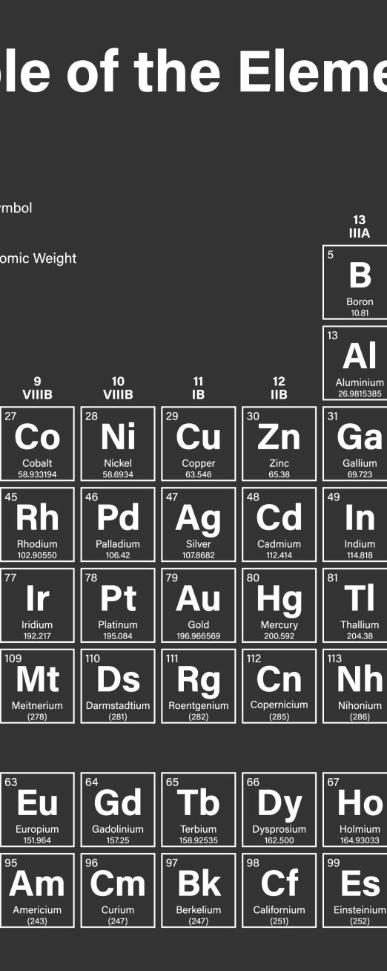
RPPR Purpose & Goal
Track the use and fate of toxic chemicals
Balance of Inputs and Outputs
Calculate NonProduct Output (NPO)
  Aka production-related waste
Calculate chemical “use”
  Shipped as (or in) product + consumed + NPO
NPO per use is a measure of efficiency!

Slide 15
What is Pollution Prevention?
Input substitution
Product reformulation
Production process modification
In-process recycling
Improved operation and maintenance

Slide 16
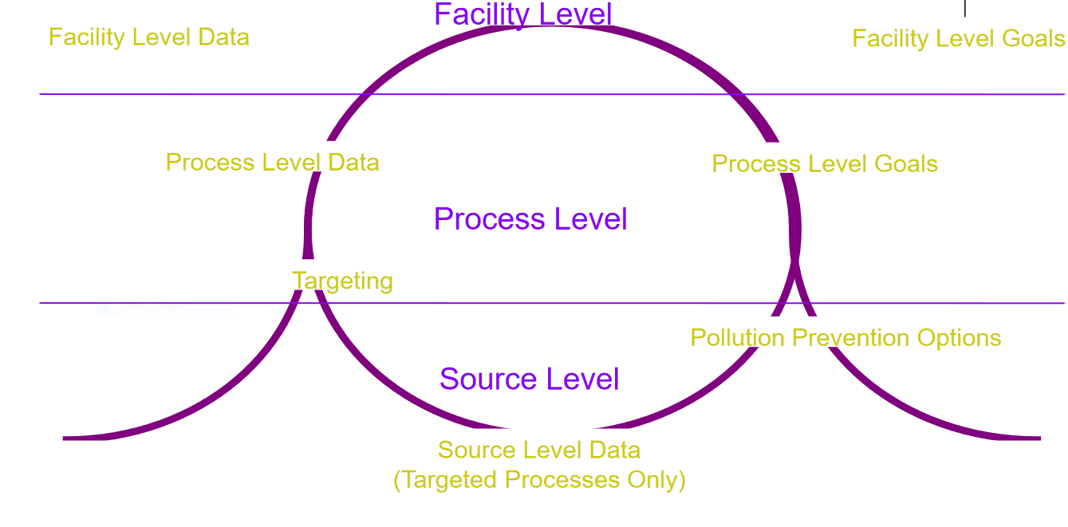
Overview of P2 Planning Process

Slide 17
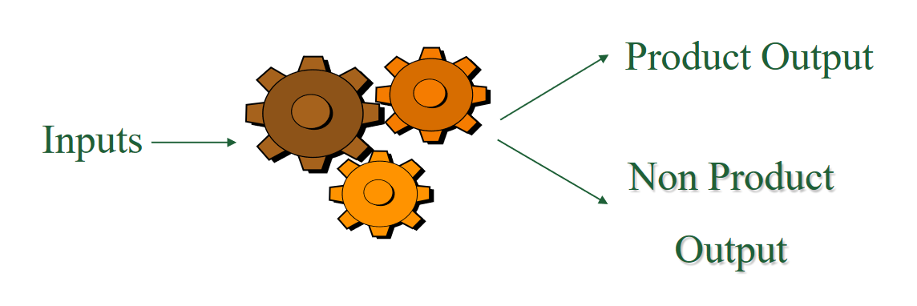
Nonproduct Output Definition
(see N.J.A.C. 7:1K-1.5)
Nonproduct Output (NPO) means all hazardous substances or hazardous wastes that are generated prior to storage, out-of-process recycling, treatment, control, or disposal, and that are not intended for use as a product

Slide 18
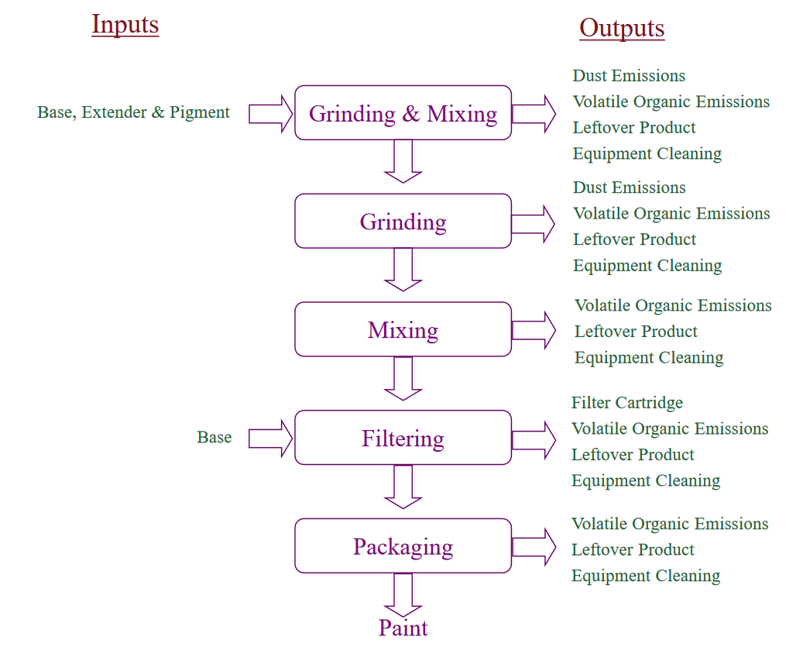
Process Flow Diagram
(process flow diagram for a paint formulation process)

Slide 19
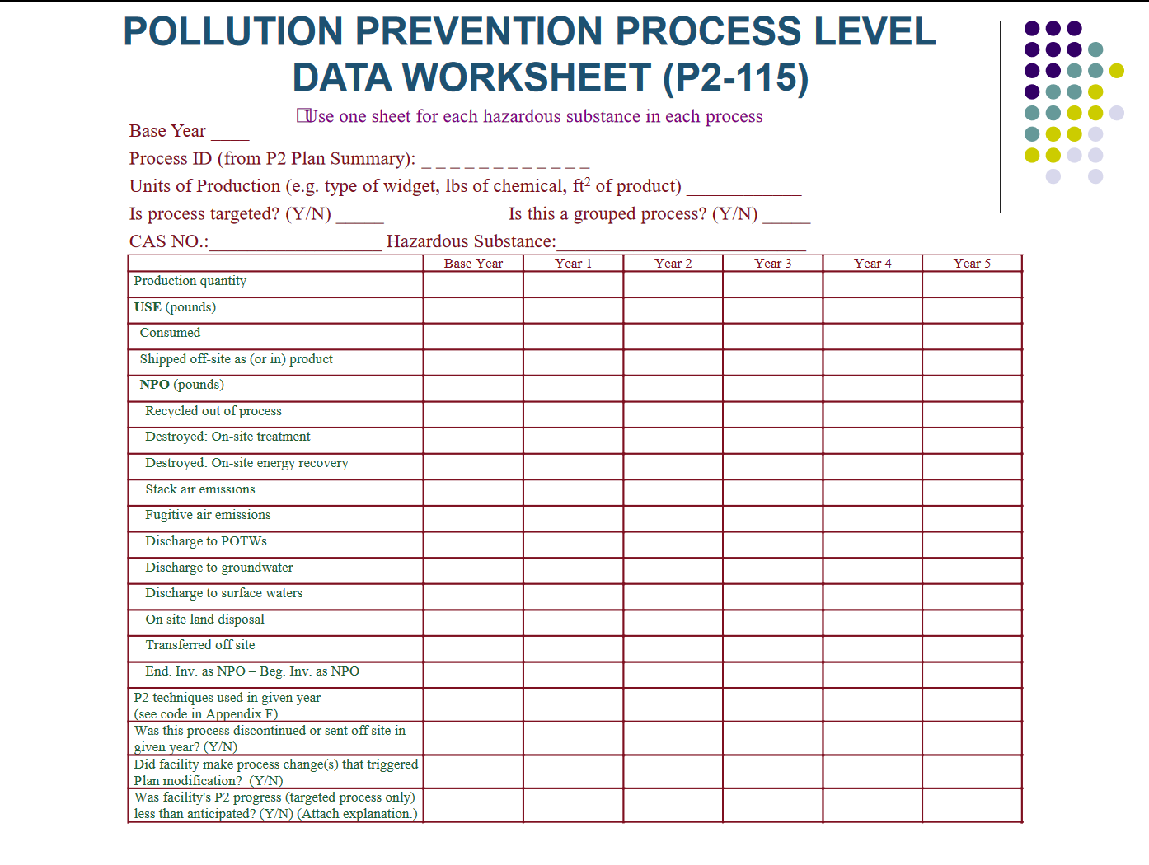

Slide 20
Cost Data
Storage & handling
Monitoring, tracking, & reporting
Treatment
Transportation & disposal
Manifest & labeling
Permit fees
Liability insurance
Health & safety compliance
Raw material costs

Slide 21

Part II of a Pollution Prevention Plan
Identify specific pollution prevention methods
  Analyze methods the facility intends to adopt
  Set personalized five-year pollution prevention goals

Slide 22

What is a Source?
A source is the point in the process where NPO leaves the production process
  Water discharges prior to treatment
  Waste generation prior to treatment
  Air emissions prior to treatment

Slide 23
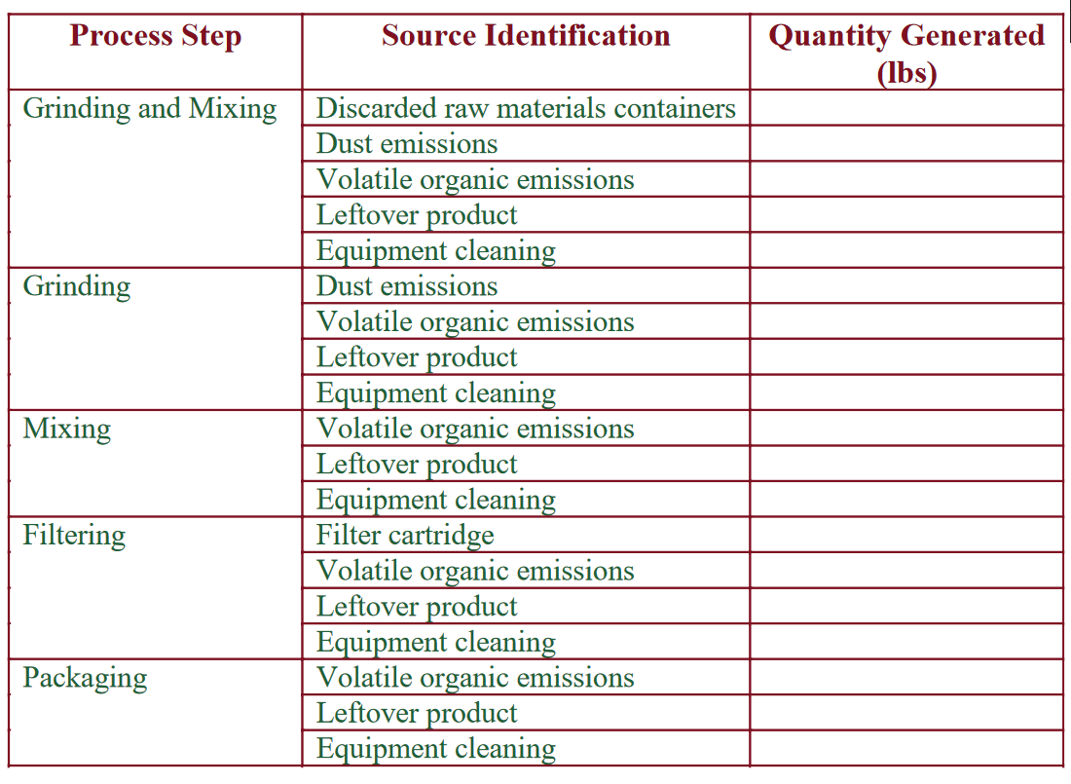
Example Source-Level NPO
(based on example process flow diagram)

Slide 24

Identifying Pollution Prevention Options
Identify options that reduce the use and generation of NPO of hazardous substances

Slide 25
Feasibility of Option Analysis
Technical analysis
Financial analysis
  Storage & handling
  Monitoring, tracking, reporting
  Treatment
  Transportation & disposal
  Manifest & labeling
  Permit fees
  Liability insurance
  Health & safety compliance
  Raw material costs
Impact on releases to air, water & waste
Rationale for not implementing options

Slide 26
Reasons for Pollution Prevention
Save money: reduces the use and release of hazardous substances and is more cost effective than pollution control
Make your business more competitive: increases efficiency in the use of raw materials, energy, & water
Avoid regulatory requirements: eliminates or recues waste otherwise requiring treatment/disposal and reduces paperwork/costs
Reduce exposure to workers & consumers
Benefit the environment

Slide 27
Office of Pollution Prevention
Supports materials accounting practices throughout NJ to help reduce the amount of potentially harmful substances
Performs the following functions/services:
  Captures information regarding the use and disposal of hazardous substances
  Provides resources that encourage good materials handling
  Investigates complaints and notifications of unauthorized activities
  Conducts inspections
  Issues enforcement documents (formal & informal) which may included penalties

Slide 28


Slide 29
Polling Question #2
Read the activity below and select the part of the environmental management hierarchy that corresponds to it.
A company buys and uses a drum crushing device to reduce the volume of waste generated.
  Pollution Prevention
  Out-of-process Recycling
  Treatment/Control
  Disposal
  None of the Above

Slide 30
Introduction to P2 Planning
(Steps 1-3)

Slide 31
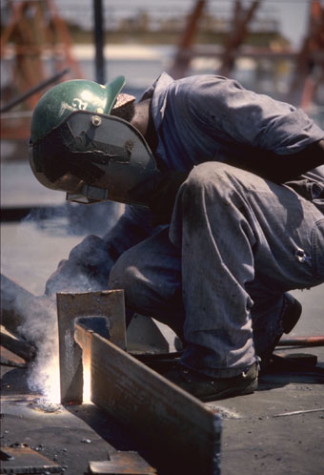
Introduction to P2 Planning
Threshold Triggers
Definitions
Policy Statements
Leadership

Slide 32

Covered Facilities
Regulated Under Federal Emergency Planning & Community Right to Know Act (a.k.a. Toxics Release Inventory or SARA Title III, Section 313)
and
Have A DEP Permit (Water, Air or Waste)
Ability to Expand Over Time

Slide 33

Covered Substances
SARA Title III, Section 313 TRI Chemicals
Currently Approximately 775 Hazardous Substances and 33 Chemical Categories
NJ List Expands with EPA List
Hazardous Waste

Slide 34
Understand Pollution
Prevention
What is Pollution Prevention?
What is NOT Pollution Prevention?
What is Nonproduct Output(NPO)?
What is a Source of NPO?
What Constitutes In-process Recycling?
What is a Product?

Slide 35
What is Pollution Prevention?
Input Substitution
Product Reformulation
Production Process Modification
In-Process Recycling
Improved Operation & Maintenance

Slide 36
What is NOT Pollution Prevention?
Treatment Systems
Control Systems
Substituting One Hazardous Substance for Another Hazardous Substance
Shifting Risks from One Media to Another Media
Out-of-Process Recycling

Slide 37
NPO vs. Releases
Surface Water
Discharge
Fugitive
Release
Permitted Air
Release
Water
Treatment
Untreated
Air
Air Treatment
Wastewater
POTW
Discharge
Untreated
Air
In-Process
Recycling
Input
Off-site
Incineration
Process
Solid or
Haz Waste
Generated
Input
Nonproduct Output
On-site
Landfilling
Releases
Input
Treatment Systems
Product
Conventional
Inputs/Outputs

Slide 38
In-process Recycling
Returning Hazardous Substances to Production Process(es)
Dedicated Equipment
Directly Connected
Physically Integrated
Reduces Nonproduct Output or Multi-media Release

Slide 39
In-process Recycling Example
Cleaning
Solvent
REACTOR
Storage
Accumulation
Tank
Recovery
Multiple Batches
Still
Bottoms
Air Emissions
POTW Discharge

Slide 40
Products
Planned Result
Used as a Commodity in Trade by the General Public
More than one Product per Process
Intermediate Products (Site Limited)

Slide 41
Establish a Pollution
Prevention Policy
Corporate Commitment to Pollution Prevention
Employee Involvement and Incentives
Commitment to Progress
Accountability
Coordination With Other Policies
  Energy Conservation
  Water Conservation
Certify That It Is Corporate Policy to Achieve Goals of the Pollution Prevention Plan

Slide 42

Provide Senior Leadership
& Staff a Team
Commitment From Senior Management
Disciplines to Consider
  Environmental
  Production
  Finance and Accounting
  Sales and Marketing
  Research and Development
Other Employee Involvement
  Incentives
  Ideas
  Implementation

Slide 43
Polling Question #3
Read the activity below and select the part of the environmental management hierarchy that corresponds to it.
A chemical manufacturer institutes a leak detection and repair initiative.
  Pollution Prevention
  Out-of-process Recycling
  Treatment/Control
  Disposal
  None of the Above

Slide 44
Polling Question #4
Now, identify the type of pollution prevention that is being used.
A chemical manufacturer institutes a leak detection and repair initiative.
  Input Substitution
  Product Reformulation
  Production Process Modification
  In-process Recycling
  Housekeeping

Slide 45
P2 Plan: Part 1
(Steps 4-7)

Slide 46

Identify and Group Production Processes
Facilities Identify Their Processes
What Equipment, Activities or Techniques are Used?
Identify Number of Unit Operations or Steps
Future Reporting Based on How Processes Identified Now
Notes:
Ken, do you want us to identify the “step number”?

Slide 47
Group Similar Processes
Grouping is Optional
Reduces Number of Individual Analyses
Consolidates - Does Not Eliminate
Considered a Single Process for All Future Planning and Reporting

Slide 48
Grouping Criteria
Function of Raw Material
Function of Equipment
Similar Ingredients
Similar Products
Other Criteria Developed by Facility

Slide 49
Grouping Examples
Facility With Several Machines that Print or Coat Wallpaper
  Good Grouping: Machines Function in the Same Fashion with Similar Efficiency.
  Bad Grouping: Grouping Similar Machines with Different Operating Specifications
Facility Uses Several Different Hazardous Substances (Cleaning vs. Pigment Carrier)
  Good Grouping: Several Different Solvent Mixtures used as a Pigment Carrier
  Bad Grouping: Same Solvent(s) Used to Clean Machinery and Used as a Pigment Carrier

Slide 50
Identify Units of Product
Ex 1: You coat paper; use “square feet coated” rather than “pounds of paper.”
Ex 2: You use solvent to clean machinery; use pounds of solvent per “widget produced”
Ex 3: You produce both solvent and latex paint; these are separate products; track Use and NPO per unit of production separately.
Develop a unit of product that reflects the way the material is used
Notes:
Some Facilities have Data Systems that Track Quantities of Products
May include batch sheets, formulations
Use this Data for Process Level Materials Accounting

Slide 51

Units of Product Example
Company Makes 2 types of coated paper
  Product A has 2 coatings
  Product B has 6 coatings
Process is continuous line system: paper is alternately dipped, then dried
Company measures and sells product by the pound of paper
Price per pound of products A & B is equal
Material use and production time for Product B is 3 times greater
By examining material use and relating use to unit of product, company realized it needed to adjust its pricing decision

Slide 52
Identifying Processes & Sources
SOURCES
Delivery
& Storage
Spills/Leaks
Fugitive Emissions
Spills/Leaks
Fugitive Emissions
Leftover Material
Cleaning Material
P
R
O
C
E
S
S
Blending
Filtering
Filter Cartridge
Fugitive Emissions
Leftover Product
Cleaning Material
Packaging
Fugitive Emissions
Leftover Material
Cleaning Material
Off-spec Product
PRODUCT

Slide 53
Identify Sources of Nonproduct Output
Points Where Nonproduct is Generated
NOT Releases from Treatment Systems
⭐️ Facility Walkthrough is Helpful
No Quantities Required for Part I Planning

Slide 54
Facility Level
Facility Level Data
Facility Level Goals
Process Level Data
Process Level Goals
Process Level
Targeting
Pollution Prevention Options
Source Level
Source Level Data
(Targeted Processes Only)
Notes:
Start at Facility Level, Then Move Down to Process Level, Then to Sources. At this point you’ll be ready for Part II of the Plan.

Slide 55
Facility Level Data
NJ Release and Pollution Prevention Report (RPPR or DEQ-114)
Find General Balance between Inputs and Outputs
Chemical Specific
Determine Quantities Recycled
Record Quantities Released
Calculate Quantities Used (Throughput)
  * Inputs - Ending Inventory
  * Consumed + Shipped + NPO

Slide 56
Facility Level Material Balance
INPUTS
OUTPUTS
Ending
Inventory
Starting
Inventory
Manufactured
Consumed
in a Reaction
Brought
On-Site
Shipped
in/as Product
Recycled
Out-of-Process
Non
Product
Output
Notes:
Materials Accounting Method: Find General Balance Between Inputs & Outputs

Slide 57
USE Equation Derivation
INPUTS
OUTPUTS
Starting Inventory
+
Brought On-Site
+
Manufactured
+
Recycled Out of Process
Consumed
+
Shipped as/in Product
+
NPO
+
Ending Inventory
=
Subtract Ending Inventory from other side of equation to get USE amount.
USE = INPUTS - Ending Inventory
USE = Consumed + Shipped as/in Product + NPO
OR

Slide 58
Process Level Data
P2-115
Find General balance Between Inputs and Outputs
Chemical Specific
Calculate Quantities Used (Throughput)
  * Inputs - Ending Inventory
  * Consumed + Shipped + NPO
Record Quantities Released
Determine Quantities Recycled

Slide 59
Process Level Material Balance
INPUTS
OUTPUTS
Starting Inventory
Ending
Inventory
Consumed
in a Reaction
Manufactured
Brought
On-Site
Shipped
in/as Product
Recycled
Out-of-Process
Non
Product
Output
Notes:
Estimates and Best Engineering Judgment
Quantities
- Contained in Products
- Consumed
- Used
- Generated as NPO
- Released from each Production Process
- Recycled outside of each Production Process

Slide 60
Hazardous Waste Data
⭐️ Required to Assess all Hazardous Wastes at the Facility, not just TRI-listed Chemicals
Inclusion of RCRA Hazardous Waste Biennial Report may be Sufficient for Facility-level Data
Associate Hazardous Waste with Process that Generated It

Slide 61

Cost Analysis
Storage & Handling (Includes Safety & Health Compliance)
Monitoring, Tracking & Reporting
Treatment
Transportation & Disposal
Manifesting & Labeling
Permit Fees
Liability Insurance
Material Costs
Notes:
Analyze Total Costs of Hazardous Substance Use and Generation
Why is there an asterisk after Material Costs?

Slide 62
Target Priority Processes
Focus resources before:
  Estimating Source-Level NPO
  Developing Pollution Prevention Options
  Generating Reduction Goals
Targeting Criteria
  Combination of Processes Accounting for 90% or More of the:
    Use,
    Nonproduct Output, OR
    Releases from the Total of All Hazardous Substances

Slide 63
Targeting Example- NPO

Slide 64
Polling Question #5
Read the activity below and select the part of the environmental management hierarchy that corresponds to it.
A large warehouse instituted a new policy whereby all new purchases of chemicals are put in the back row of storage. The warehouse operators are instructed to use the oldest material first.
  Pollution Prevention
  Out-of-process Recycling
  Treatment/Control
  Disposal
  None of the Above

Slide 65
Polling Question #6
Now, identify the type of pollution prevention that is being used.
A large warehouse instituted a new policy whereby all new purchases of chemicals are put in the back row of storage. The warehouse operators are instructed to use the oldest material first.
  Input Substitution
  Product Reformulation
  Production Process Modification
  In-process Recycling
  Housekeeping

Slide 66
Finding Options & Setting Goals
(Steps 8-9)

Slide 67
Finding Options & Setting Goals
Quantify Source Level NPO
(only for targeted processes and sources)
01
Identify P2 Options
02
Set Reduction Goals
03
Notes:
Part II of the P2 Plan.
N.J.A.C. 7:1K- 4.5

Slide 68
Facility Level Data
(inputs & outputs)
Process Level Data
(inputs & outputs)
Source Level NPO
(targeted processes)
Air
Haz
Waste
Water
[ RPPR ]
[ P2-115 ]
Notes:
Quantify Source Level NPO.
Done for Targeted Process & Sources.
Required by N.J.A.C. 7:1K- 4.5 (a) 2

Slide 69
Three Process Steps
1. Delivery & Storage
2. Blending
3. Packaging
PRODUCT

Slide 70
Source: Point in a process where NPO leaves the process
Control
Device
HVAC system to Control Device
Hood
Hood
Blending
Tank
Raw Material
Raw Material
(Blending)
(Product Storage & Shipping)
(Packaging)
(Delivery & Storage)

Slide 71
Identify each Source of NPO
Control
Device
HVAC system to Control Device
Hood
Hood
Air
Air
Blending
Tank
Hazardous Waste
Raw Material
Air
Raw Material
(Floor sweepings)
Liquid waste
(Floor Drain)
To POTW

Slide 72
List NPO Sources
SOURCES
Delivery
& Storage
Fugitive Emissions
Spills/Leaks
P
R
O
C
E
S
S
Fugitive Emissions
Spills/Leaks
Floor Sweepings
Residual Material left in Tank
Cleaning Waste
Blending
Packaging
Fugitive Emissions
Spills/Leaks
Cleaning Waste
Off-spec Product
PRODUCT
Notes:
List all of your Sources.

Slide 73
Quantify NPO
SOURCES
Pounds
Delivery
& Storage
Fugitive Emissions
Spills/Leaks
30 lbs. MIBK
20 lbs. MIBK
P
R
O
C
E
S
S
Fugitive Emissions
Spills/Leaks
Floor Sweepings
Residual Material left in Tank
Cleaning Waste
70 lbs. MIBK
Blending
10 lbs. MIBK
10 lbs. Chromium Oxide
20 lbs MIBK / 40 lbs Cr3O2
160 lbs toluene
Packaging
Fugitive Emissions
Spills/Leaks
Cleaning Waste
Off-spec Product
5 lbs. MIBK
25 lbs MIBK / 15 lbs Cr3O2
160 lbs toluene
5 lbs MIBK / 3 lbs Cr3O2
PRODUCT
Notes:
Estimate the Quantify of NPO from each Source.
Required by N.J.A.C. 7:1K- 4.5 (a) 2

Slide 74

Use Source Level Data:
Find where NPO is Generated
Find P2 Options
Notes:
(Read the Slide)

Slide 75
Finding P2 Options
Brainstorming
NJ Technical Assistance Program (NJME)
  (732) 445-8289
EPA Literature & databases
www.newmoa.org/prevention
Focus on Sources & Processes
  Identified in Part I of your plan
  Quantified in Part II of your plan
Document All Options
Notes:
More on NJTAP this afternoon.
Document ALL Options
you don’t have to institute them - just write them down.

Slide 76

General P2 Methods
Good Operating Practices
Improve Maintenance & Recordkeeping
Change Production Schedules
  minimizes equipment & feedstock changeovers
Notes:
Management approaches
Do not require equipment changes.

Slide 77

Spill & Leak Prevention
Improve Storage Procedures
Implement Inspection/Monitoring Programs
Install:
  Overflow Alarms
  Automatic Shutoff Valves
  Vapor Recovery Systems

Slide 78
Process Modifications
Institute Recirculation within a Process
Modify Equipment Layout or Piping
Use a Different Catalyst
Notes:
Usually Require Equipment Modifications.

Slide 79
Inventory Control
Use raw materials before their shelf life expires
Ship products before they expire
Notes:
More Management Approaches.

Slide 80
After Identifying Options,
Conduct a Feasibility Analysis
Technical Analysis
Financial Analysis

Slide 81

Technical Analysis
Is the option Technically Feasible?
  How will it impact product?
  What equipment will be needed?
  Will it have an impact on Health & Safety Issues?
  Will permit modifications be needed?

Slide 82

Financial Analysis
Is the option Economically Feasible?
  Do we have the capital?
  How long will it take to recover the investment?
  Will this change have an impact on production?

Slide 83
Estimating Costs/Savings
Part I Cost Part II Cost or Savings
Part 1 Cost
Estimate costs of using hazardous substances:
$ 1,000 Storage & Handling
$ 1,500 Safety & Health Compliance
$ 600 Monitoring, Tracking & Reporting
$ 1,200 Transportation & Disposal
$ 200 Manifesting & Labeling
$ 400 Permit Fees
$ 1,000 Liability Insurance
$ 100 Other Costs
___________________
$ 6,000 Total
Part 2 Cost or Savings
Estimate the Costs or Savings of implementing each option:
$ 1,000 Storage & Handling
$ 0 Safety & Health Compliance
$ 0 Monitoring, Tracking & Reporting
$ 500 Transportation & Disposal
$ 0 Manifesting & Labeling
$ 500 Permit Fees
$ 0 Liability Insurance
$ 100 Other Costs
___________________
$ 2,100 Total
Total Savings = $ 3,900
Notes:
Option = Substitution for non-hazardous chemical.
Storage = Stays the same.
S&H = Zero
Monitoring/Tracking/ Reporting = Zero
Manifesting = Zero
Liability = Zero
Transportation & Disposal = Reduced (but still have some cost).
Permit Fees = Increased (DEP modifications)
Savings = $ 3,900

Slide 84

After Conducting the Feasibility Analysis Select Options that are both:
Technically Feasible
Financially Feasible
Notes:
Option not Technically Feasible
You don’t need a Financial analysis.
Option not Technically & Financially Feasible
you don’t have to implement it.
No options HAVE TO be Implemented.

Slide 85
Select P2 Options & then
Develop Numerical Goals for:
Use Reductions
NPO Reductions
Notes:
Goals set for each Hazardous Substance.

Slide 86
Develop Implementation Schedule & Consider:
Fiscal Constraints
Time Constraints
Notes:
Timing: Option: Cost:
Immediate Shift Changes $ 0.0
Short Range Repair leaks Cheap
Mid-Range Employee Training $
Long Range Equipment Upgrade $$$$
[ Required by N.J.A.C. 7:1K- 4.5 (a) 11 ]

Slide 87
Set Use & NPO Goals for:
Process Level
Facility Level
Notes:
Required by N.J.A.C. 7:1K- 4.5 (a) 7-10

Slide 88
Process Level Goals
Use Technical Analysis to estimate reductions
5-Year Goals
Goals indexed to the “Unit of Production”
Notes:
Projected over 5-years
Unit of production will separate
P2 Changes from Production Changes.

Slide 89

Facility Level Goals
Goals for each Hazardous Substance
5-Year Use & NPO Goals
Goals Expressed in Two Ways:
  Pounds
  Percent
Notes:
Base Year to 5th Year.
Goals Expressed in:
Pounds
Percent
Process Level does not add to Facility level
Facility based on Cumulative Process Reduction
but
Process level reduction “per unit of Product”

Slide 90
Reporting
Plan Summary (DEP-113)
RPPR (DEQ-114)
Notes:
Fu’s Presentation.

Slide 91
Polling Question #7
Read the activity below and select the part of the environmental management hierarchy that corresponds to it.
A surface coating company installs a distillation unit to recover spent solvents from their coating lines. The material is moved to the distillation area in 55-gallon drums.
  Pollution Prevention
  Out-of-process Recycling
  Treatment/Control
  Disposal
  None of the Above

Slide 92
Electronic Reporting: A & B
(Steps 10-11)

Slide 93
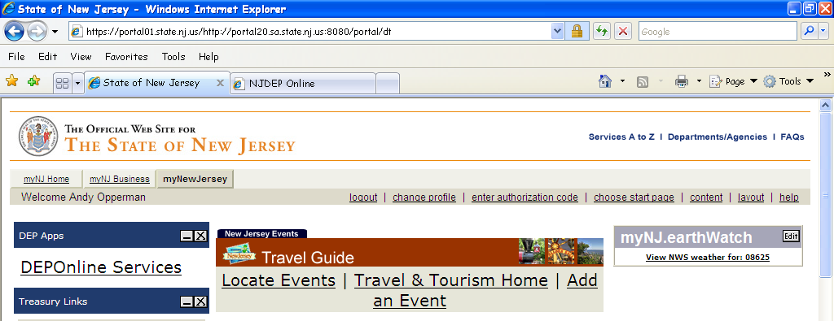
Submission is by Internet-based Electronic Reporting
For eReporting you will need a “myNewJersey” account with access to DEPOnline Services

Slide 94
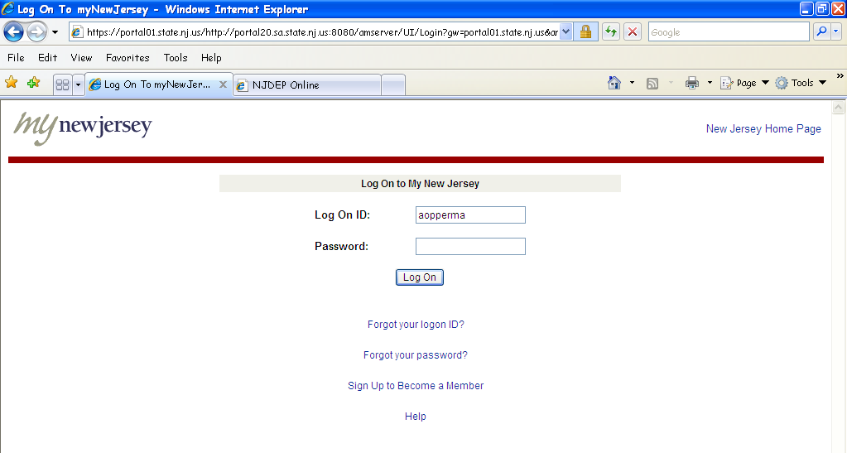
eReporting Log On
To get to myNewJersey you need to have a Log On ID and Password

Slide 95
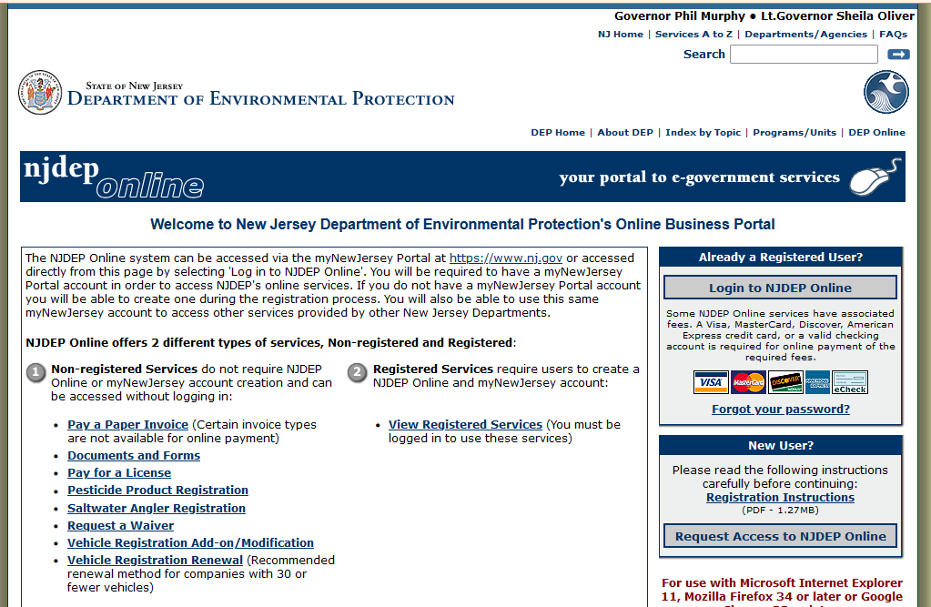
Get a myNewJersey Log On ID & Password
To get a myNewJersey Log On ID
and Password …
Create an account with www.njdeponline.com

Slide 96
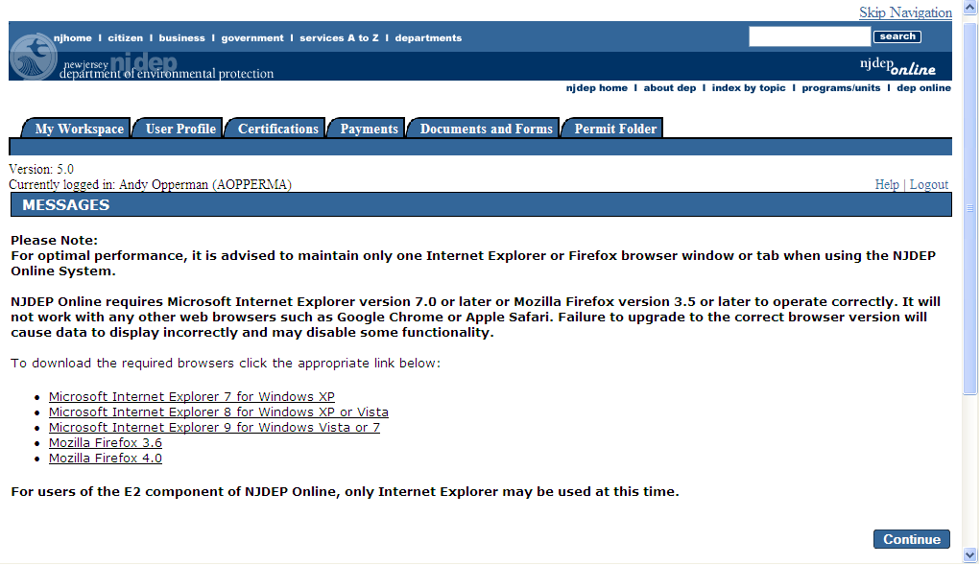
Entering the Portal
After logging in, select “DEP Online Services,” and then click on the “Continue” button as shown here

Slide 97
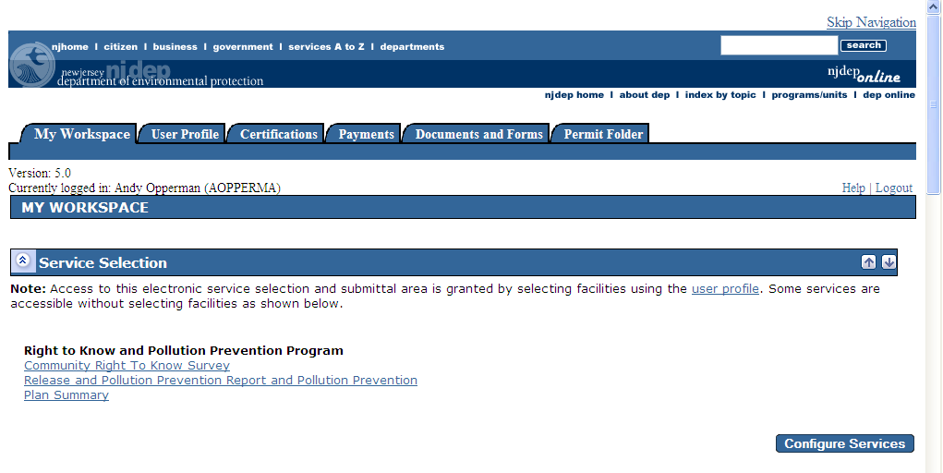
RPPR & P2 Plan Summary Access
If RPPR & P2 Plan Summary are not in your Service Selection, you will need to “Configure Services”

Slide 98
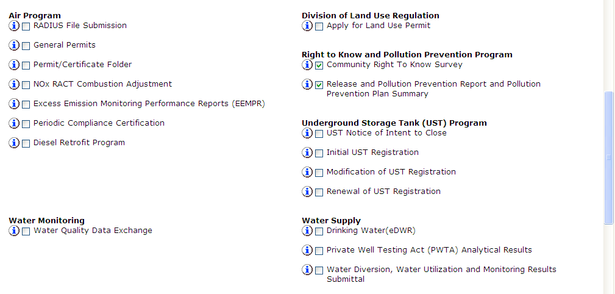

Configuring Services
You may need to configure your services by adding “RPPR & P2 Plan Summary”

Slide 99
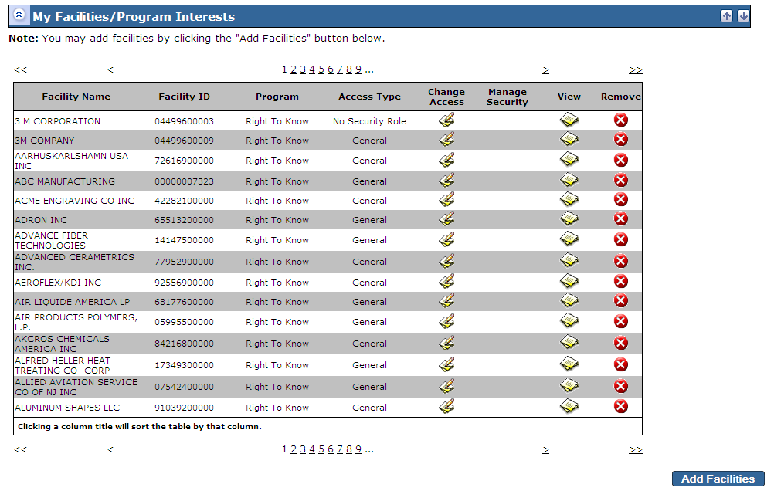
Add Facilities
This section is in the My Workspace tab following “Service Selection”
Facility
Names
& FACID
Numbers
have been
masked

Slide 100
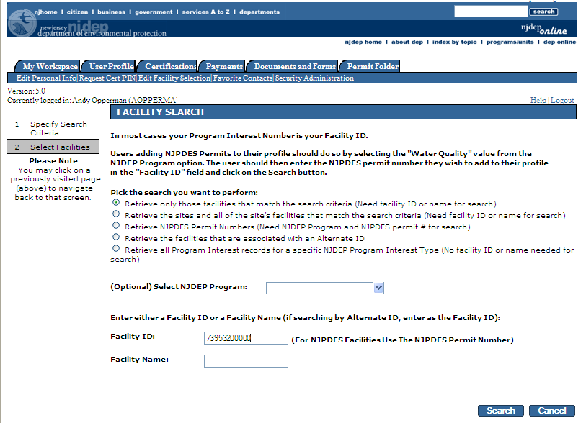
Facility Search
Enter your facility’s CRTK Facility ID (FACID) number & click Search

Slide 101
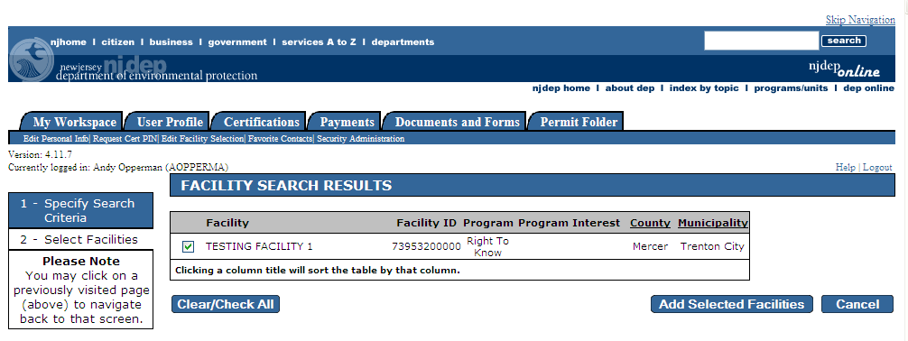
Add Selected Facilities
“Add Selected Facilities” screen …
Select your facility using the check box and “Add Selected Facilities”

Slide 102
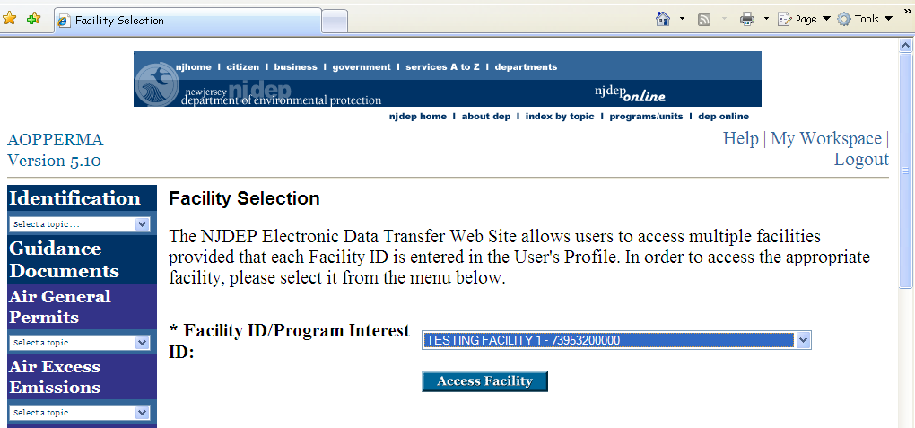
Facility Selection

Slide 103
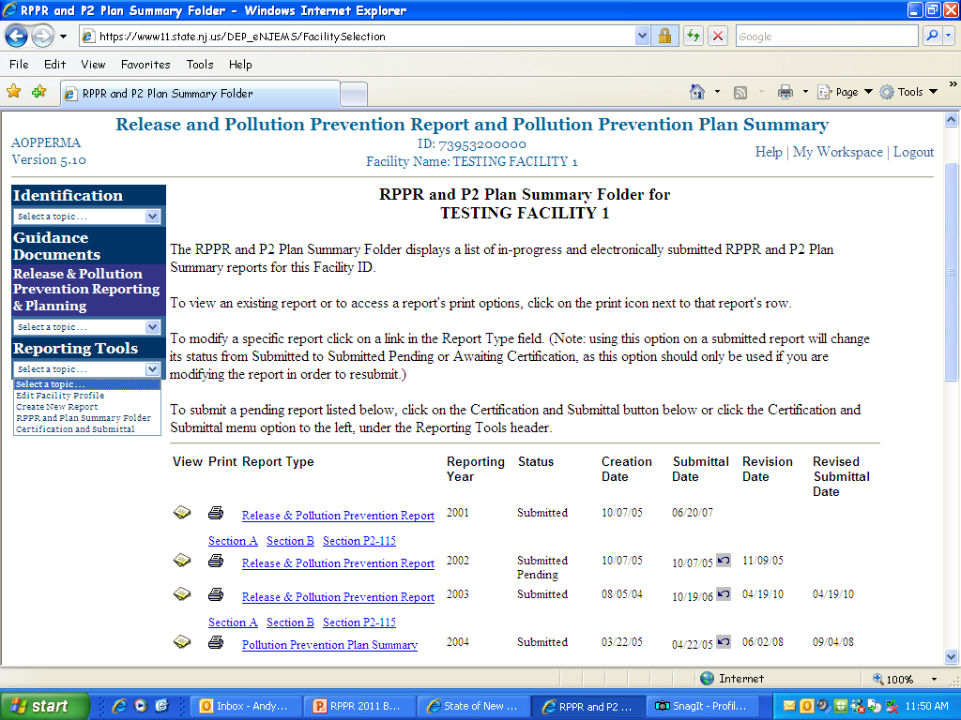
RPPR & P2 Plan Summary Folder
Your “RPPR & P2 Plan Summary Folder”

Slide 104
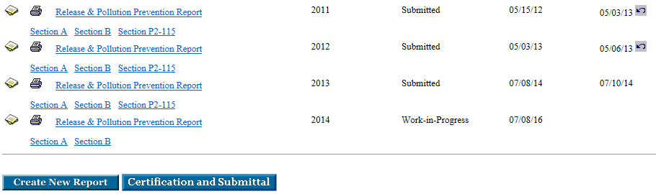
Folder
“Folder” includes Two Important Buttons
2018
19
19
2019
20
20
2020
21
21
2021
22
When you are ready to submit the report, click the “Certification and Submittal” button
To create the RPPR, click the “Create New Report” button

Slide 105
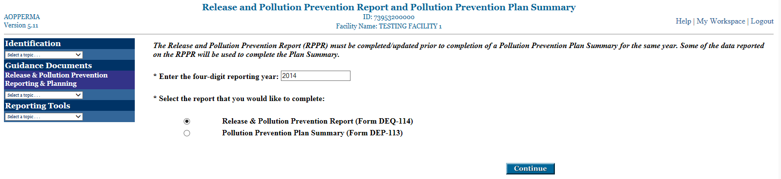
Create a New Report
Enter reporting year “2022” and select the radio button for the RPPR
2022

Slide 106
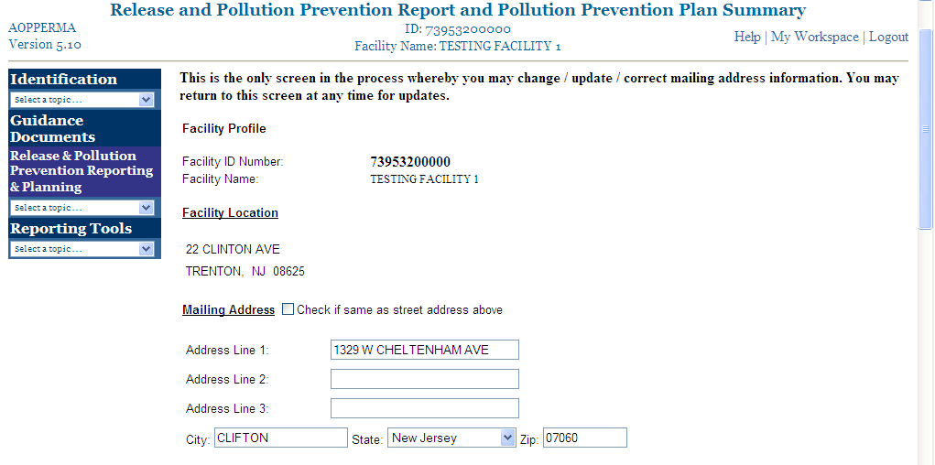
Ignore this Screen
(Click continue at bottom)
This text does not apply to our program for the Release and
Pollution Prevention
Report (RPPR)

Slide 107
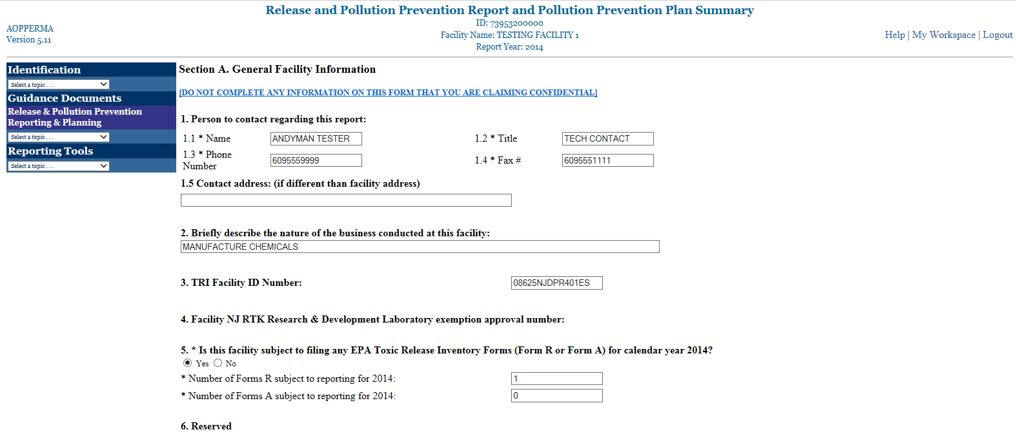
RPPR has 5 Different Sections
Section A. General Facility Information
Section A. General Facility Information
2022
2022
2022

Slide 108
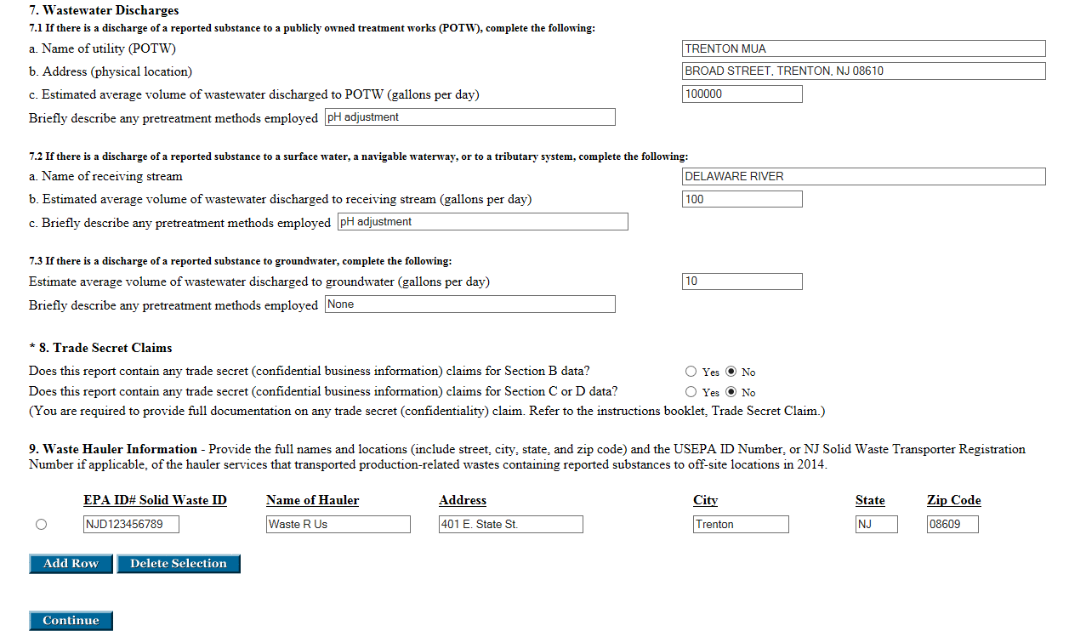
2022

Slide 109
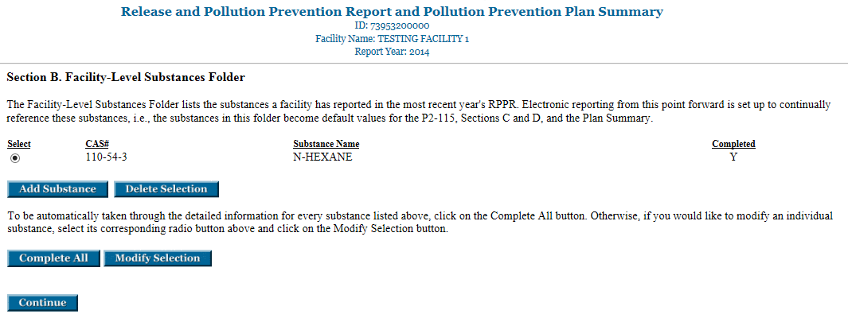
RPPR
Section B. Facility-Level Substances Folder
2022

Slide 110
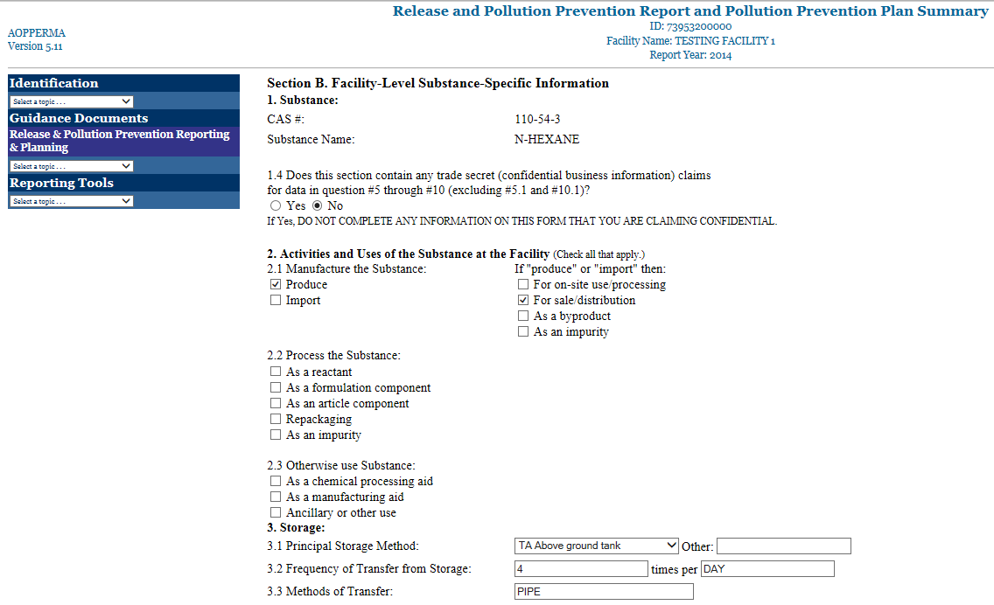
RPPR
Section B. Facility-Level Substance-Specific Information
2022

Slide 111
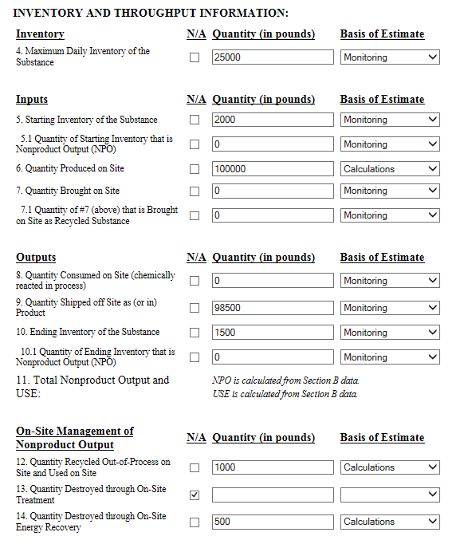

Slide 112
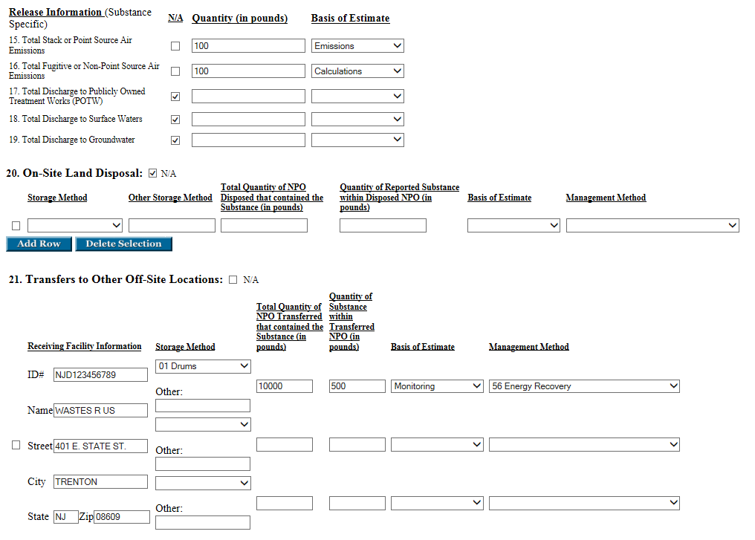

Slide 113
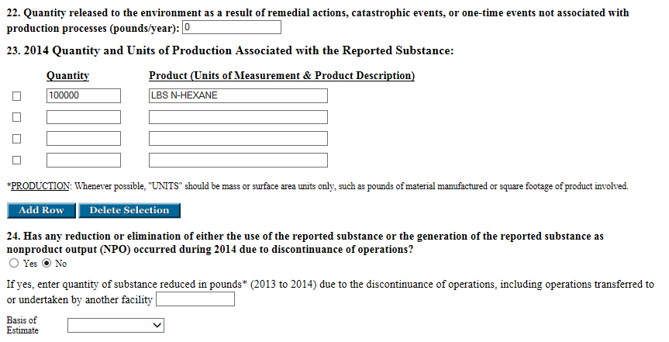
2022
2022
2021 to 2022

Slide 114
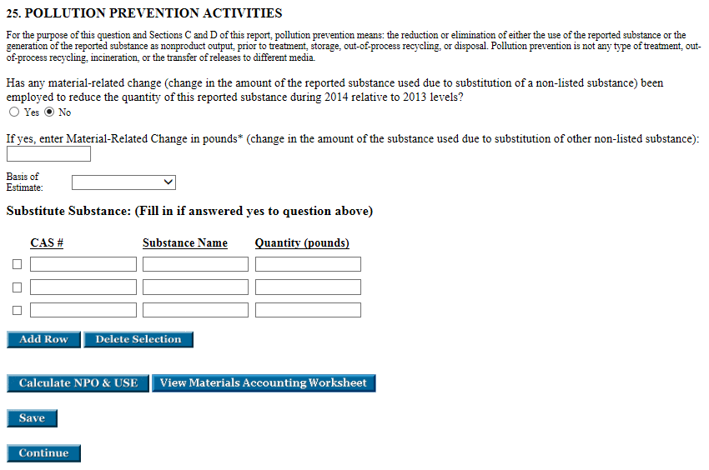
2022
2021

Slide 115
RPPR Data Elements for Materials Accounting
Starting inventory of substance (at the beginning of the year)
Quantity produced on site
Quantity brought on site
Quantity consumed on site (chemically reacted in processes)
  NOT metals!
Quantity shipped off site as (or in) product
  e.g. mixtures, metals, metal compounds
Ending inventory of substance (at the end of the year, in all forms)
Total Nonproduct Output (NPO)
  All releases, on-site waste management and all off-site transfers - that are not product

Slide 116
Release and Pollution Prevention Report
Self Verification of Materials Accounting Data Worksheet
(All Quantities Must Be Reported In Pounds except for Dioxin and Dioxin-Like Compounds Reported in Grams)
FAC_ID: CAS#: Substance:
Inputs Outputs
5. Starting Inventory 8. Quantity Consumed
(chemically altered)
6. Quantity Produced 9. Quantity Shipped Off Site
On Site as (or in) Product
7. Quantity Brought 10. Ending Inventory
On Site
12. Quantity Recycled 12. Quantity Recycled Out-of ________________
Out-of Process & Process & Re-Used on Site
Re-Used on Site
13. Quantity Destroyed through On-Site Treatment
14. Quantity Destroyed through On-Site Energy Recovery
15. Stack Air Emissions 16. Fugitive Air Emissions 17. Discharge to POTWs 18. Discharge to Surface Waters 19. Discharge to Groundwaters 20. On-Site Land Disposal ________________
21. Other Off-Site Transfers _________________
Sum of Inputs: ≈ Sum of Outputs: _______________
Notes:
Required by N.J.A.C. 7:1K- 4.5 (a) 7-10

Slide 117
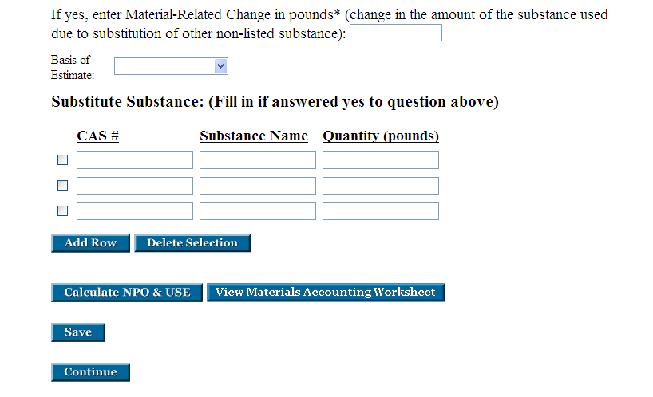
End of Section B
(Important Buttons)

Slide 118
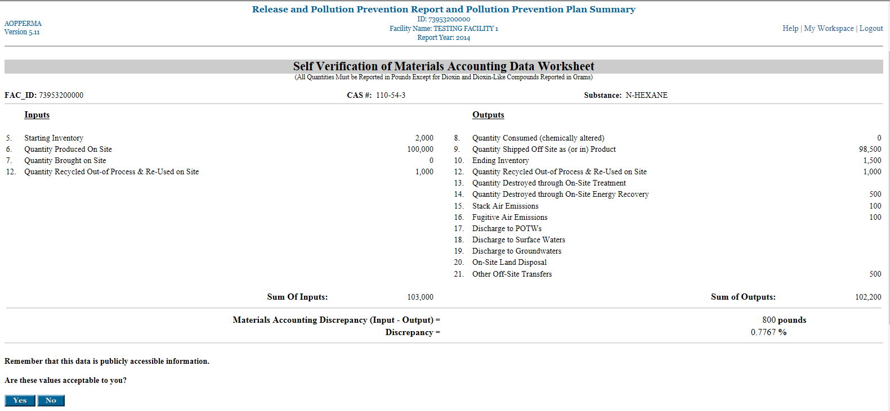
2022
The materials accounting must balance within five percent (± 5%). In theory, Inputs should equal Outputs. In reality, best estimates prevail.

Slide 119
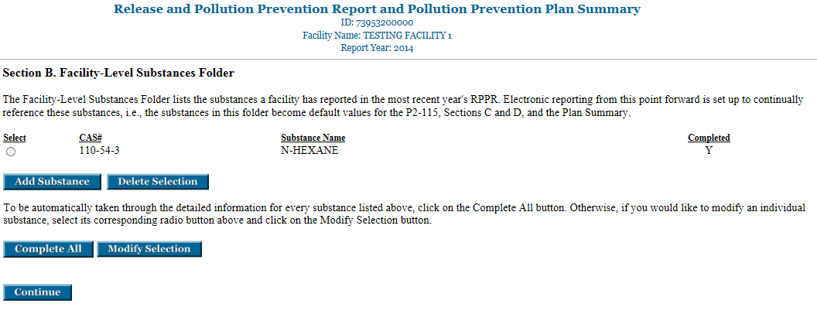
RPPR
Section B. Facility-Level Substances Folder - complete
2022

Slide 120
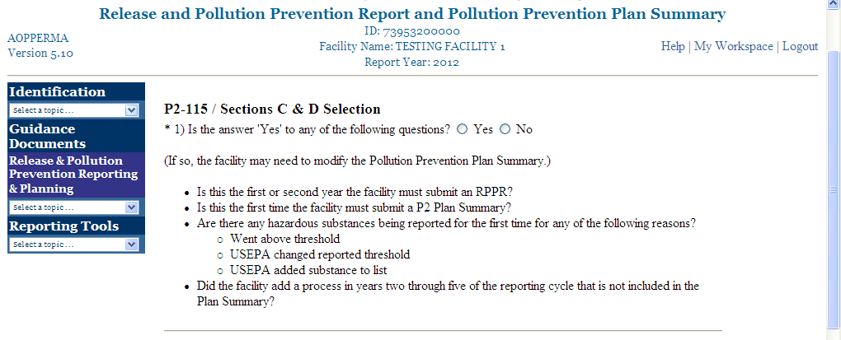
RPPR
P2-115 / Sections C & D Selection screen
2022
P2-115 process-level data worksheet is the recommended approach for P2 Progress Reporting because they are required to be in your P2 Plan!

Slide 121
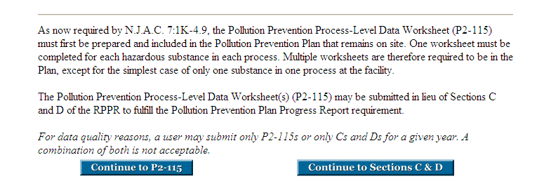
RPPR
P2-115 / Sections C & D Selection screen (continued)

Slide 122
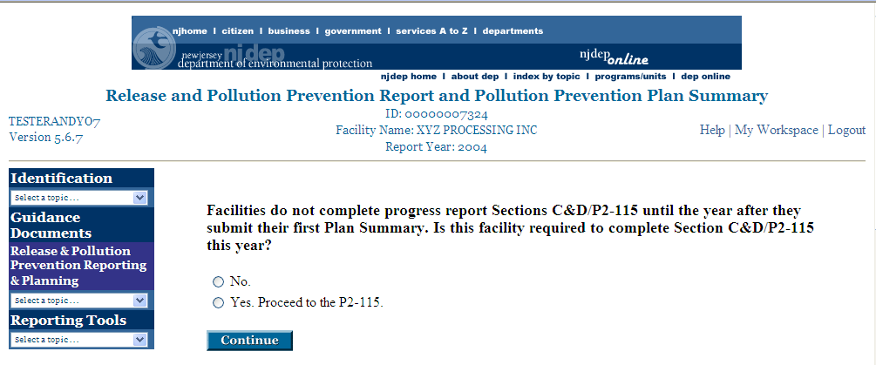
P2 Progress Reporting
2022
If you are in Report Year 1 or Report Year 2 of reporting, you will select “No.”

Slide 123
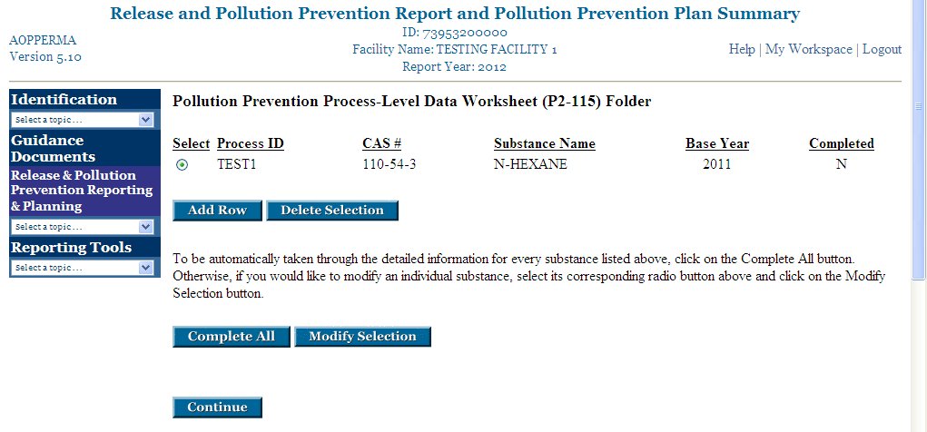
RPPR
P2-115 Folder - Select Process
2022
2021

Slide 124
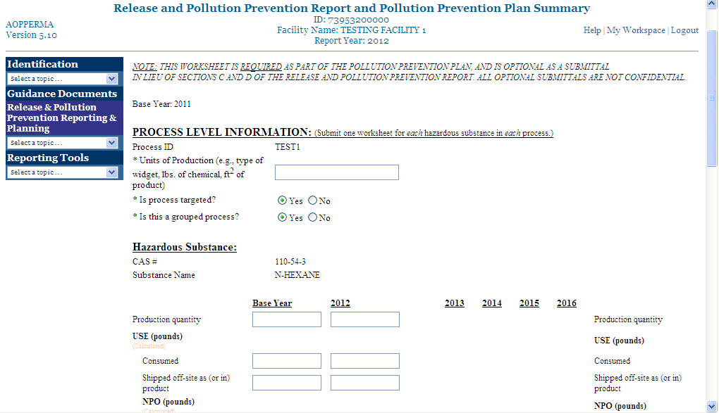
RPPR
P2-115 Process Level Information screen
2022
2021
Fill in data for 2021 & 2022 completely & “Continue”
2023
2025
2026
2022
2024

Slide 125
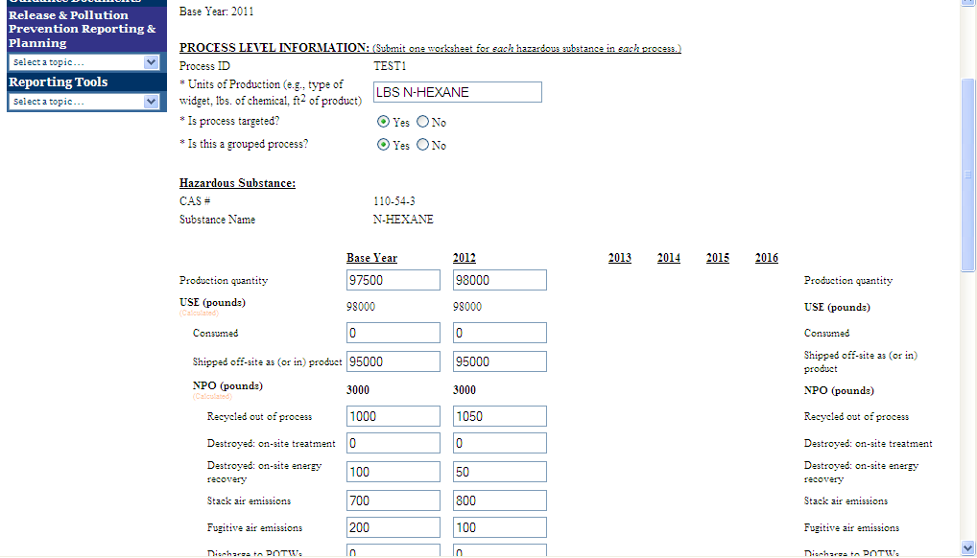
RPPR
P2-115 Process Level Information screen
2021
Data filled in for
Base Year and Current Year
2022
2023
2024
2025
2026

Slide 126
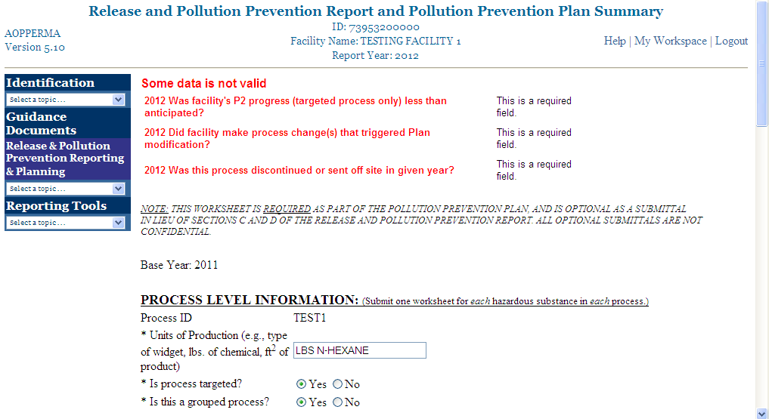
RPPR
P2-115 Process Level Information screen
2022
2022
2022
2022
2021
Sample error
messages

Slide 127
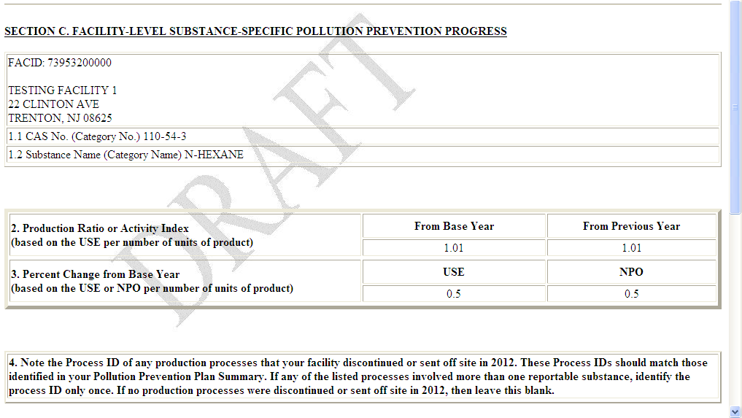
RPPR
Section C. Facility-Level Substance-Specific P2 Progress
Prepared Section C
from P2-115 data
2022
2022

Slide 128
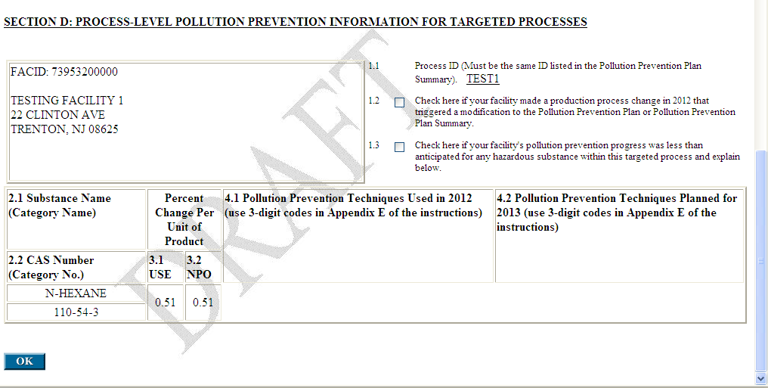
RPPR
Section D. Process-Level P2 Info for Targeted Processes
2022
2022
2023
Prepared Section D
from P2-115 data
Completing the P2-115 worksheet prepares Sections C & D for you.
Review your P2 progress and then click on the “OK” button.

Slide 129
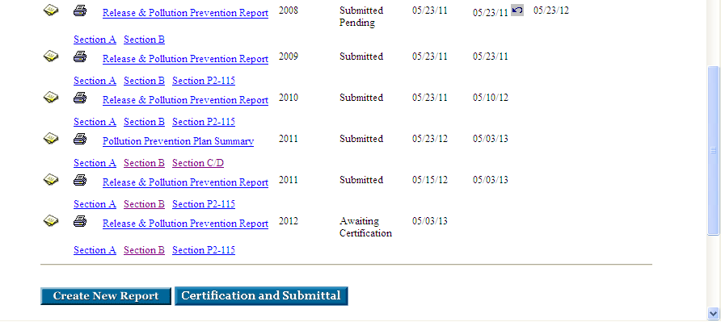
RPPR is now complete and “Awaiting Certification” & Submittal
2018
05/23/19 05/23/19
2019
05/23/20 05/10/20
2020
05/23/21 05/03/21
2021
05/15/22 05/03/22
2022
05/03/23

Slide 130
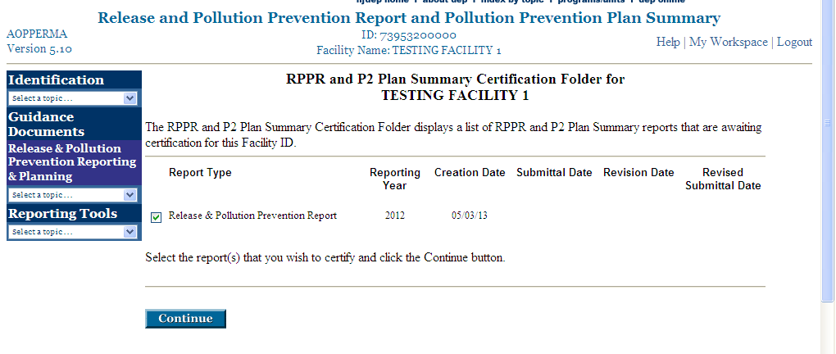
Certification and Submittal
2022
05/03/23

Slide 131
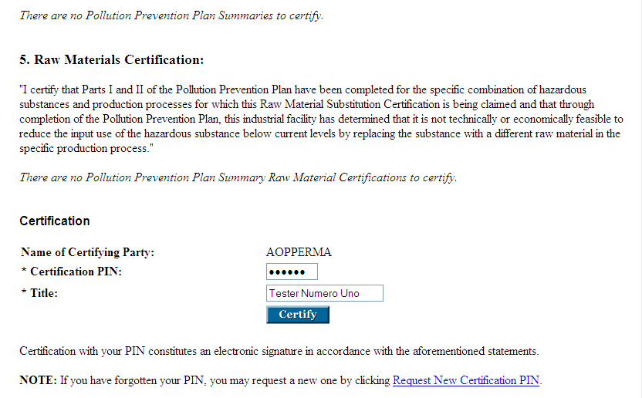
Certification and Submittal
Click on Forgot PIN button (not shown)

Slide 132
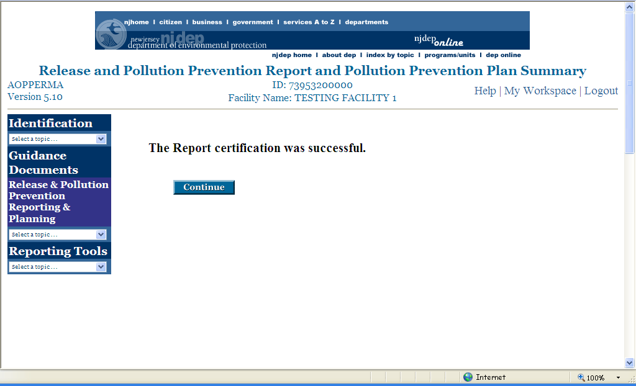
Certification was Successful!
This is your only notification!
However, the report “Status” changes from “Awaiting Certification” to “Submitted.”

Slide 133
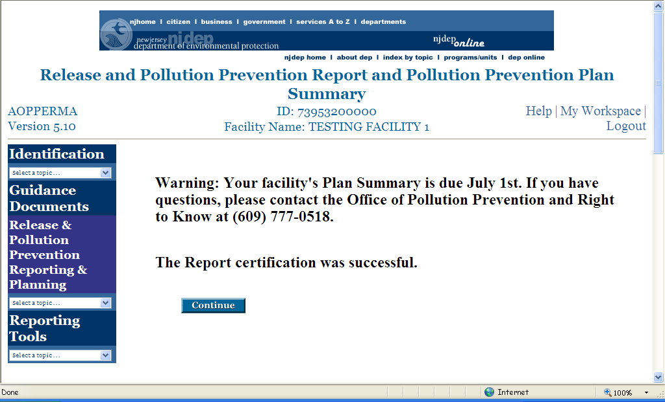
Certification was Successful!
This is your only notification!
Notice to any facility that has a Pollution Prevention Plan & Plan Summary due.

Slide 134
Common Reporting Errors
Metals & metal compounds are NOT “Produced” nor “Consumed”
When reporting a Metal compound category, report quantities of the parent metal only, not the entire compound
Metals have no Btu value and, therefore, are not to be reported as “Energy Recovery” on-site or off-site
Do not attempt to report materials accounting data in any manner other than quantified numbers; e.g. EPA TRI range codes of A, B or C; “1-10” pounds; “< 10” pounds; using scientific notation; etc.
  These are not possible with e-reporting

Slide 135
Common Reporting Errors
Applying & reporting any unit of measurement other than pounds to materials accounting data
  note: see “Dioxins” - reported in grams
Double counting of “Consumed” & “Shipped as (or in) Product”
Double counting of “Shipped as (or in) Product” & “Transferred Off-Site” (as nonproduct output)
Double counting of “POTW Discharges” & “Transferred Off-Site”
Exercise due diligence!! Electronic reporting (eReports) will provide edit checks and error notices, thereby eliminating most errors!

Slide 136
Benefits of the RPPR & P2 Plan Summary
Built-in warnings and error flags to assist you and to provide higher quality data; better data quality reduces the possibility of follow-up inquiries from the DEP.
Instant assessment of materials accounting data and materials balance (via the Materials Accounting Worksheet).
Pre-population of many data elements from the previous year’s report (once you have first created an e-document).
Automatic queuing of RPPR or P2 Plan Summary sections - you can not proceed to the next section before completing the current section - keeps you organized in preparing your report.
User has increased availability of e-documents (once submitted, the system will retain prior years’ documents) - valuable for reference as well as for revisions if necessary.

Slide 140
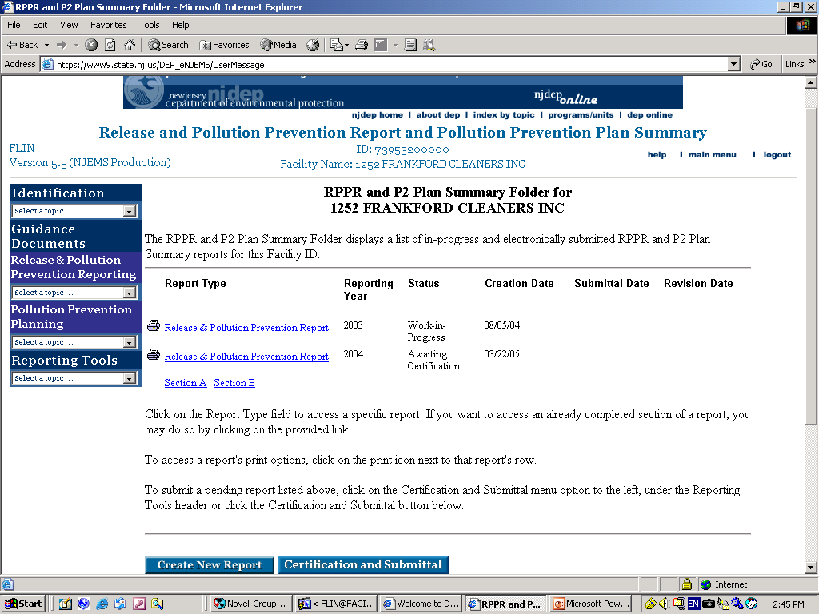
2021
05/23/22
2012
5/20/2013
2022
05/03/23

Slide 141
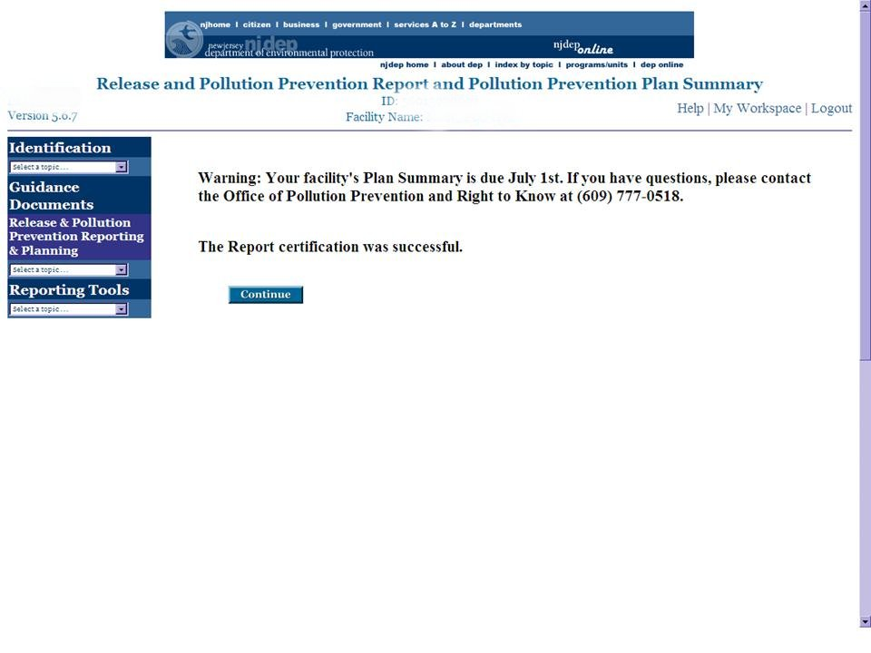
Pay Attention to this “Warning”. If you saw this that means your New or Renewal Pollution Plan Summary is due by July 1st.

Slide 142

You must first complete the 2022 RPPR before you create the Plan Summary. To proceed, click “Create New Report.”
2021
05/23/21 05/23/21
2022
05/03/22 05/03/22
2012
5/15/2013
5/20/2013

Slide 143

Type in the year, 2022, select the report type, and click “Continue.”
2022

Slide 144

You must complete all fields with an asterisk(*) before proceeding to Section B of the Plan Summary.

Slide 145

Pay attention to 4.a and 4.b as 4.a is to determine how many pages of Section C’s and 4.b is to determine how many Section D’s will be.
After completing Section A, click “Continue” to go to Section B.

Slide 146

When using the system for the first time, this screen will be blank. Click “Add Substance” to add the substance(s).

Slide 147

These substances populate from the RPPR Section B. You must select all of them and click “Return.”

Slide 148

Complete the facility’s five-year USE and NPO reduction goals and click “Continue.”

Slide 149

The goals are checked against the numbers reported in Section B of the RPPR for USE and NPO. In this example, there is a discrepancy with the RPPR.

Slide 150

Correct the goals and click “Continue.”

Slide 151

Note: In this example two rows were automatically created based on the answer to Question 4 of Section a. The Folder is for both Section C and D and automatically updates the status of both columns as you enter data.

Slide 152

To proceed to Sections C & D from the folder select the Process ID and click “Modify Selection.” If you select a targeted process, the system will automatically queue Section C and D for that process.
Do not use punctuation or spaces in the ID.

Slide 153

PROCESS1
To add the substances used in this process, click “Add Substance.” You will only be able to add those substances reported in Section B of the RPPR.

Slide 154

Select the substance(s) related to this process and click “Return.”

Slide 155

Check to make sure you have all the substances associated with this process.

Slide 156

2022
2011
01/2021
11/2025
01/2021
12/2025

Slide 157

2022
2022

Slide 158

Since PROCESS2 is not targeted, you will not be prompted to complete Section D.

Slide 159

This Folder shows the status of Sections C and D.

Slide 160

If the number of targeted processes is not the same as reported in Section A 4.a or 4.b, you will see this error.

Slide 161

If the mistake is in Section A, select “RPPR and Plan Summary Folder” from the “Reporting Tools” dropdown menu. Do not use the “Back” button.
If Section A 4.b is correct, change the field to “Yes”, select the radio button for the process, and click “Modify Selection.”

Slide 162


Slide 163

2022
2011
01/2021
11/2025
11/2025
11/2025

Slide 164

Once Sections C and D are completed, click “Continue” to proceed to the “RPPR and P2 Plan Summary Folder” for Certification.

Slide 165

2021
05/20/22
The P2 Plan Summary Status will change to “Awaiting Certification” and is ready for submission.
2022
05/03/23
2012
5/20/2013
2012
2022
05/20/23
5/20/2013

Slide 166
Certification and Submittal:
Click on “Certification and Submittal” or under Reporting Tools on the left tool bar.
NOTE: You may submit multiple years and report types under one submission certification.
2022
05/20/22
2022
05/03/23
2012
5/20/2013
2012
05/20/23
2022
5/20/2013

Slide 167

Certification and Submittal (continued):
Select the report(s) that you want to certify and click “Continue.”
2022 5/03/23
2022 5/03/23

Slide 168

Did you make any changes to the RPPR after completing the P2 Plan Summary? – Some data may not be valid if you did!
(Note: This is specific to a reporting year.)
Click “Certify” after reading the text.

Slide 169

2022
2022
Read and check all applicable Certification Statements.
2022
Type in Certification PIN and Title of certifying individual. Then click the “Certify” button.

Slide 170

The certification and submittal has been successful when you see this page.

Slide 171


Printing or Viewing your Report
To print (or view), click the View or Printer Icon in front of the report title.
2016
06/21/17 06/23/17
08/05/17 08/05/17
2017
06/16/18 06/17/18
06/21/18
2018
06/21/19 06/23/19
2018
04/09/19 04/10/19
05/21/19
2021
06/25/22 06/27/22
10/16/22
5/20/2013
2022
5/20/2013
2012
5/20/2013
Pollution Prevention Plan Summary
2022
2012
Submitted
5/20/2013
5/20/2013

Slide 172

You can print (or view) the entire report by clicking, “View/Print All.”
2022
To print one or more sections, check the box(es) and click “View/Print Selection.”
Note: If your report is not yet complete, error messages may appear in your printout.

Slide 173

At this point, use the standard printing options on your Internet browser. After printing, this is the one time you may use the “Back” button on your browser. You will be returned to the “View/Print Selection” window. From here you may print additional sections of the report, log out, or select any other option from the drop-down lists.
2022

Slide 174
Polling Question #8
Read the activity below and select the part of the environmental management hierarchy that corresponds to it.
A paint manufacturer reduces the amount of piping needed by moving storage tanks and mixing vessels closer together.
  Pollution Prevention
  Out-of-process Recycling
  Treatment/Control
  Disposal
  None of the Above

Slide 175
Polling Question #9
Now, identify the type of pollution prevention that is being used.
A paint manufacturer reduces the amount of piping needed by moving storage tanks and mixing vessels closer together.
  Input Substitution
  Product Reformulation
  Production Process Modification
  In-process Recycling
  Housekeeping

Slide 176
Updating
(Step 12)
Final step of Pollution Prevention Planning is to begin again!

Slide 177
What now?
Pollution prevention teams do not retire
Pollution Prevention Plans are not completed
Initial successes will provide an incentive to do more
When long-term projects succeed, resources become available to start new projects
If problems arise for one option, a stable planning structure provides a way to look for alternatives

Slide 178
Mid-cycle Updates
Part IB of your P2 Plan must be updated annually
P2-115 (process-level reporting)
Certain changes (below) may require Plan modification and Plan Summary updating (next 2 slides)
  Ceases operation of a targeted production process or significantly expands the operation of a targeted production process;
  Significantly modifies a targeted production process, unless due to implementation of pollution prevention techniques at the industrial facility;
  Reclassifies an existing nonproduct output as a product, intermediate, or co-product;
  Modifies a grouping decision that affects a targeted process; or
  Modifies a targeting decision.

Slide 179
Mid-cycle Updates (continued)
Facility-level inventory data required in Part IA of a Pollution Prevention Plan;
Process-level inventory data required in Part IA of a Pollution Prevention Plan;
Facility-level and process-level pollution prevention reductions required to be recorded in Part IB of a Pollution Prevention Plan or reported in a Release and Pollution Prevention Report;
Process-level pollution prevention reductions required to be recorded in Part IB of a Pollution Prevention Plan or reported in a Release and Pollution Prevention Report;

Slide 180
Mid-cycle Updates (continued)
Five-year pollution prevention goals required in Part II of a Pollution Prevention Plan and in a Pollution Prevention Plan Summary;
Description of targeted production processes required in Part II of a Pollution Prevention Plan and in a Pollution Prevention Plan Summary;
Planned pollution prevention options required in Part II of a Pollution Prevention Plan;
Implementation schedules for pollution prevention options required in Part II of a Pollution Prevention Plan.

Slide 181
Five-year Revisions
After 5 years you must generate a new P2 Plan, with a new base year. For example, if you have a 2021 base year Plan, you will update it every year until you are required to prepare a 2026 base year Plan, for which the Plan Summary would be due by July 1, 2027.
Re-evaluation may show that changes in technology or finances have made the previously infeasible now feasible

Slide 182
Polling Question #10
Read the activity below and select the part of the environmental management hierarchy that corresponds to it.
A company sends their waste solvent off-site for recovery.
  Pollution Prevention
  Out-of-process Recycling
  Treatment/Control
  Disposal
  None of the Above

Slide 183
Administrative Checklist Review

Slide 184
Pursuant to N.J.A.C. 7:1K-4.3, Part 1 of a Pollution Prevention Plan shall include:
Part IA: Two required certifications (7:1k-4.3(b)1)
  The first one must be signed by the highest-ranking corporate official with direct operating responsibility and must read: “I certify under penalty of law that I have read the Pollution Prevention Plan and that the Pollution Prevention Plan is true, accurate, and complete to the best of my knowledge.” (president, VP, plant manager)
  The second must be signed by the highest-ranking corporate official at the facility and must read: “I certify under penalty of law that I am familiar with the Pollution Prevention Plan and that it is the corporate policy of this industrial facility to achieve the goals of the Pollution Prevention Plan.” (plant manager)
The following names and telephone numbers must be included:
  Owner/operator of the facility
  Highest ranking corporate official at the facility
  Union representative (if applicable)

Slide 185
Facility-level Information
(7:1K-4.3(b)2)
(Annual inclusion of the Release & Pollution Prevention Report in the plan is acceptable except for use quantities, which must be calculated. NOTE: Annual inputs should equal outputs within 5% or less.)
Chemical name and CAS number (or Category Code) for each hazardous substance.
Inventory data for annual inputs (in pounds):
  Stored at facility on first day of reporting year
  Brought into facility as non-recycled material
  Manufactured as product, co-product, or NPO at the facility
  Recycled out of process and use as an input
Inventory data for annual output (in pounds):
  Stored at facility on last day of reporting year
  Consumed at the facility
  Shipped off-site as product/co-product
  Generated as NPO
  Recycled out of process both on-site and off-site

Slide 186
Facility-level Information
(7:1K-4.3(b)2)
(continued)
Annual release data:
  Released to air through stack emissions
  Released to air through fugitive emissions
  Discharged to the waters of the State
  Generated as other waste streams
Annual chemical use calculation:
  USE = Inputs – Ending Inventory

Slide 187
Process-level information (7:1K-4.3(b)3, 7:1K-4.9)
Inclusion of P2-115 (Covers next 11 bullets except grouping decision)
Process ID
Grouped process (Y/N)
Identification of product/co-product/intermediate product
Total quantity of production
Description of grouping decision (if applicable) including description of unit for measuring production

Slide 188
Process-level inventory data (7:1K-4.3(b)4)
The following information should be collected annually for each hazardous substance, in pounds
Inventory data for each production process:
  Contained in products/co-products/intermediate products
  Consumed at the facility
  Used
  Generated as NPO
  Released
  Recycled out of process both on-site and off-site

Slide 189
Hazardous waste data (7:1K-4.3(b)5)
Facility-level data (Inclusion of RCRA Hazardous Waste Biannual Report may be sufficient) measured in pounds:
  Amount generated (GM)
  Amount treated out-of-process (GM)
  Amount stored out-of-process (GM)
  Amount disposed out-of-process (GM)
  Address of treatment, storage, or disposal facilities (TSDs) (OI)
  Description of type of treatment at each TSD (GM)
  Amounts recycled on/off-site (GM)
Process-level data
  Pounds of each hazardous waste generated at each production process

Slide 190
Cost data (7:1K-4.3(b)6)
An estimate for each source or production process, of the costs of using hazardous substances, generating hazardous substances as NPO, and releasing hazardous substances, including, at a minimum:
  Storage and handling (including safety and health compliance)
  Monitoring, tracking, and reporting
  Treatment
  Transportation and disposal
  Manifesting and labeling
  Permit fees
  Liability insurance (if applicable)

Slide 191
Pursuant to N.J.A.C. 7:1K-4.4, a Pollution Prevention Plan shall include:
Targeting (please check only one of the following four options)
  Facility targeted 100% of all processes
  Facility targeted processes that contributed 90% based on USE of hazardous substances
  Facility targeted process that contributed 90% based on NPO generated
  Facility targeted process that contributed 90% based on RELEASE of hazardous substances

Slide 192
Pursuant to N.J.A.C. 7:1K-4.5, Part II of a Pollution Prevention Plan shall include:
Estimate Source Level NPO (7:1K-4.5(a)2)
  Estimate in pounds the annual quantities of each hazardous substance generated as NPO at each source within each targeted production process.
Identifying Pollution Prevention Options (7:1K-4.5(a)4)
  Identify pollution prevention options that reduce the use and generation of hazardous substances.
Feasibility analysis of options including: (7:1K-4.5(a)5, 12 & 13)
  Technical analysis: is the option technically feasible?
  Financial analysis: is the option financially feasible?
    Monitoring costs
    Treatment costs
    Transportation and disposal costs
    Manifest and labeling costs
    Permit fees
    Liability insurance costs (if applicable)
    Cost savings due to more efficient use of raw materials
  Impact on Releases – Impact of P2 options on releases to air, water, waste
  Rationale for not implementing P2 options

Slide 193
5 Year Goals for NPO and USE Reductions (7:1K-4.5(a)7-11) (Same as those reported on the Plan Summary (DEP-113))
  Change in use in pounds
  Change in NPO in pounds
  Change in use reported as a percent
  Change in NPO reported as a percent
  Percent change in use per unit product for targeted processes
  Percent change in NPO per unit of product for targeted processes
  Start and completion dates for implementing P2 options (NOTE: Planned reductions need to match P2 options implemented.)

Slide 194
Part IB: Plan Progress Report (RPPR Sections C, D) calculations (This part may be skipped until July of the year following submission of the initial Plan Summary. Calculations are not required if P2-115 was submitted to the Department)
Facility level information on pollution prevention reductions (7:1K-4.3(c)1) (NOTE: negative numbers indicate the facility became less efficient)
  Calculations of change in USE (in pounds and percent) compared to base year
  Calculations of change in NPO (in pounds and percent) compared to base year
Targeted Production Processes (7:1K-4.3(c)2)
  Calculations of the change in USE per unit of product compared to the base year
  Calculations of the change in NPO per unit of production compared to the base year
  Pollution prevention techniques listed for each reduction

Slide 195
Polling Question #11
Read the activity below and select the part of the environmental management hierarchy that corresponds to it.
A company makes an off-spec batch of glue. The company lays the glue out on a cardboard to let the solvents evaporate. The waste glue no longer has solvents in it and can be shipped off-site as solid waste.
  Pollution Prevention
  Out-of-process Recycling
  Treatment/Control
  Disposal
  None of the Above

Slide 196
Frequently Asked Questions

Slide 197
Q: Who is required to prepare a Pollution Prevention Plan and submit Plan Summary and a Release and Pollution Prevention Report (RPPR)?
A: Any “employer” (NJAC 7:1G-1.2) or any “priority industrial facility” (NJAC 7:1K-1.5) that is subject to the reporting requirements of the Federal Emergency Planning and Community Right to Know Act of 1986, section 313, the Toxic Chemical Release Inventory (TRI), is subject to the preparation of a Pollution Prevention Plan and submission of a Pollution Prevention Plan Summary and Release and Pollution Prevention Report (RPPR).
[NJAC 7:1K-3.1 and 7:1G-4.1(a)]
The facility must report on the RPPR and include in their P2 Plans and Plan Summaries any TRI substances that reach the NJ threshold, which is 10,000 lbs. (Note: the NJ threshold only applies once the federal threshold has been reached.)
[NJAC 7:1K-3.4(a) and 3.5(a) and 7:1G-4.1(b)]

Slide 198
Q: Is there any exemption to this requirement?
A: Hazardous substances are exempt from pollution prevention planning if the sum of the amount of the hazardous substance generated as NPO and shipped in product is 500 pounds or lower, as indicated on Section B of the most recent Release and Pollution Prevention Report. These substances are still required to be included in Section B of the RPPR but are exempt from P2 Planning (i.e., P2 Plan, Plan Summary, and Progress Report Sections C & D or P2-115.)
[NJAC 7:1K-3.1(h)]

Slide 199
Q: I prepared my P2 Plan and submitted my Plan Summary. What other requirements are there?
A: Part IB of your P2 Plan must be updated annually.
[NJAC 7:1K-3.8]
After 5 years you must generate a new P2 Plan, with a new base year.
[NJAC 7:1K-3.7]

Slide 200

Q: If US EPA adds new hazardous substances or lowers the threshold of existing substances on the TRI list or if I start to manufacture, process, or otherwise use above threshold quantities of any hazardous substance already on the list, must I modify my RPPR, P2 Plan, and Plan Summary?
A: Facilities are required to include substances in Section B of their RPPRs by July 1 of the year after they went above threshold (i.e., the reporting year). The Plan and Plan Summary may have to be modified if the substance is still above threshold the second reporting year, following the guidelines listed here:
If a hazardous substance is involved in a targeted process: (note: processes with PBTs must be targeted, per NJAC 7:1K4.4(a)2)
Facilities are required to modify their P2 Plans and submit Plan Summary revisions by July 1 of the second reporting year. Progress Reports (P2-115 or Sections C and D) are to include these substances by July 1 of the third year.
If a hazardous substance is involved in a non-targeted process:
Facilities may modify their P2 Plan and Plan Summary, according to the above schedule, but are not required to do so. A facility may retarget its processes but is not required to do so. (Processes containing PBTs must be targeted.)
[NJAC 7:1K-3.9(a-c), (g)]

Slide 201
Q: If I add any hazardous substances to my P2 plan after I did my original plan, do I use my original base year? Should I establish a new five year goal or stay within the planning cycle?
A: For hazardous substances added to the P2 Plan after the original Plan was done, the base year should be the year after the facility went above the manufacture/process/otherwise use threshold for that substance. Do not use the original base year from when the Plan was done for these added substances. For example, if a facility prepared a base year 2024 Pollution Prevention Plan, it would be for those substances present in 2024 at the facility above the threshold. If that facility then went above threshold in 2026 for either a newly listed substance or one that was already on the list, revisions should be done to the P2 Plan and Plan Summary for that substance using 2027 as a base year.
For consistency purposes, your facility must stay within the five-year planning cycle established during the preparation of your original P2 Plan. Do not set up different five-year planning cycles for different hazardous substances, or create a new Plan; Instead, use a shorter cycle for the newly added substance.

Slide 202
Q: If my facility goes below the threshold for manufacture, process, or otherwise use of a hazardous substance, or the substance is deleted from Tri or appendix a of the P2 rules, do we still need to keep that substance in the P2 plan and plan summary?
A: In this situation, a company must notify the Department in writing of such change and the reason for the change before July 1 of the year following the change in status. If the substance is expected to come back above threshold, the substance should stay in the P2 Plan and Plan Summary, maintaining the same base year. If, however, the substance is below threshold due to its elimination or phasing out, it should be removed from the P2 Plan and Plan Summary. If a facility falls below threshold for all hazardous substances regulated under the P2 Rules, it is no longer subject to pollution prevention planning; however, the facility still must notify the Department in writing prior to July 1 of the year following the change in status.
[NJAC 7:1K-3.9(d-f)]

Slide 203
Q: Are there any other situations that would trigger modifications to my facility’s Pollution Prevention Plan?
A: If one or more of the following actions occur, a facility is required to modify its P2 Plan and Plan Summary by July 1 of the calendar year following the year in which the changes occurred:
Ceases operation of a targeted production process or significantly expands the operation of a targeted production process;
Significantly modifies a targeted production process, unless due to implementation of pollution prevention techniques at the industrial facility;
Reclassifies an existing nonproduct output as a product, intermediate, or coproduct;
Modifies a grouping decision that affects a targeted process; or
Modifies a targeting decision.
[NJAC 7:1K-3.9(a)]

Slide 204
Polling Question #12
Read the activity below and select the part of the environmental management hierarchy that corresponds to it.
A parts manufacturer determines that the majority of its products can be cleaned with a citric based cleaner and the need for aggressive solvents is reduced.
  Pollution Prevention
  Out-of-process Recycling
  Treatment/Control
  Disposal
  None of the Above

Slide 205
Polling Question #13
Now, identify the type of pollution prevention that is being used.
A parts manufacturer determines that the majority of its products can be cleaned with a citric based cleaner and the need for aggressive solvents is reduced.
  Input Substitution
  Product Reformulation
  Production Process Modification
  In-process Recycling
  Housekeeping

Slide 206






Contact
Laura.Henne@dep.nj.gov
Laura Henne
www.nj.gov/dep/enforcement/opppc.html
Pollution Prevention Program Manager
Bureau of Sustainability
609-777-0518
Like & follow us!
@newjerseydep
@nj.dep

