Slide 1
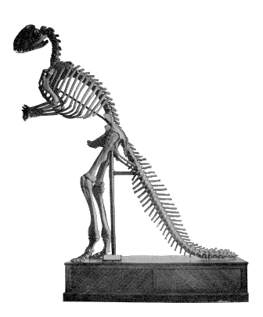

PREHISTORIC LIFE OF NEW JERSEY
Notes:
The descriptions given here in the notes sections of this presentation come from various online sources. It is not our intention to violate any copyright or ownership.
The images and information presented here is provided for educational purposes and no part of this presentation is intended for commercial use or profit.
Links and footnotes within the text still connect to the sites they were linked to when the data was first collected.
If any copyright owners wish to have credit given or to have data removed, please contact this office at (609) 292-1474 or by email to marc.rogoff@dep.nj.gov
This presentation was made possible through the contributions of the following people:
Marc Rogoff
New Jersey Department of Environmental Protection
Ted Pallis and Richard Dalton
New Jersey Geological and Water Survey
David Parris
New Jersey State Museum

Slide 2
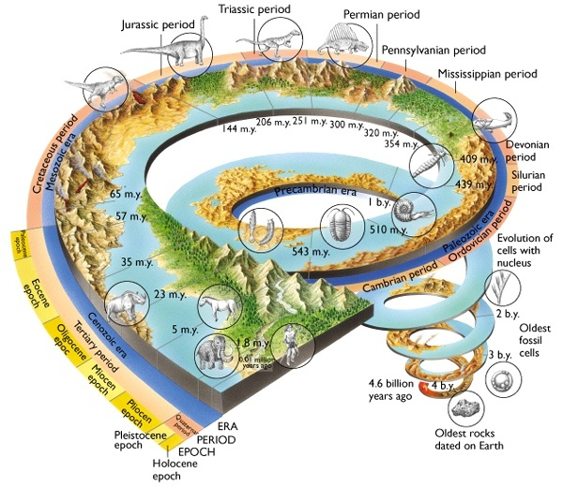
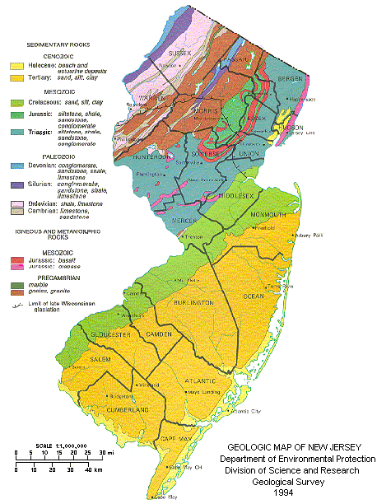
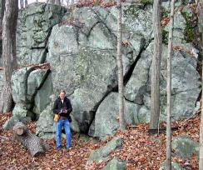
Oldest rocks in
New Jersey
1.37 b.y.
Notes:
The Time Spiral shows the Periods, Eras, and the most significant events in Earths’ history over the last 4.6 Billion Years.
Note that life forms visible to the unaided eye only appeared around 600 million years ago. (A little over 1 turn of the spiral)
For most of Earths’ history, the dominant life forms were too small to see. (4 + more turns of the spiral)
The oldest rocks/exposed formation in New Jersey are the Wanaque Tonalite Gniess (metamorphic) at 1.37 billion years old.
All recorded human history would fit within the black line at the end of the spiral.
Also note: The dinosaurs existed for about 1/3 of a turn of the last spiral, less than ½ of a turn before humans. (And technically still exist in the form of birds) This means they are geologically recent and are extremely successful as a group of organisms.
T. rex is closer in time to humans than it is to the earliest dinosaurs.
For a more expanded view of the geological history of New Jersey, go to https://www.nj.gov/dep/seeds/ghnj.htm

Slide 3
NORTH
CENTRAL
SOUTH
Notes:
The complete chart. Includes the time and color key. The following 3 pages break the chart into general regions.
Text from this poster can be found at https://www.nj.gov/dep/seeds/docs/plonj.doc
You can download this poster or purchase a printed version at https://www.nj.gov/dep/njgs/enviroed/index.htm
Note the presence of ancient land mammal fossils that have been found in the ocean.
This is indicative of the fact that at the time these animals lived, the sea-level was lower than it is today, and their habitats were in fact dry land. (This occurred at the time of the most recent ice-ages)
For a listing of FOSSIL SITES IN NEW JERSEY go to http://www.njesta.org/fossilsites.html

Slide 4
NORTH CENTRAL SOUTH
Notes:
Northern NJ
Click on an organism to go to its descriptive page.
Note that north Jersey was underwater during much of its history.
The black line that starts near the Cephalopod and crosses the state ending near the Grallator shows the southern extent of the last ice age glaciers. Everything north of the line was covered by ice up to nearly 1 mile thick at its highest. Everything south of the line was a wetland of melted ice and thick vegetation.

Slide 5

Deinosuchus
Cretaceous
NORTH CENTRAL SOUTH
Notes:
Central NJ
Click on an organism to go to its descriptive page.
Note the abundance of fossils along the “Great Pathway” between New York City and Philadelphia. (This area has been used for transportation since before colonial times and is now the main pathway for such roads as 295 and the NJ Turnpike.)
This region, known as the Inner Coastal Plain marks the boundary of the coast during the Cretaceous. A time of deposition of many fine productive sediments and fossils.
NJ is known as the “Garden State” due to the quality of the sediments within this region.

Slide 6
NORTH CENTRAL SOUTH
Notes:
Southern NJ
Click on an organism to go to its descriptive page.
Note the lack of fossils throughout much of the Pinelands region of the state.
This is due to the area being washed out at the end of the last ice age and most material was eroded. Also, this area is sparsely populated and little construction has occurred. It is also protected by federal law.

Slide 7
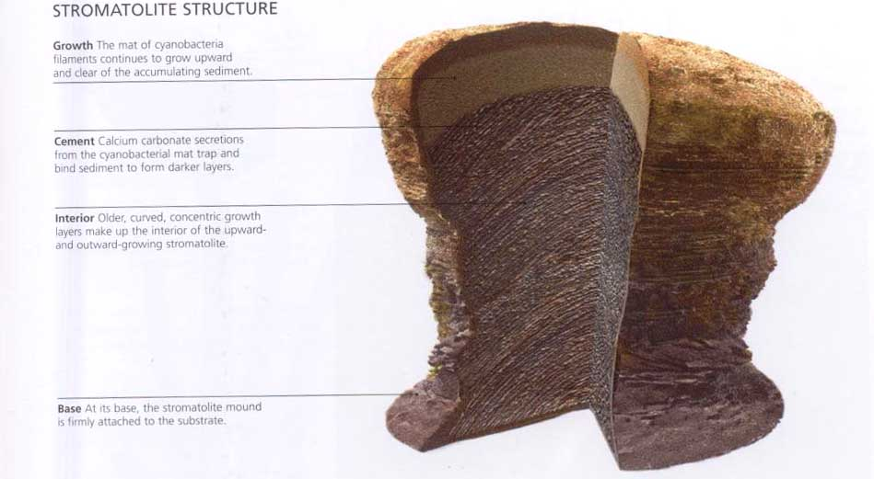
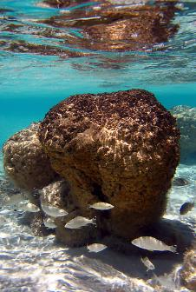
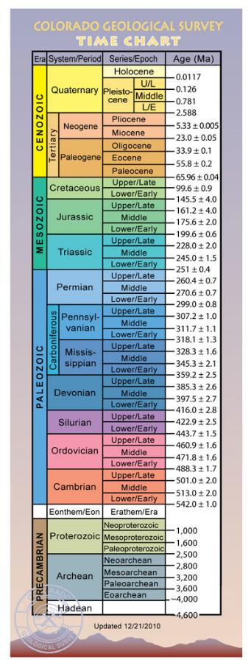
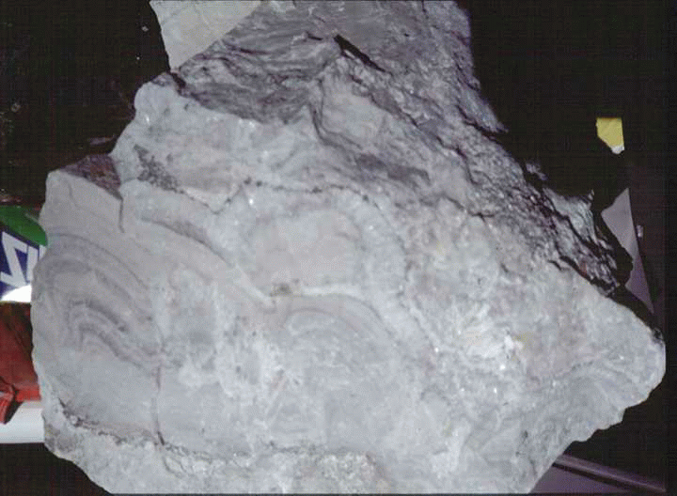
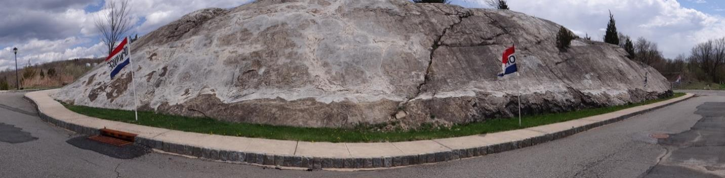
STROMATOLITES
NORTH CENTRAL SOUTH
Notes:
Stromatolites were discovered in the 1.2 billion-year-old Franklin Marble from the New Jersey Highlands during routine fieldwork by Rich Volkert of the New Jersey Geological Survey. Stromatolites are the fossilized remains of colonies of cyanobacteria that often have a characteristic dome-shaped laminated structure. The laminations are thin mats that were constructed by the microorganisms as they trapped fine grains of calcium carbonate on their sticky filaments. A new organic mat was then constructed over the sediment, trapping another layer of sediment and producing the next lamination. The Franklin Marble was formed from limestone deposited in a marine (ocean) environment during the Precambrian Era. Stromatolites in the marble provide tangible evidence for the occurrence of ancient biological activity in this environment in New Jersey.
Finding field trip sites that are accessible, informative, unique, and safe is often a challenge in New Jersey. Two such sites in the Hamburg Quadrangle of Sussex County provide an exceptional teaching opportunity for all grade levels, as they exhibit a variety of characteristics that are both easy to see and are representative of their paleoenvironment. The first site, described by Monteverde (2004) and by Freile et al. (2007), is a glacially-smoothed exposure of the Allentown Dolomite Formation containing well-preserved stromatolites. This outcrop is located at lat: 41.142693º, long: -74.577880º, near Hamburg, NJ. The exposure is noted for the numerous stromatolite “heads,” both large and small, along with mudcracks, ooids, styolites, ripples, rip-up clasts, and cross-bedding. These features provide consistent support for a wave-dominated, shallow-water environment, with periodic subaerial drying events. Because of glacial erosion and polish, the surface is unusually smooth and clear of chemical weathering effects that would otherwise hide or degrade such surface features. Glacial erosion also is evident by the numerous striations on the bedding planes and the larger glacial grooves (N30ºE) found at the top of the outcrop.
Stromatolites are layered mounds, columns, and sheet-like sedimentary rocks. They were originally formed by the growth of layer upon layer of cyanobacteria, a single-celled photosynthesizing microbe that lives today in a wide range of environments ranging from the shallow shelf to lakes, rivers, and even soils. Cyanobacteria are prokaryotic cells (the simplest form of modern carbon-based life) in that they lack a DNA-packaging nucleus. Bacteria, including the photosynthetic cyanobacteria, were the only form of life on Earth for the first 2 billion years that life existed on Earth.
Although simple, cyanobacteria were ultimately responsible for one of the most important "global changes" that the Earth has undergone. Being photosynthetic, cyanobacteria produce oxygen as a by-product. Photosynthesis is the only major source of free oxygen gas in the atmosphere. As stromatolites became more common 2.5 billion years ago, they gradually changed the Earth's atmosphere from a carbon dioxide-rich mixture to the present-day oxygen-rich atmosphere. This major change paved the way for the next evolutionary step, the appearance of life based on the eukaryotic cell (cell with a nucleus).
##
Note: To return to the maps, click on the North, Central, or South links above the time scale image on the right.

Slide 8
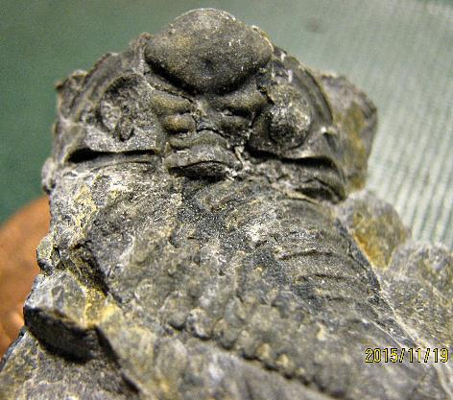
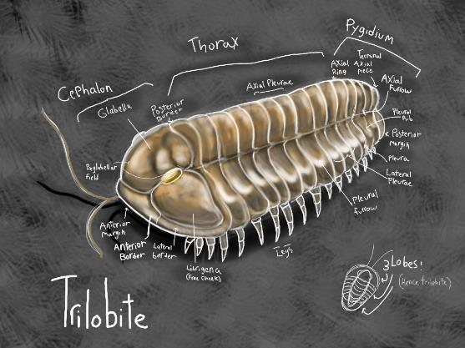
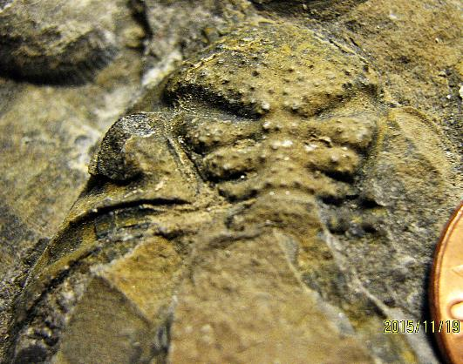
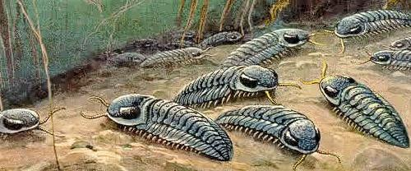
Trilobites
NORTH CENTRAL SOUTH
Notes:
Trilobites ( /ˈtraɪləˌbaɪt, ˈtrɪ-, -loʊ-/;^{[4][5]} meaning "three lobes") are a fossil group of extinct marine arachnomorph arthropods that form the class Trilobita. Trilobites form one of the earliest known groups of arthropods. The first appearance of trilobites in the fossil record defines the base of the Atdabanian stage of the Early Cambrian period (521 million years ago), and they flourished throughout the lower Paleozoic era before beginning a drawn-out decline to extinction when, during the Devonian, all trilobite orders except the Proetids died out. Trilobites disappeared in the mass extinction at the end of the Permian about 252 million years ago. The trilobites were among the most successful of all early animals, roaming the oceans for over 270 million years.^{[6]}
The earliest trilobites known from the fossil record are redlichiids and ptychopariid bigotinids dated to some 540 to 520 million years ago.^{[1][2]} Contenders for the earliest trilobites include Profallotaspis jakutensis (Siberia), Fritzaspis spp. (western USA), Hupetina antiqua (Morocco)^{[10]} and Serrania gordaensis (Spain).^{[11]} All trilobites are thought to have originated in present-day Siberia, with subsequent distribution and radiation from this location.^{[1]}
Exactly why the trilobites became extinct is not clear; with repeated extinction events (often followed by apparent recovery) throughout the trilobite fossil record, a combination of causes is likely. After the extinction event at the end of the Devonian period, what trilobite diversity remained was bottlenecked into the order Proetida. Decreasing diversity^{[29]} of genera limited to shallow-water shelf habitats, coupled with a drastic lowering of sea level (regression) meant that the final decline of trilobites happened shortly before the end of the Permian mass extinction event.^{[21]} With so many marine species involved in the Permian extinction, the end of nearly 300 million successful years for the trilobite would not have been unexpected at the time.^{[29]}
Trilobites have no known direct descendants. Their closest living relatives would be the chelicerates. Though horseshoe crabs are often cited as their closest living relatives, they are no closer evolutionarily than other cheliceratans.^{[30]}
##
Note: The multiple arrows on the time scale image refers to multiple locations in New Jersey where the fossils of this organism are found when the geologic times for each are different.

Slide 9
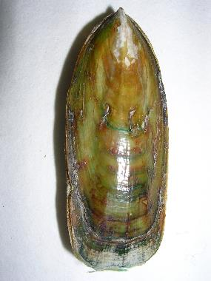
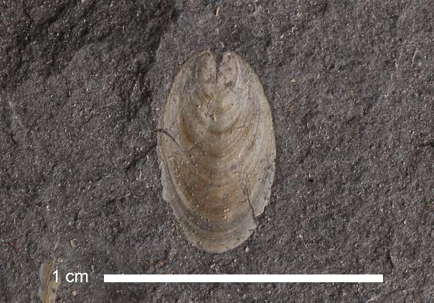
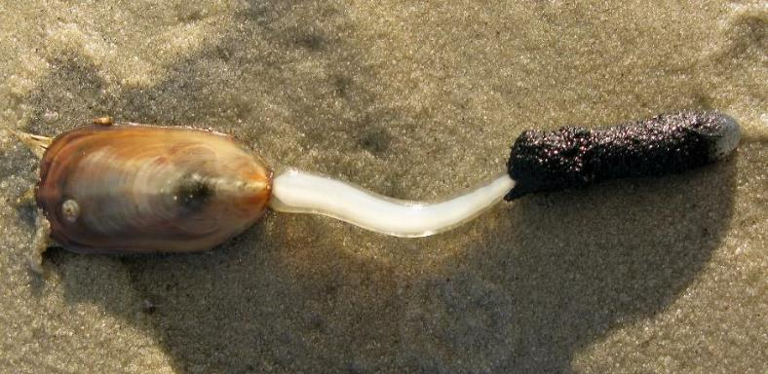
LINGULOIDs
NORTH CENTRAL SOUTH
Notes:
Lingula is the only genus of an extensive group of extinct bivalves known as brachiopods that inhabited the seas from the early Cambrian through their peak in the late Paleozoic. Known also as “Lamp Shells”, brachiopods are one of the most common fossils found in North America. Lingula are still around today.
Brachiopods (/ˈbrækioʊˌpɒd/), phylum Brachiopoda, are a group of lophotrochozoan animals that have hard "valves" (shells) on the upper and lower surfaces, unlike the left and right arrangement in bivalve molluscs. Brachiopod valves are hinged at the rear end, while the front can be opened for feeding or closed for protection. Two major groups are recognized, articulate and inarticulate. The word "articulate" is used to describe the tooth-and-groove features of the valve-hinge which is present in the articulate group, and absent from the inarticulate group. This is the leading diagnostic feature (fossilizable), by which the two main groups can be readily distinguished. Articulate brachiopods have toothed hinges and simple opening and closing muscles, while inarticulate brachiopods have untoothed hinges and a more complex system of muscles used to keep the two halves aligned. In a typical brachiopod a stalk-like pedicle projects from an opening in one of the valves near the hinges, known as the pedicle valve, keeping the animal anchored to the seabed but clear of silt that would obstruct the opening.
The word "brachiopod" is formed from the Ancient Greek words βραχίων ("arm") and πούς ("foot").^{[3]} They are often known as "lamp shells", since the curved shells of the class Terebratulida look rather like pottery oil-lamps.^{[2]}
Fossil record
Over 12,000 fossil species are recognized,^{[9]}grouped into over 5,000 genera. While the largest modern brachiopods are 100 millimetres (3.9 in) long,^{[2]} a few fossils measure up to 200 millimetres (7.9 in) wide.^{[39]} The earliest confirmed brachiopods have been found in the early Cambrian, inarticulate forms appearing first, followed soon after by articulate forms.^{[40]} Three unmineralized species have also been found in the Cambrian, and apparently represent two distinct groups that evolved from mineralized ancestors.^{[41]} The inarticulate Lingula is often called a "living fossil", as very similar genera have been found all the way back to the Ordovician. On the other hand, articulate brachiopods have produced major diversifications, and suffered severe mass extinctions^{[39]}—but the articulate Rhynchonellida and Terebratulida, the most diverse present-day groups, appeared at the start of the Ordovician and Carboniferous respectively.^{[38]}
##

Slide 10
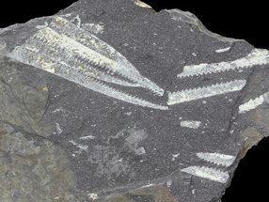
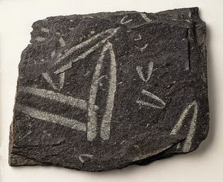
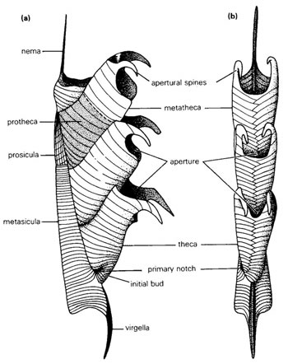
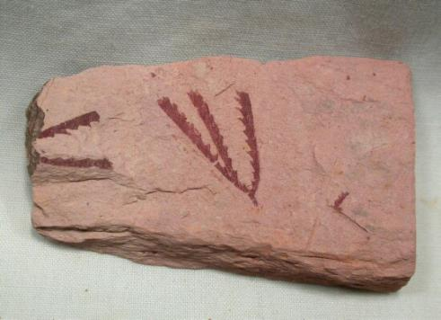
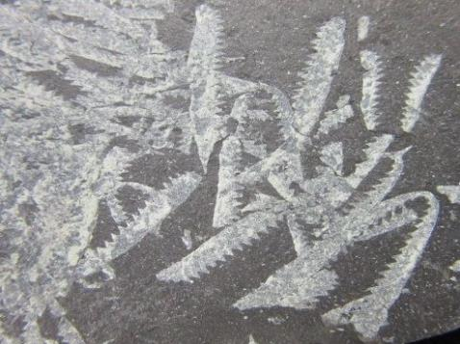
graptolites
NORTH CENTRAL SOUTH
Notes:
https://www.nj.gov/dep/njgs/pricelst/gsreport/gsr28.pdf
The Ordovician fossil record contains a diversity of marine invertebrates, including graptolites, trilobites, brachiopods, and conodonts (early vertebrates). A typical marine community consisted of these animals, plus red and green algae, early fish, cephalopods, corals, crinoids, and gastropods. A drop in sea level may have contributed to the mass extinctions that characterized the end of the Ordovician, in which perhaps 60% of all marine invertebrate genera went extinct.
During the Ordovician Period in New Jersey, shallow seas gave way to deeper oceanic conditions. The shallow water limestone's and their reef-building organisms were replaced by dark colored shale's and mud stones and organisms typical of a deep-water environment. This change between environments is evident in the Valley and Ridge Province of northwestern New Jersey.
Graptolithina is a subclass of the class Pterobranchia, the members of which are known as graptolites. These organisms are colonial animals known chiefly as fossils from the Middle Cambrian (Miaolingian, Wuliuan) through the Lower Carboniferous (Mississippian).
##

Slide 11
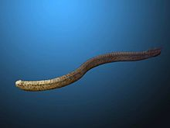
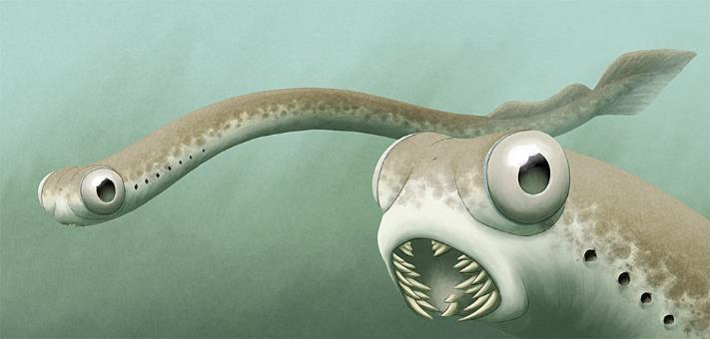
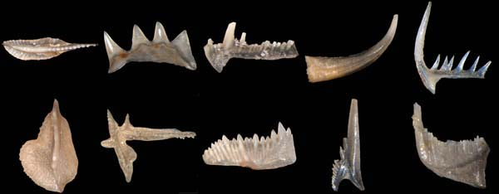
conodonts
NORTH CENTRAL SOUTH
Notes:
Conodonts (Greek kōnos, "cone", + odont, "tooth") are extinct agnathan chordates resembling eels, classified in the class Conodonta. For many years, they were known only from tooth-like microfossils found in isolation and now called conodont elements. Knowledge about soft tissues remains limited. The animals are also called Conodontophora (conodont bearers) to avoid ambiguity.
Conodonts are considered index fossils; fossils used to define and identify geological periods.
##

Slide 12
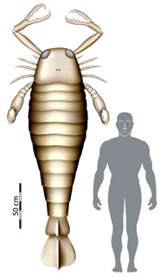
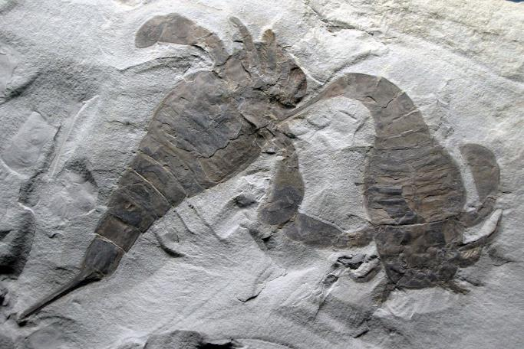
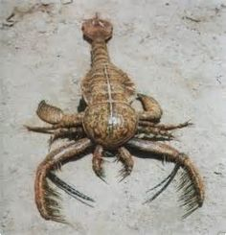
eurypterids
NORTH CENTRAL SOUTH
Notes:
Eurypterids, often informally called sea scorpions, are an extinct group of arthropods related to horseshoe crabs that include the largest known arthropods to have ever lived. They are members of the extinct order Eurypterida (Chelicerata); which is the most diverse Paleozoic chelicerate order in terms of species.^{[1]} The name Eurypterida comes from the Greek words eury- (meaning "broad" or "wide") and pteron (meaning "wing").^{[2]} This name was chosen due to the pair of wide swimming appendages, reminiscent of wings, on the first fossil eurypterids discovered. The largest, such as Jaekelopterus, reached 2.5 metres (8 ft 2 in) in length, but most species were less than 20 centimetres (8 in). They were formidable predators that thrived in warm shallow water, in both seas and lakes,^{[3]} from the mid Ordovician to late Permian (467.3 to 252 million years ago).
##

Slide 13
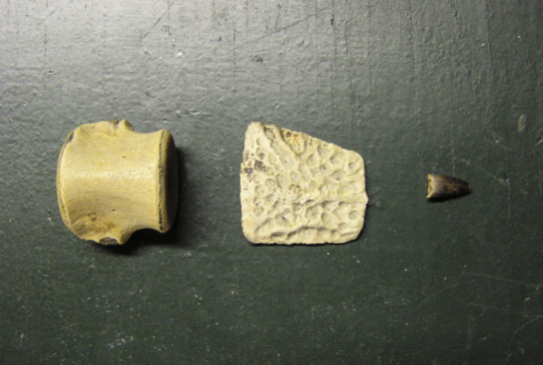

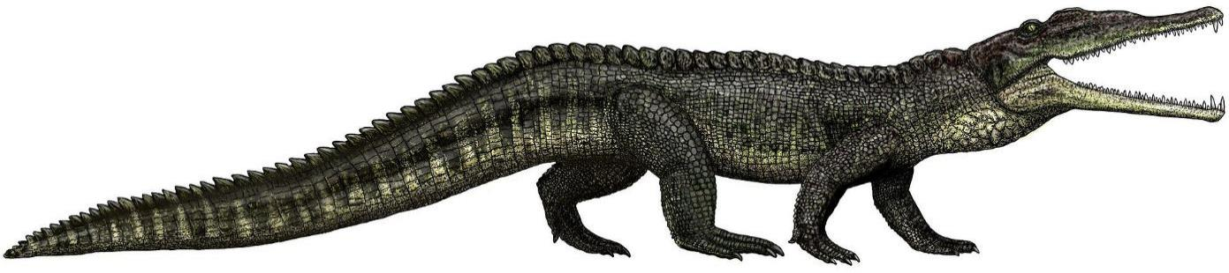
Phytosaurs
NORTH CENTRAL SOUTH
Notes:
Phytosaurs are an extinct group of large, mostly semiaquatic Late Triassic archosauriform reptiles. Phytosaurs belong to the family Phytosauridae and the order Phytosauria. Phytosauria and Phytosauridae are often considered to be equivalent groupings containing the same species, but some studies have identified non-phytosaurid phytosaurians. Phytosaurs were long-snouted and heavily armoured, bearing a remarkable resemblance to modern crocodilians in size, appearance, and lifestyle, as an example of convergence or parallel evolution. The name "phytosaur" means "plant reptile", as the first fossils of phytosaurs were mistakenly thought to belong to plant eaters. The name is misleading because the sharp teeth in phytosaur jaws clearly show that they were predators.
Rutiodon ("Wrinkle tooth") is an extinct genus of archosaur belonging to the family Phytosauridae. It lived during the Late Triassic period and was about 3 to 8 meters in length.^{[1]} Rutiodon is known from the eastern United States (North Carolina, New York, New Jersey).^{[2]}
The type species of Rutiodon is R. carolinensis. A second species, R. manhattanensis, was discovered in 1910 near Fort Lee, New Jersey, and named in reference to its close proximity to Manhattan.
https://wikivisually.com/wiki/Rutiodon
Note the big gap in time between this animal and Eurypterids on the prior page of this powerpoint. During the later half of the Paleozoic, the levels of deposition in NJ were overcome by erosional forces so that the fossil record is sparse during this time. However, this was a superb time for deposition in Pennsylvania! Thus the alternate name for one of its periods, the Pennsylvanian. (Famous for the deposition of coal)
##

Slide 14
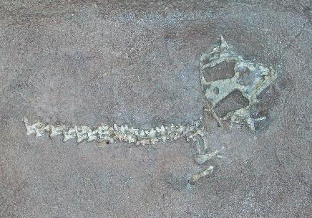
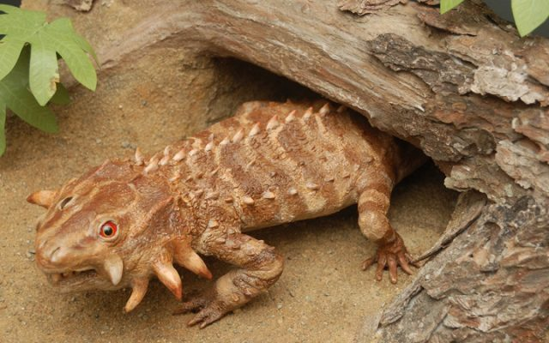
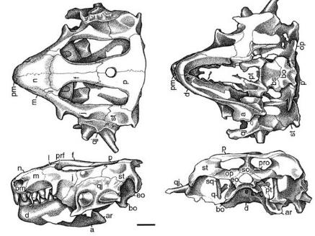
HYPSOGNATHUS
NORTH CENTRAL SOUTH
Notes:
Hypsognathus ('high jaw') is an extinct genus of procolophonid parareptile from the Late Triassic of New Jersey and Connecticut.^{[1]}
Hypsognathus resembled a moderately sized lizard, with a length of 33 centimeters (13 in), although it was unrelated to modern lizards. Because of its broad teeth, Hypsognathus is thought to have been herbivorous. Its body is low and broad with a relatively short tail. Hypsognathus has some spikes on the side of its head, probably for protection against predators.^{[2]}

Slide 15
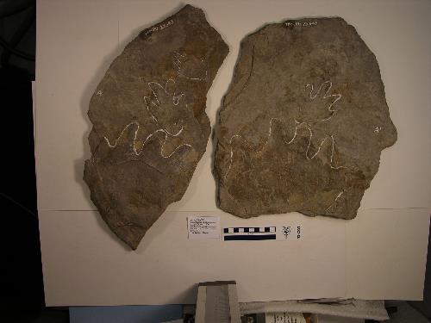
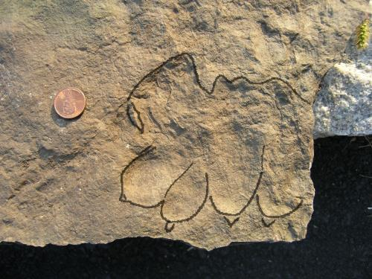
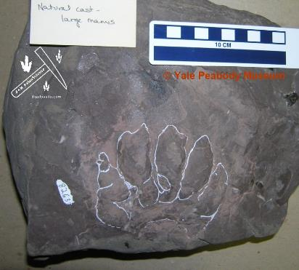
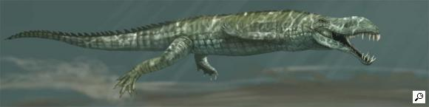
APATOPUS
NORTH CENTRAL SOUTH
Notes:
Apatopus is an ichnogenus, or a name based on footprints, that may have been from a phytosaur. The trackmaker lived in the early Triassic. It was named by Baird in 1957.
Of special relevance regarding its phytosaurian identity is the fact that the tracks are positioned in a way that indicates that the limbs were held directly under the body, a gait known in true archosaurs like crocodiles and dinosaurs but previously thought absent in phytosaurs. This raises the question of whether this trait was shared by the last common ancestor between archosaurs and phytosaurs or if it evolved independently between these groups.^{[1][2]}

Slide 16
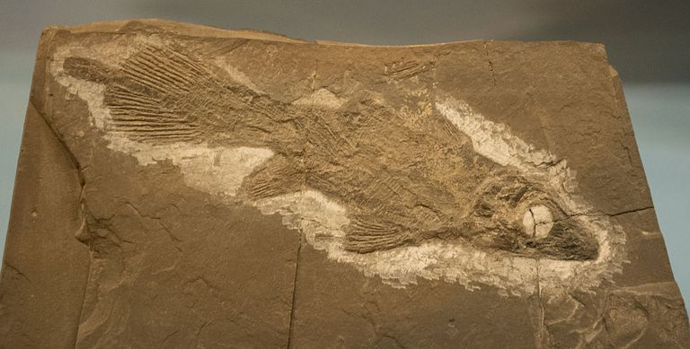
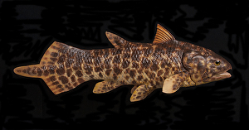
DIPLURUS
NORTH CENTRAL SOUTH
Notes:
You may be familiar with the Coelacanth, the allegedly extinct fish that experienced a sudden resurrection when a living specimen was caught off the coast of South Africa in 1938. The fact is, though, that most genera of Coelacanths truly did go extinct tens of millions of years ago; a good example is Diplurus, hundreds of specimens of which have been found preserved in New Jersey sediments. (Coelacanths, by the way, were a type of lobe-finned fish closely related to the immediate ancestors of the first tetrapods.)
Diplurus is a genus of prehistoric mawsoniid coelacanth fish which lived during the Triassic period.
The coelacanths (/ˈsiːləkænθ/ ( listen) SEE-lə-kanth) constitute a now-rare order of fish that includes two extant species in the genus Latimeria: the West Indian Ocean coelacanth (Latimeria chalumnae) primarily found near the Comoro Islands off the east coast of Africa and the Indonesian coelacanth (Latimeria menadoensis).^{[2]} They follow the oldest-known living lineage of Sarcopterygii (lobe-finned fish and tetrapods), which means they are more closely related to lungfish and tetrapods than to ray-finned fishes. They are found along the coastlines of the Indian Ocean and Indonesia.^{[3][4]} Since there are only two species of coelacanth and both are threatened, it is the most endangered order of animals in the world. The West Indian Ocean coelacanth is a critically endangered species.
Coelacanths belong to the subclass Actinistia, a group of lobed-finned fish related to lungfish and certain extinct Devonian fish such as osteolepiforms, porolepiforms, rhizodonts, and Panderichthys.^{[5]} Coelacanths were thought to have become extinct in the Late Cretaceous, around 66 million years ago, but were rediscovered in 1938 off the coast of South Africa.^{[6][7]}
The coelacanth was long considered a "living fossil" because scientists thought it was the sole remaining member of a taxon otherwise known only from fossils, with no close relations alive,^{[5]} and that it evolved into roughly its current form approximately 400 million years ago.^{[1]} However, several recent studies have shown that coelacanth body shapes are much more diverse than previously thought.^{[8][9][10]}
##
Note: These fossils are occasionally found at the Granton Quarry site where Icarosaurus was found.

Slide 17
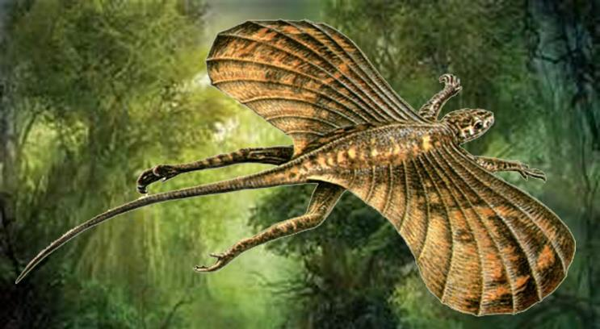
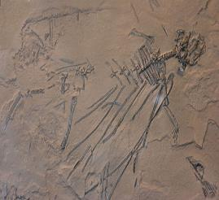
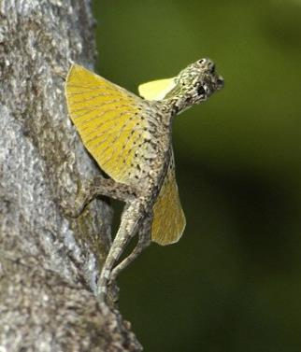
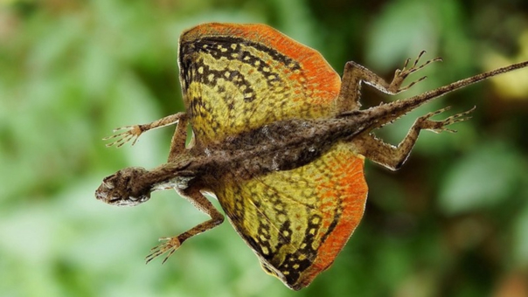
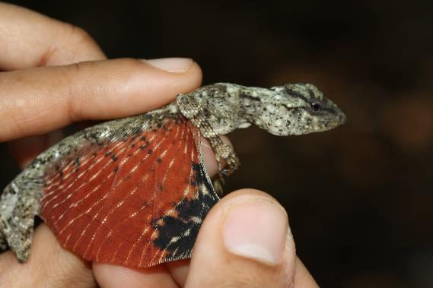
ICAROSAURUS
NORTH CENTRAL SOUTH
Notes:
Icarosaurus (meaning "Icarus lizard") is an extinct genus of kuehneosaurid reptile from the Late Triassic (Carnian age) Lower Lockatong Formation of New Jersey, dated to around 228 million years ago.^{[1]} It is closely related to lizards and the tuatara. Based on a partial skeleton missing part of the tail, some ribs, a hand, and parts of the legs, it was a small animal, about 10 centimeters (4 in) long from the skull to the hips. Like its relative Kuehneosaurus, it was able to glide short distances using 'wings' consisting of highly elongated ribs covered with skin, with the upper surface convex and the lower surface concave, thus creating a simple airfoil structure well-suited to gliding.^{[2][3]} This method of gliding is also seen in Coelurosauravus and the modern Draco, neither of which are closely related to Icarosaurus.
Discovery and history
The only known fossil skeleton of Icarosaurus was found in 1960 in North Bergen, New Jersey by 16 year old Alfred Siefker, who stumbled upon the specimen while exploring a shale quarry with two friends, one of which first spotted the Icarosaurus. Mr. Siefker promptly bought it from him for a telescope, a book, several other fossils and $30 in cash.
In 1966 Siefker brought the specimen to scientists at the American Museum of Natural History in New York for identification and preparation.^{[2][4]} It was described by paleontologist Edwin Harris Colbert, ^{(9/28/1905 – 11/15/2001)} chairman and curator of the museum's vertebrate paleontology department, who named it Icarosaurus siefkeri in honor of Siefker.^{[3]}.
When discovered, the 18-cm-long Icarosaurus was the oldest known example of a reptile that had taken to the air, preceding the pterosaurs and birds by as much 50 million years. Its 25-cm wingspan did not allow powered flight, only gliding.
Mr. Siefker briefly achieved 1960's-style celebrity, appearing on ''To Tell the Truth'' and in Life Magazine.
The fossil remained in the collections of the AMNH until 1989 when Siefker reclaimed the specimen, which he kept in a private collection during the following decade.
Needing money to pay medical bills, Siefker tried to sell the fossil to several museums, but his asking price of $5 million was too high. In 2000, the fossil was sold at auction in San Francisco through the auction house Butterfield & Butterfield, despite concerns from paleontologists that the sale could render the specimen unavailable for scientific study.^{[4]} The fossil sold for US$167,000, only half of its appraised value, to Dick Spight of California. That same year, Spight donated the Icarosaurus holotype back to the AMNH, where it was put on display on October 7th 2000.^{[4]}
The fossil was discovered in the Granton Quarry in North Bergen where today there is a street (Granton Avenue) that marks the general location of the site. Fossils at the site are rare, with the construction of a Lowe’s and a MacDonald’s nearby, whatever secrets it contained have been mostly obliterated. Although small, Icarosaurus siefkeri not only puts North Bergen on the map in the prehistorical sense but also gives us a basic indicator of what the area was like millions of years ago during the Triassic period.
## (Reproduction)
Note: The fossil site is still present and frequently visited. It is dangerous to walk there due to the crumbling nature of the shale and the high amount of poison ivy present. The property is claimed by several groups, so trespassing rules may apply. It is best to join a group venture to the site where permission has been obtained to use the property.
(I have led two trips there in the past and fossils were found by nearly all participants.)

Slide 18
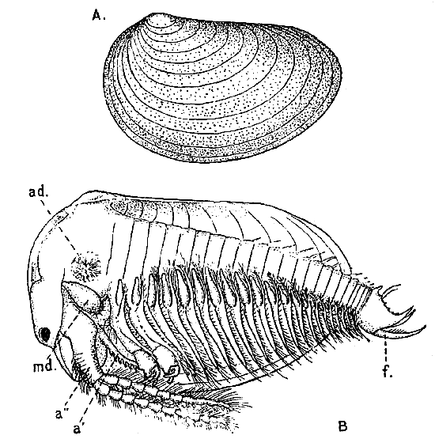
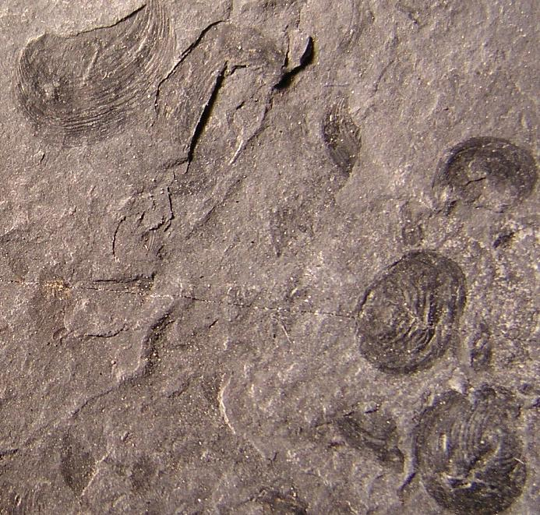
ESTHERIA OVATA
NORTH CENTRAL SOUTH
Notes:
Estheria Ovata
A genus (sometimes made the type of the family Estheriidae) of small branchiopod crustaceans in which the carapace is developed into a bivalve shell not unlike that of some mollusks and enclosing the whole body.
Estheria are an extinct genus of bivalved branchiopod crustaceans (‘Clam Shrimp’) that thrived from the Carboniferous to the Cretaceous (360.7 to 99.7 Mya).^{[1]} They fed on detritus, being very small slow moving, nektonic organisms that filter fed as they floated. They have been found in both marine and freshwater environments.^{[2]} They resemble the unrelated bivalved molluscs.^{[1]}
Clam shrimp are extant, and known from the fossil record, from at least the Devonian period and perhaps before.^{[2]} They were originally classified in a single order Conchostraca, which later proved to be paraphyletic, being separated into three different orders: Cyclestherida, Laevicaudata, and Spinicaudata.
Geological history
Extinct species of these crustaceans are often studied by geologists. In freshwater deposits, generally poor in fossils, the well-preserved clam shrimp shells are found quite often. They help identify the age of the corresponding strata.
During the past geological periods clam shrimp were apparently more numerous and diverse than they are now. 300 extinct species are known, and half as many living species. The oldest clam shrimp, such as Asmussia murchisoniana, were found in Devonian deposits. Many extinct species, especially Triassic ones, lived in the sea, where no clam shrimp remain today.
##
Note: These fossils are frequently found at the Granton Quarry site where Icarosaurus was found.

Slide 19
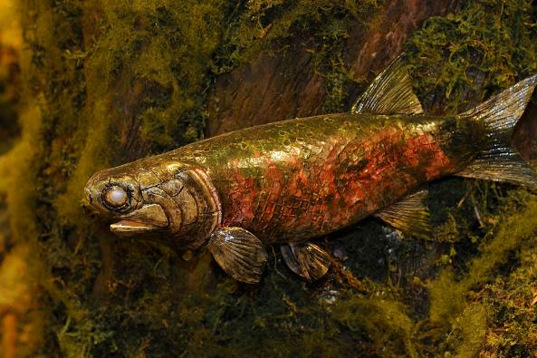
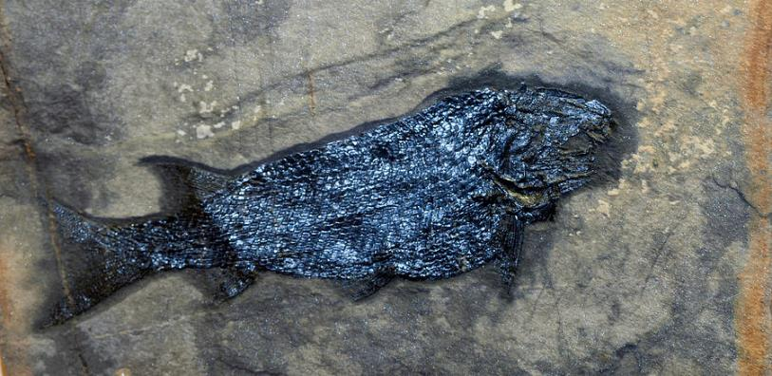
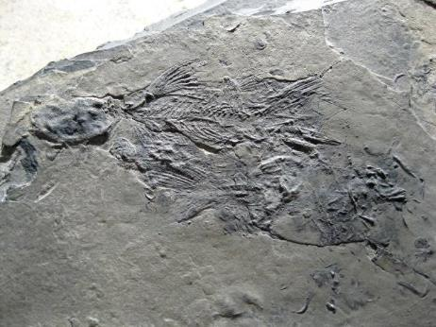
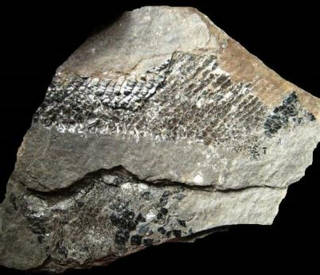
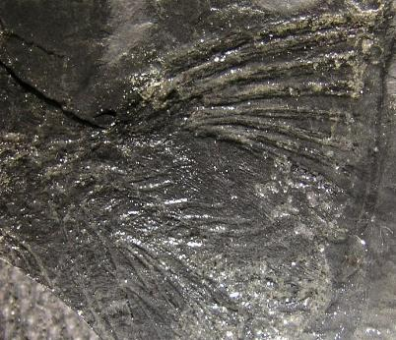
REDFIELDUS
NORTH CENTRAL SOUTH
Notes:
Redfieldius gracilis is an extinct boney fish belonging to the redfieldiiformes. It lived in the Lower Jurassic period (about 198-190 million years ago) and its fossil remains were found in North America.
This fish was of medium size, and usually did not exceed the length of 20 centimeters. The body was slightly sturdy, oval in shape; The muzzle was rounded, the eyes large and the mouth was equipped with small teeth. Like all its close relatives, also Redfieldius was endowed with a single triangular dorsal fin very backward, practically speculating with the one, very similar in shape and size. The ventral fins were small, while the pectoral flippers were slightly larger. The caudal fin was slightly heterocerac, while there was only one branchiostegal reduced to a plate-shaped bone. All fins were equipped with extremely thin hubs. The scales were rhomboidal and were larger than those in the front of the body, arranged in diagonal rows. The outer nasal opening was enclosed by a premaxillary bone, a nasal, a rostral, and an adnasal bone.
Redfieldius, unlike other closely related fishes, was endowed with a skull strongly ornamented by tubercles especially around the orbit and the tip of the muzzle.

Slide 20


SEMIONOTUS
NORTH CENTRAL SOUTH
Notes:
Semionotus ("Flag-Back") is an extinct genus of ray-finned fish found throughout Northern Pangaea (North America and Europe) during the late Triassic, becoming extinct in the Early Jurassic.

Slide 21






GRALLATOR
NORTH CENTRAL SOUTH
Notes:
http://www.digsfossils.com/fossils/footprints_main.html
Grallator is an ichnogenus (form taxon based on footprints) which covers a common type of small, three-toed print made by a variety of bipedal theropod dinosaurs. Grallator-like footprints have been found in formations dating from the Late Triassic through to the early Cretaceous periods. They are found in the United States, Canada, Europe, Australia and China but are most abundant on the east coast of North America, especially the Triassic and Early Jurassic formations of the northern part of the Newark Supergroup.^{[1][2]} The name Grallator translates into "stilt walker", although the actual length and form of the trackmaking legs varied by species, usually unidentified. The related term "Grallae" is an ancient name for the presumed group of long-legged wading birds, such as storks and herons. These footprints were given this name by their discoverer, Edward Hitchcock, in 1858.^{[1]}
Grallator footprints are characteristically three-toed (tridactyl) and range from 5 to 15 centimeters (or 2 to 6 inches) long. Though the tracks show only three toes, the trackmakers likely had between four and five toes on their feet. While it is usually impossible to match these prints with the exact dinosaur species that left them, it is sometimes possible to narrow down potential trackmakers by comparing the proportions in individual Grallator ichnospecies with known dinosaurs of the same formation.
The most famous, and archetypal tracks that conform to the Grallator are those found on the East Coast of North America, specifically from the Late Triassic to Early Jurassic Newark Supergroup. These footprints were likely made by an unidentified, primitive dinosaur similar to Coelophysis.^{[1]} The Newark Supergroup footprints show digits II, III and IV, but no trace of the shorter digits I and V which would likely have been present in a dinosaur of this stage. The outer two digits would have been stubby and ineffective, not touching the ground during walking or running.^{[1]} Despite losing most of their effectiveness, dinosaur evolution had not yet removed these digits to fully streamline the foot. This is known because rare specimens are found with traces of these outer digits. Digits II, III and IV have 3, 4 and 5 phalanges respectively, giving Grallator a ?-3-4-5-? digital formula.
##

Slide 22




ANCHISAURIPUS
NORTH CENTRAL SOUTH
Notes:
The classic Early Jurassic age theropod footprints Eubrontes giganteus, Anchisauripus sillimani, and Grallator parallelus were established by Edward Hitchcock in 1836-1847 and are the type ichnospecies of their respective ichnogenera. All the tracks come from cyclical lacustrine and marginal lacustrine to fluvial strata from an interval spanning about one million years in the Early Jurassic age Meriden and Agawam groups of the Hartford and Deerfield basins of Connecticut, Massachusetts and New Jersey. Based on osteometric comparisons with skeletal material, these three ichnospecies were most likely made by theropod dinosaurs, as usually assumed. Although treated here as distinct ichnogenera, it is possible that their major proportional differences derive from allometric growth with individuals of several related species in one genus or even within one species of trackmaker. The rigorous establishment of these classic ichnological taxa forms a basis for more wide-ranging studies of theropod diversity in the early Mesozoic.

Slide 23




Plesiosaurs
NORTH CENTRAL SOUTH
Notes:
The Plesiosauria (/ˌpliːsiəˈsɔːriə, -zi-/;^{[1][2]} Greek: πλησίος, plesios, meaning "near to" and sauros, meaning "lizard") or plesiosaurs are an order or clade of Mesozoic marine reptiles (marine Sauropsida), belonging to the Sauropterygia.
Plesiosaurs first appeared in the latest Triassic Period, possibly in the Rhaetian stage, about 203 million years ago.^{[3]} They became especially common during the Jurassic Period, thriving until their disappearance due to the Cretaceous–Paleogene extinction event at the end of the Cretaceous Period, about 66 million years ago. They had a worldwide oceanic distribution.
Plesiosaurs were among the first fossil reptiles discovered. In the beginning of the nineteenth century, scientists realized how distinctive their build was and they were named as a separate order in 1835. The first plesiosaurian genus, the eponymous Plesiosaurus, was named in 1821. Since then, more than a hundred valid species have been described. In the early twenty-first century, the number of discoveries has increased, leading to an improved understanding of their anatomy, relationships and way of life.
Plesiosaurs had a broad flat body and a short tail. Their limbs had evolved into four long flippers, which were powered by strong muscles attached to wide bony plates formed by the shoulder girdle and the pelvis. The flippers made a flying movement through the water. Plesiosaurs breathed air and bore live young; there are indications that they were warm-blooded.
Plesiosaurs showed two main morphological types. Some species, with the "plesiosauromorph" build, had (sometimes extremely) long necks and small heads; these were relatively slow and caught small sea animals. Other species, some of them reaching a length of up to seventeen metres, had the "pliosauromorph" build with a short neck and a large head; these were apex predators, fast hunters of large prey. The two types are related to the traditional strict division of the Plesiosauria into two suborders, the long-necked Plesiosauroidea and the short-neck Pliosauroidea. Modern research, however, indicates that several "long-necked" groups might have had some short-necked members or vice versa. Therefore, the purely descriptive terms "plesiosauromorph" and "pliosauromorph" have been introduced, which do not imply a direct relationship. "Plesiosauroidea" and "Pliosauroidea" today have a more limited meaning. The term "plesiosaur" is properly used to refer to the Plesiosauria as a whole, but informally it is sometimes meant to indicate only the long-necked forms, the old Plesiosauroidea.
##

Slide 24





DEINOSUCHUS
NORTH CENTRAL SOUTH
Notes:
Given how many states its remains have been discovered in, the 30-foot-long, 10-ton Deinosuchus must have been a common sight along the lakes and rivers of late Cretaceous North America, where this prehistoric crocodile snacked on fish, sharks, marine reptiles, and pretty much anything that happened to cross its path. Unbelievably, given its size, Deinosuchus wasn't even the biggest crocodile that ever lived--that honor belongs to the slightly earlier Sarcosuchus, also known as the SuperCroc.
A Croc Scute From Ramenessin Brook
##

Slide 25






Mosasaurs
NORTH CENTRAL SOUTH
Notes:
Mosasaurs (from Latin Mosa meaning the 'Meuse river', and Greek σαύρος sauros meaning 'lizard') are an extinct group of large marine reptiles containing 38 genera in total. Their first fossil remains were discovered in a limestone quarry at Maastricht on the Meuse in 1764. Mosasaurs probably evolved from an extinct group of aquatic lizards^{[1]} known as aigialosaurs in the Early Cretaceous. During the last 20 million years of the Cretaceous period (Turonian-Maastrichtian ages), with the extinction of the ichthyosaurs and pliosaurs, mosasaurs became the dominant marine predators. They became extinct as a result of the K-Pg event at the end of the Cretaceous period, about 66 million years ago.
Although the Inversand pit presently sits on dry land just behind a newly-constructed mini-mall, at the end of the Cretaceous the site was under about 100 feet of water. The tyrannosauroid Dryptosaurus hunted two (maybe three) species of hadrosaur on the nearby shore, while marine crocodylians and mosasaurs patrolled the coastal waters. During this time the mosasaurs were the top predators in the sea, and the marl pits of southern New Jersey have yielded a diversity of the aquatic predators. Mosasaurus hoffmanni, Mosasaurus dekayi, Mosasaurus conodon, Plioplatecarpus, Leiodon sectorius, Halisaurus platyspondylus, and Prognathodon rapax are all known from material collected from New Jersey, but this is not the only location that they're known from. These same species are known from localities in Europe (and elsewhere), too, suggesting similar marine ecosystems across the ancient Atlantic (Mulder 1999).
Mosasaurs were large marine reptiles reaching up to 50 feet in length. Abundant during the latter half of the Cretaceous period, all fossil evidence indicates that the mosasaur had disappeared by the time the Cretaceous period closed. Although several species of mosasaurs have been reported in New Jersey, the most common material recovered is the teeth of Mosasaurus conodon. These teeth range in size from ½ to a little under two inches in size, with the average being a little less than 1 inch. The shape can differ depending on the position in the jaw but can generally be described as having a lens shape when viewed on profile, at least one cutting edge is always present and if not too stream worn, fine striations along with growth cracks can be seen. Most teeth will show a noticeable curve. At the base of the tooth, there is a conical shaped cavity where the tooth would attach to the root. Mosasaurs shed their teeth. The crowns of the replacement teeth are initially pointing horizontally backward gradually moving upwards to a vertical position. Only snakes replace teeth in a similar manner, leading to some speculation that the two may be distantly related. The teeth of the mosasaur may easily be confused with those of the crocodilian.
##

Slide 26




ISCHYRHIZA MIRA
NORTH CENTRAL SOUTH
Notes:
Ischyrhiza is an extinct genus of sawfish from the Cretaceous and Paleogene belonging to the primitive Batoidea family Sclerorhynchidae. Fossils of it have been found in North America, Japan, Bolivia, Chile, Peru and other various places.
Ischyrhiza mira (Leidy)
Age Cretaceous - Occurrence Common
The sawfish is not a shark but a skate. These somewhat common “teeth” that are collected in the streams of NJ are really the rostral spines that lined the elongated and flattened bill of the skate. These spines are unique and and easy to identify. Not nearly as distinctive are the oral teeth of Ischyrhiza mira. These are common, but their small size (3 mm) requires the use of a fine meshed screen when collecting.
The Cretaceous sawfishes (order Sclerorhynchiformes) are not related to the modern sawfishes (Pristiformes). They differ from modern sawfishes in a number of ways, the rostral spines have an enamel coating and are not set into sockets. Instead, the spines are connected to the rostrum via connective tissue and are continually replaced (rather than continually growing but never replaced as in the modern sawfishes).
##

Slide 27



COW SHARKS
NORTH CENTRAL SOUTH
Notes:
Origins of Cow Sharks
Cow sharks first appear in the fossil record in the late Cretaceous as the genus Hexanchus, while the genus Notorynchus first appears in the late Paleocene. They have not changed much in the 60 or so million years. Today, there are four extant cow sharks. The two most common are N. cepedianus (the Bluntnose sevengill), and H. griseus (the Broadnose sixgill).
Description of Cow Sharks
Cow sharks in general have a characteristic appearance in that they only have a single dorsal fin toward the back of the shark. They are missing the large central dorsal fin that is found on most sharks. They also have very round, blunt snouts.
The sixgill sharks have (you guessed it) six gill slits, while the sevengill sharks have (right again) seven gill slits. Sixgill sharks are also larger than sevengill sharks. The Broadnose sixgill sharks have been known to reach lengths up to 4.82 m (15.8 ft) (Castro, p. 27), while sevengill sharks have been known to reach lengths of up to 2.64 m (8.7 ft) (Castro, p. 39).
The sixgill shark has a dark gray to brown color, with a lighter underside, while the sevengill shark has numerous small dark spots on the dorsal surface.
##

Slide 28




ISCHYODUS – RATFISH
NORTH CENTRAL SOUTH
Notes:
Ischyodus is an extinct genus of cartilaginous fish belonging to the subclass Holocephali, which includes the modern-day chimaeras. Fossils are known from Europe (including Russia), North America, and New Zealand.
Ischyodus was similar to the present-day chimaera Chimaera monstrosa, which is found in the Atlantic Ocean and Mediterranean Sea. Just like C. monstrosa, Ischyodus had large eyes, a long whip-like tail, small lips, large pectoral fins and dorsal fin, and a dorsal spike attached to the front of the dorsal fin. The spike probably served as a method of protection against predators, and may have been venomous, as it is in modern chimaeras.^{[1]}
Unlike sharks that continually replace rows of teeth throughout their life, chimaeras possess three pairs of mineralized tooth plates. They used these teeth to crush bivalves, crustaceans and echinoderms associated with the seafloor. Due to their cartilaginous skeleton, specimens of early chimaeras are known from just isolated tooth-plates and fin-spines. Fragments of chimaera tooth-plates are common in the Cretaceous streams of New Jersey, finding plates complete enough for identification is a bit more difficult.
##

Slide 29




HYPOSAURUS
NORTH CENTRAL SOUTH
Notes:
Hyposaurus is a genus of extinct marine dyrosaurid crocodyliform. Fossils have been found in Paleocene aged rocks of the Maria Farinha Formation in Pernambuco, Brazil,^{[1]} Iullemmeden Basin in West Africa,^{[2]} ?Campanian–Maastrichtian (Late Cretaceous) Shendi Formation of Sudan^{[3]} and Maastrichtian (Late Cretaceous) through Danian (Early Paleocene) strata in New Jersey, Alabama and South Carolina. Isolated teeth comparable to Hyposaurus have also been found in Thanetian (Late Paleocene) strata of Virginia.^{[4][5]} It was related to Dyrosaurus and is the only dyrosaurid known from the western hemisphere.
The priority of the species H. rogersii has been debated,^{[6][7]} however there is no sound basis for the recognition of more than one species from North America. The other North American species (i.e. H. fraterculus, H. ferox and H. natator) are therefore considered nomina vanum (i.e. empty names).^{[5]}
This fearsome marine crocodile was first described in 1849 by the noted paleontologist Richard Owen. His type specimen is from our New Jersey greensands. Its long tail, snout and body, with smooth, lightweight armor lead him to conclude that unlike most modern crocodiles, Hyposaurus spent its life in the ocean, hunting sea creatures. It probably preyed on the fish, rays, smaller sharks, turtles and ammonites that are also found in the quarry.

Slide 30





Cephalopods / ammonites
NORTH CENTRAL SOUTH
Notes:
Cephalopod / Ammonite – “Petrified Snakes”
A cephalopod (/ˈsɛfələpɒd, ˈkɛf-/) is any member of the molluscan class Cephalopoda (Greek plural κεφαλόποδα, kephalópoda; "head-feet") such as a squid, octopus or nautilus. These exclusively marine animals are characterized by bilateral body symmetry, a prominent head, and a set of arms or tentacles (muscular hydrostats) modified from the primitive molluscan foot. Fishermen sometimes call them inkfish, referring to their common ability to squirt ink. The study of cephalopods is a branch of malacology known as teuthology.
Cephalopods became dominant during the Ordovician period, represented by primitive nautiloids. The class now contains two, only distantly related, extant subclasses: Coleoidea, which includes octopuses, squid, and cuttlefish; and Nautiloidea, represented by Nautilus and Allonautilus. In the Coleoidea, the molluscan shell has been internalized or is absent, whereas in the Nautiloidea, the external shell remains. About 800 living species of cephalopods have been identified. Two important extinct taxa are the Ammonoidea (ammonites) and Belemnoidea (belemnites).
##

Slide 31




SCLERORHYNCHUS
NORTH CENTRAL SOUTH
Notes:
Sclerorhynchus is an extinct genus of primitive batoidean that lived in the Cretaceous. The namesake of the Mesozoic suborder Sclerorhynchoidea, it is not quite clear whether they were closer to the Rajiformes (skates and rays) or to the Pristiformes (sawfishes). Its fossils have been found mainly around the Mediterranean region. The related Ganopristis might actually belong in Sclerorhynchus.
Sclerorhynchus was about 1 metre (3.3 ft) long, and looked somewhat like a modern sawfish, having a long snout with tooth-like serrations along the sides. In other respects, it looked like a flattened shark with enlarged, wing-like pectoral fins. It probably used these to glide over the ocean floor, propelled by its tail, weeding out shrimps, shellfish and flounders from the sand with its long snout.^{[1]}

Slide 32





HADROSAURUS FOULKII
NORTH CENTRAL SOUTH
Notes:
The official state fossil of New Jersey, Hadrosaurus remains a poorly understood dinosaur, albeit one that has lent its name to a vast family of late Cretaceous plant-eaters (the hadrosaurs, or duck-billed dinosaurs). To date, only one incomplete skeleton of Hadrosaurus has ever been discovered--by the American paleontologist Joseph Leidy, near the town of Haddonfield--leading paleontologists to speculate that this dinosaur might better be classified as a species (or specimen) of another hadrosaur genus.
Hadrosaurus (/ˌhædrəˈsɔːrəs/;^{[2][3]} from Greek ἁδρός, hadros, meaning "bulky" or "large", and σαῦρος, sauros, meaning "lizard")^{[4][5][6][7]} is a valid^{[8]} genus of hadrosaurid dinosaur that lived in North America during the Late Cretaceous Period.
Hadrosaurus foulkii, the only species in this genus, is known from a single specimen consisting of much of the skeleton and parts of the skull. The specimen was collected in 1858 from the Woodbury Formation in New Jersey, USA, representing the first dinosaur species known from more than isolated teeth to be identified in North America. Using radiometric dating of bivalve shells from the same formation, the sedimentary rocks where the Hadrosaurus fossil was found have been dated at some time between 80.5 and 78.5 million years ago.^{[9]}
In 1868 the only known specimen became the first ever mounted dinosaur skeleton and since 1991 the species H. foulkii has become the official state dinosaur of New Jersey.
In 1838, John Estaugh Hopkins was digging in a marl pit (on a small tributary of the Cooper River in Haddonfield, New Jersey, and part of the Campanian-age Woodbury Formation) when he uncovered large bones, putting them on display at his home, also in Haddonfield. In 1858, these bones sparked the interest of a visitor, William Parker Foulke. The skeleton was dug out from the marl pit in 1858 by Foulke. The excavation site, known as the Hadrosaurus foulkii Leidy site, is now a National Historic Landmark. Foulke contacted paleontologist Joseph Leidy, and together they recovered an almost complete set of limbs, along with a pelvis, several parts of the feet, 28 vertebrae (including 18 from the tail), eight teeth and two small parts of the jaw. Foulke and Leidy studied the fossils together, and in 1858, Leidy formally described and named Hadrosaurus foulkii in honor of his collaborator.^{[1]}
Leidy recognized that these bones were from a dinosaur by their similarity to those of Iguanodon, discovered in England some decades before, but the skeleton of Hadrosaurus was far more complete. Leidy's monograph Cretaceous Reptiles of the United States, describing Hadrosaurus more completely and with illustrations, was written in 1860, but the American Civil War delayed its publication until 1865.
Benjamin Waterhouse Hawkins' mounted Hadrosaurus, the first mounted dinosaur skeleton in the world.
Leidy reconstructed Hadrosaurus as a biped, in contrast to the view at the time that such dinosaurs were quadrupedal. The entire skeleton was completely assembled in 1868 by a team including English sculptor and naturalist Benjamin Waterhouse Hawkins and was put on display at Philadelphia Academy of Natural Sciences. It was the first-ever mounted dinosaur skeleton.^{[1]} The skeleton is usually kept 'behind-the-scenes' in the Academy's collections. However, from November 22, 2008, until April 19, 2009, a fully assembled cast of the skeleton and an exhibit about the science and culture surrounding the dinosaur's discovery was open to the public.
Hadrosaurus was named the state fossil of New Jersey, designated in 1994. It is one of the most celebrated dinosaurs ever and is of great historic importance.^{[1]}
When the skeleton was first assembled, it was displayed with a plaster skull sculpted by Hawkins. Many other artists have recreated Hadrosaurus with skulls from other, related species such as Gryposaurus and Brachylophosaurus. A statue of Hadrosaurus, sculpted by Haddonfield resident John Giannotti, now stands in the center of the town of Haddonfield, commemorating its discovery there.
Despite the fact that the family Hadrosauridae has Hadrosaurus as its type genus, the skeleton lacks a skull and was long viewed as too incomplete to compare to other hadrosaurs for classification purposes, leading most scientists to consider it a nomen dubium, or dubious name.^{[8]} However, a re-evaluation of the fossil material in 2011 noted several distinct characteristics of the skeleton that could allow the genus Hadrosaurus and species H. foulkii to remain in use as valid taxa.^{[8]}
Hadrosaurus has also traditionally served as the basis for a large subfamily called Hadrosaurinae, which was seen as a group of largely crestless group of hadrosaurs related to the crested subfamily Lambeosaurinae. However, the changing view of Hadrosaurus classification in relation to other hadrosaurs has led some scientists to rename these subfamilies. In a 2008 study, Hadrosaurus was found to be more primitive than either lambeosaurines or other "hadrosaurines", and not a particularly close relative of classic "hadrosaurines" such as Edmontosaurus and Saurolophus. As a result of this, the name Hadrosaurinae was restricted to Hadrosaurus alone, and the subfamily comprising the traditional "hadrosaurines" was renamed the Saurolophinae.^{[10]}
##

Slide 33







DRYPTOSAURUS AQUILUNGUIS
NORTH CENTRAL SOUTH
Notes:
You probably weren't aware that the very first tyrannosaur to be discovered in the United States was Dryptosaurus, and not the much more famous Tyrannosaurus rex. The remains of Dryptosaurus ("tearing lizard") were excavated in New Jersey in 1866, by the famous paleontologist Edward Drinker Cope, who later sealed his reputation with more extensive discoveries in the American West. (Dryptosaurus, by the way, originally went by the much more euphonious name Laelaps.)
Dryptosaurus (/ˌdrɪptoʊˈsɔːrəs/ DRIP-toh-SOR-əs) is a genus of tyrannosauroid that lived approximately 67 million years ago during the latter part of the Cretaceous period in what is now New Jersey. Dryptosaurus was a large, bipedal, ground-dwelling carnivore, that could grow up to 7.5 m (24.6 ft) long. Although largely unknown now outside of academic circles, a famous painting of the genus by Charles R. Knight made it one of the more widely known dinosaurs of its time, in spite of its poor fossil record. First described by Edward Drinker Cope in 1866 and later renamed by Othniel C. Marsh in 1877, Dryptosaurus is among the first theropod dinosaurs known to science.
Dryptosaurus is estimated to have been 7.5 metres (24.6 ft) long and to have weighed 1.5 metric tons (1.7 short tons), although this is based on partial remains of one individual.^{[1]} Like its relative Eotyrannus, Dryptosaurus seems to have had relatively long arms when compared with more derived tyrannosaurs such as Tyrannosaurus. Its hands, which are also relatively large were believed to have had three fingers. Brusatte et al. (2011), however, observed an overall similarity in the shape of the available phalanges of Dryptosaurus with those of derived tyrannosaurids and noted that Dryptosaurus may have had only two functional digits.^{[2]} Each of its fingers were tipped by a talonlike 8 inch claw.^{[3]} Its forelimb morphology suggests that forelimb reduction in tyrannosauroids may not have proceeded in a uniform fashion.^{[2]} Dryptosaurus may have used both its arms and its jaws and as weapons when hunting, capturing and processing prey.^{[2]} The type specimen is a fragmentary skeleton belonging to a single adult individual. ANSP 9995 consists of a fragmentary right maxilla, a fragmentary right dentary, a fragmentary right surangular, lateral teeth, 11 middle-distal caudal vertebrae, both the left and right humeri, three manual phalanges from the left hand (I-1, II-2, and an ungual), the shafts of the left and right pubic bones, a fragmentary right ischium, the left femur, the left tibia, the left fibula, the left astragalus, and a midshaft fragment of metatarsal III. The ontological maturity of the holotype individual is supported by the fact that the neurocentral sutures are closed in all its caudal vertebrae.^{[2]} AMNH FARB 2438 consists of left metatarsal IV, which are likely from the same individual as the holotype.^{[4]}
Restoration
The fragmentary right maxilla preserves the three alveoli in full and the fourth only partially. The authors were able to ascertain that Dryptosaurus had ziphodont dentition. The shape of the alveolus situated on the anterior portion of the fragment suggests that it housed a tooth that was smaller and more circular than the others; an incisiform tooth which is common in tyrannosauroids. The disarticulated teeth recovered are transversely narrow, serrated (17-18 denticles/cm) and recurved. The femur is only 3% longer than the tibia. The longest manual ungual phalanx recovered measured 176 mm (6.9 in) in length. The morphology of the proximal portion of metatarsal IV suggests that Dryptosaurus had an arctometatarsalian foot, an advanced feature shared by derived tyrannosauroids such as Albertosaurus and Tyrannosaurus, in which the third metatarsal is “pinched” between the second and fourth metatarsals.
According to Brusatte et al. (2011), Dryptosaurus can be distinguished based on the following characteristics: the combination of a reduced humerus (humerus: femur ratio = 0.375) and a large hand (phalanx I-1:femur ratio = 0.200), the strong mediolateral expansion of the ischial tubercle, which is approximately 1.7 times as wide as the shaft immediately distally, the presence of an ovoid fossa on the medial surface of the femoral shaft immediately proximal to the medial condyle, which is demarcated anteriorly by the mesiodistal crest and demarcated medially by a novel crest, the presence of a proximomedially trending ridge on the anterior surface of the fibula immediately proximal to the iliofibularis tubercle, the lip on the lateral surface of the lateral condyle of the astragalus is prominent and is overlapping the proximal surface of the calcaneum, metatarsal IV is observed with a flat shaft proximally, resulting in a semiovoid cross section that is much wider mediolaterally than it is long anteroposteriorly.
Discovery and species
Prior to the discovery of Dryptosaurus in 1866, New World theropods were known only from some isolated theropod teeth discovered in Montana by Joseph Leidy in 1856.^{[5]} The discovery of this genus gave North American paleontologists the opportunity to observe an articulated, albeit incomplete, theropod skeleton. During the 19th century, this genus unfortunately became a wastebasket taxon for the referral of isolated theropod elements from across North America given that tyrannosauroids were not recognized as a distinct group of large theropods in the late 19th century, and numerous theropod species were assigned to it (often as Lælaps or Laelaps) only to be later reclassified.
The genus name Dryptosaurus, means "tearing lizard", and is derived from the Greek words "dryptō" (δρύπτω), meaning "I tear" and "sauros" (σαυρος) meaning "lizard".^{[6]} The specific name aquilunguis, is derived from the Latin for "having claws like an eagle's", a reference to the claws on its three-fingered hand. E. D. Cope (1866) published a paper on the specimen within a week of its discovery, and named it Laelaps aquilunguis at a meeting of the Academy of Natural Sciences in Philadelphia.^{[2]} "Laelaps", which is derived from the Greek for “hurricane” or “storm wind”, was also the name of a dog in Greek mythology that never failed to catch what it was hunting.^{[7]} Laelaps gained popularity as both a poetic and evocative name and became one of the first dinosaurs described from North America, following Hadrosaurus and Trachodon. Later it was discovered that the name Laelaps had already been given to a genus of mite, and Cope's lifelong rival O.C. Marsh changed the name in 1877 to Dryptosaurus. The type species is Dryptosaurus aquilunguis.
Brusatte et al. (2011) noted that well-preserved, historic casts of most of the type material ANSP 9995/AMNH FARB 2438 are housed in the collections of the Natural History Museum in London (NHM OR50100). The casts show some detail that is no longer preserved on the original specimens which have significantly degraded due to pyrite disease.^{[8]}
Misassigned species
Laelaps trihedrodon was coined by Cope in 1877 for a partial dentary (now missing) from the Morrison Formation of Colorado. Five damaged partial tooth crowns (AMNH 5780) mistakenly thought to have belonged to the L. trihedrodon holotype share many features in common with Allosaurus and probably belong to that genus. However some of the Allosaurus-like characters of the teeth are primitive to theropods as a whole and may have been present in other large-bodied Morrison Formation theropod species.^{[9]}
"Laelaps" macropus was coined by Cope for a partial hind limb found in the Navesink Formation that Joseph Leidy had referred earlier to the ornithomimid Coelosaurus, distinguishing it from Dryptosaurus by its longer toes.^{[10]} Thomas R. Holtz listed it as an indeterminate tyrannosauroid in his contribution to the second edition of the Dinosauria.^{[11]} In 2017, it was given the new generic name Teihivenator.^{[12]} A forthcoming research paper opines that the remains of Laelaps macropus are a mixture of non-diagnostic tyrannosauroid and ornithomimid elements, rendering the species a nomen dubium.^{[citation needed]}
Classification
Since the time of its discovery, Dryptosaurus has been classified in a number of theropod families. Cope (1866), Leidy (1868) and Lydekker (1888) noted obvious similarities with the genus Megalosaurus which was known at the time from remains discovered in southeastern England. Based on this line of reasoning, Cope classified it as a megalosaurid. Marsh, however, examined the remains and later assigned to its own monotypic family, Dryptosauridae. The fossil material assigned to Dryptosaurus was reviewed by Ken Carpenter in 1997 in light of the many different theropods discovered since Cope's day. He felt that due to some unusual features it couldn't be placed in any existing family, and like Marsh, felt that it warranted placement in Dryptosauridae.^{[4]} This phylogenetic assignment was also supported by the work of Russell (1970) and Molnar (1990).^{[13][14]} Other phylogenetic studies during the 1990s suggested that Dryptosaurus was a coelurosaur, though its exact placement within that group remained uncertain.
In 1946, Charles W. Gilmore was the first to observe that certain anatomical features may link Dryptosaurus with coeval Late Cretaceous tyrannosaurids, Albertosaurus and Tyrannosaurus.^{[15]} This observation was also supported by the work of Baird and Horner (1979), but did not have wide acceptance until a new discovery was made in 2005.^{[16]} Dryptosaurus was the only large carnivore known in eastern North America until the discovery of the basal tyrannosauroid Appalachiosaurus in 2005.^{[17]} Appalachiosaurus which is known from more complete remains, is similar to Dryptosaurus in both body size and morphology.^{[18]} This discovery made it clear that Dryptosaurus was a primitive tyrannosauroid. Detailed phylogenetic analysis by Brusatte et al. (2011) confirmed the tyrannosauroid affinities of Dryptosaurus and assigned it as an “intermediate” tyrannosauroid that is more derived than basal taxa such as Guanlong and Dilong, but more primitive than members of the more derived Tyrannosauridae.^{[19]}
Paleoecology
The type specimen of Dryptosaurus ANSP 9995 was recovered in the West Jersey Marl Company Pit, in what came to be known as the Hornerstown Formation in Barnsboro, in Gloucester County, New Jersey. The specimen was collected by quarry workers in marl and sandstone that were deposited during the Maastrichtian stage of the Cretaceous period, approximately 67 million years ago.^{[3][21]}
The southern New Jersey Hornerstown Formation is also known as the New Egypt Formation in central New Jersey. Studies suggest that the New Egypt Formation is a marine unit, and it is considered to be the deeper-water equivalent of the Tinton and Red Bank formations.^{[22]} This formation overlies the Navesink Formation, from which potential Dryptosaurus referred material has been reported.
During the Maastrichtian stage the Western Interior Seaway, which stretched in a north-south direction from the present-day Arctic Ocean down to the Gulf of Mexico, separated Dryptosaurus and its coeval fauna from western North America which was dominated by tyrannosaurids. Although certainly a carnivore, the paucity of known Cretaceous East Coast dinosaurs make ascertaining the specific diet of Dryptosaurus difficult.^{[3]} Hadrosaurids are known from the same time and place as Dryptosaurus, the island continent of Appalachia, and they may have been a prominent part of its diet. Nodosaurs were also present, although less likely to be hunted due to their armor plating.^{[3]} When hunting, both the skull and hands were important for the capture and processing of prey.
Cultural significance
The 1896 watercolor painting (center) by Charles R. Knight titled “Leaping Laelaps” may represent the earliest depiction of theropods as highly active and dynamic. Knight's hand was guided by E. D. Cope and reflects their progressive opinion about theropod agility despite their large size, as well as the opinion of Henry Fairfield Osborn, the curator of vertebrate paleontology at the American Museum of Natural History at the time of the painting's commission. The original painting is now preserved in the AMNH collections. By contrast, the typical illustrations of large carnivorous dinosaurs like Megalosaurus, in the late 1800s, depicted the animals as large, tail-dragging behemoths.
Efforts were taken by Gary Vecchiarelli of Project: Dryptosaurus to get a mount of the skeleton established in a more permanent location hosted in New Jersey State Museum in Trenton. (Left)
Project: Dryptosaurus was established as a non-profit organization dedicated to educating the public and scientific community about the world’s forgotten second dinosaur skeleton from New Jersey, and thus resurrecting this specimen to its rightful position in the chronology of dinosaur discoveries. The Project’s backers and supporters include respected professionals in the paleo-community. The Project has been featured in Prehistoric Times magazine in Issue #94 and Weird New Jersey in Issue #34. Project: Dryptosaurus overall is dedicated to advancing the science of dinosaur paleontology as well and is currently working on non-profit status as indicated on the website.^{[23]}
## (Reproduction)

Slide 34



ENCHODUS
The Saber-Toothed Herring
NORTH CENTRAL SOUTH
Notes:
New Jersey's Jurassic and Cretaceous fossil beds have yielded the remains of a large variety of prehistoric fish, ranging from the ancient skate Myliobatis to the ratfish ancestor Ischyodus to three separate species of Enchodus (better known as the Saber-Toothed Herring), not to mention the obscure genus of Coelacanth mentioned in a previous slide. Many of these fish were preyed on by the sharks of southern New Jersey, when the bottom half of the Garden State was submerged under water.
##

Slide 35




BELEMNITELLA
The Squid Pens
NORTH CENTRAL SOUTH
Notes:
Belemnitida (or belemnites) is an extinct order of cephalopods which existed during the Mesozoic era, from the Hettangian age of the Lower Jurassic to the Maastrichtian age of the Upper Cretaceous. The belemnite is the state fossil of Delaware.
Description
Belemnites were superficially squid-like. They possessed ten arms of equal length studded with small inward-curving hooks used for grasping prey.^{[2]} However, they lacked the pair of specialized tentacles present in modern squid.^{[3]}
Belemnites (and other belemnoids) were distinct from modern squid by possessing hard internal skeletons. The internal skeleton was composed of the guard or rostrum (plural: rostra), a heavy solid structure at the posterior of the animals. The rostrum was usually bullet-shaped and projects prominently backward, but in the suborder Belemnotheutina, it was only present as a thin layer. While the inherited camerate portion of the internal skeleton (see below) was of aragonite, the evolutionarily novel rostrum was composed of calcite. Due to its more geologically stable calcite constitution, the rostrum is often the only remains of the animals preserved, often in very large numbers in a given area.
The rostrum is in turn attached to a chambered conical shell known as the phragmocone. At the tip of the phragmocone beneath the rostrum is a tiny spherical or cuplike nodule known as the protoconch, the remains of the embryonic shell. The space between the phragmocone and the rostrum is known as the alveolus (plural: alveoli). At the forward part of the phragmocone is a thin very fragile structure known as the proostracum (plural: proostraca). It is usually spoon-like in shape. It extends over the dorsal part of the mantle.
Fossils which preserve the soft parts of belemnites indicate that like modern coleoids, they possessed an ink sac, hard beaks, tail fins that were either apical or lateral, and large eyes. Additionally they had a pro-ostracum which is a tongue-like projection from the main body of the shell.^{[4]} Well preserved specimens have even retained evidence of strong muscular fibers in the mantle, indicating that they were powerful swimmers like modern squid and unlike other cephalopods of their time such as ammonoids and cymatoceratid nautiloids.
Belemnitella americana is a common fossil at Poricy Brook (https://poricypark.org/fossil-beds) and Big Brook (http://www.njfossils.net/cover.html) Parks.
##

Slide 36





EXOGYRA
NORTH CENTRAL SOUTH
Notes:
Gyra is an extinct genus of fossil marine oysters in the family Gryphaeidae, the foam oysters or honeycomb oysters.^{[1]} These bivalves grew cemented by the more cupped left valve. The right valve is flatter, and the beak is curved to one side. Exogyra lived on solid substrates in warm seas during the Jurassic and Cretaceous periods.
The oysters Exogyra and Pycnodonte were the most common bivalves of the Cretaceous period. Lying on the seabed floor with the convex side in the mud and the flat side position at the seafloor surface for camouflage. Exogyra first appeared in the lower Cretaceous and had disappeared by the upper Cretaceous. These fossil remains can be found in abundance at numerous locations in Monmouth County.
Five species of Exogyra that have been reported from New Jersey;
Exogyra cancellata (Stephenson)
Exogyra costata (Say)
Exogyra erraticostata (Stephenson)
Exogyra spinifera (Stephenson)
Exogyra ponderosa (Roemer)
Oysters are often found riddled with bore holes. This is from the boring sponge.
##

Slide 37




HALISAURUS
NORTH CENTRAL SOUTH
Notes:
Halisaurus is an extinct genus of marine lizard belonging to the mosasaur family. The holotype, consisting of an angular and a basicranium fragment discovered near Hornerstown, New Jersey, already revealed a relatively unique combination of features and prompted a new genus to be described. It was named by Othniel Charles Marsh in 1869 and means "ocean lizard". It was renamed by Marsh to Baptosaurus in 1870, since he believed the name to already be preoccupied by the fish Halosaurus. According to modern rules, a difference of a letter is enough and the substitute name is unneeded, making "Baptosaurus" a junior synonym.
Since its description, more complete remains have been uncovered from fossil deposits throughout the world with particularly complete remains found in Morocco and the United States. The genus remains a key taxon in mosasaur systematics due to its unique set of features and as the most complete representative of its subfamily, the Halisaurinae.
With a length of 3–4 m (9.8–13.1 ft), Halisaurus was comparatively small by mosasaur standards. Though bigger than earlier and more basal mosasaurs, such as Dallasaurus, the sleek Halisaurus would have been dwarfed by many of its contemporaries, such as Tylosaurus and larger species of Clidastes.

Slide 38

PYCNODONTE
NORTH CENTRAL SOUTH
NORTH CENTRAL SOUTH
Notes:
Pycnodonte is a genus of extinct oysters, fossil marine bivalve mollusks in the family Gryphaeidae, the foam oysters or honeycomb oysters. Shells of species in this genus are found around the world in fossil shell beds from the Valanginian (140.2 Ma) to the Early Pleistocene (0.781 Ma).^{[2]} They are a commonly found fossil in Cretaceous shellbeds of the Navesink Formation in New Jersey.^{[3]}
##

Slide 39




SQUALICORAX
The Crow shark
NORTH CENTRAL SOUTH
Notes:
These sharks are of medium size, up to 5 m (usually around 2 m) in length. Their bodies were like the modern gray sharks, but the shape of the teeth is strikingly similar to that of a tiger shark. The teeth are numerous, relatively small, with a curved crown and serrated, up to 2.5 – 3 cm in height (the only representative of the Mesozoic Lamniformes with serrated teeth). Large numbers of fossil teeth have been found in Europe, North Africa, and North America.
Squalicorax was a coastal predator, but also scavenged as evidenced by a Squalicorax tooth found embedded in the metatarsal (foot) bone of a terrestrial hadrosaurid dinosaur that most likely died on land and ended up in the water.^{[1]} Other food sources included turtles, mosasaurs, ichthyodectes, and other bony fishes and sea creatures.
One doesn't normally associate the interior of New Jersey with deadly prehistoric sharks--which is why it's surprising that this state has yielded so many of these fossilized killers, including specimens of Galeocerdo, Hybodus and Squalicorax. The last member of this group is the only Mesozoic shark known conclusively to have preyed on dinosaurs, since the remains of an unidentified hadrosaur were discovered in one specimen's stomach.
Crow Shark
Squalicorax pristodontus (Morton)
Squalicorax lindstromi (Davis) aka Squalicorax kaupi (Agassiz)
Age - Cretaceous Commonality - Very common
Squalicorax teeth have a worldwide distribution and are common in New Jersey, easily identifiable to genus even when damaged or water-worn. They are the only Cretaceous tooth found in NJ with serrations and have a distinctive shape. While there are a number of species reported from NJ, S. pristondontus and S. Lindstromi (formally S. kaupi) are by far are the most common. I’ve included these two species on one page just for the convenience of describing the differences. The teeth are flat teeth with large compressed roots. The two species look very similar. S. pristondontus is the larger of the two averaging between 3/4 and 1 1/2 inches with S. Lindstromi going between 1/2 to 5/8’s of an inch. S. Lindstromi has a distinct notch on the distal side of the crown with finer serrations than S. pristondontus. The teeth of both these species hold up well to stream wear.
##

Slide 40







Gastropods
NORTH CENTRAL SOUTH
Notes:
The gastropods (/ˈɡæstroʊpɒdz/), more commonly known as snails and slugs, belong to a large taxonomic class of invertebrates within the phylum Mollusca, called Gastropoda. This class includes snails and slugs of all species and sizes, from microscopic to Achatina achatina, the largest known land gastropod. Many thousands of species of sea snails and slugs, as well as freshwater snails, freshwater limpets, and land snails and slugs, live on Earth.
The class Gastropoda contains a vast total of named species, second only to the insects in overall number. The fossil history of this class goes back to the Late Cambrian.
The first gastropods were exclusively marine, with the earliest representatives of the group appearing in the Late Cambrian (Chippewaella, Strepsodiscus),^{[22]} though their only gastropod character is a coiled shell, so they could lie in the stem lineage, if they are gastropods at all.^{[23]} Early Cambrian organisms like Helcionella and Scenella are no longer considered gastropods,^{[citation needed]} and the tiny coiled Aldanella of earliest Cambrian time is probably not even a mollusk.^{[citation needed]}
As such, it's not until the Ordovician that the first crown-group members arise.^{[24]} By the Ordovician period the gastropods were a varied group present in a range of aquatic habitats. Commonly, fossil gastropods from the rocks of the early Palaeozoic era are too poorly preserved for accurate identification. Still, the Silurian genus Poleumita contains fifteen identified species. Fossil gastropods were less common during the Palaeozoic era than bivalves.
Most of the gastropods of the Palaeozoic era belong to primitive groups, a few of which still survive. By the Carboniferous period many of the shapes seen in living gastropods can be matched in the fossil record, but despite these similarities in appearance the majority of these older forms are not directly related to living forms. It was during the Mesozoic era that the ancestors of many of the living gastropods evolved.
One of the earliest known terrestrial (land-dwelling) gastropods is Maturipupa, which is found in the Coal Measures of the Carboniferous period in Europe, but relatives of the modern land snails are rare before the Cretaceous period, when the familiar Helix first appeared.
In rocks of the Mesozoic era, gastropods are slightly more common as fossils; their shells are often well preserved. Their fossils occur in ancient beds deposited in both freshwater and marine environments. The "Purbeck Marble" of the Jurassic period and the "Sussex Marble" of the early Cretaceous period, which both occur in southern England, are limestones containing the tightly packed remains of the pond snail Viviparus.
Rocks of the Cenozoic era yield very large numbers of gastropod fossils, many of these fossils being closely related to modern living forms. The diversity of the gastropods increased markedly at the beginning of this era, along with that of the bivalves.
Certain trail-like markings preserved in ancient sedimentary rocks are thought to have been made by gastropods crawling over the soft mud and sand. Although these trace fossils are of debatable origin, some of them do resemble the trails made by living gastropods today.
Gastropod fossils may sometimes be confused with ammonites or other shelled cephalopods. An example of this is Bellerophon from the limestones of the Carboniferous period in Europe, the shell of which is planispirally coiled and can be mistaken for the shell of a cephalopod.
Gastropods are one of the groups that record the changes in fauna caused by the advance and retreat of the Ice Sheets during the Pleistocene epoch.
Gastropods are one of the most diverse groups of animals and include such common forms as snails, slugs, and whelks. Most gastropods have a single, usually spirally coiled shell into which the body can be withdrawn, but the shell is lost or reduced in some groups. In most New Jersey collecting locations fossil gastropods are only found as internal molds or casts known as steinkerns. This is the result of acidic ground water dissolving the original shell material ((see the aragonite dissolution discussion). A few locations in New Jersey do produce original shell material.
(Richards et al, 1962) lists over 130 species of gastropod from New Jersey and this number is low.
##

Slide 41





HYBODUS
NORTH CENTRAL SOUTH
Notes:
Hybodus ("humped tooth") is an extinct genus of Chondrichthyans. First appearing towards the end of the Permian period, and disappearing during the Late Cretaceous, during the Triassic, Jurassic, and Cretaceous periods the hybodonts were especially successful and could be found in shallow seas across the world. For reasons that are not fully understood, the hybodonts became extinct near the end of the Late Cretaceous period.

Slide 42







Sea turtles
NORTH CENTRAL SOUTH
Notes:
http://fossilsofnj.com/reptiles/turtle.htm
Taphrosphys sulcatus was first found in 1865 by Joseph Leidy, a giant of American paleontology who also identified the first substantially complete dinosaur skeleton. That creature, also found in New Jersey, in Haddonfield, was named Hadrosaurus foulkii.
Bothremydidae is an extinct family of side-necked turtles. They belong to suborder Pleurodira and the order Testudines. Like their modern relatives, bothremydidids often inhabited freshwater, but several species were instead marine;^{[1]} they are unrelated to modern sea turtles. They were actively mobile omnivores. They became extinct in the Oligocene or Miocene.^{[2][3]}
##

Slide 43




THORACOSAURUS
NORTH CENTRAL SOUTH
Notes:
Thoracosaurus is an extinct genus of eusuchian crocodylomorph which existed during the Late Cretaceous and early Paleocene. The animal is usually regarded as a gavialoid crocodilian,^{[1]} though the phylogenetic study published by Lee & Yates (2018) indicated that it was more likely to be a non-crocodilian eusuchian.^{[2]} The genus contains the species Thoracosaurus neocesariensis in North America ^{[3]} and Thoracosaurus isorhynchus (T. macrorhynchus being a junior synonym of T. isorhynchus)^{[4]} in Europe. A number of species have been referred to this genus, but most are dubious.^{[1]}
Thoracosaurus scanicus was a fairly large gavialoid, with a length of more than 4.4 m (14.4 ft) and a 55 cm skull.^{[5]}
"Thoracosaurus neocesariensis", translates to "New Jersey crocodile" New Jersey in Latin would be translated as Neocaesarea (or, more conventionally, Neocesaria). This derives from the Roman name for the Isle of Jersey, Caesarea, from which the word "Jersey" derives, along with a Scandinavian-ey ending seen in other Channel island names which refers to it as an island. The word "caesarea" literally refers to the Caesers, likely as a territory.

Slide 44





SCAPANORHYNCHUS TEXANUS
NORTH CENTRAL SOUTH
Notes:
Scapanorhynchus ("Spade Snout") is an extinct genus of shark that lived from the early Cretaceous until possibly the Miocene if S. subulatus is a mitsukurinid and not a sand shark.^{[1][2]} Their extreme similarities to the living goblin shark, Mitsukurina owstoni, lead some experts^{[3][4]} to consider reclassifying it as Scapanorhynchus owstoni. However, most shark specialists regard the goblin shark to be distinct enough from its prehistoric relatives to merit placement in its own genus.
Scapanorhynchus had an elongated, albeit flattened snout and sharp awl-shaped teeth ideal for seizing fish or tearing chunks of flesh from its prey. It was a small shark normally measuring about 65 cm, though the largest species, S. texanus, is thought to have reached up to 3 m (10 ft) in length, about the size of a modern goblin shark.^{[5][6]} (SOHEL) The largest tooth ever found is 7 cm near Atlantic City.
Scapanorhynchus texanus (Roemer)
Age - Cretaceous Commonality - Abundant
Widespread in North America during the late Cretaceous the teeth of Scapanorhynchus texanus are commonly found teeth in New Jersey. There is a marked difference in appearance between the anterior and lateral teeth, the anterior teeth have a long slender crown marked with strong to coarse striations. (sometimes referred to as folds). The roots have a pronounced lingual protuberance and a deep nutrient grove. The lateral teeth are more blade-like and the root compressed with a reduced lingual protuberance and nutrient groove. The cusplets on anterior teeth may or may not be present, when present are usually reduced in nature. On lateral teeth the cusplets have a triangular shape and there may be a smaller secondary set of cusplets. The teeth range in size from 3/4 to 2 inches in length.

Slide 45





PROCOLPOCHELYS
NORTH CENTRAL SOUTH
Notes:
Procolpochelys is an extinct genus of sea turtle from the Miocene of what is now Maryland, Virginia, and New Jersey. Its fossils have been found in the Calvert Formation. It was first named by Hay in 1908.^{[1]} New Jersey species studied and named by Joseph Leidy. (One at or near Tinton Falls in Monmouth County and the other from the Shilo marl in Cumberland County.)
##

Slide 46






MYLIOBATIS
The Eagle Ray
NORTH CENTRAL SOUTH
Notes:
Myliobatis is a genus of eagle rays in the family Myliobatidae. Myliobatis species can reach a width of up to about 1.8 m (6 ft).^{[2]} Body consist of a rhomboidal disc, wider than long, with a one dorsal fin. The head is broad and short, with eyes and spiracles on the sides. The tail is slender, with 1-2 large spines at the base, without tail fin.^{[3]}
The teeth are arranged in the lower and upper jaw in flat tooth plates called pavement teeth, each consisting of about 7 series of plates. Mouth plates are useful to crush clam shells and crustaceans.^{[3]}
The eagle rays are a group of cartilaginous fishes in the family Myliobatidae, consisting mostly of large species living in the open ocean rather than on the sea bottom.
Eagle rays feed on mollusks and crustaceans, crushing their shells with their flattened teeth. Devil and manta rays filter plankton from the water. They are excellent swimmers and are able to breach the water up to several metres above the surface. Compared with other rays, they have long tails, and well-defined rhomboidal bodies. They are ovoviviparous, giving birth to up to six young at a time. They range from 0.48 to 9.1 m (1.6 to 29.9 ft) in length.^{[1]}
The common eagle ray, M. aquila, is distributed throughout the Eastern Atlantic, including the Mediterranean Sea and the North Sea. Another important species is the bat eagle ray, M. californica, in the Pacific Ocean. These rays can grow extremely large, up to 1.8 m (6 ft) including the tail. The tail looks like a whip and may be as long as the body. It is armed with a sting. Eagle rays live close to the coast in depths of 1 to 30 m (3 to 98 ft) and in exceptional cases they are found as deep as 300 m (980 ft). The eagle ray is most commonly seen cruising along sandy beaches in very shallow waters, its two wings sometimes breaking the surface and giving the impression of two sharks traveling together.
##

Slide 47



megalodon
NORTH CENTRAL SOUTH
Notes:
Megalodon (Carcharocles megalodon), meaning "big tooth", is an extinct species of shark that lived approximately 23 to 2.6 million years ago (mya), during the Early Miocene to the end of the Pliocene. It was formerly thought to belong to the family Lamnidae, making it closely related to the great white shark (Carcharodon carcharias). However presently there is near unanimous consensus that it belongs to the extinct family Otodontidae, which diverged from the ancestry of the great white shark during the Early Cretaceous. Its genus placement is still debated, authors placing it in either Carcharocles, Megaselachus, Otodus, or Procarcharodon.
Scientists suggest that megalodon looked like a stockier version of the great white shark, though it may have looked like the basking shark (Cetorhinus maximus) or the sand tiger shark (Carcharias taurus). Regarded as one of the largest and most powerful predators to have ever lived, fossil remains of megalodon suggest that this giant shark reached a length of 18 meters (59 ft). Their large jaws could exert a bite force of up to 110,000 to 180,000 newtons (24,000 - 41,000 lbf). Their teeth were thick and robust, built for grabbing prey and breaking bone.
Megalodon probably had a major impact on the structure of marine communities. The fossil record indicates that it had a cosmopolitan distribution. It probably targeted large prey, such as whales, seals, and giant turtles. Juveniles inhabited warm coastal waters where they would feed on fish and small whales. Unlike the great white, which attacks prey from the soft underside, megalodon probably used its strong jaws to break through the chest cavity and puncture the heart and lungs of its prey.
The animal faced competition from whale-eating cetaceans, such as Livyatan and ancient killer whales (Orcinus citoniensis), which likely contributed to its extinction. As it preferred warmer waters, it is thought that oceanic cooling associated with the onset of the ice ages, coupled with the lowering of sea levels and resulting loss of suitable nursery areas, may have also contributed to its decline. A reduction in the diversity of baleen whales and a shift in their distribution toward polar regions may have reduced megalodon's primary food source. The extinction of the shark appeared to affect other animals; for example, the size of baleen whales increased significantly after the shark had disappeared.
Evolution
Relationship between megalodon and other sharks, including the great white shark (Carcharodon carcharias)^{[15]} While the earliest megalodon remains were reported from the Late Oligocene dated to around 28 million years ago (mya),^{[16][17]} competing figures still exist as to when it evolved, such as 16 mya and 23 mya.^{[18]} It is believed that megalodon became extinct around the end of the Pliocene, probably about 2.6 mya;^{[18][19]} reported Pleistocene megalodon teeth, younger than 2.6 million years old, are considered to be unreliable claims.^{[19]}
Megalodon is now considered to be a member of the family Otodontidae, genus Carcharocles, as opposed to its previous classification into Lamnidae, genus Carcharodon.^{[18][19][20][21]} Megalodon's classification into Carcharodon was due to dental similarity with the great white shark, but most authors currently believe that this is due to convergent evolution. In this model, the great white shark is more closely related to the shark Isurus hastalis than to megalodon, as evidenced by more similar dentition in those two sharks; megalodon teeth have much finer serrations than great white shark teeth. The great white shark is more closely related to the mako shark (Isurus spp.), with a common ancestor around 4 mya.^{[9][15]} Proponents of the former model, wherein megalodon and the great white shark are more closely related, argue that the differences between their dentition are minute and obscure.^{[22]:23–25}
The genus Carcharocles currently contains four species: C. auriculatus, C. angustidens, C. chubutensis, and C. megalodon.^{[14]:30–31} The genus was proposed by D. S. Jordan and H. Hannibal in 1923 to contain C. auriculatus. In the 1980s, megalodon was assigned to Carcharocles.^{[9][14]:30} Before this, in 1960, the genus Procarcharodon was erected by French ichthyologist Edgard Casier, which included those four sharks and was considered separate from the great white shark. It is now considered a junior synonym of Carcharocles.^{[14]:30} The genus Palaeocarcharodon was erected alongside Procarcharodon to represent the beginning of the lineage, and, in the model wherein megalodon and the great white shark are closely related, their last common ancestor. It is believed to be an evolutionary dead-end and unrelated to the Carcharocles sharks by authors who reject that model.^{[22]:70}
Another model of the evolution of this genus, also proposed by Casier in 1960, is that the direct ancestor of the Carcharocles is the shark Otodus obliquus, which lived from 60 mya to 13 mya during the Paleocene and Miocene epochs.^{[15][23]} In this model, O. obliquus evolved into O. aksuaticus, which evolved into C. auriculatus, and then into C. angustidens, and then into C. chubutensis, and then finally into C. megalodon. The evolution of this lineage is characterized by the increase of serrations, the widening of the crown, the development of a more triangular shape, and the disappearance of the lateral cusps.^{[14]:28–31[23]} The genus Otodus is ultimately derived from Cretolamna, a shark from the Cretaceous period.^{[20][24]}
Another model of the evolution of Carcharocles, proposed in 2001 by paleontologist Michael Benton, is that the three other species are actually a single species of shark that gradually changed over time between the Paleocene and the Pliocene, making it a chronospecies.^{[14]:17[17][25]} Some authors suggest that C. auriculatus, C. angustidens, and C. chubutensis should be classified as a single species in the genus Otodus, leaving C. megalodon the sole member of Carcharocles.^{[17][26]}
The genus Carcharocles may be invalid, and the shark may belong in the genus Otodus, making it Otodus megalodon.^{[4]} A 1974 study on Paleogene sharks by Henri Cappetta erected the subgenus Megaselachus, classifying the shark as Otodus (Megaselachus) megalodon, along with O. (M.) chubutensis. A 2006 review of Chondrichthyes elevated Megaselachus to genus, and classified the sharks as Megaselachus megalodon and M. chubutensis.^{[4]} The discovery of fossils assigned to the genus Megalolamna in 2016 led to a re-evaluation of Otodus, which concluded that it is paraphyletic, that is, it consists of a last common ancestor but it does not include all of its descendants. The inclusion of the Carcharocles sharks in Otodus would make it monophyletic, with the sister clade being Megalolamna.^{[20]} There was one apparent description of the shark in 1881 classifying it as Selache manzonii.^{[27]}
Range and habitat
Megalodon had a cosmopolitan distribution;^{[18][46]} its fossils have been excavated from many parts of the world, including Europe, Africa, the Americas, and Australia.^{[22]:67[53]} It most commonly occurred in subtropical to temperate latitudes.^{[18][22]:78} It has been found at latitudes up to 55° N; its inferred tolerated temperature range was 1–24 °C (34–75 °F). It arguably had the capacity to endure such low temperatures due to mesothermy, the physiological capability of large sharks to conserve metabolic heat by maintaining a higher body temperature than the surrounding water.^{[18]}
Megalodon inhabited a wide range of marine environments (i.e., shallow coastal waters, areas of coastal upwelling, swampy coastal lagoons, sandy littorals, and offshore deep- water environments), and exhibited a transient lifestyle. Adult megalodon were not abundant in shallow water environments, and mostly inhabited offshore areas. Megalodon may have moved between coastal and oceanic waters, particularly in different stages of its life cycle.^{[14]:33[54]} Megalodon teeth have been excavated from regions far away from continental lands, such as the Marianas Trench in the Pacific Ocean.^{[14]:iv}
Fossil remains show a trend for specimens to be larger on average in the southern hemisphere than in the northern, with mean lengths of 11.6 and 9.6 meters (38 and 31 ft), respectively; and also larger in the Pacific than the Atlantic, with mean lengths of 10.9 and 9.5 meters (36 and 31 ft) respectively. They do not suggest any trend of changing body size with absolute latitude, or of change in size over time (although the Carcharocles lineage in general is thought to display a trend of increasing size over time). The overall modal length has been estimated at 10.5 meters (34 ft), with the length distribution skewed towards larger individuals, suggesting an ecological or competitive advantage for larger body size.^{[21]}
Locations of fossils
Megalodon had a global distribution and fossils of the shark have been found in many places around the world, with occasional large specimens in the Manasquan/Shark River formations from Farmingdale. See https://www.nj.gov/dep/njgs/enviroed/oldpubs/bulletin4.pdf
##

Slide 48






Diatryma
GASTORNIS
The Terror Bird
NORTH CENTRAL SOUTH
Notes:
Gastornis is an extinct genus of large flightless birds that lived during the late Paleocene and Eocene epochs of the Cenozoic era. The genus is currently thought to contain three or four distinct species, known from incomplete fossil remains, found in western-central Europe (England, Belgium, France and Germany). More complete specimens are known from a fourth, North American species, which had previously been classified in the distinct genus Diatryma. Many scientists now consider Diatryma to be so similar to the other species of Gastornis that it should also be included in that genus. A fifth species, also previously classified in its own genus, is known from China.
Gastornis species were very large birds and have traditionally been considered to be predators of small mammals. However, several lines of evidence, including the lack of hooked claws in known Gastornis footprints and studies of their beak structure have caused scientists to reinterpret these birds as herbivores that probably fed on tough plant material and seeds.
##

Slide 49







Giant ground sloth
NORTH CENTRAL SOUTH
Notes:
Megalonyx cf. jeffersonii Desmarest
Ground sloths are a diverse group of extinct sloths, in the mammalian superorder Xenarthra. The term is used as a reference for all extinct sloths because of the large size of the earliest forms discovered, as opposed to existing tree sloths. The Pilosans of the Caribbean, the most recent survivors, lived in the Antilles, possibly until 1550 BC. However, radiocarbon dating suggests an age of between 2819 and 2660 BC for the last occurrence of Megalocnus in Cuba.^{[1]} Ground sloths had been extinct on the mainland of North and South America for 10,000 years or more.^{[2]} Their later survival in the Caribbean correlates with the later colonization of this area by humans. Some island populations persisted 5,000–6,000 years longer than their continental relatives.^{[3]}
Much ground sloth evolution took place during the late Paleogene and Neogene of South America while the continent was isolated. At their earliest appearance in the fossil record, the ground sloths were already distinct at the family level. The presence of intervening islands between the American continents in the Miocene allowed a dispersal of forms into North America. A number of mid- to small-sized forms are believed to have previously dispersed to the Antilles. They were hardy as evidenced by their diverse numbers and dispersals into remote areas given the finding of their remains in Patagonia (Cueva del Milodón)^{[4]} and parts of Alaska.
Description: The giant ground sloth, Megalonyx, is represented at Big Brook by its claw bones. There have been only a few of these claws recovered. They are flattened and curved, gradually forming a blunt point. The claw cores are always missing the claw sheaths, made of chitin. They are 19 cm (about 7.5 in) long and about 10 cm (about 4 in) wide.
There have been other parts of the skeleton, such as vertebra, have been found in other parts of the state. So far, there has been no other identifiable material found at Big Brook or at least recognized.
Size: Judging from the size of the claw core and comparing with complete skeletons found in other southern states, the giant ground sloth was about the size of a modem horse, about 2.5 meters (about 7.5 feet) in length.
Notes: The presence of the giant ground sloth is inconsistent with the usual Ice Age fauna and probably existed during the interglacial periods when the temperature was much like it is today. Even during the warm periods, New Jersey represented the northeastern range of Megalonyx. A claw that was found at Big Brook is presently on display in the New Jersey State museum in Trenton.
Extinction in North America
Radiocarbon dating places the disappearance of ground sloths in the United States at around 11,000 years ago. The Shasta ground sloth visited Rampart Cave in the Grand Canyon seasonally, leaving behind a massive stratified dung deposit, and seemed to be flourishing during the period of 13,000 to 11,000 BP, when the deposition suddenly stopped.^{[20]} Steadman et al. argue that it is no coincidence that studies have shown that ground sloths disappeared from an area a few years after the arrival of humans.^{[3]} Trackways preserved in New Mexico (probably dating from between 10 to 15.6 thousand years ago) that appear to show a group of humans chasing or harassing three Nothrotheriops or Paramylodon ground sloths may record the scene of a hunt. The tracks are interpreted as showing seven instances of a sloth turning and rearing up on its hind legs to confront its pursuers, while the humans approach from multiple directions, possibly in an attempt to distract it.^{[21][22][23]}
Those who argue in favor of humans being the direct cause of the ground sloths' extinction point out that the few sloths that remain are small sloths that spend most of their time in trees, making it difficult for them to be spotted. Although these sloths were well hidden, they still would have been affected by the climate changes that others claim wiped out the ground sloths. Additionally, after the continental ground sloths disappeared, insular sloths of the Caribbean survived for approximately 6,000 years longer, which correlates with the fact that these islands were not colonized by humans until about 5500 yr BP.^{[3]}
It is difficult to find evidence that supports either claim on whether humans hunted the ground sloths to extinction.^{[24]}
##

Slide 50





walrus
NORTH CENTRAL SOUTH
Notes:
The walrus (Odobenus rosmarus) is a large flippered marine mammal with a discontinuous distribution about the North Pole in the Arctic Ocean and subarctic seas of the Northern Hemisphere. The walrus is the only living species in the family Odobenidae and genus Odobenus. This species is subdivided into three subspecies:^{[2]} the Atlantic walrus (O. r. rosmarus) which lives in the Atlantic Ocean, the Pacific walrus (O. r. divergens) which lives in the Pacific Ocean, and O. r. laptevi, which lives in the Laptev Sea of the Arctic Ocean.
Taxonomy and evolution
The walrus is a mammal in the order Carnivora. It is the sole surviving member of the family Odobenidae, one of three lineages in the suborder Pinnipedia along with true seals (Phocidae) and eared seals (Otariidae). While there has been some debate as to whether all three lineages are monophyletic, i.e. descended from a single ancestor, or diphyletic, recent genetic evidence suggests all three descended from a caniform ancestor most closely related to modern bears.^{[11]} Recent multigene analysis indicates the odobenids and otariids diverged from the phocids about 20–26 million years ago, while the odobenids and the otariids separated 15–20 million years ago.^{[12][13]} Odobenidae was once a highly diverse and widespread family, including at least twenty species in the subfamilies Imagotariinae, Dusignathinae and Odobeninae.^{[14]} The key distinguishing feature was the development of a squirt/suction feeding mechanism; tusks are a later feature specific to Odobeninae, of which the modern walrus is the last remaining (relict) species.

Slide 51



CERVALCES SCOTTI
the elk-moose
NORTH CENTRAL SOUTH
Notes:
Cervalces is an extinct deer genus that lived during the Pliocene and Pleistocene epochs. Cervalces gallicus, the ancestral species, lived in Europe from the Pliocene to the Pleistocene strata. Cervalces scotti, the stag-moose, lived in Pleistocene North America.^{[1]} Cervalces latifrons, the broad-fronted moose,^{[2]} and Cervalces carnutorum were found in Pleistocene Europe and Asia.
Cervalces scotti, the elk moose or stag-moose, is an extinct species of large moose that lived in North America during the Late Pleistocene epoch.^{[1]} It had palmate antlers that were more complex than those of a moose and a muzzle more closely resembling that of a typical deer^{[2]} It is the only known North American member of the genus Cervalces.
It was as large as the moose, with an elk-like head, long legs, and palmate antlers that were more complex and heavily branching than the moose.^{[3]} Cervalces scotti reached 2.5 m (8.2 ft) in length and a weight of 708.5 kg (1,562 lb). ^{[4][5]} The stag-moose resided in North America during an era with other megafauna such as the woolly mammoth, ground sloth, long horn bison, and saber toothed cat.^{[6]} The species became extinct approximately 11,500 years ago, toward the end of the most recent ice age, as part of a mass extinction of large North American mammals.^{[7][8]}
The first evidence of Cervalces scotti found in modern times was discovered at Big Bone Lick, Kentucky by William Clark, circa 1805. A more complete skeleton was found in 1885 by William Barryman Scott in New Jersey.^{[1]} Mummified remains have also been found.^{[9]}

Slide 52




reindeer
NORTH CENTRAL SOUTH
Notes:
The reindeer (Rangifer tarandus), also known as the caribou in North America,^{[3]} is a species of deer with circumpolar distribution, native to Arctic, sub-Arctic, tundra, boreal and mountainous regions of northern Europe, Siberia and North America.^{[2]} This includes both sedentary and migratory populations. Rangifer herd size varies greatly in different geographic regions. The Taimyr herd of migrating Siberian tundra reindeer (R. t. sibiricus) in Russia is the largest wild reindeer herd in the world,^{[4][5]} with numbers varying between 400,000 and 1,000,000. What was once the second largest herd is the migratory boreal woodland caribou (R. t. caribou) George River herd in Canada, with former variations between 28,000 and 385,000. As of January 2018, there are fewer than 9,000 animals estimated to be left in the George River herd as reported by the Canadian Broadcasting Corporation.^{[6]} The New York Times in April 2018 similarly reported of the disappearance of the only herd of southern mountain caribous in the lower 48 states, with an expert calling it "functionally extinct" after the herd's size dwindled to a mere three animals.^{[7]}
Taxonomy and evolution
The species' taxonomic name, Rangifer tarandus, was defined by Carl Linnaeus in 1758. The woodland caribou subspecies' taxonomic name Rangifer tarandus caribou was defined by Gmelin in 1788.
Based on Banfield's often-cited A Revision of the Reindeer and Caribou, Genus Rangifer (1961),^{[15]} R. t. caboti (the Labrador caribou), R. t. osborni (Osborn's caribou—from British Columbia) and R. t. terraenovae (the Newfoundland caribou) were considered invalid and included in R. t. caribou.
The "glacial-interglacial cycles of the upper Pleistocene had a major influence on the evolution" of Rangifer tarandus and other Arctic and sub-Arctic species. Isolation of Rangifer tarandus in refugia during the last glacial – the Wisconsin in North America and the Weichselian in Eurasia-shaped "intraspecific genetic variability" particularly between the North American and Eurasian parts of the Arctic.^{[3]}
In 1986 Kurtén reported that the oldest reindeer fossil was an "antler of tundra reindeer type from the sands of Süssenborn" in the Pleistocene (Günz) period (680,000 to 620,000 BP).^{[1]} By the 4-Würm period (110,000-70,000 to 12,000–10,000 BP) its European range was very extensive. Reindeer occurred in ... Spain, Italy and southern Russia.
Reindeer [was] particularly abundant in the Magdalenian deposits from the late part of the 4-Wurm just before the end of the Ice Age: at that time and at the early Mesolithic it was the game animal for many tribes. The supply began to get low during the Mesolithic, when reindeer retired to the north. — Kurtén 1968:170
"In spite of the great variation, all the Pleistocene and living reindeer belong to the same species."^{[1]}
Humans started hunting reindeer in the Mesolithic and Neolithic periods and humans are today the main predator in many areas. Norway and Greenland have unbroken traditions of hunting wild reindeer from the last glacial period until the present day. In the non-forested mountains of central Norway, such as Jotunheimen, it is still possible to find remains of stone-built trapping pits, guiding fences and bow rests, built especially for hunting reindeer. These can, with some certainty, be dated to the Migration Period, although it is not unlikely that they have been in use since the Stone Age.[

Slide 53



CLAMs
NORTH CENTRAL SOUTH
Notes:
Clam is a common name for several kinds of bivalve molluscs. The word is often applied only to those that are edible and live as infauna, spending most of their lives partially buried in the sand of the ocean floor. Clams have two shells of equal size connected by two adductor muscles and have a powerful burrowing foot.^{[1]} Clams in the culinary sense do not live attached to a substrate (whereas oysters and mussels do) and do not live near the bottom (whereas scallops do). In culinary usage, clams are commonly eaten marine bivalves, as in clam digging and the resulting soup, clam chowder. Many edible clams such as palourde clams are oval or triangular;^{[2]} however, razor clams have an elongated parallel-sided shell, suggesting an old-fashioned straight razor.^{[3]}
Some clams have life cycles of only one year, while at least one may be over 500 years old.^{[4]} All clams have two calcareous shells or valves joined near a hinge with a flexible ligament, and all are filter feeders.
Bivalves, animals with two shells, are the most noticeable and abundant fossils. The common large, heavy, smooth shells are Pycnodonte (Gryphea) convexa. Another large shell is Exogyra costata. In both these species of oysters, one shell is cup shaped and the other is flat. The delicately ribbed shell of a Spondylus (Dianchora) echinata may sometimes be found attached to the inside of one of the large shells. The oyster Agerostrea mesenterica is a narrow, crescent-shaped shell with sharp, tooth-like ripples. It is hinged at one narrow end. The fragile scallops (Pecten) and Lima pelagica are rarely found, and then usually only as impressions in the marl or as shell fragments.
Bivalves appear in the fossil record first in the early Cambrian more than 500 million years ago
##
Evolutionary history
The Cambrian explosion took place around 540 to 520 million years ago (Mya). In this geologically brief period, all the major animal phyla diverged and these included the first creatures with mineralized skeletons. Brachiopods and bivalves made their appearance at this time and left their fossilized remains behind in the rocks.^{[41]}
Possible early bivalves include Pojetaia and Fordilla; these probably lie in the stem rather than crown group. Watsonella and Anabarella are perceived to be (earlier) close relatives of these taxa.^{[42]} Only five genera of supposed Cambrian "bivalves" exist, the others being Tuarangia, Camya and Arhouriella and potentially Buluniella.^{[43]} Bivalves have also been proposed to have evolved from the rostroconchs.
Bivalve fossils can be formed when the sediment in which the shells are buried hardens into rock. Often, the impression made by the valves remains as the fossil rather than the valves. During the Early Ordovician, a great increase in the diversity of bivalve species occurred, and the dysodont, heterodont, and taxodont dentitions evolved. By the early Silurian, the gills were becoming adapted for filter feeding, and during the Devonian and Carboniferous periods, siphons first appeared, which, with the newly developed muscular foot, allowed the animals to bury themselves deep in the sediment.^{[44]}
By the middle of the Paleozoic, around 400 Mya, the brachiopods were among the most abundant filter feeders in the ocean, and over 12,000 fossil species are recognized.^{[45]} By the Permian–Triassic extinction event 250 Mya, bivalves were undergoing a huge radiation of diversity. The bivalves were hard hit by this event, but re-established themselves and thrived during the Triassic period that followed. In contrast, the brachiopods lost 95% of their species diversity.^{[40]} The ability of some bivalves to burrow and thus avoid predators may have been a major factor in their success. Other new adaptations within various families allowed species to occupy previously unused evolutionary niches. These included increasing relative buoyancy in soft sediments by developing spines on the shell, gaining the ability to swim, and in a few cases, adopting predatory habits.^{[44]}
For a long time, bivalves were thought to be better adapted to aquatic life than brachiopods were, outcompeting and relegating them to minor niches in later ages. These two taxa appeared in textbooks as an example of replacement by competition. Evidence given for this included the fact that bivalves needed less food to subsist because of their energetically efficient ligament-muscle system for opening and closing valves. All this has been broadly disproven, though; rather, the prominence of modern bivalves over brachiopods seems due to chance disparities in their response to extinction events.^{[46]}
Diversity of extant bivalves
The adult maximum size of living species of bivalve ranges from 0.52 mm (0.02 in) in Condylonucula maya,^{[47]} a nut clam, to a length of 1,532 millimetres (60.3 in) in Kuphus polythalamia, an elongated, burrowing shipworm.^{[48]} However, the species generally regarded as the largest living bivalve is the giant clam Tridacna gigas, which can grow to a length of 1,200 mm (47 in) and a weight of more than 200 kg (441 lb).^{[49]} The largest known extinct bivalve is a species of Platyceramus whose fossils measure up to 3,000 mm (118 in) in length.^{[50]}
Clams
Class: Bivalvia (Linnaeus, 1758)
Clams have two shells connected by two adductor muscles and have a powerful burrowing foot. In most New Jersey collecting locations fossil clams are only found as internal molds or casts known as steinkerns. This is the result of acidic ground water dissolving the original shell material (see aragonite dissolution discussion). A few locations in New Jersey do produce original shell material and I've included examples of both types of preservation.
This example is from the old Inversand marl pit, workers there referred to these as "squirrel heads".

Slide 54





oyster
NORTH CENTRAL SOUTH
Notes:
Oyster is the common name for a number of different families of salt-water bivalve molluscs that live in marine or brackish habitats. In some species the valves are highly calcified, and many are somewhat irregular in shape. Many, but not all, oysters are in the superfamily Ostreoidea.
Some kinds of oysters are commonly consumed by humans, cooked or raw, and are regarded as a delicacy. Some kinds of pearl oysters are harvested for the pearl produced within the mantle. Windowpane oysters are harvested for their translucent shells, which are used to make various kinds of decorative objects.
(Pelecypoda)
Pycnodonte (Gryphaea) convexa (Say)
Description: The bottom (left) valve is larger than the flatter upper (right) valve. The bottom valve is strongly convexed and only has concentric growth ridges. The upper valve is strongly concaved and has concentric growth ridges but may also have shallow radiating grooves. The inner surfaces of both are smooth except for the large muscle scar. In large individuals, the bottom valve can be quite thick and may weigh up to a pound. The hinge is straight along the surface of the upper valve. The bottom valve may be attached to other objects, more than likely other Exogyra or Pycnodonte shells, but to a lesser extent then the modern type of attachment seen in modern oyster populations. Both valves may have drill holes from or be encrusted by the boring sponge, Cliona cretacica.
Commonality: This oyster occurs very commonly in the oyster beds of the Navesink formation at Big Brook.
Similar fossils: Both valves are distinctive and are hard to confuse with any other oyster except Exogyra. Pycnodonte differs from Exogyra by its non-spiral nature and lack of ornamentation.
Size: Pycnodonte can be between 2 to 10 cm (about .75 to 4 in) wide and long.
Notes: Pycnodonte, along with Exogyra, formed vast oyster beds in a more or less continuous belt parallel to the coastline of that time. This belt starts at New Jersey, runs down to Georgia, over to Texas and up to Kansas.
Some paleontologists think that Pycnodonte, along with other oysters that have highly convexed shells such as Exogyra, might have become extinct at the end of the Cretaceous because of their inability to effectively flap their upper valve to remove the accumulation of sand in the bottom valve. If this were so, then the genius would not have lasted as long as they did and would not be as prolific.
Interestingly, this oyster lasts through to the end of the Cretaceous and is fairly prolific in the early Tertiary. Exogyra apparently becomes extinct at the end of the Cretaceous. They may be found articulated when found in situ.
Some older sources label the genera of this oyster as Gryphaea. This is an older assignment and can be disregarded.
Bivalvia (/ˈbaɪvælviə/), in previous centuries referred to as the Lamellibranchiata and Pelecypoda, is a class of marine and freshwater molluscs that have laterally compressed bodies enclosed by a shell consisting of two hinged parts.
Bivalves as a group have no head and they lack some usual molluscan organs like the radula and the odontophore. They include the clams, oysters, cockles, mussels, scallops, and numerous other families that live in saltwater, as well as a number of families that live in freshwater. The majority are filter feeders. The gills have evolved into ctenidia, specialised organs for feeding and breathing. Most bivalves bury themselves in sediment where they are relatively safe from predation. Others lie on the sea floor or attach themselves to rocks or other hard surfaces. Some bivalves, such as the scallops and file shells, can swim. The shipworms bore into wood, clay, or stone and live inside these substances.
The shell of a bivalve is composed of calcium carbonate, and consists of two, usually similar, parts called valves. These are joined together along one edge (the hinge line) by a flexible ligament that, usually in conjunction with interlocking
"teeth" on each of the valves, forms the hinge. This arrangement allows the shell to be opened and closed without the two halves detaching. The shell is typically bilaterally symmetrical, with the hinge lying in the sagittal plane. Adult shell sizes of bivalves vary from fractions of a millimetre to over a metre in length, but the majority of species do not exceed 10 cm (4 in).
Bivalves have long been a part of the diet of coastal and riparian human populations. Oysters were cultured in ponds by the Romans, and mariculture has more recently become an important source of bivalves for food. Modern knowledge of molluscan reproductive cycles has led to the development of hatcheries and new culture techniques. A better understanding of the potential hazards of eating raw or undercooked shellfish has led to improved storage and processing. Pearl oysters (the common name of two very different families in salt water and fresh water) are the most common source of natural pearls. The shells of bivalves are used in craftwork, and the manufacture of jewellery and buttons. Bivalves have also been used in the biocontrol of pollution.
Bivalves appear in the fossil record first in the early Cambrian more than 500 million years ago. The total number of living species is about 9,200. These species are placed within 1,260 genera and 106 families. Marine bivalves (including brackish water and estuarine species) represent about 8,000 species, combined in four subclasses and 99 families with 1,100 genera. The largest recent marine families are the Veneridae, with more than 680 species and the Tellinidae and Lucinidae, each with over 500 species. The freshwater bivalves include seven families, the largest of which are the Unionidae, with about 700 species.
Evolutionary history
The Cambrian explosion took place around 540 to 520 million years ago (Mya). In this geologically brief period, all the major animal phyla diverged and these included the first creatures with mineralized skeletons. Brachiopods and bivalves made their appearance at this time, and left their fossilized remains behind in the rocks.^{[41]}
Possible early bivalves include Pojetaia and Fordilla; these probably lie in the stem rather than crown group. Watsonella and Anabarella are perceived to be (earlier) close relatives of these taxa.^{[42]} Only five genera of supposed Cambrian "bivalves" exist, the others being Tuarangia, Camya and Arhouriella and potentially Buluniella.^{[43]} Bivalves have also been proposed to have evolved from the rostroconchs.
Bivalve fossils can be formed when the sediment in which the shells are buried hardens into rock. Often, the impression made by the valves remains as the fossil rather than the valves. During the Early Ordovician, a great increase in the diversity of bivalve species occurred, and the dysodont, heterodont, and taxodont dentitions evolved. By the early Silurian, the gills were becoming adapted for filter feeding, and during the Devonian and Carboniferous periods, siphons first appeared, which, with the newly developed muscular foot, allowed the animals to bury themselves deep in the sediment.^{[44]}
By the middle of the Paleozoic, around 400 Mya, the brachiopods were among the most abundant filter feeders in the ocean, and over 12,000 fossil species are recognized.^{[45]} By the Permian–Triassic extinction event 250 Mya, bivalves were undergoing a huge radiation of diversity. The bivalves were hard hit by this event, but re-established themselves and thrived during the Triassic period that followed. In contrast, the brachiopods lost 95% of their species diversity.^{[40]} The ability of some bivalves to burrow and thus avoid predators may have been a major factor in their success. Other new adaptations within various families allowed species to occupy previously unused evolutionary niches. These included increasing relative buoyancy in soft sediments by developing spines on the shell, gaining the ability to swim, and in a few cases, adopting predatory habits.^{[44]}
For a long time, bivalves were thought to be better adapted to aquatic life than brachiopods were, outcompeting and relegating them to minor niches in later ages. These two taxa appeared in textbooks as an example of replacement by competition. Evidence given for this included the fact that bivalves needed less food to subsist because of their energetically efficient ligament-muscle system for opening and closing valves. All this has been broadly disproven, though; rather, the prominence of modern bivalves over brachiopods seems due to chance disparities in their response to extinction events.^{[46]}
Diversity of extant bivalves
The adult maximum size of living species of bivalve ranges from 0.52 mm (0.02 in) in Condylonucula maya,^{[47]} a nut clam, to a length of 1,532 millimetres (60.3 in) in Kuphus polythalamia, an elongated, burrowing shipworm.^{[48]} However, the species generally regarded as the largest living bivalve is the giant clam Tridacna gigas, which can grow to a length of 1,200 mm (47 in) and a weight of more than 200 kg (441 lb).^{[49]} The largest known extinct bivalve is a species of Platyceramus whose fossils measure up to 3,000 mm (118 in) in length.^{[50]}
In his 2010 treatise, Compendium of Bivalves, Markus Huber gives the total number of living bivalve species as about 9,200 combined in 106 families.^{[51]} Huber states that the number of 20,000 living species, often encountered in literature, could not be verified and presents the following table to illustrate the known diversity:
##

Slide 55






LAMNA
the mackerel sharks
NORTH CENTRAL SOUTH
Notes:
Lamna is a genus of mackerel sharks in the family Lamnidae, containing two extant species: the porbeagle (L. nasus) of the North Atlantic and Southern Hemisphere, and the salmon shark (L. ditropis) of the North Pacific.
The Lamniformes (from the Greek word, Lamna "fish of prey") are an order of sharks commonly known as mackerel sharks (which may also refer specifically to the family Lamnidae). It includes some of the most familiar species of sharks, such as the great white and extinct megalodon, as well as more unusual representatives, such as the goblin shark and megamouth shark.
Members of the order are distinguished by possessing two dorsal fins, an anal fin, five gill slits, eyes without nictitating membranes, and a mouth extending behind the eyes. Also, unlike other sharks, they maintain a higher body temperature than the surrounding water.^{[2]}
Extinct, the Otodontidae lived from the early-mid Cretaceous to the Pliocene, and reached huge sizes. S disputed possibility exists that the Carcharocles sharks derived from Otodus, which would mean that Cretolamna would belong in this group.
##

Slide 56





peccary
NORTH CENTRAL SOUTH
Notes:
A peccary (also javelina or skunk pig) is a medium-sized hoofed mammal of the family Tayassuidae (New World pigs) in the suborder Suina along with the Old World pigs, Suidae. They are found throughout Central and South America and in the southwestern area of North America. Peccaries usually measure between 90 and 130 cm (3.0 and 4.3 ft) in length, and a full-grown adult usually weighs about 20 to 40 kg (44 to 88 lb).
Peccaries, which are native to the Americas, are often confused^{[3]} with the pig family that originated in Afro-Eurasia, especially since some domestic pigs brought by European settlers have escaped over the years and now run wild as "razorback" hogs in many parts of the United States.^{[4]}
Evolution
Peccaries first appeared in the fossil records of the Late Eocene or Early Oligocene periods in Europe. Fossils have later been found in all continents except Australia and Antarctica. It became extinct in the Old World sometime after the Miocene period, possibly because of competition from evolving pigs. Extinct genera include the Miocene-aged Macrogenis and Floridachoerus.^{[22]} Simojovelhyus, known from a lower partial mandible with three molars from late Oligocene strata near the town of Simojovel in Chiapas, Mexico, was originally described as a helohyid.^{[2]}
Although they are common in South America today, peccaries did not reach that continent until about three million years ago during the Great American Interchange, when the Isthmus of Panama formed, connecting North America and South America. At that time, many North American animals—including peccaries, llamas and tapirs—entered South America, while some South American species, such as the ground sloths, and opossums, migrated north.^{[23]}
##

Slide 57





Mammut
american Mastodon
NORTH CENTRAL SOUTH
Notes:
Starting in the mid-19th century, in Greendell, American Mastodon remains have been periodically recovered from various New Jersey townships, often in the wake of construction projects. These specimens date from the late Pleistocene epoch, when Mastodons (and, to a lesser extent, their Woolly Mammoth cousins) tramped across the swamps and woodlands of the Garden State--which was much colder tens of thousands of years ago than it is today!
Mastodons (Greek: μαστός "breast" and ὀδούς, "tooth") are any species of extinct proboscideans in the genus Mammut (family Mammutidae), distantly related to elephants, that inhabited North and Central America during the late Miocene or late Pliocene up to their extinction at the end of the Pleistocene 10,000 to 11,000 years ago.^{[1]} Mastodons lived in herds and were predominantly forest dwelling animals that fed on a mixed diet obtained by browsing and grazing with a seasonal preference for browsing, similar to living elephants.
M. americanum, the American mastodon, is the youngest and best-known species of the genus. They disappeared from North America as part of a mass extinction of most of the Pleistocene megafauna, widely believed to have been related to overexploitation by Clovis hunters, and possibly also to climate change
Taxonomy
The first remnant of Mammut, a tooth some 2.2 kg (5 lb) in weight, was discovered in the village of Claverack, New York, in 1705. The mystery animal became known as the "incognitum".^{[2]} The first bones to be collected and studied scientifically were found in 1739 at Big Bone Lick State Park, Kentucky, by French soldiers, who carried them to the Mississippi River, from where they were transported to the National Museum of Natural History in Paris.^{[3]} Some time later, similar teeth were found in South Carolina, which, according to the slaves, looked remarkably similar to those of African elephants. This was soon followed by discoveries of complete bones and tusks in Ohio; people started referring to the "incognitum" as a mammoth, like the ones that were being dug out in Siberia.^{[2]} Anatomists noted that the teeth of mammoth and elephants were different from those of the "incognitum", which possessed rows of large conical cusps, indicating that they were dealing with a distinct species. In 1806 the French anatomist Georges Cuvier named the incognitum "mastodon".^{[2]}
The name mastodon (or mastodont) means "breast tooth" (Ancient Greek: μαστός "breast" and ὀδούς, "tooth"),^{[4][5]} and was assigned by the French naturalist Georges Cuvier in 1817, for the nipple-like projections on the crowns of its molars.
Mastodon as a genus name is obsolete;^{[6]} the valid name is Mammut, a name that preceded Cuvier's description, making Mastodon a junior synonym. The change was met with resistance, and authors sometimes applied "Mastodon" as an informal name; consequently it became the common term for members of the genus.
M. americanum, the American mastodon, the best known and the last species of Mammut. Its earliest occurrences date from the early-middle Pliocene (early Blancan stage). It had a continent-wide distribution, especially during the Pleistocene epoch,^{[7]} known from fossil sites ranging from present-day Alaska and New England in the north, to Florida, southern California, and as far south as Honduras.^{[8]} The American mastodon resembled a woolly mammoth in appearance, with a thick coat of shaggy hair.^{[9]} It had tusks that sometimes exceeded 5 meters (16 ft) in length; they curved upwards, but less dramatically than those of the woolly mammoth.^{[10]} Its main habitat was cold spruce woodlands, and it is believed to have browsed in herds.^{[9]} It became extinct at the end of the Pleistocene approximately 11,000 years ago.
Extinction
Fossil evidence indicates that mastodons probably disappeared from North America about 10,500 years ago^{[1]} as part of a mass extinction of most of the Pleistocene megafauna that is widely believed to have been a result of human hunting pressure.^{[42][43]} The latest Paleo-Indians entered the Americas and expanded to relatively large numbers 13,000 years ago,^{[44]} and their hunting may have caused a gradual attrition of the mastodon population.^{[45][46]} Analysis of tusks of mastodons from the American Great Lakes region over a span of several thousand years prior to their extinction in the area shows a trend of declining age at maturation; this is contrary to what one would expect if they were experiencing stresses from an unfavorable environment, but is consistent with a reduction in intraspecific competition that would result from a population being reduced by human hunting.^{[46]}
##

Slide 58







Mammuthus
Wooly Mammoth
NORTH CENTRAL SOUTH
Notes:
The woolly mammoth (Mammuthus primigenius) is an extinct species of mammoth that lived during the Pleistocene until its extinction in the early Holocene epoch, and was one of the last in a line of mammoth species, beginning with Mammuthus subplanifrons in the early Pliocene. The woolly mammoth diverged from the steppe mammoth about 400,000 years ago in East Asia. Its closest extant relative is the Asian elephant. The appearance and behaviour of this species are among the best studied of any prehistoric animal because of the discovery of frozen carcasses in Siberia and Alaska, as well as skeletons, teeth, stomach contents, dung, and depiction from life in prehistoric cave paintings. Mammoth remains had long been known in Asia before they became known to Europeans in the 17th century. The origin of these remains was long a matter of debate, and often explained as being remains of legendary creatures. The mammoth was identified as an extinct species of elephant by Georges Cuvier in 1796.
The woolly mammoth was roughly the same size as modern African elephants. Males reached shoulder heights between 2.7 and 3.4 m (8.9 and 11.2 ft) and weighed up to 6 metric tons (6.6 short tons). Females reached 2.6–2.9 m (8.5–9.5 ft) in shoulder heights and weighed up to 4 metric tons (4.4 short tons). A newborn calf weighed about 90 kilograms (200 lb). The woolly mammoth was well adapted to the cold environment during the last ice age. It was covered in fur, with an outer covering of long guard hairs and a shorter undercoat. The color of the coat varied from dark to light. The ears and tail were short to minimize frostbite and heat loss. It had long, curved tusks and four molars, which were replaced six times during the lifetime of an individual. Its behavior was similar to that of modern elephants, and it used its tusks and trunk for manipulating objects, fighting, and foraging. The diet of the woolly mammoth was mainly grass and sedges. Individuals could probably reach the age of 60. Its habitat was the mammoth steppe, which stretched across northern Eurasia and North America.
The woolly mammoth coexisted with early humans, who used its bones and tusks for making art, tools, and dwellings, and the species was also hunted for food. It disappeared from its mainland range at the end of the Pleistocene 10,000 years ago, most likely through climate change and consequent shrinkage of its habitat, hunting by humans, or a combination of the two. Isolated populations survived on St. Paul Island until 5,600 years ago and on Wrangel Island until 4,000 years ago. After its extinction, humans continued using its ivory as a raw material, a tradition that continues today. It has been proposed the species could be recreated through various means, but none of these are yet feasible.
Evolution
The earliest known members of Proboscidea, the clade which contains modern elephants, existed about 55 million years ago around the Tethys Sea. The closest known relatives of the Proboscidea are the sirenians (dugongs and manatees) and the hyraxes (an order of small, herbivorous mammals). The family Elephantidae existed six million years ago in Africa and includes the modern elephants and the mammoths. Among many now extinct clades, the mastodon (Mammut) is only a distant relative of the mammoths, and part of the separate family Mammutidae, which diverged 25 million years before the mammoths evolved.^{[16]} The following cladogram shows the placement of the genus Mammuthus among other proboscideans, based on characteristics of the hyoid bone in the neck:^{[17]}
Extinction
Most woolly mammoth populations disappeared during the late Pleistocene and early Holocene, alongside most of the Pleistocene megafauna (including the Columbian mammoth). This extinction formed part of the Quaternary extinction event, which began 40,000 years ago and peaked between 14,000 and 11,500 years ago. Scientists are divided over whether hunting or climate change, which led to the shrinkage of its habitat, was the main factor that contributed to the extinction of the woolly mammoth, or whether it was due to a combination of the two. Whatever the cause, large mammals are generally more vulnerable than smaller ones due to their smaller population size and low reproduction rates. Different woolly mammoth populations did not die out simultaneously across their range, but gradually became extinct over time. Most populations disappeared between 14,000 and 10,000 years ago. The last mainland population existed in the Kyttyk Peninsula of Siberia 9,650 years ago.^{[91][92]} A small population of woolly mammoths survived on St. Paul Island, Alaska, well into the Holocene^{[93][94][95]} with the most recently published date of extinction being 5,600 years B.P.^{[96]} The last known population remained on Wrangel Island in the Arctic Ocean until 4,000 years ago, well into the start of human civilization and concurrent with the construction of the Great Pyramid of ancient Egypt.^{[97][98][99][100]}
Changes in climate shrank suitable mammoth habitat from 7,700,000 km² (3,000,000 sq mi) 42,000 years ago to 800,000 km² (310,000 sq mi) 6,000 years ago.^{[109][110]} Woolly mammoths survived an even greater loss of habitat at the end of the Saale glaciation 125,000 years ago, and it is likely that humans hunted the remaining populations to extinction at the end of the last glacial period.^{[111][112]} Studies of an 11,300–11,000-year-old trackway in south-western Canada showed that M. primigenius was in decline while coexisting with humans, since far fewer tracks of juveniles were identified than would be expected in a normal herd.^{[51]}
The decline of the woolly mammoth could have increased temperatures by up to 0.2 °C (0.36 °F) at high latitudes in the northern hemisphere. Mammoths frequently ate birch trees, creating a grassland habitat. With the disappearance of mammoths, birch forests, which absorb more sunlight than grasslands, expanded, leading to regional warming.^{[113]}
##

Slide 59





EQUUS
The Ice-Age Horse
NORTH CENTRAL SOUTH
Notes:
Equus is a genus of mammals in the family Equidae, which includes horses, donkeys, and zebras. Within Equidae, Equus is the only recognized extant genus, comprising seven living species. The term equine refers to any member of this genus, including horses. Like Equidae more broadly, Equus has numerous extinct species known only from fossils. The genus most likely originated in North America and spread quickly to the Old World. Equines are odd-toed ungulates with slender legs, long heads, relatively long necks, manes (erect in most subspecies), and long tails. All species are herbivorous, and mostly grazers, with simpler digestive systems than ruminants, but able to subsist on lower-quality vegetation.
The genus Equus was first described by Carl Linnaeus in 1758. It is the only recognized extant genus in the family Equidae.^{[7]} The first equids were small, dog-sized mammals (e.g. Eohippus) adapted for browsing on shrubs during the Eocene, around 54 million years ago (Mya). These animals had three toes on the hind feet and four on the front feet with small hooves in place of claws, but also had soft pads.^{[8]} Equids developed into larger, three-toed animals (e.g. Mesohippus) during the Oligocene and Miocene.^{[7][8]} From there, the side toes became progressively smaller through the Pleistocene until the emergence of the single-toed Equus.^{[9]}
The genus Equus, which includes all extant equines, is believed to have evolved from Dinohippus, via the intermediate form Plesippus. One of the oldest species is Equus simplicidens, described as zebra-like with a donkey-like head shape. The oldest material to date was found in Idaho, USA. The genus appears to have spread quickly into the Old World, with the similarly aged E. livenzovensis documented from western Europe and Russia.^{[9]} Molecular phylogenies indicate that the most recent common ancestor of all modern equines (members of the genus Equus) lived ~5.6 (3.9-7.8) Mya. Direct paleogenomic sequencing of a 700,000-year-old middle Pleistocene horse metapodial bone from Canada implies a more recent 4.07 Mya for the most recent common ancestor within the range of 4.0 to 4.5 Mya.^{[10]}
Mitochondrial evidence supports the division of Equus species into noncaballoid (which includes zebras and asses) and caballoids or "true horses" (which includes E. ferus and E. przewalskii).^{[11][12]} Of the extant equine species, the lineage of the asses may have diverged first,^{[7]} possibly as soon as Equus reached the Old World.^{[12]} Zebras appear to be monophyletic and differentiated in Africa, where they are endemic.^{[11]}
Molecular dating indicates the caballoid lineage diverged from the noncaballoids 4 Mya.^{[11]} Genetic results suggest that all North American fossils of caballine equines, as well as South American fossils traditionally placed in the subgenus E. (Amerhippus), belong to E. ferus.^{[13]} Remains attributed to a variety of species and lumped together as New World stilt-legged horses (including E. francisci, E. tau, and E. quinni) probably all belong to a second species that was endemic to North America.^{[14]} The possible causes of the extinction of horses in the Americas (about 12,000 years ago) have been a matter of debate. Hypotheses include climate change and overexploitation by newly arrived humans.^{[15][16]} Horses only returned to the American mainland with the arrival of the conquistadores in 1519.^{[17]}
Pleistocene extinctions
Digs in western Canada have unearthed clear evidence horses existed in North America until about 12,000 years ago.^{[33]} However, all Equidae in North America ultimately became extinct. The causes of this extinction (simultaneous with the extinctions of a variety of other American megafauna) have been a matter of debate. Given the suddenness of the event and because these mammals had been flourishing for millions of years previously, something quite unusual must have happened. The first main hypothesis attributes extinction to climate change. For example, in Alaska, beginning approximately 12,500 years ago, the grasses characteristic of a steppe ecosystem gave way to shrub tundra, which was covered with unpalatable plants.^{[34][35]} The other hypothesis suggests extinction was linked to overexploitation by newly arrived humans of naive prey that were not habituated to their hunting methods. The extinctions were roughly simultaneous with the end of the most recent glacial advance and the appearance of the big game-hunting Clovis culture.^{[36][37]} Several studies have indicated humans probably arrived in Alaska at the same time or shortly before the local extinction of horses.^{[37][38][39]} Additionally, it has been proposed that the steppe-tundra vegetation transition in Beringia may have been a consequence, rather than a cause, of the extinction of megafaunal grazers.^{[40]}
In Eurasia, horse fossils began occurring frequently again in archaeological sites in Kazakhstan and the southern Ukraine about 6,000 years ago.^{[29]} From then on, domesticated horses, as well as the knowledge of capturing, taming, and rearing horses, probably spread relatively quickly, with wild mares from several wild populations being incorporated en route.^{[30][41]}
##

Slide 60




Woodland musk ox
NORTH CENTRAL SOUTH
Notes:
Bootherium bombifrons - Known variously as Harlan's musk ox, helmeted musk ox and woodland musk ox, appears to have been the most abundant and widely distributed musk ox in North America. Its fossils have been collected from Alaska to Texas and from California to the continental shelf off New Jersey. Remains date from about 500,000 to 11,100 years ago.

Slide 61
Notes:
9 of the animals listed within this site can also be seen at https://www.thoughtco.com/dinosaurs-and-prehistoric-animals-new-jersey-1092088
“Dig It!” is a classroom workshop that comes to your school. The program includes the stories and samples of many of the fossil organisms featured in this presentation* as well as the opportunity to look through Miocene sediments and find fossils (pictured above) that the participants can keep.
Go to https://www.nj.gov/dep/seeds/speak.htm and fill out a request form. Workshop locations must provide snap-and-seal baggies for each participant, nearby parking (the fossils are heavy), and an elevator if there are stairs involved (again, they are heavy).
* Slides that include “##” in the comment section indicate the fossils that can be seen in the workshop.

