Slide 1
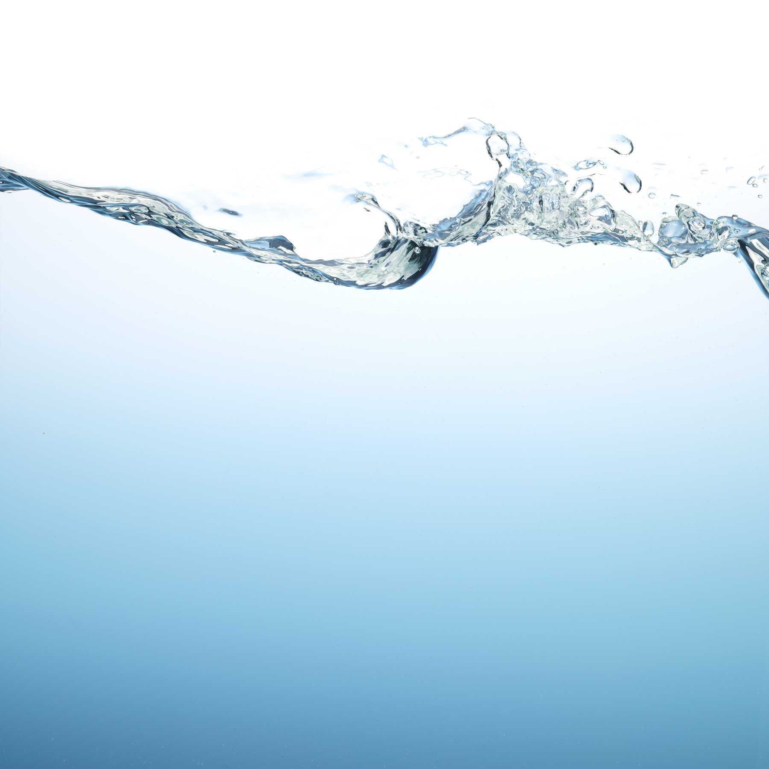
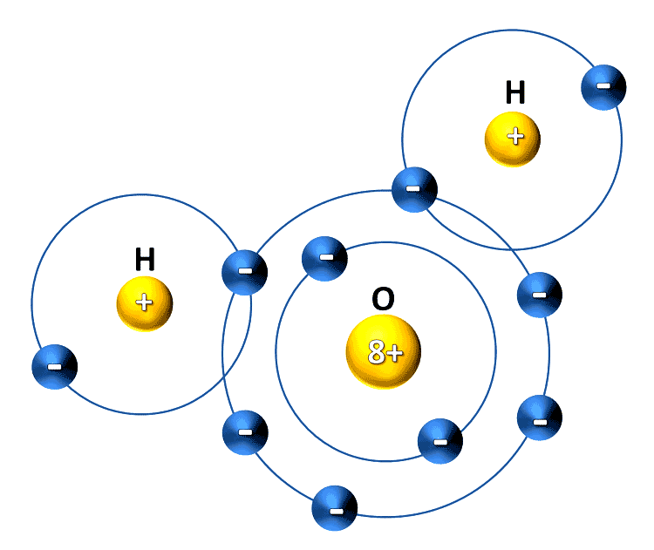
The wonderful world of WATER
Notes:
Needs intro music and water SFX – perhaps waves on shore.
1. Water covers nearly 70 percent of the Earth’s surface.
2. The Nile River is the longest river in the world at 4132 miles long.
3. Every year, 3.4 million people die because they lack clean water, sanitation, and hygienic necessities. 99 percent of these deaths occur in the developing world.
4. 780 million people lack access to an improved water source — approximately 1 in 9 people.
5. One 5-minute shower uses more water than one person in the slum of a developing country uses for a whole day.
6. Today, a larger number of people own a mobile phone than those who have access to a toilet.
7. People suffering from water-related illnesses fill half of the world's hospital beds.
8. 10 percent of the global disease burden could be reduced with improved water supply. Not only would it increase hydration, but sanitation and hygiene as well.
9. Just 33 percent of what the world spends on bottled water every year would pay to provide clean water for the 780 million without it.
10. Lack of access to clean water and sanitation kills children at a rate of 200 an hour.
11. Safe drinking water in undeveloped areas allows children — especially young girls — the opportunity to go back to school and in turn, fosters economic development.

Slide 2
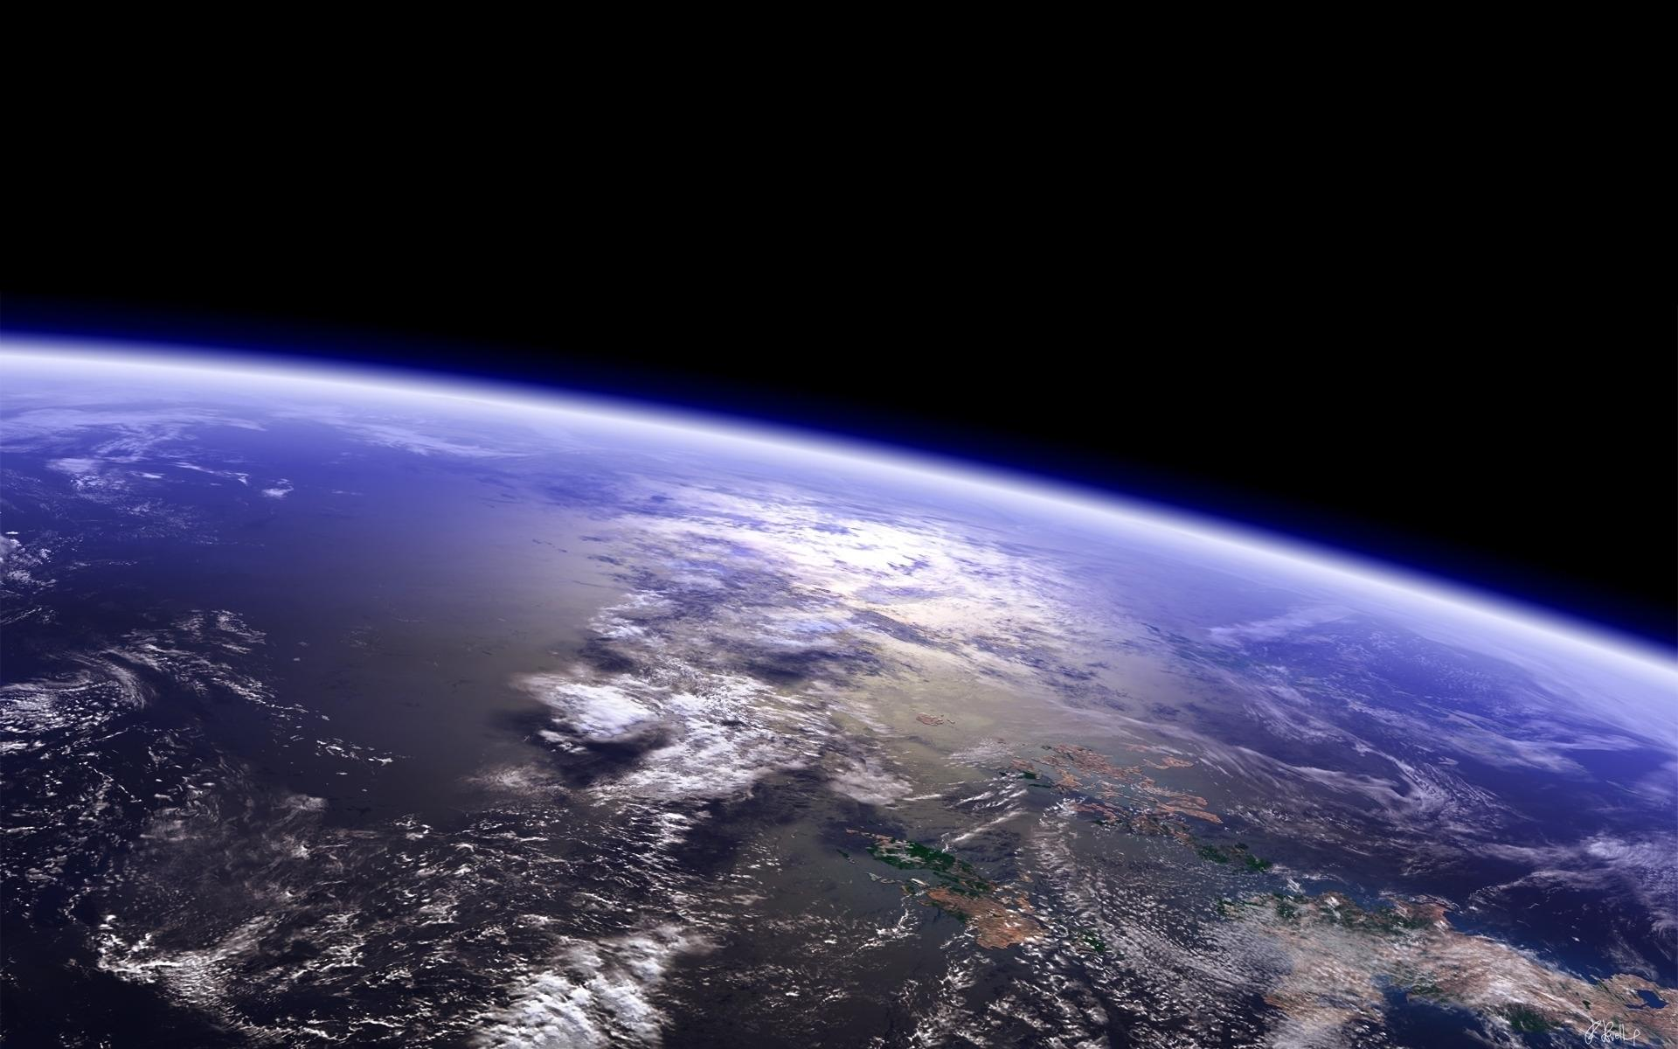
we live in a world of WATER . . .
Notes:
We live in a world of water……
Sound of water should play thru full sequence of next 17 images ending with drop.

Slide 5
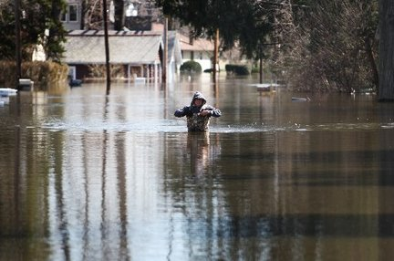

Slide 7
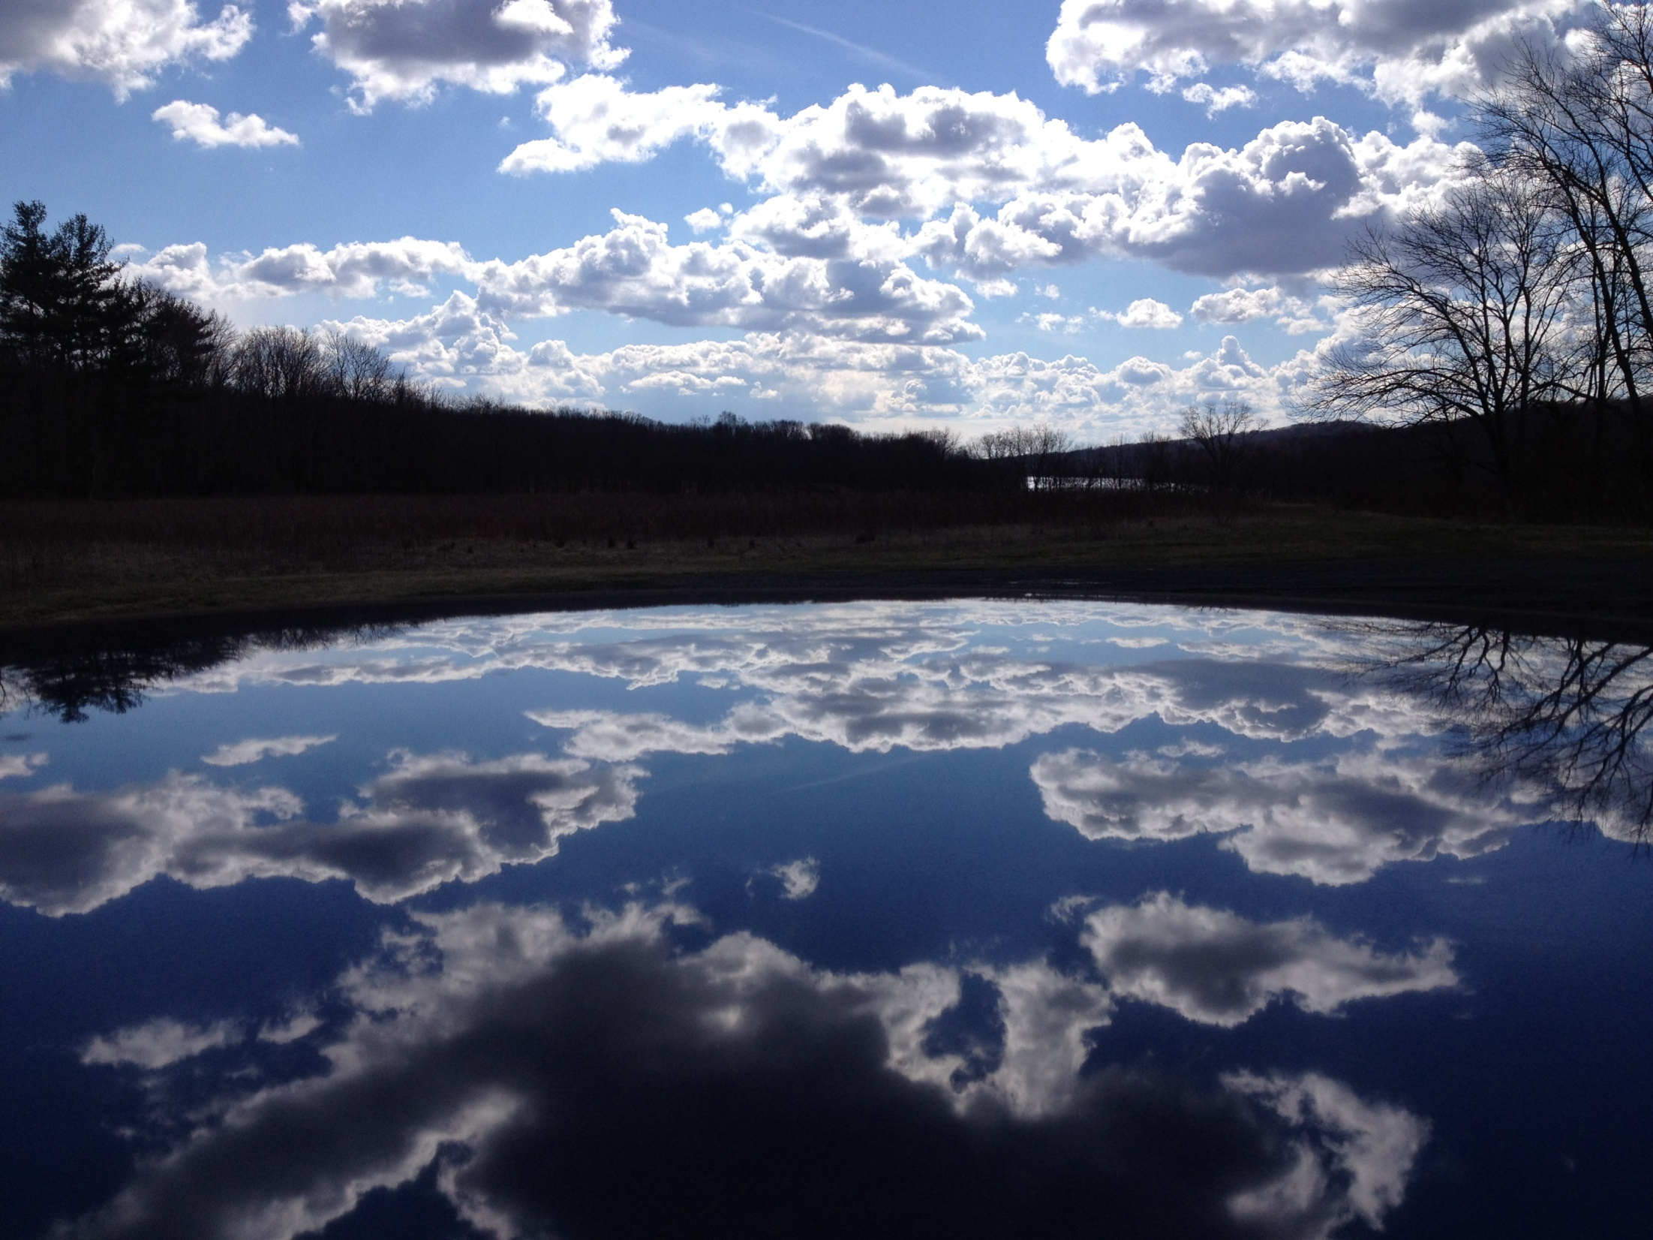

Slide 9
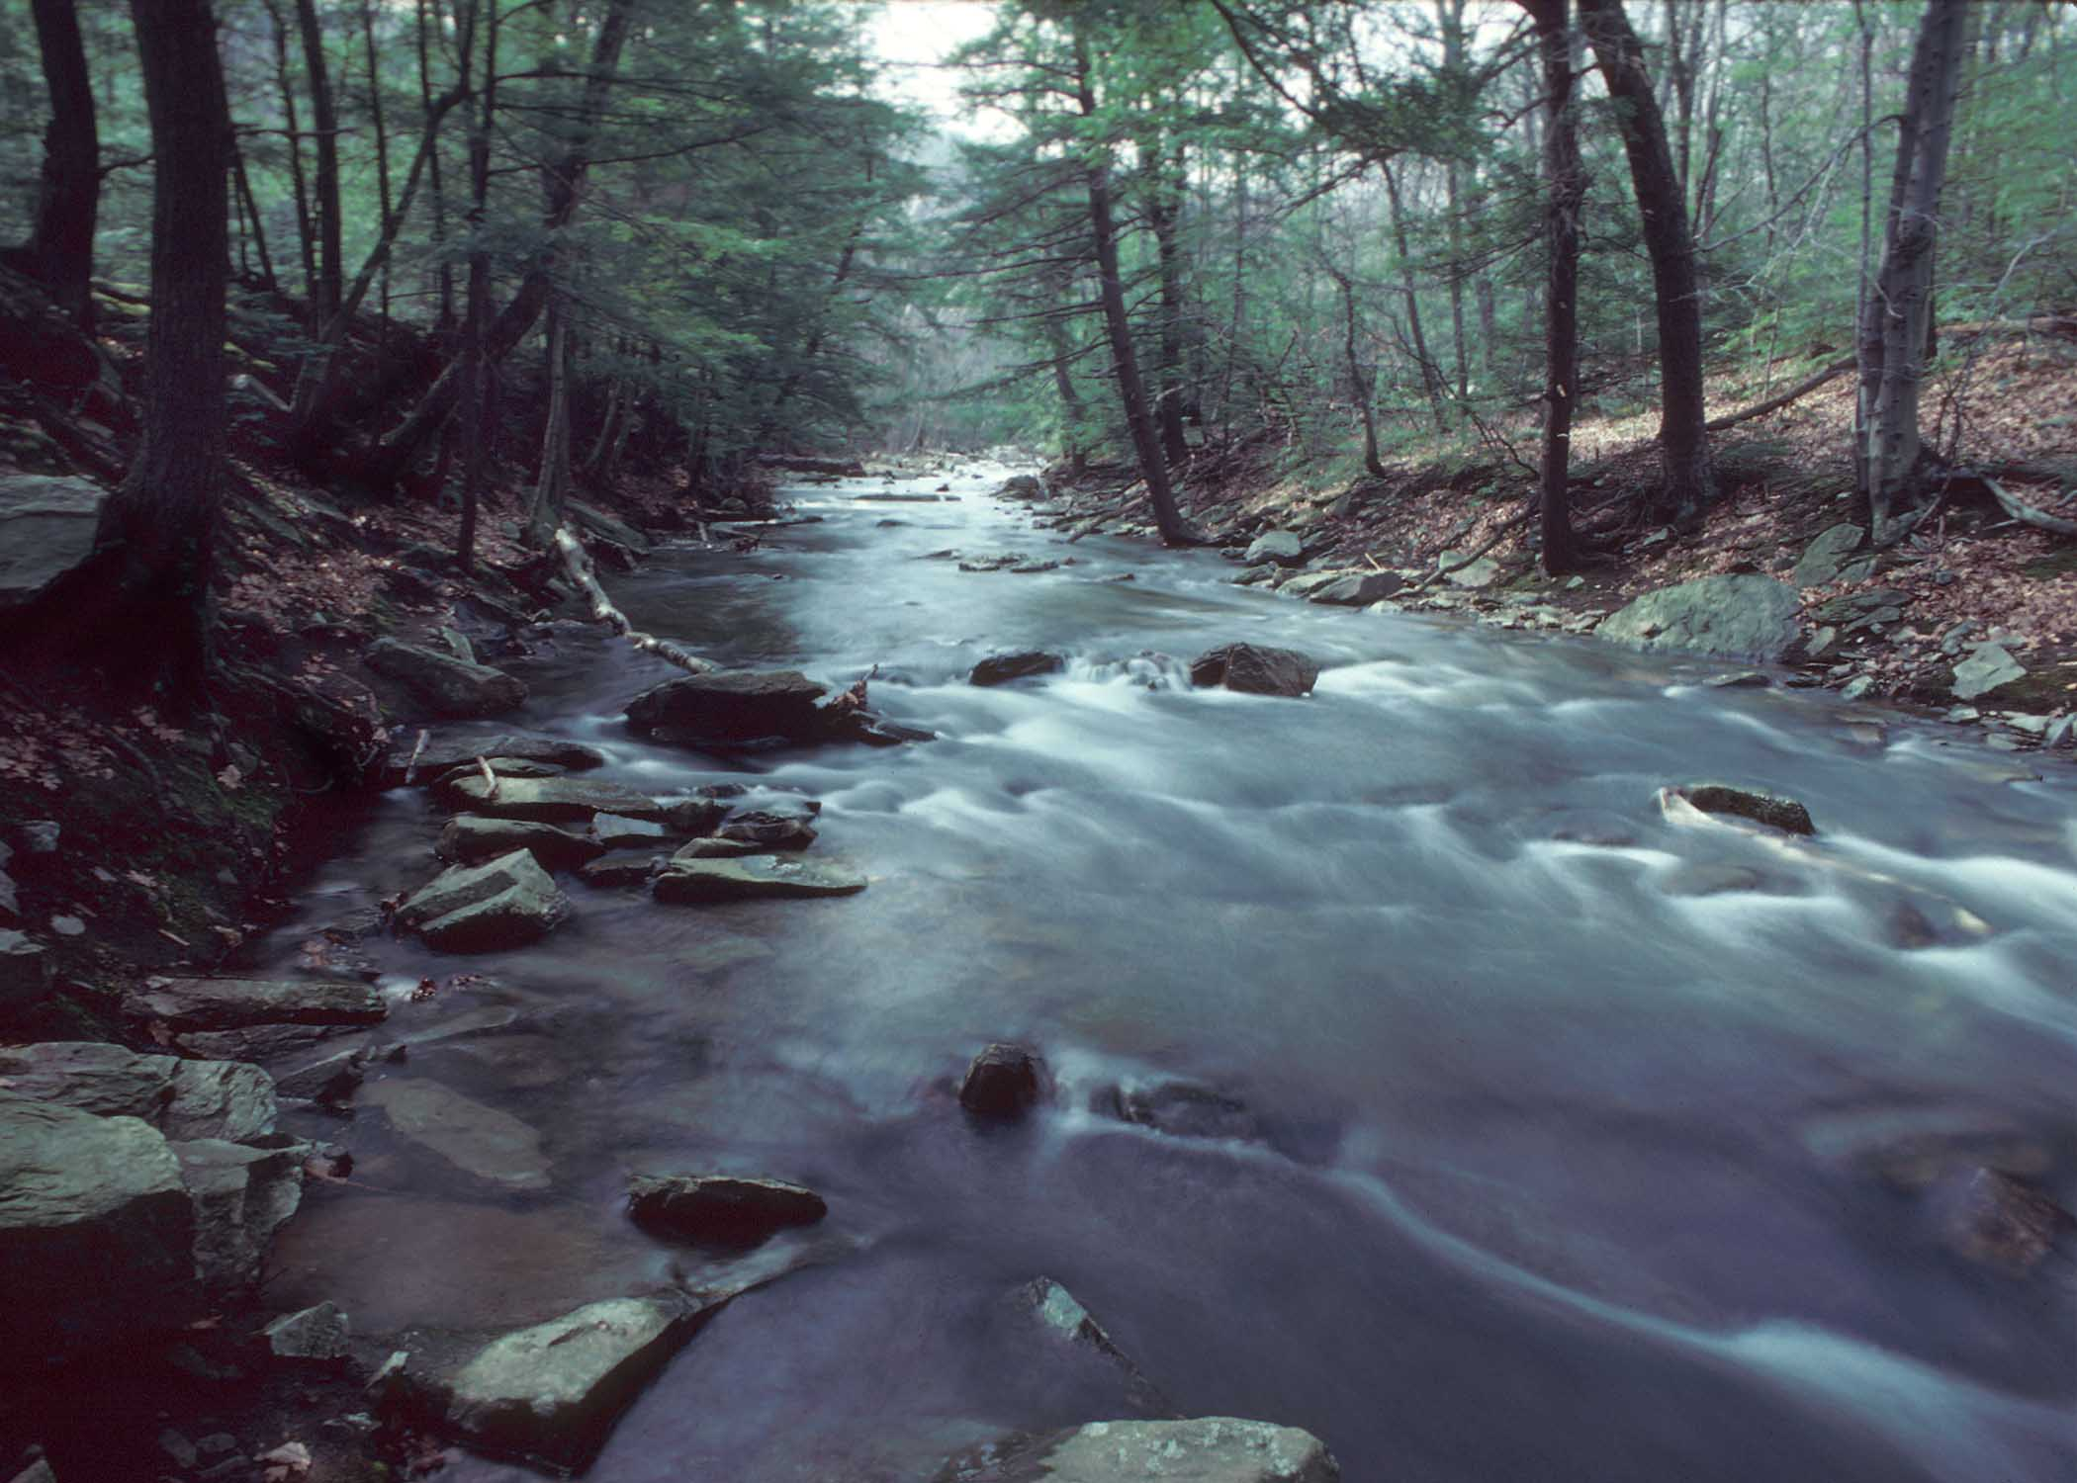

Slide 10
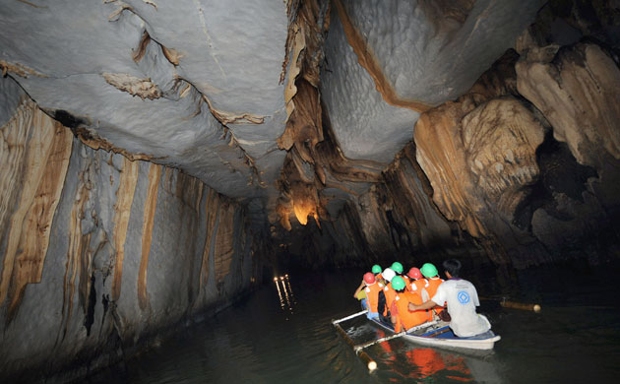

Slide 11
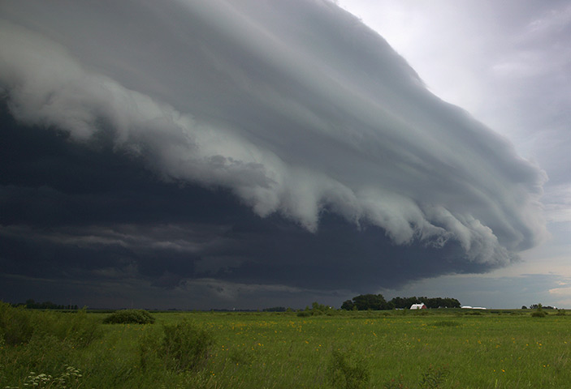

Slide 12
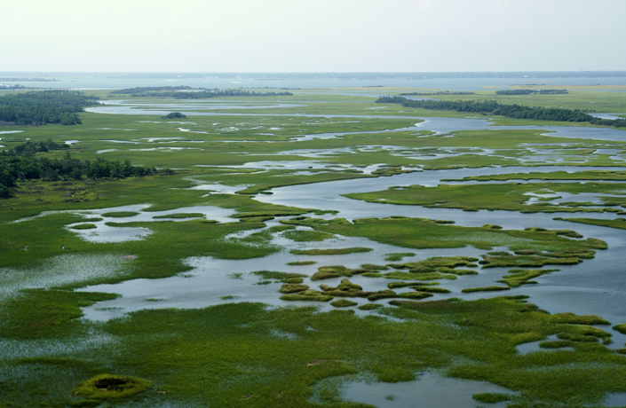

Slide 13
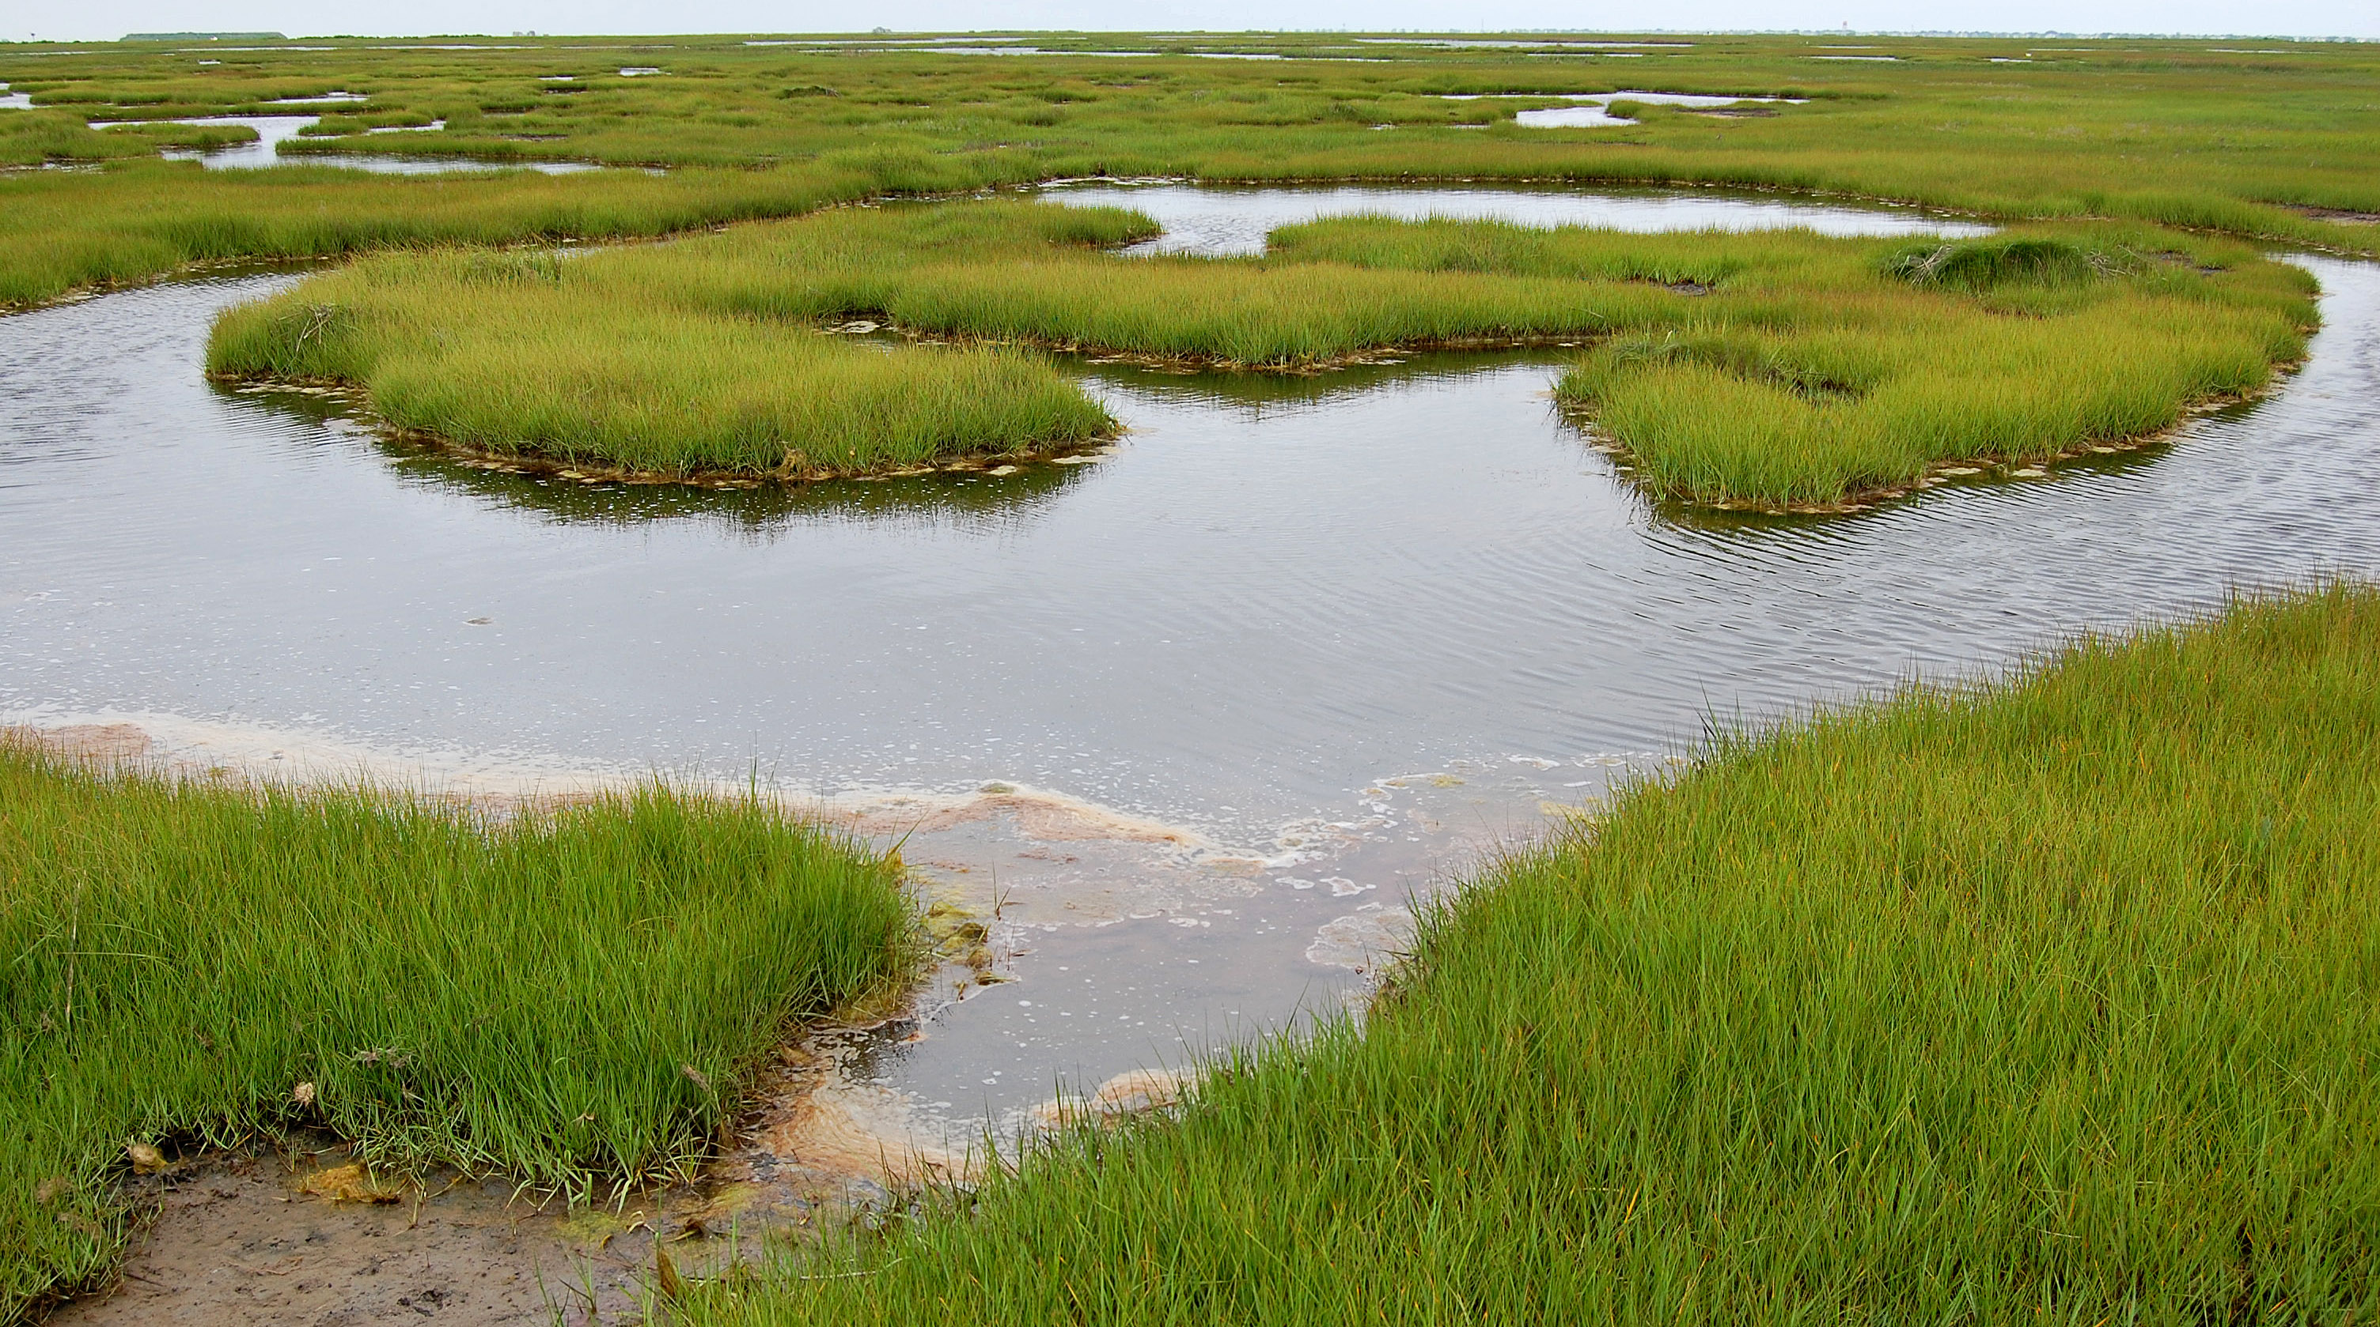

Slide 14
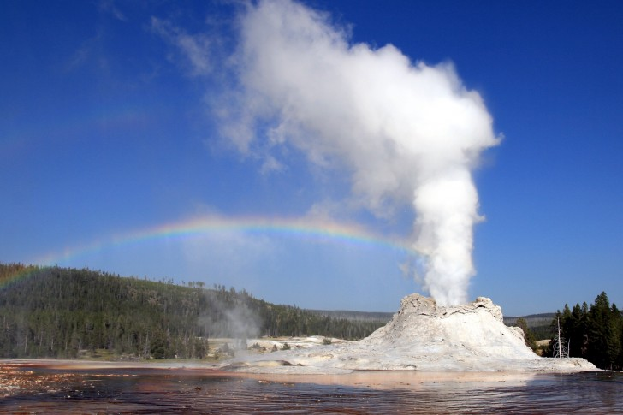

Slide 15
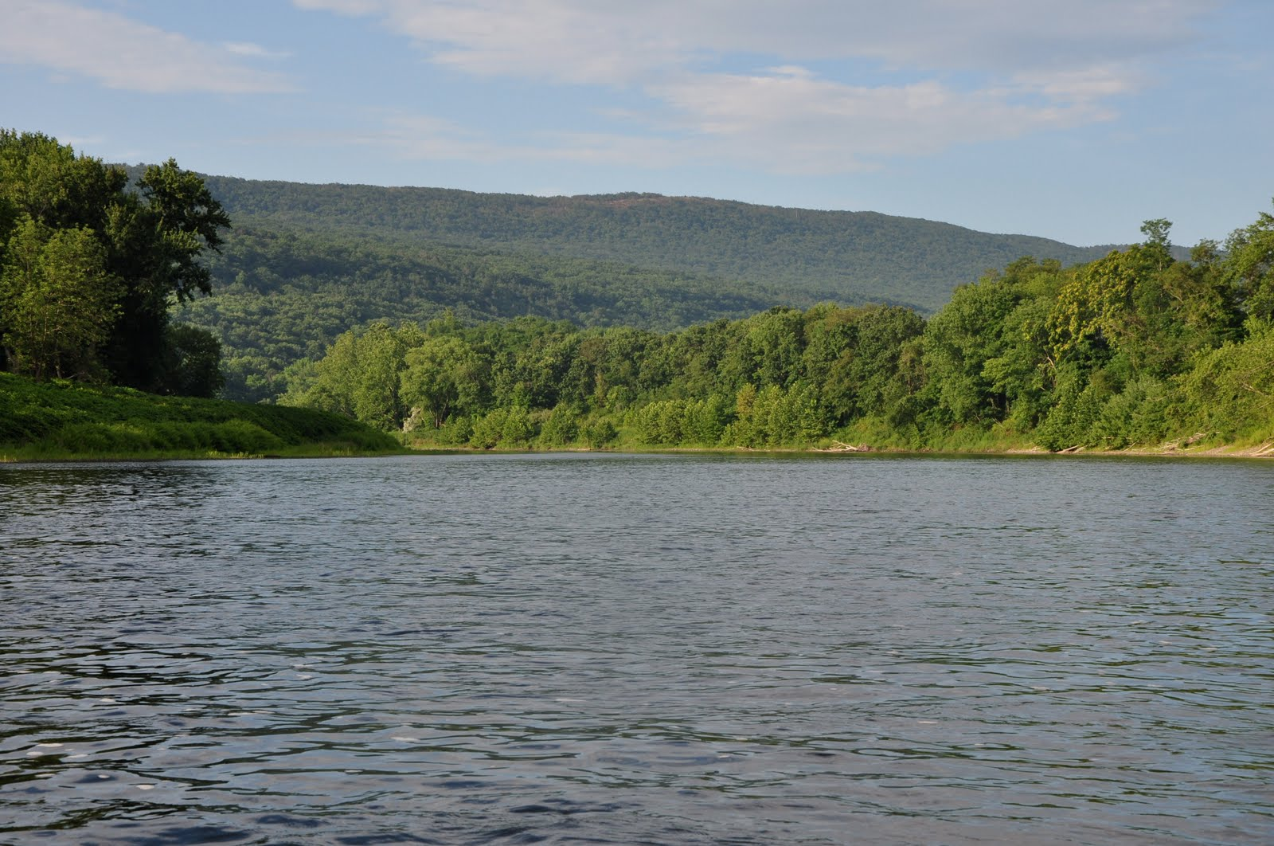

Slide 16
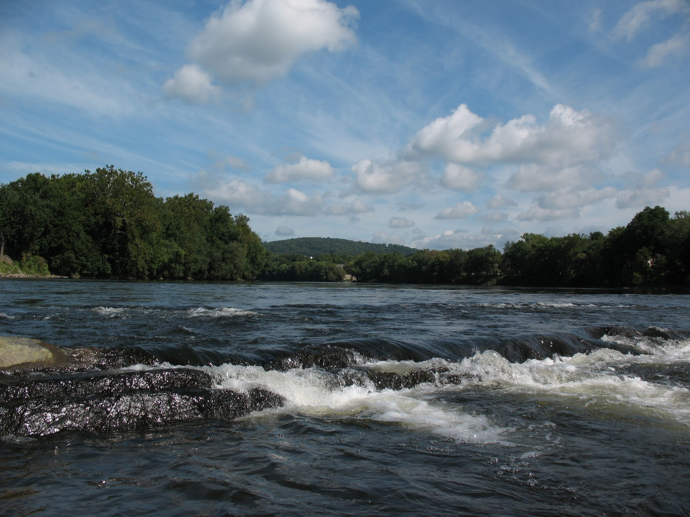

Slide 17
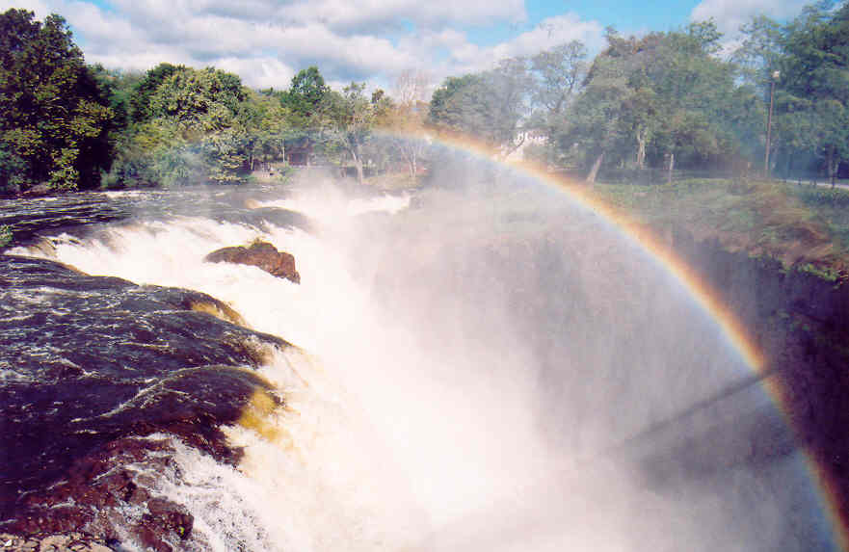

Slide 18
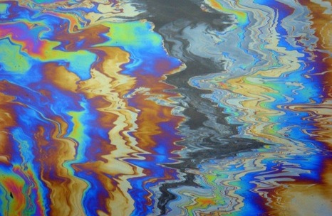
Polluted water image

Slide 19
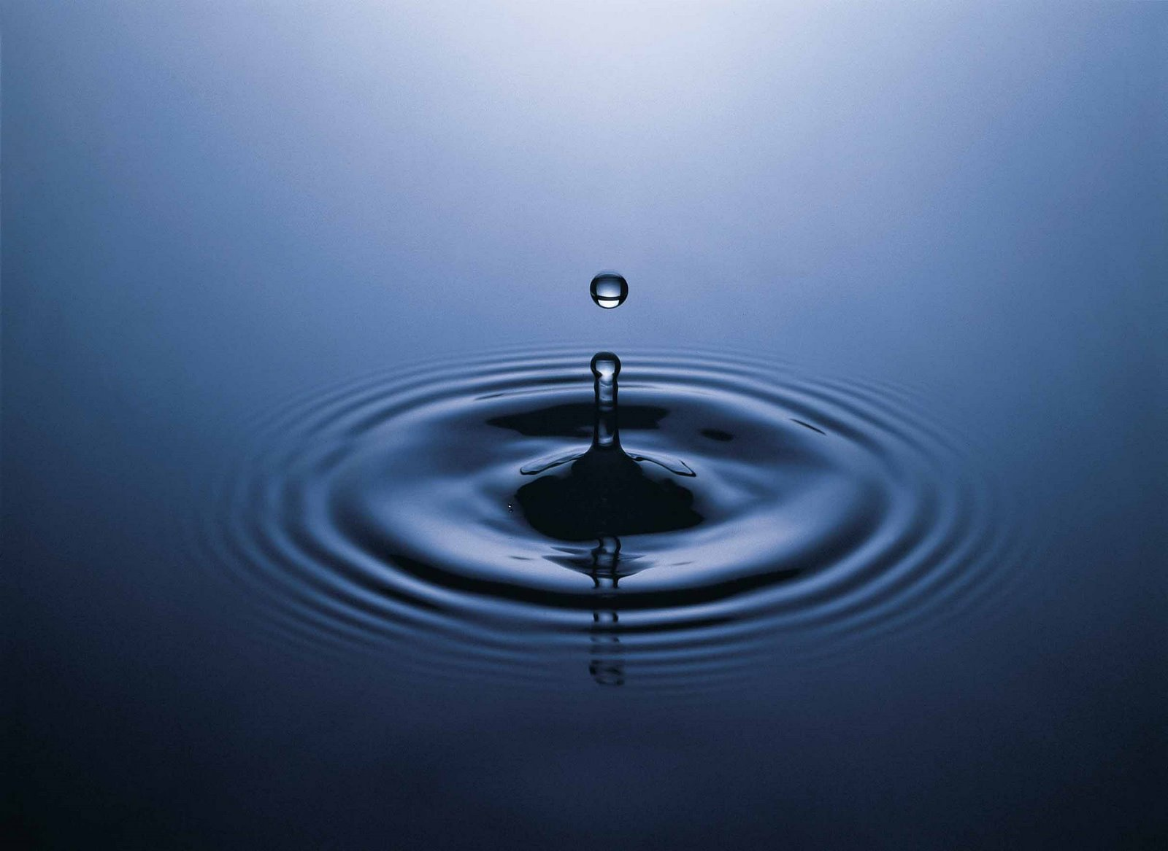
Notes:
SFX of drop ends sequence

Slide 20
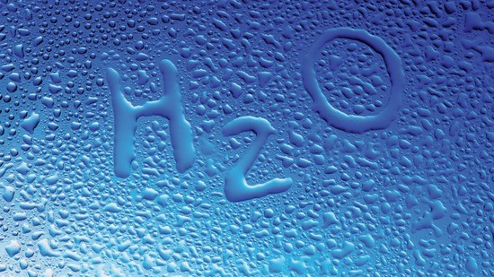
What is water?

Slide 21
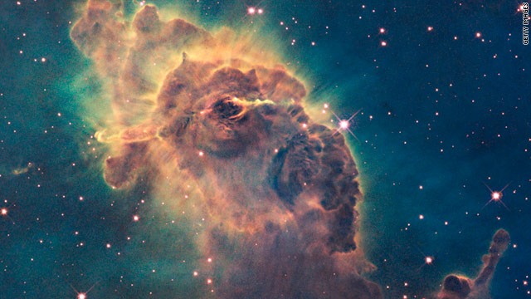
Water is the most common compound in the universe and is made of the first and third most common elements in the universe;
Notes:
Etherial SFX – Serrie for example for this and next slide

Slide 22
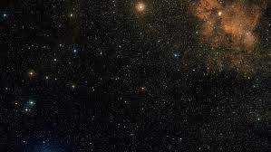
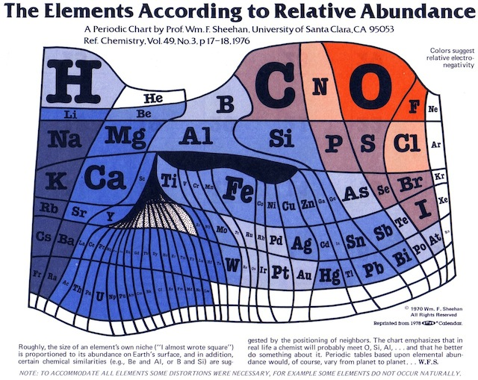
Hydrogen and Oxygen.

Slide 23
Chemically known as Dihydrogen Monoxide, Dihydrogen Oxide or Hydrogen Hydroxide. . .
H
H
O
Its’ name has been used for some time as an internet hoax!
Notes:
Joke sting sfx at end

Slide 24
The Dangers of Dihydrogen Monoxide!
DHMO is
Found in all cancer cells
Lethal in doses as small as a teaspoon
Can cause severe burns
Is the main component in acid rain
Oxidizes metals
Contributes to soil erosion
Prolonged exposure causes tissue damage
Associated with dangerous hurricanes
Used by terrorists worldwide
All joking aside, water does have a great feature that few other compound have…
Notes:
Scary ambiance sfx

Slide 25
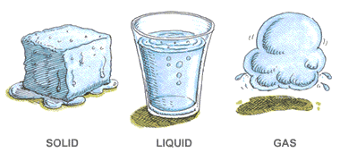
An
It can naturally be found in 3 different phases!
Solid,
Liquid,
and Gas!

Slide 26
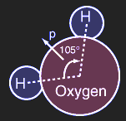
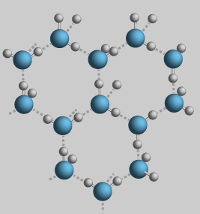
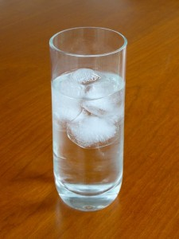
Normally, water is a very stable molecule…
But when it freezes…
The structure of the molecule changes…it expands by 8%!
Making it less dense than the water around it, and because of that, ice floats!
Notes:
Sound of stuff crystalizing

Slide 27
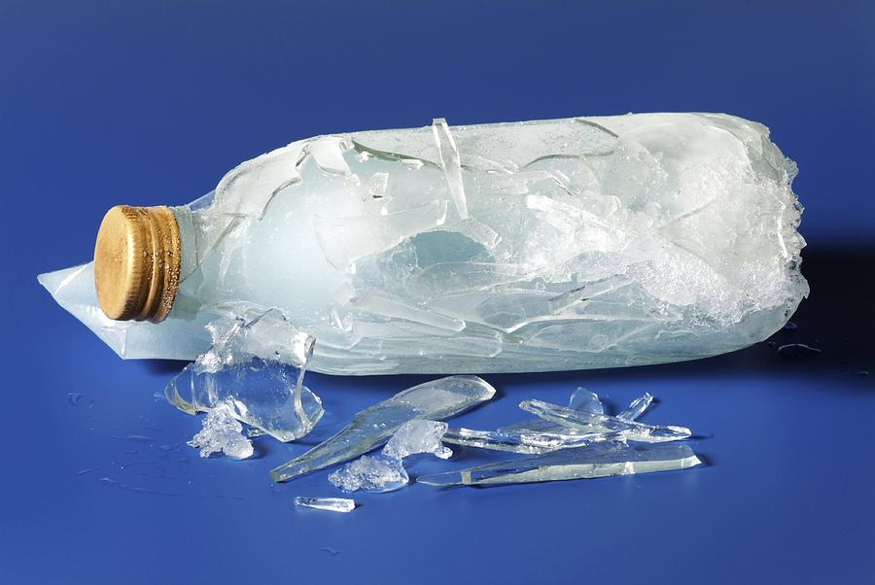
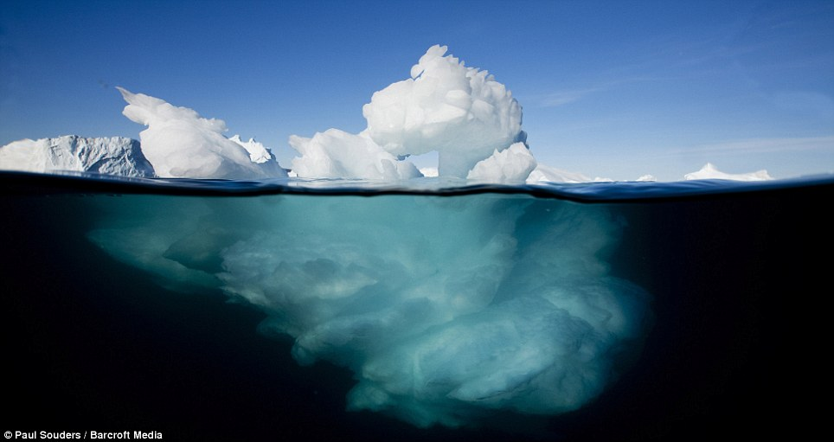
This property can easily be seen if you freeze a glass bottle of water.
“Magical” qualities…
This is also why icebergs float and liquid water can be seen flowing under a frozen river or lake.
If ice sank, life on earth would not be possible!
Notes:
Sound of glass breaking

Slide 28
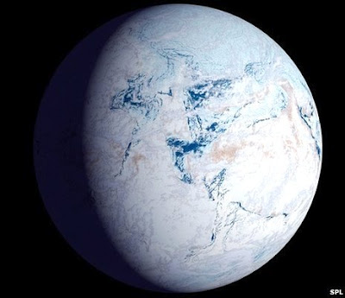
And our world would be a big ball of ice…
Fortunately, this is not the case!

Slide 29
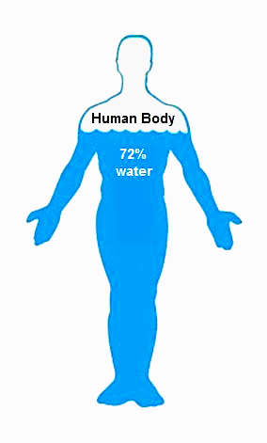
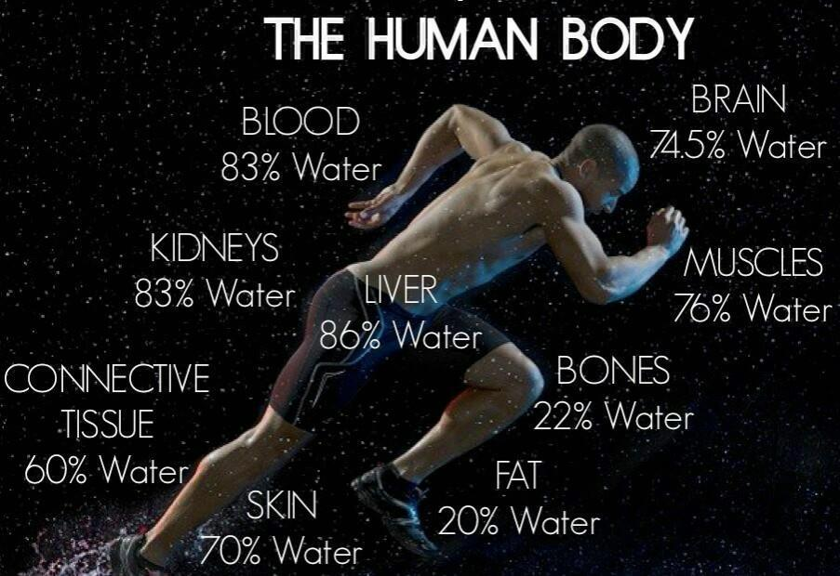
Why is water
important?
Notes:
About 75% of the body is water. The blood fluid, of a person weighing 150 pounds has about 10 lbs or 5 qts of water and is 92% water; red blood cells = 65% water, white blood cells = 70% , general body cells - 80% , protoplasm = 75% , saliva (about 3 pts, daily) = 99%, gastric juice (1-2 quarts daily) = 99%, skin perspiration (1-5 pts. daily) = 99%. lungs use up to one quart; kidnesy use 1-2 quarts,; brain is 85% water, nerves 75%, heart=75%, lungs 75%, liver 70%, kidneys = 80%.

Slide 30
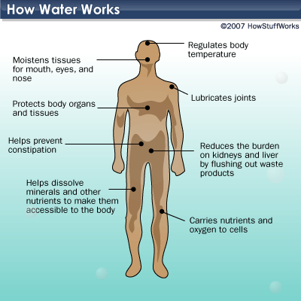
Water serves many biological functions:
Biological benefits for humans
Notes:
Water is the body's solvent; it is the medium of all chemical activities in the body, which are many. Water is the medium of exchange of all life-giving supplies from one point to another until they reach the cells , and of all wastes from one point to another until they are removed by excretion. Without water, the blood could not move. Water is the lubricant of all moving parts. It is the regulator of body temperature. The body cells are "water-cooled!" Violent exercise continued for 26 minutes would generate enough heat to coagulate the albuminous substances in the body--similar to cooking the white of an egg-- unless this heat were promptly released. The cells are surrounded by water and thus are "water--cooled!" When there is there is a deficiency of water, the process of elimination will continue, but to do so the blood and tissues will be robbed of some of their water content. This will hinder their normal procedures. If this continues, it may lower blood pressure; headaches , tiredness, and other conditions may result. Constipation may develop. Kidneys , lungs and pores will be hindered in eliminating waste from the body and so the wastes will accumulate all the way back to each cell, and the inside of the body becomes like a stagnated pool. If one loses all of the stored glycogen (blood sugar) , all of the reserve fat, and even half the body protein, the life is not in danger, but 10% of the body's water is serious, and a loss of 20-22% of the body's water is fatal. A person deprived of water will die in 60 to 80 hours. It is important to supply the body in the neighbourhood of 8 glasses of pure water a day? (Ezekiel 4:11) Natural remedies using water in compress Fevers :Cold compress or rags to the forhead relieves; luke warm bath; cool enema; drink lots of water. Muscles sore: use very cold compresses Headaches : try walking in a bath tub with 2 inches of cold water, this causes the blood to flow from the feet; headache gone.
Water helps remove the dangerous toxins that your body takes in from the air you breathe, the food you eat and the chemicals used in the various products you use on your skin and hair. Other things water does for your body is to cushion your joints. Water carries oxygen and nutrients into all your cells. Water also helps regulate your body temperature. You need water to keep your metabolism working properly. In order for this to happen, there is a certain level of water in each of our bodies that we need to maintain. If we don't keep that amount, our bodies will start to dehydrate. An easy way to think of it is to think of your car's need for oil. If your oil level gets too low, your engine will start to run rough. If you totally deplete your oil supply in your car, your engine will stop running. Same with your body. Therefore it is easy to see why it is very important to drink six to eight glasses of water a day. Some of the things that may happen to your body if you do not have enough water are that your blood pressure can fall to dangerously low levels. Blood clots may form. Your normal kidney function is impaired. You may get terrible constipation. Some of the signals your body gives you of a low water level are constipation, terribly dry skin, and increased incidence of urinary tract infections and reoccurring headaches. A man drowns inside and dies because his brain got clogged with too much water, this only happened because he drank around 15-20L of water...so it is recommended that you don't drink more than 5L a day....

Slide 31
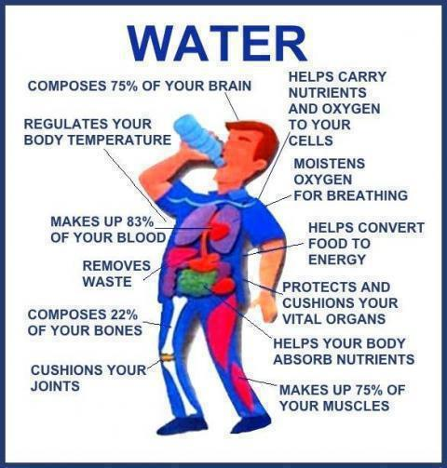
All chemical reactions in the body need water
Water allows nutrients to move throughout the body
Water removes toxins from the body
Your blood sugar can drop to zero, you can lose 100% of your body fat and 50 % of your protein and you will suffer no ill effects. But losing 20% of the water in your body is fatal!
Biological benefits for humans

Slide 32
Water plays an extremely important
role in the natural environment!

Slide 33
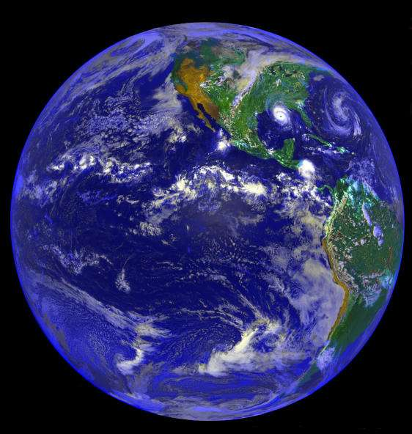
Water covers 70% of the surface of our planet!

Slide 34
Without water our world would look much different!
Surprisingly, there is less water than you may think…

Slide 35
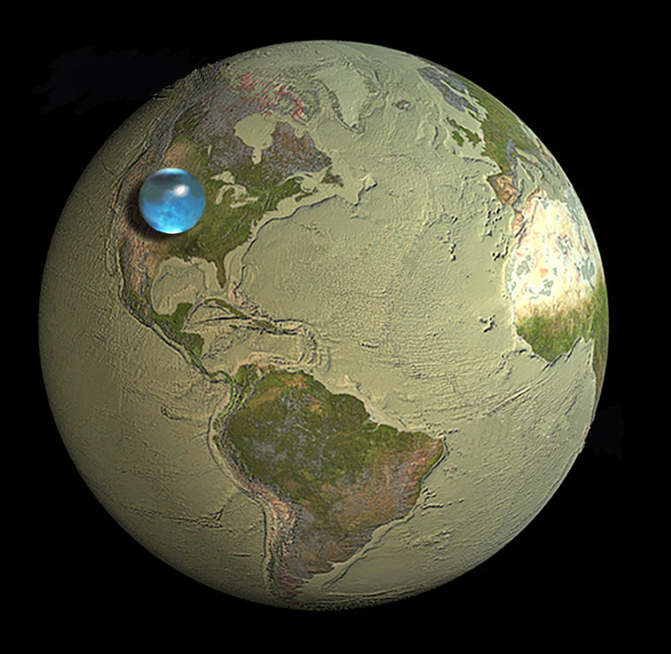
This image shows how much water there really is.
Notes:
1. Water covers nearly 70 percent of the Earth’s surface.
2. The Nile River is the longest river in the world at 4132 miles long.
3. Every year, 3.4 million people die because they lack clean water, sanitation, and hygienic necessities. 99 percent of these deaths occur in the developing world.
4. 780 million people lack access to an improved water source — approximately 1 in 9 people.
5. One 5-minute shower uses more water than one person in the slum of a developing country uses for a whole day.
6. Today, a larger number of people own a mobile phone than those who have access to a toilet.
7. People suffering from water-related illnesses fill half of the world's hospital beds.
8. 10 percent of the global disease burden could be reduced with improved water supply. Not only would it increase hydration, but sanitation and hygiene as well.
9. Just 33 percent of what the world spends on bottled water every year would pay to provide clean water for the 780 million without it.
10. Lack of access to clean water and sanitation kills children at a rate of 200 an hour.
11. Safe drinking water in undeveloped areas allows children — especially young girls — the opportunity to go back to school and in turn, fosters economic development.

Slide 36
The smaller drop is how much of that is fresh water

Slide 37
The smallest drop is the water we can actually drink.

Slide 38
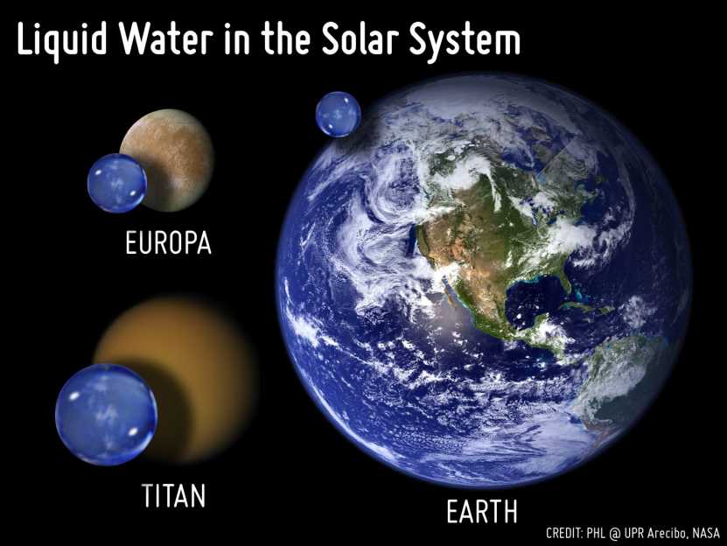
Other worlds nearby have even more water!

Slide 39
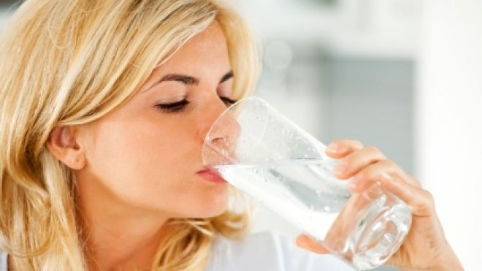
How do we use water?

Slide 40
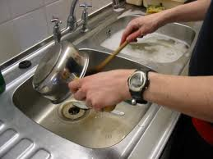
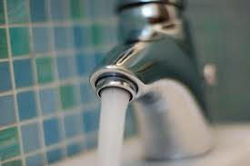
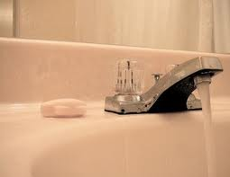
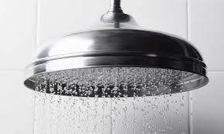
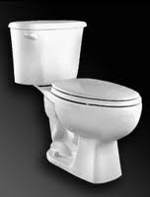
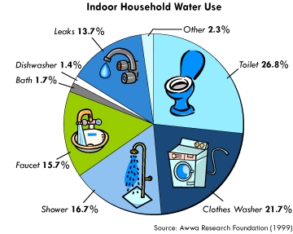
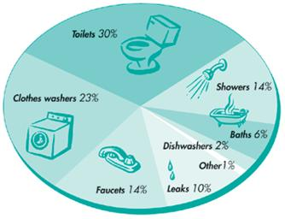
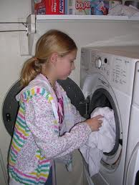
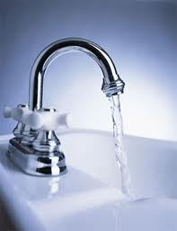
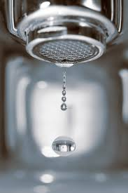
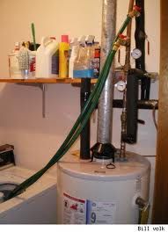
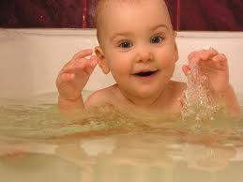
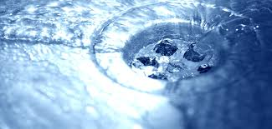
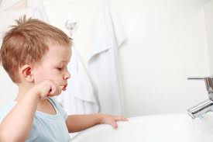
Notes:
Running water SFX

Slide 41
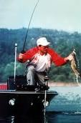
RECREATIONAL
USES OF WATER
Notes:
People playing SFX

Slide 42
AGRICULTURAL
USES OF WATER
Notes:
Outdoor sounds

Slide 43
INDUSTRIAL
USES OF WATER
Notes:
Industrial sounds

Slide 44
WATER ON
THE AIRWAVES
Notes:
Industrial sounds

Slide 45
How much water
do we use?

Slide 46
Doctors tell you to drink 8 glasses of water a day.
But in reality you use a lot more than that.
The average American uses 32,911 glasses every day.
That’s 751,777 gallons a year!
Notes:
Water pouring SFX

Slide 47
751,777 gallons would fill this water tank. →
It is also the amount of water that flows over Niagara falls every second!
Notes:
Waterfall SFX

Slide 48
You are probably asking,
“How is it possible that I use that much water?”
You clearly don’t drink that much.
Most of the water you use is “Hidden Water”,
which is water used to grow and make the things
you eat, wear, and use, and to generate energy.

Slide 49
To make a typical peanut butter and jelly sandwich you would need about 25 gallons of water.
That is about the same amount of water in a standard fish tank.

Slide 50
The water you needed was for growing the peanuts, fruit, wheat, sugar and other ingredients in the sandwich.
Let’s see some other examples…

Slide 51
To make one cup of coffee you would need about 40 gallons of water.
Hidden examples
40 gallons is a common garbage pail size.

Slide 52
To make a cheeseburger
you would need about
700 gallons of water.
700 gallons of water would overflow this propane tank. →

Slide 53
To make one pair of blue jeans you would need about 3000 gallons of water.
Hidden examples
That is about the same amount of water as a small backyard swimming pool.

Slide 54
How do we abuse water?

Slide 55
Water pollution can be simplified into 2 categories:
Point Source Pollution
Non-Point Source Pollution

Slide 56
Water is also wasted in large amounts:
Water is a precious resource that must be protected!

Slide 57
How can we protect our water?

Slide 58
Water conservation activities at home,
at school and in your communities:
To learn more . . . Go to www.nj.gov/dep!

Slide 59
New jersey department of environmental protection
N
J
D
E
P
Thank You!
Notes:
Outro music and NJDEP chime.

