Slide 1

Wet Weather Flow Treatment and Disinfection Demonstration Project
“A Cost-Effective 21st Century Solution to a
20th Century Problem”
NJ Clean Water Council
November. 14, 2017
Stanley V. Cach Jr., P.E., P.P., BCEE., D.WRE
NJDEP Project Manager
Division of Water Quality

Slide 2
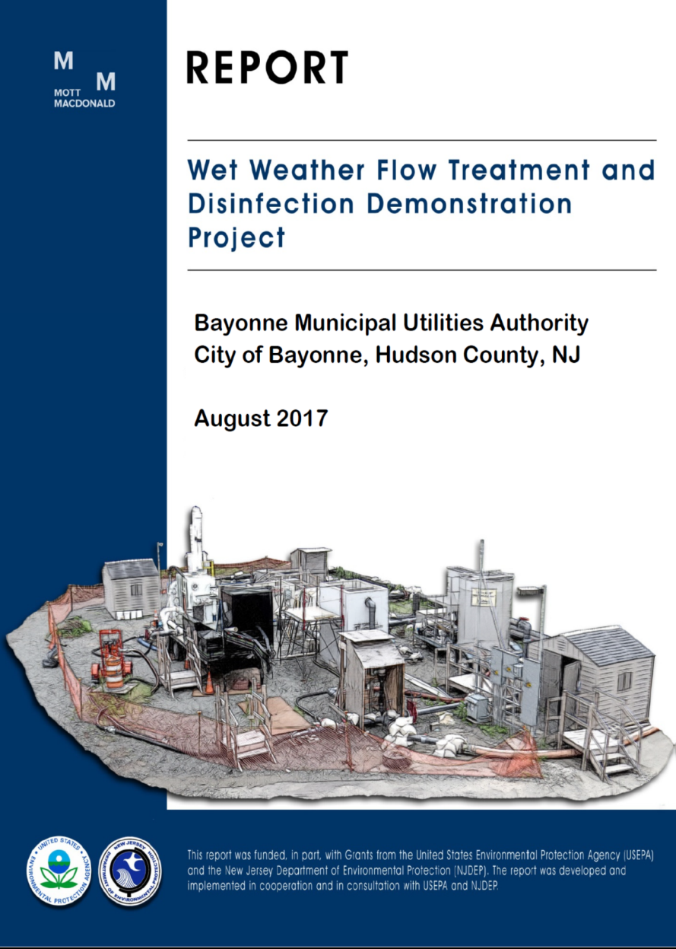
The Report
Background
Project Objectives
Project Collaboration
Technologies Tested
Findings
Conclusions
October 2017

Slide 3


Background: CSO Options
ELIMINATE REDUCE/STORE TREAT
Separate Green POTW
I/I Reduction Gray Satellite/End of Pipe
LID
S/F Removed 700 Tons/YR
281
Individual CSO Outfalls
Permitted
71
CSO Outfalls
Eliminated
210 CSO Outfalls
CSO FLOW
~23 BGY

Slide 4
Background: A Cost Effective Alternative
Satellite/End of Pipe Technologies
  CSO Feasibility Studies (2005-2007)
    Technologies were limited & not fully proven
    Performance was not independently validated
  SSO Abatement Alternative Analysis (2014)
    Satellite technologies chosen instead to storage, transport and treat at POTW

Slide 5
One Comprehensive Study:
Wet Weather Flow Treatment & Disinfection Demonstration Project
One study for all CSO permittees
Purpose: verify performance & costs
Duration: over 2 years (2014-2015)
Location: Oak Street Facility, City of Bayonne
Collaboration:
  Technical Advisory Committee
  Regulatory Oversight Team

Slide 6
Project Collaboration
Project Leadership
NJDEP
Division of Water Quality
Bayonne Municipal Utilities Authority
Mott MacDonald (Project Manager)
Technical Advisory Committee (7)
NJDEP
Division of Water Quality
USEPA
Office of Research and Development – Cincinnati/ Edison
Rutgers University
Mott MacDonald
Moffa and Associates Consulting Engineers
Regulatory Oversight Team (15)
NJDEP
Division of Water Quality
Division of Water Monitoring & Standards
Office of Quality Assurance
Office of Science
USEPA
Office of Research and Development – Edison
Quality Assurance Staff
Rutgers University
Operational Support
Passaic Valley Sewerage Commission
Suez/ United Water
Notes:
Who: A collaborative funding & technical effort
City of Bayonne; NJDEP; USEPA; Rutgers University; PVSC & Technology Manufacturers.
Collaboration & peer review
Technical Advisory Committee & Regulatory Oversight Committee.

Slide 7
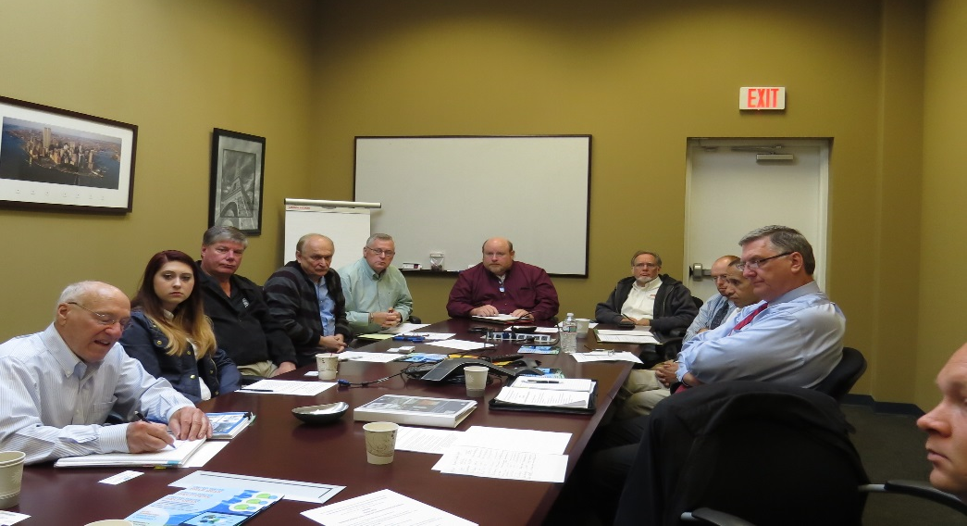
Project Collaboration:
Technical Advisory Committee
The Trinity
Committee Members:
Peter Moffa, P.E.
Richard Field P.E., D.WRE, BCEE (EPA ORD, Retired)
Jurek Patoczka, PhD, P.E.
Daniel Murray, P.E. (EPA ORD)
Committee Members (cont’d):
Qizhong Guo, PhD, P.E. (Rutgers)
Stanley Cach, P.E., D. WRE BCEE (NJDEP)
Shadab Ahmad, P.E. (NJDEP)

Slide 8
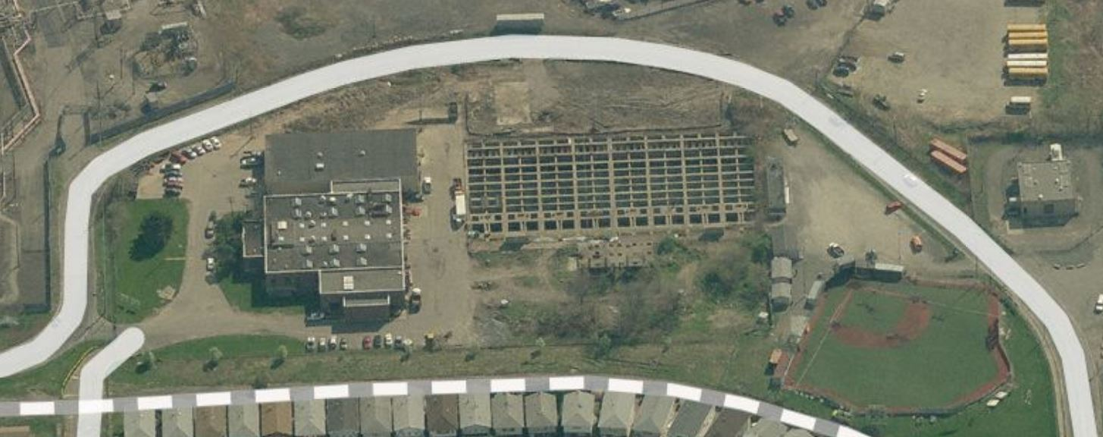
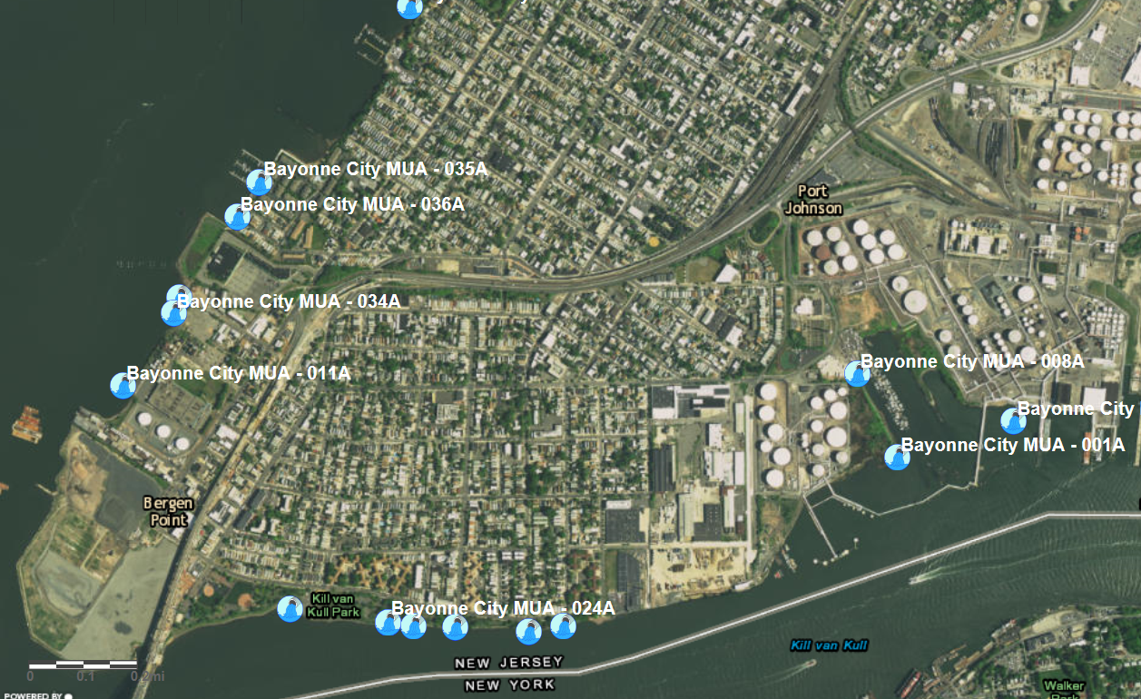
Demonstration Project Site
Bayonne
MUA
Newark Bay
Project Site
Kill van Kull

Slide 9
Project Objectives
Select & verify the performance of end of pipe technologies to treat CSO discharges
  Under field conditions
  For solids removal & disinfection
  At remote satellite locations
Improve engineering practitioners understanding of wet weather technologies
  Reliability
  Scalability
  Anticipated capital and O & M costs

Slide 10
Technologies Tested:
SIX (6) PILOT TECHNOLOGIES
18 treatment scenarios during 9 storm events
200-300 samples per event
Technology | Type | Function
Storm King | Vortex | Solid removal
Terre Kleen | Plate settler unit | Solid removal
Flex Filter | Compressed media filter | Enhanced solid removal
Trojan | Low pressure UV | Disinfection
Aquionics | Medium pressure UV | Disinfection
Injexx/Verdent | Peracetic acid (PAA) | Disinfection
Notes:
Flex Filter
Compressed media filter
Advanced solid removal

Slide 11
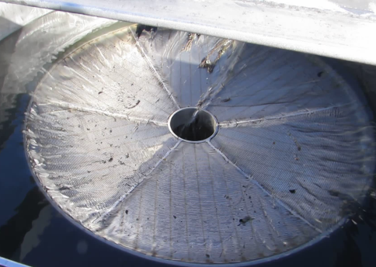
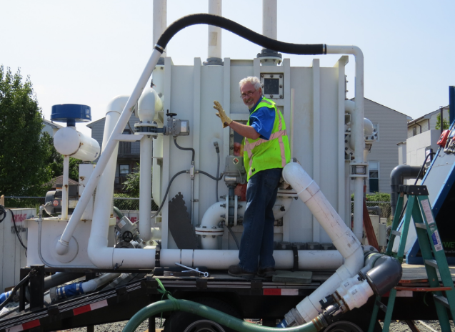
Why These
Technologies?
Technologies were chosen for their:
  Suitability for remote satellite facilities
  Documented performance
    Ability to meet CSO performance limits
  Simple operation
  Small footprint
  Ease of maintenance
  Cost
    Construction and O&M
Storm King
Flex Filter

Slide 12
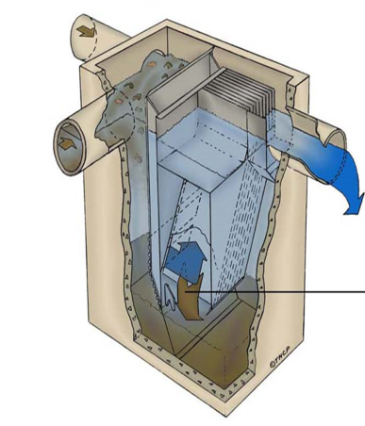
Why High-rate Solids Removal?
Vortex type- Storm King
  A vortex hydrodynamic solids separation w/ swirl self-cleaning screen
  No moving parts & non powered
  Remote & self-activating
  Anticipated reduction:
    TSS: 30-50%
    BOD: 20-30%
Plate Settler Unit- Terre Kleen
  Gravimetric solids separation
Terre Kleen

Slide 13
Why Enhanced High-rate
Solid Removal?
Compressed Media Filter – FlexFilter
  Innovative technology
  Remote, simple operation
  No chemicals required
    No ramp up time
  Anticipated reduction:
    TSS: 85-90%
    BOD: 50-60%
  Self contained & easy retrofit
Flex Filter

Slide 14
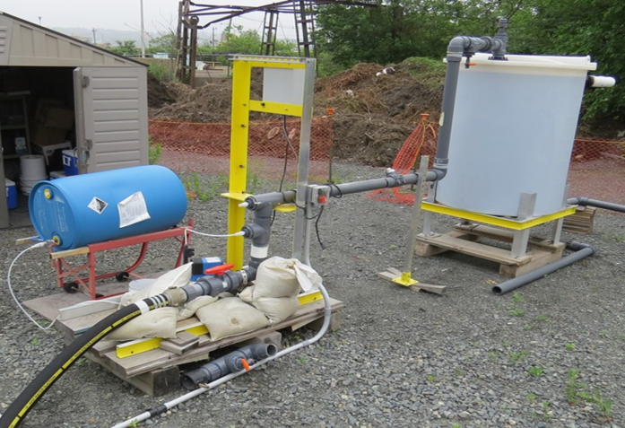
Why Chemical Disinfection?
Peracetic Acid - Injexx/Verdent
  Emerging technology per USEPA
  High rate disinfectant
    Stronger oxidant than hypochlorite
    No harmful by-products
    Could require no neutralizing agents
    Longer effective shelf life
    Contact time less than 5 minutes
  Can be used in combination w/ UV
Injexx/Verdent

Slide 15
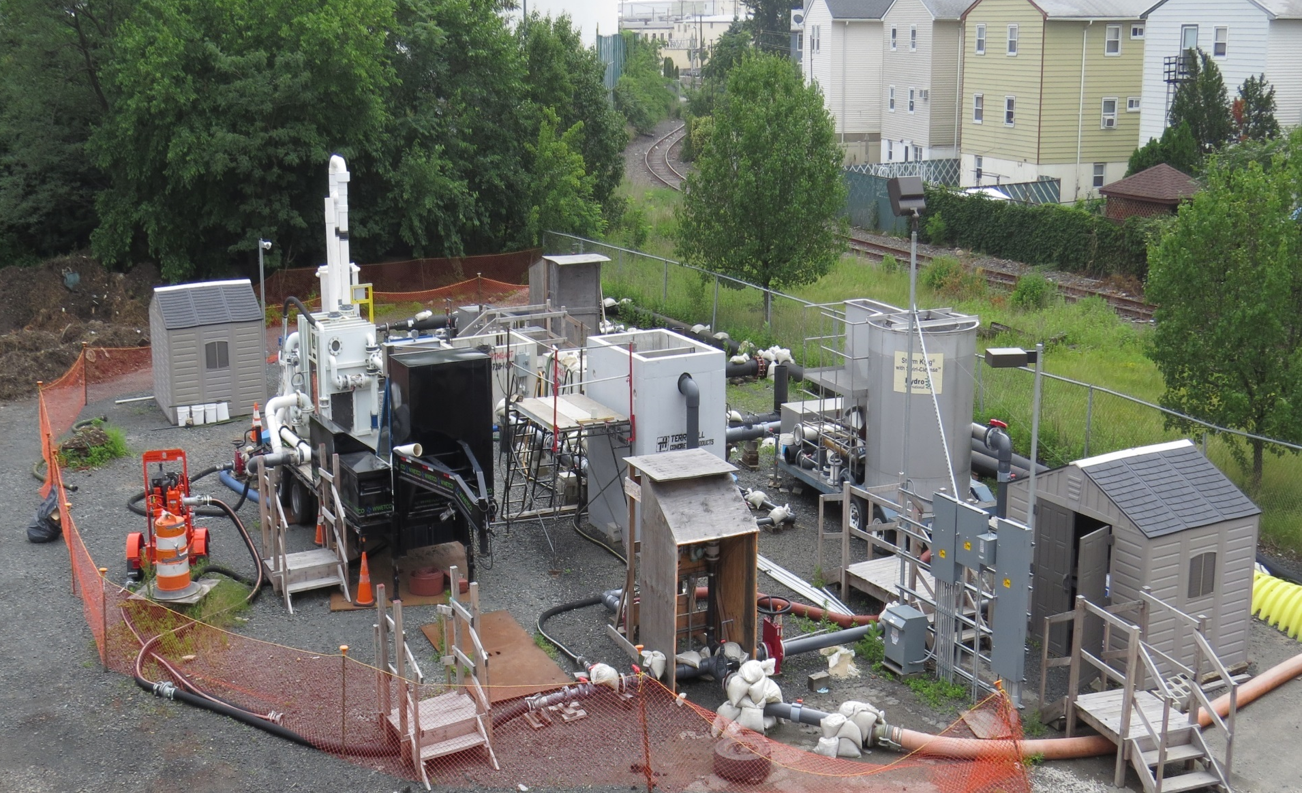
Demo Project Site (Aerial View)
Disinfection
Solid Removal
Influent

Slide 16
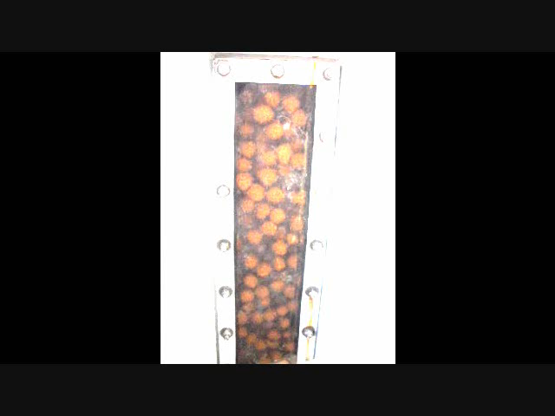
Video
WWETCO
Bio-FlexFilter™
(Compressed Media Filter)
Backwash Ends
Filter Drain
Media Compression
Filtration
Backwash
Video courtesy of WesTech

Slide 17
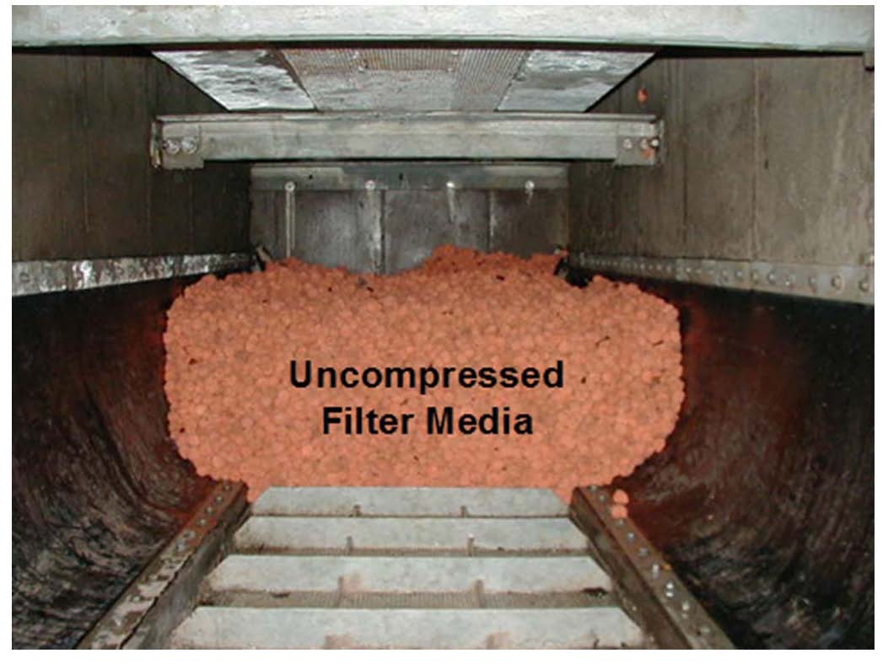
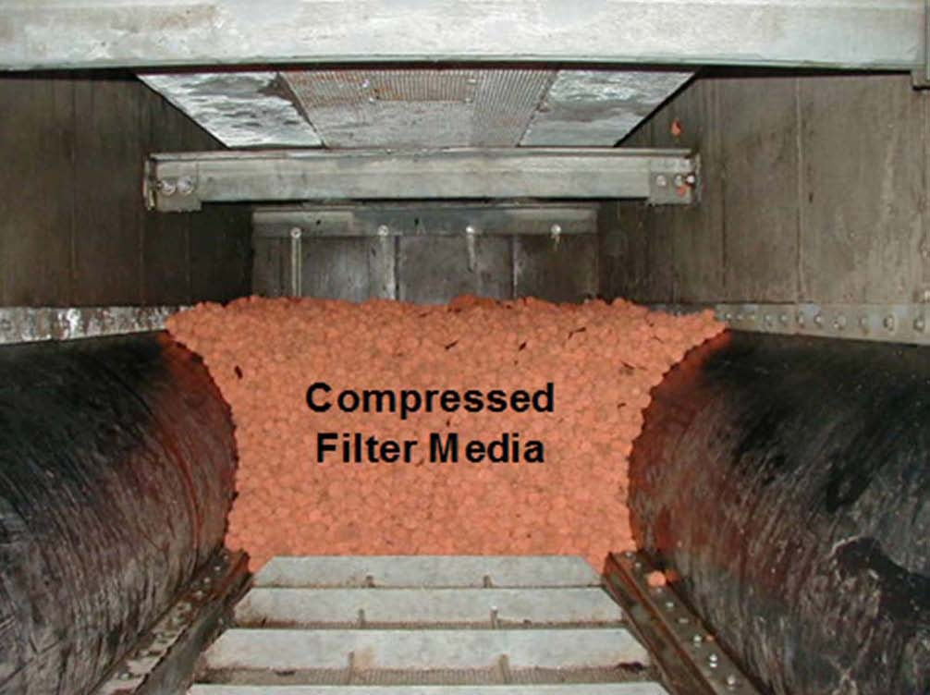
Photos Courtesy of
WesTech Engineering, Inc.

Slide 18
Technology Findings
Storm King & Terre Kleen (High-rate Solid Removal)
  Effective treatment for grit removal/inorganics
  Unable to reduce lighter solids for UV disinfection treatment
Storm King
Flex Filter (Enhanced High-rate Solid Removal)
  Effectively reduces TSS (90%) for UV or chemical disinfection treatment
  Flex Filter effluent concentrations for TSS & CBOD averaged 25 & 48 mg/l respectively (excluding the first event)
Flex Filter

Slide 19
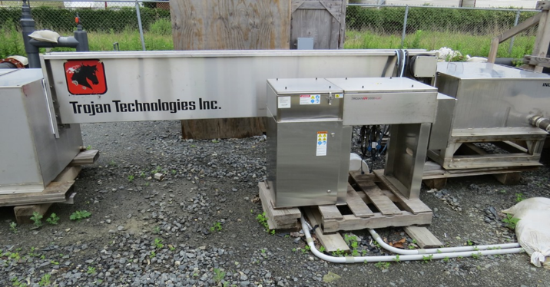
Technology Findings (cont’d)
Trojan
Trojan & Aquionics (UV)
  The Trojan UV 3000Plus unit using low-pressure-lamps:
    Required approx. 25 mJ/cm² irradiation energy input
    Achieved 3 log (ave.) inactivation of pathogen indicators
  The Aquionics 250+W unit using medium-pressure lamps:
    Required more than 45 mJ/cm² irradiation energy input
    Achieved a 3 log (ave.) inactivation of pathogen indicators
Notes:
Define water quality objectives

Slide 20
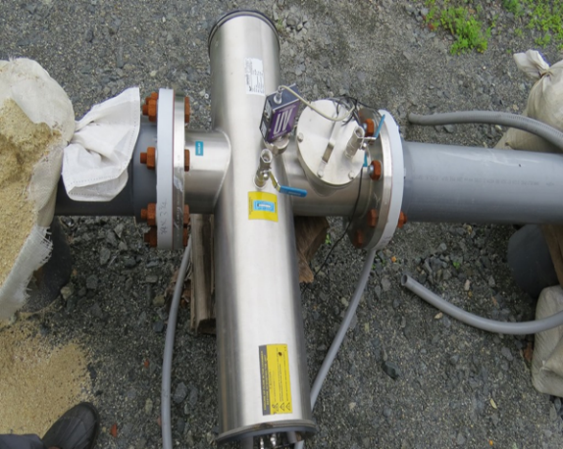
Technology Findings (cont’d)
Trojan & Aquionics (UV)
  As expected, there was a strong correlation between water transmittance and water quality parameters concentrations for TSS, CBOD₅ & COD
  As these parameters’ concentration increased, UVT decreased
Aquionics
Notes:
Define water quality objectives

Slide 21
Technology Findings (cont’d)
5. Injexx/Verdent (Peracetic Acid – PAA at 12% solution)
  Positive correlation between the applied dose of PAA as normalized by COD present in the wastewater and the log reduction of pathogen indicators
  PAA dose of 0.01 mg/l of PAA per mg/l of COD present in wastewater resulted in 3 log reduction of fecal coliforms (on average) with slightly higher effectiveness for E. coli and slightly lower for Enterocci
  Increasing the relative dose to above 0.015 mg/l of PAA per mg/l of COD increased log reduction to 4 (limited data)
  Hydraulic retention time ~ 3 minutes
Injexx/Verdent
Notes:
Define water quality objectives

Slide 22
Technology Conclusions
Coarse screens (1/2” opening) should precede any treatment scenarios
Compressed media filter – Flex Filter
  Most consistent and effective solids-removal technology
UV
  Effectively achieve water quality objectives at 40% UV transmissivity or greater
  Compressed media filtration, or equivalent, must precede UV
  The effluent from the Flex Filter averaged approx. 27 mg/l for TSS & 40% on UVT (excluding simulation runs)

Slide 23
Technology Conclusions(cont’d)
Peracetic Acid
  Effective disinfectant for wet weather flows
  Compared to chlorine:
    Similar or lower dosages needed
    Shorter contact time required (typ. 3 mins.)
    No neutralizing agent required
    Potentially less toxic then chlorine
    Longer shelf life
Flex Filter - Compressed media filter, followed by UV and/or Peracetic acid disinfection, can achieve water quality standards (suspended solids and disinfection)

Slide 24
Costs Conclusions
Construction and Operation & Maintenance (O&M) Costs
  can be significantly lower than regional solutions (transport and treatment or sewer separation)
Equipment and O&M cost curves are available in section 12 of the report
Estimated Footprint, Construction and O&M Costs:
Compressed Media Filter
Design Flow (MGD) | Filter Matrix Cell (width x length)¹ | Matrix Foot Print² Square Feet -Acres |  | Construction Cost ³ ($M) | Annual O/M Cost⁴ ($)
5 | 5(6x12) | 1,700 | 0.04 | 3.1 | 17,200
10 | 5(6x24) | 2,200 | 0.05 | 4.0 | 23,400
25 | 5(13x30) | 5,400 | 0.11 | 9.8 | 36,600
100 | 10(27x30) | 21,000 | 0.48 | 38.0 | 104,800
250 | 24(27x30) | 50,000 | 1.15 | 90.5 | 226,000

Slide 25
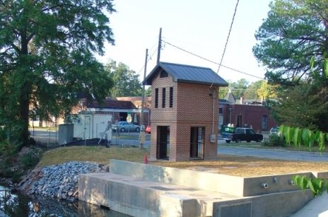
Project Conclusions
High-performance satellite end-of-pipe treatment can:
  be used to protect public health and aquatic biology
  be a cost effective alternative
  provide incremental CSO reductions
  offer green spaces & other community amenities
Satellite Treatment
facilities can be:
  Unmanned
  Odor free
  Adaptable to multiple
  locations
    Small footprint
    Below grade

Slide 26
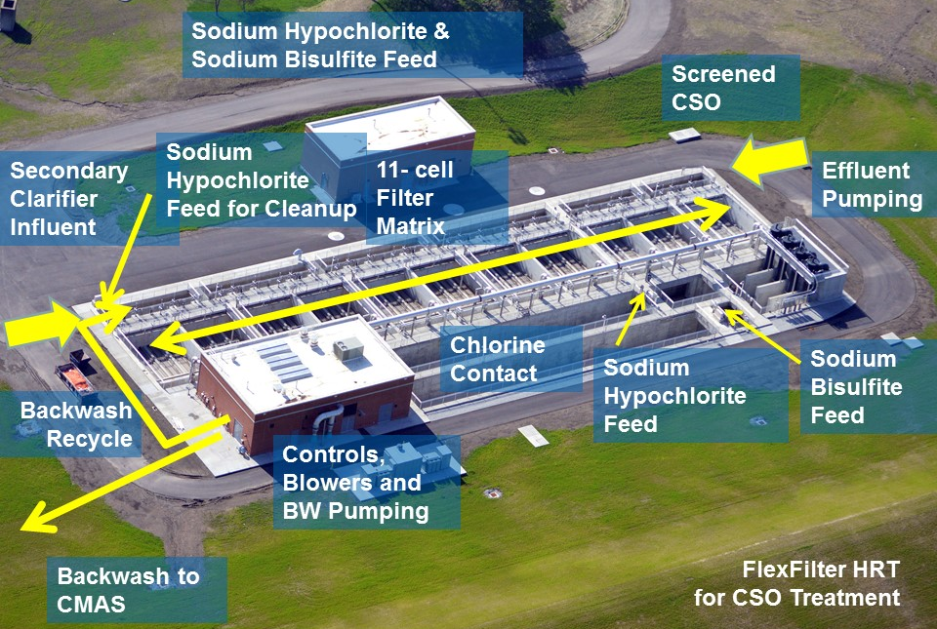
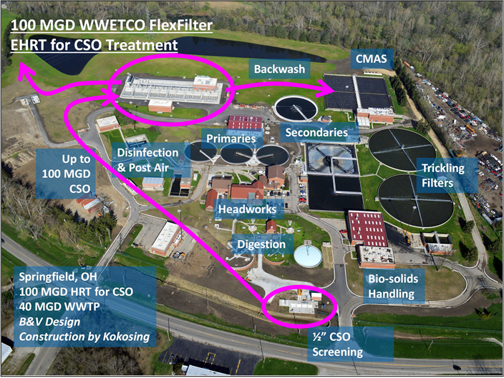
Springfield, Ohio – WTP:
CMAS
Auxiliary EHRT Facility
High-rate/ High-performance CSO treatment
Compressed media filter and chemical disinfection technologies
Operating Power: < $5 per MGD for CSO treatment
Small footprint
Courtesy of Black & Veatch

Slide 28
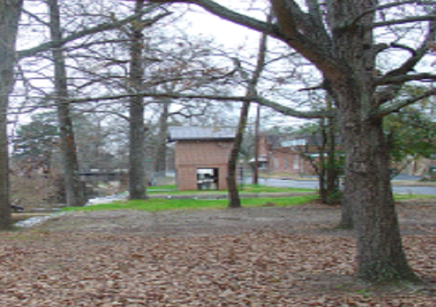

Slide 29
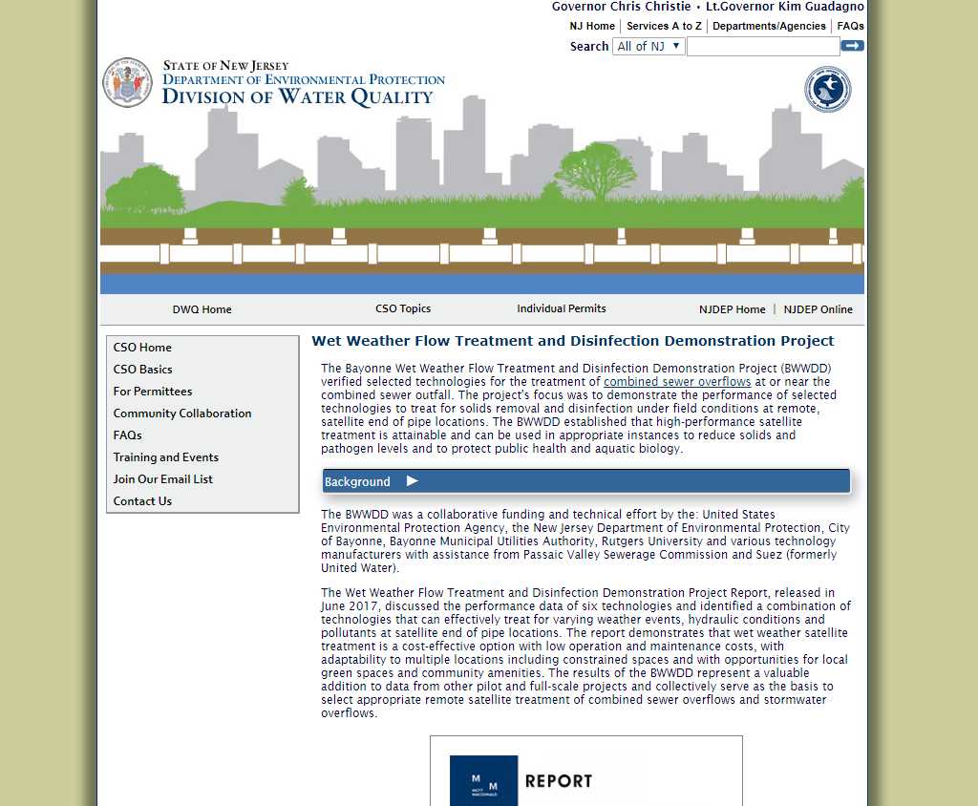
Access the Full Report
nj.gov/dep/dwq/cso-wet.htm

Slide 30

Wet Weather Flow Treatment & Disinfection Demonstration
Project
nj.gov/dep/dwq/cso-wet.htm
Stanley V. Cach Jr., P.E., P.P., BCEE., D.WRE
NJDEP Project Manager
Division of Water Quality
&
John Dening, CFM, P.E.
Mott MacDonald
Senior Project Manager

