Slide 1
2014 New Jersey Clean Air Council Public Hearing Presentation NJNG CNG Advantage Pilot Program
April 8, 2014

Slide 2
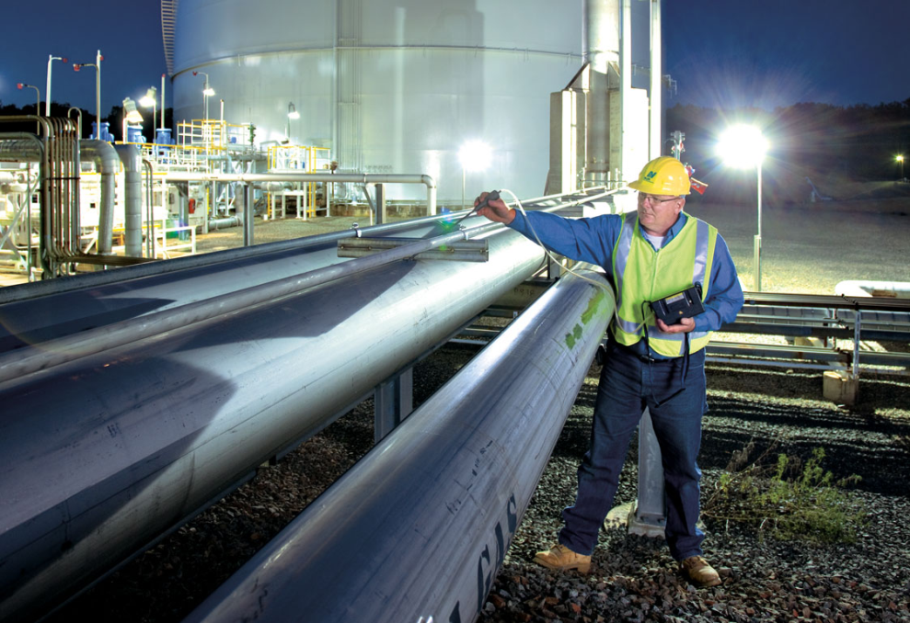
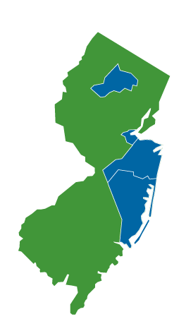
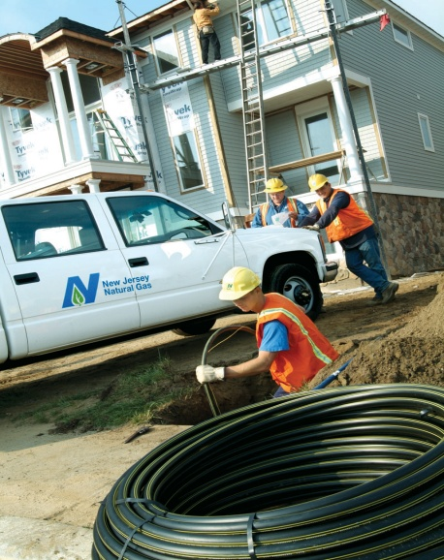
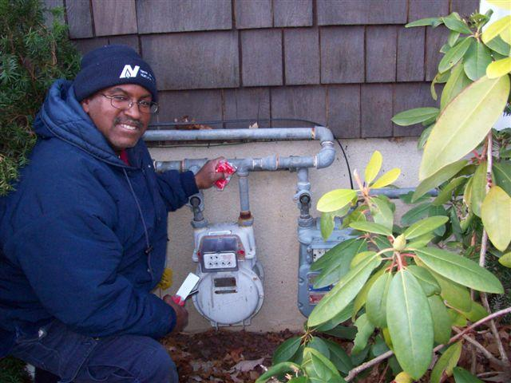
New Jersey Natural Gas
NJR’s largest subsidiary
Monmouth, Ocean and parts of Morris, Middlesex and Burlington counties
Growing customer base primarily residential and commercial
Expects to add between 14,000 and 16,000 new customers over the next two fiscal years
Net plant, property and equipment of more than $1.4 billion
Highest customer satisfaction rate of any major utility in New Jersey for the 21st consecutive year
Notes:
Review slide

Slide 3
America’s Abundant Energy Source

Slide 4
Natural Gas and Crude Oil Prices Move Independently
Oil is priced according to World Markets
Natural Gas is priced according to North American Markets
Oil prices continue to increase
Natural Gas prices are at historical lows
On an energy equivalency basis(btus), the ratio of oil to natural gas pricing has grown by a factor of over 3X!

Slide 5
The Three E’s
Economic
Lower delivered fuel price, 30-50 percent less ($1.65 - $2.30 GGE*)
Competitive to petroleum fuels
American dollars stay here
Environmental benefits
Lower tailpipe emissions
NGVs can help improve air quality by displacing petroleum-powered vehicles that contribute about 75 percent of the carbon dioxide pollution found in urban areas, which also negatively impacts health, especially for those suffering from asthma or respiratory issues
Well to wheels analysis
Energy security
Domestic fuel , shale gas
Energy Independence
*gasoline Gallon Equivalent

Slide 6
NJNG Regulatory Initiatives, FEED
Fostering Environmental & Economic Development, (FEED)
Effective January 1, 2011
Investment capital and incentives
Discounted rates
No impact on existing ratepayers

Slide 7
NJNG Regulatory Initiatives, CNG Advantage Pilot Program
NJNG received approval to invest up to $10 million to build CNG vehicle refueling stations in Monmouth, Ocean and Morris counties
BPU approval, June 18, 2012
Estimated five to seven CNG public-access refueling stations
Thee contracts signed:
Shore Point Distributors, Freehold, NJ
Waste Management of NJ , Toms River, NJ
Middletown Township, Middletown, NJ
20 percent utilization of station capacity required of host fleet locations
3-year Vehicle Acquisition Plan
NJNG will focus outreach to surrounding fleets

Slide 8
NJNG NGV Customers
NJNG NGV Customers
NJ Transit
Running 76 dedicated CNG buses in NJNG franchise territory since 1997
Recently began the planned replacement of the original 76 CNG buses
Will be refurbishing, repowering and replacing key CNG station infrastructurein the near future
On July 24, 2012, NJ Transit received 46.3 millon from the FTA to add an additional 84 dedicated CNG buses to their fleet
A success story for Transit Buses!
Blue Diamond Disposal
Constructed their own CNG station, (time fill)
A total of 24 dedicated CNG Autocar refuse vehicles*
NJNG CNG Advantage Pilot Program
Waste Management Inc. – Sgned a CNG Host Station Agreement that will result in a public access CNG Station in Toms River, NJ
Shore Point Distributing Company, Inc. - Signed a CNG Host Station Agreement that will result in a public access CNG Station in Freehold Township, NJ
Middletown Township - Signed a CNG Host Station Agreement that will result in a public access CNG Station in Middletown, NJ
* Blue Diamond (Case Study) handout

Slide 9
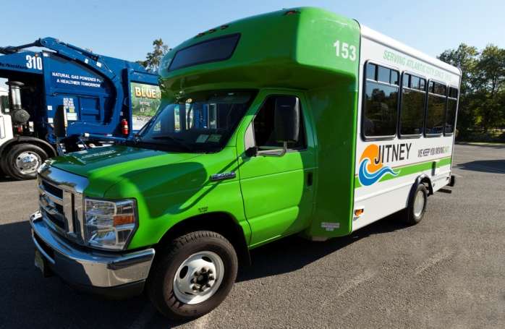
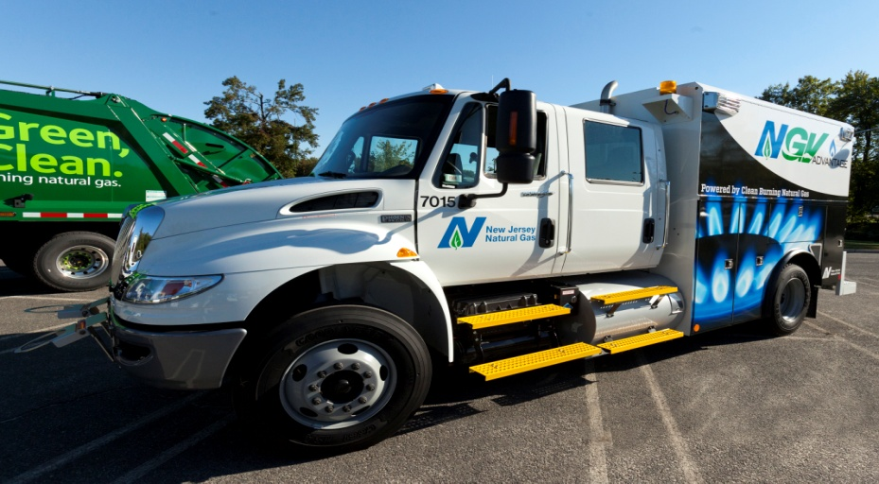
Some of the New Jersey NGVs

Slide 10
How to locate CNG Stations
Web-based locating assistance:
http://www.afdc.energy.gov/locator/stations/
http://www.altfuelprices.com/
http://www.cngprices.com
Various smart phone apps:
Android
Apple
Iphone, etc…
Industry references:
http://www.fuelingthefuture.org/
http://anga.us/issues-and-policy/transportation/tiax-natural-gas-vehicle-market-analysis

Slide 11
New Jersey Public CNG Stations
Other Public CNG Fueling Facilities:
ACUA, Atlantic City, NJ
AC Jitney Association, Atlantic City, NJ
AC Public Works, Atlantic City, NJ
South Jersey Gas, Millville, NJ
South Jersey Gas, Glassboro, NJ
Waste Management, Camden, NJ
Gulf & 7-Eleven, Newark, NJ

Slide 12
Questions?
William E. Wells, NGV Consultant
New Jersey Natural Gas, 1415 Wyckoff Road
PO Box 1464, Wall, NJ 07719
Phone: 732-919-8000/Fax: 732-919-8081
Cell: 732-684-5287/ Email: mailto:wewells@njng.com

