Slide 1


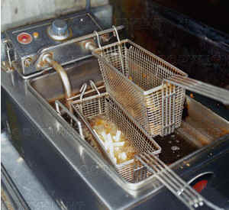
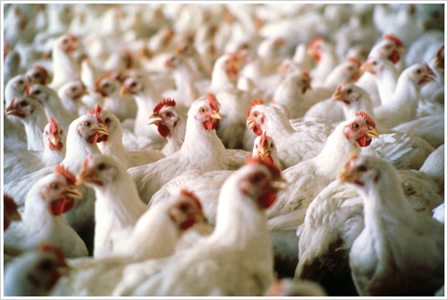
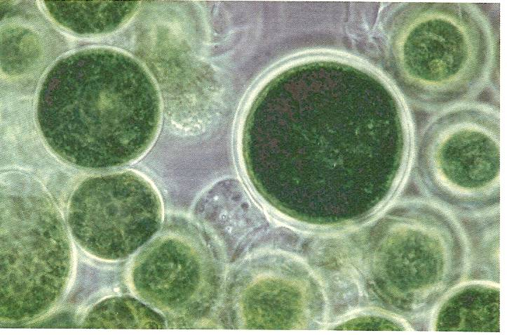
Biodiesel
America’s first
Advanced Biofuel
Raymond J. Albrecht, P.E.
Technical Representative
National Biodiesel Board rayalbrechtpe@gmail.com www.biodiesel.org
Yellow Grease
Animal Fats
Algae
Notes:
Biodiesel is America’s first Advanced Biofuel.
I’m going to tell you what that means, and how domestic resources can be used to increase energy independence and decrease environmental impacts by displacing fossil fuels.

Slide 2
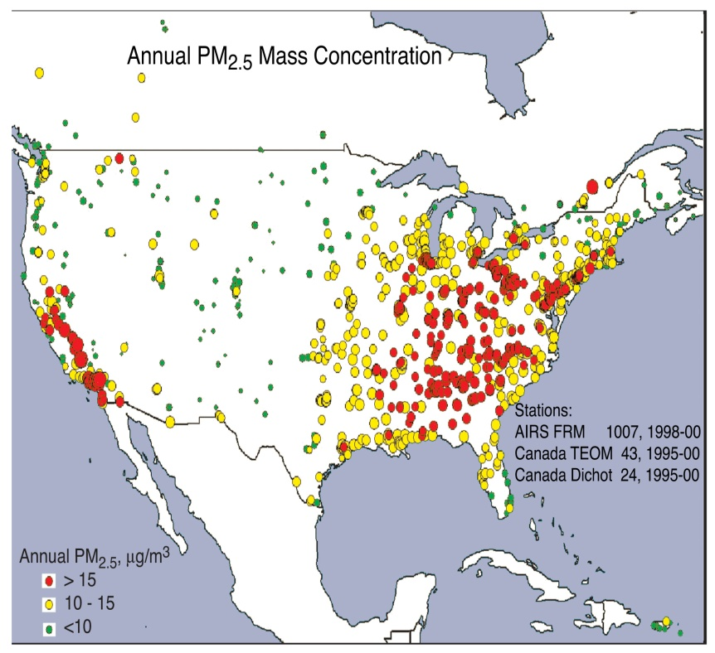

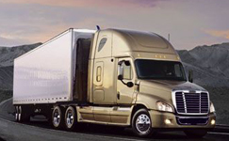


Fine Particulates in the Air That We Breathe
The Need for Clean Transportation Fuels
Notes:
PM2 concentration in ambient air.
diesel fuel, heating oil, biggest contributors
Bioheat plus heating oil blend can reduce fine particulate emissions

Slide 3
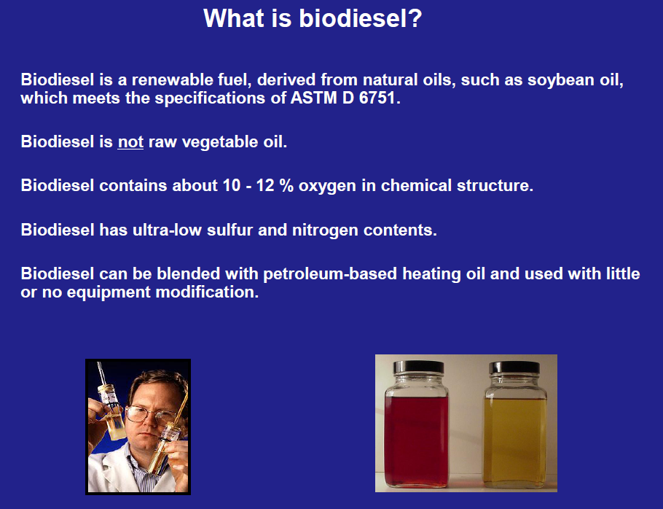

Slide 4
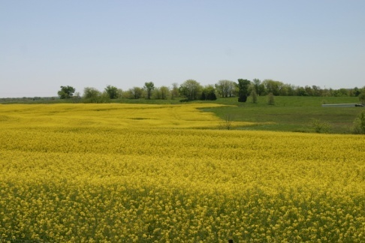
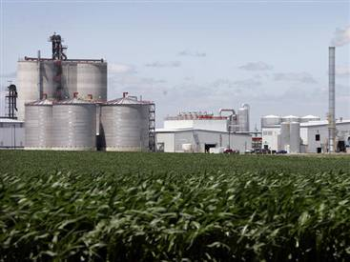
Biodiesel Feedstock Diversity
Diversity = Sustainability
NBB supports all sustainable feedstocks
Utilize existing wastes
Improve market value for underutilized co-products
Soybean and Canola Oil
Yellow Grease
Animal Fats
Corn Oil from DDGS

Slide 5

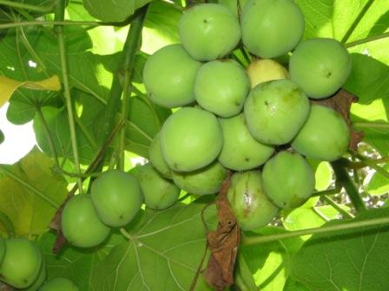
Longer Term Biodiesel Feedstock Sources
Algae
Jatropha

Slide 6
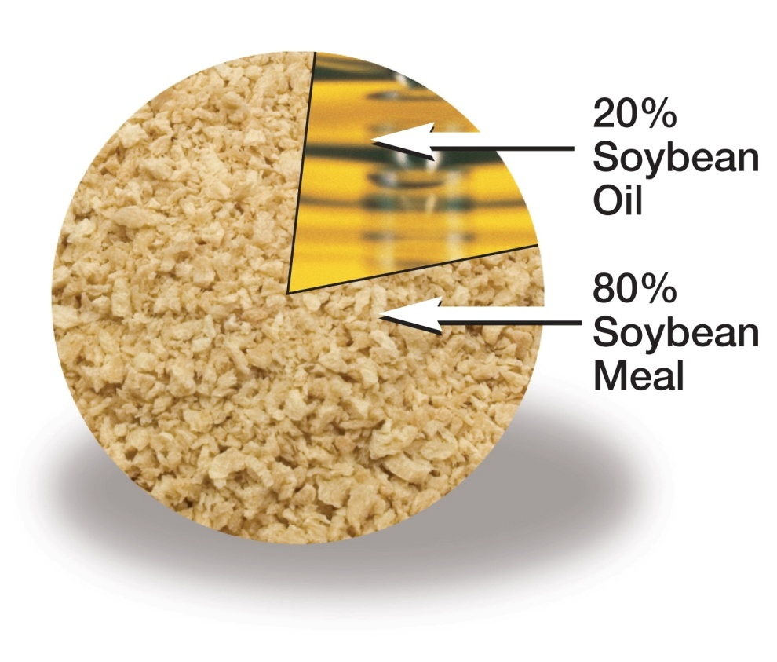
Co-products of Food Production
Protein meal for livestock feed is the driver for soybean production and pricing
Better utilization of the oil co-product can reduce the price of the protein meal.
Notes:
soy acres is that soy is not grown to produce biodiesel. Soy is grown primarily for its rich protein meal, which makes up 80% of every bean. The demand for protein meal drives the planting of soy, and yields a surplus of oil that exceeds the demand for food uses.
The US biodiesel industry has set its goal to produce a volume of biodiesel that makes the best use of existing oils. This includes the coproducts of soy meal production, recycled frying oils, animal fats, fractionated corn oil, and any other oil that cannot find its market as a food product. This can be due to due to failure to meet food grade requirements, or geography that prevents these oils from finding other markets.

Slide 7
Energy Characteristics of Biodiesel Production
Continuing Improvements in Biodiesel Production
Total Life-cycle Energy Requirements
86% Greenhouse Gas Savings vs Traditional Petroleum
Notes:
Remind that it is after the allocation.

Slide 8
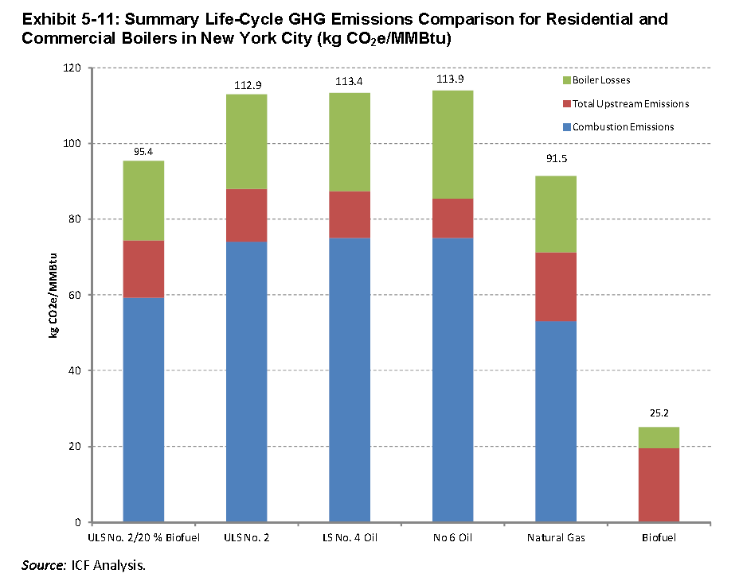
Comparison of Greenhouse Gas Emissions from Fossil Fuels vs Biodiesel
(not including methane leakage)

Slide 9
Introduction to Clean Diesel
About the Diesel Technology Forum www.dieselforum.org
  AGCO
  BP
  BorgWarner
  BOSCH
  Chrysler
  Cummins Inc
  Daimler
  Delphi Automotive
  Deere & Company
  Ford Motor Company
  General Motors
  Honeywell
  Johnson Matthey
  Honeywell
  Johnson Battery
  Mazda North American Operations
  Navistar
  Terra Environmental
  Volkswagen Group of America
  Yanmar
  Allied Members
  Association of Diesel Specialists
  National Biodiesel Board
  Western States Petroleum Association
Notes:
A quick word on the DTF.
We are a not-for profit 501 c 6 based just outside of Washington DC in Suburban MD.
Members represent the leading manufacturers of diesel engines and equipment, fuels and emissions control technology.

Slide 10
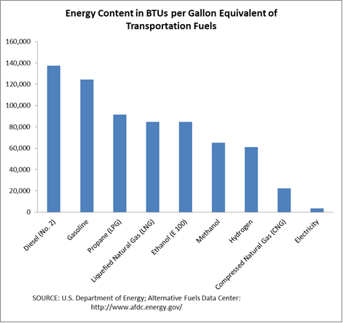
Why Diesel?
No other transportation fuel can match the energy density of diesel fuel.
More freight can be delivered on a gallon of diesel than with any other fuel.

Slide 11
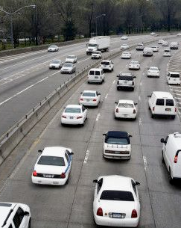
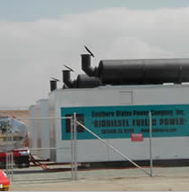
Biodiesel Emissions Performance
Transportation and
Stationary Diesel Applications
Emission Type | B100 | B20 | B2
Total Unburned Hydrocarbons Polycyclic Aromatic Hydrocarbons (PAHs) Carbon Monoxide Particulate Matter Oxides of Nitrogen (NOx) | -67% 80% -48% -47% + or - % | -20% -13% -12% -12% + or - % | -2.2% -1.3% -1.3% -1.3% + or - %

Slide 12
New clean diesel engines have reduced NOx and PM emissions by more than 95% over the last 25 years
U.S. Emission Standards – Heavy Duty Trucks
NOx (g/bhp-hr)
PM (g/bhp-hr)
98% Reduction
98% Reduction
HD Emission Standard | NOx (g/bhp-hr) | PM (g/bhp-hr)
1988 | 10.7 | 0.6
1998-2007 | 4.0 | 0.1
2007-2009 | 2.0* | 0.1
2010+ | 0.2 | 0.01
*Actual standard is NMHC*NOx with a 0.5g/bhp*hr maximum on NMHC
Notes:
Important at the outset to highlight the progress made in clean diesel engine technology.
At an event last year, then CARB executive officer james goldstene and ARB board chair mary nichols discussed the 'cooperative effort' between state regulators and the diesel industry that has led to 'major clean air innovations' in diesel technology."

Slide 13
Clean Diesel in the OTC States: Heavy Duty Trucks (Class 3-8)
* Model Year 2007 or newer
OTC States | Clean Diesel *Trucks (Class 3-8) | All Trucks (Class 3-8) | Share of Clean Diesel* Trucks
CONNECTICUT | 20,624 | 73,632 | 28.0%
DELAWARE | 6,070 | 21,652 | 28.0%
DISTRICT OF COLUMBIA | 1,842 | 9,285 | 19.8%
MAINE | 10,350 | 44,681 | 23.2%
MARYLAND | 40,498 | 123,108 | 32.9%
MASSACHUSETTS | 31,617 | 114,215 | 27.7%
NEW HAMPSHIRE | 10,713 | 39,078 | 27.4%
NEW JERSEY | 57,880 | 228,212 | 25.4%
NEW YORK | 97,073 | 330,213 | 29.4%
PENNSYLVANIA | 113,020 | 344,306 | 32.8%
RHODE ISLAND | 5,785 | 18,410 | 31.4%
VERMONT | 6,813 | 23,289 | 29.3%
VIRGINIA | 43,376 | 186,089 | 23.3%
OTC Total | 445,661 | 1,556,170 | 28.6%
National Average |  |  | 29.2%
*
*

Slide 14
Over 20% of the 2012 heavy duty fleet are powered with new clean diesel engines built after 2006
U.S. New Clean Diesel Engines in Operation – Heavy Duty
Clean Diesel Technology Package
SCR (2010)
EGR
Particulate filter
Injection improvements
Enhanced turbocharging
Ultra-low sulfur fuel
Clean Diesel w/o SCR
SCR equipped Clean Diesel
Based on Polk HD class 4-8 registrations and vehicles in operation for the U.S.
Notes:
One of the key questions we wanted to know was to what extent were these new generation clean diesel trucks making their way into the trucking population and as a result what benefits were being achieved?
Note CA penetration of diesel trucks is at 21 percent – making it 3rd overall

Slide 15
Selective Catalytic Reduction (SCR) Technology for 2010 Emission Standards Has Reduced Fuel Consumption by 3-4%
Class | Example Production Vehicle | VMT Range | 2007 MPG Range | Average 2007 MPG | 2010 MPG with SCR Range | Average 2010 MPG with SCR
4 | Ford F-450 | 30-35,000 | 7-12 | 8.8 | 7.3-12.5 | 8.8
5 | Kenworth T170 | 30-40,000 | 6-12 | 8.0 | 6.3-12.5 | 8.0
6 | Peterbilt Model 330 | 40-50,000 | 5-12 | 7.1 | 5.2-12.5 | 7.1
7 | Kenworth T370 | 40-50,000 | 4-8 | 5.3 | 4.2-8.3 | 5.6
8 | Freightliner Cascadia | 110-140,000 | 4-7.5 | 5.2 | 4.2-7.8 | 5.4
8 MPG with traditional diesel becomes about 10 MPG Equivalent with B20 Biodiesel Blend

Slide 16
Average In-use Emission Rates for 2010 Model Year and Later
(Class 4-8 trucks)
Over 90% Reduction Since 2007
Class | Example Production Vehicle | VMT Range | In-use NOx Emissions (g/mi) | In-use PM Emissions (g/mi)
4 | Ford F-450 | 30-35,000 | Pre-2007: 4.35 2007-2009: 1.66 2010+: 0.26 | Pre-2007: 0.096 2007-2009: 0.0133 2010+: 0.013
5 | Kenworth T170 | 30-40,000 | Pre-2007: 4.55 2007-2009: 1.79 2010+: 0.28 | Pre-2007: 0.085 2007-2009: 0.014 2010+: 0.014
6 | Peterbilt Model 330 | 40-50,000 | Pre-2007: 5.99 2007-2009: 2.20 2010+: 0.35 | Pre-2007: 0.186 2007-2009: 0.017 2010+: 0.017
7 | Kenworth T370 | 40-50,000 | Pre-2007: 7.47 2007-2009: 2.73 2010+: 0.43 | Pre-2007: 0.192 2007-2009: 0.022 2010+: 0.022
8 | Freightliner Cascadia | 110-140,000 | Pre-2007: 9.19 2007-2009: 2.94 2010+: 0.50 | Pre-2007: 0.233 2007-2009: 0.025 2010+: 0.025
Source: “Average in-use emissions from heavy-duty trucks”, Table 2, EPA420-F-08-027; “Update to the Accounting for the Tier 2 and Heavy-Duty 2005/2007 Requirements in MOBILE6”, Table 16, EPA420-R-03-012
Notes:
In recent time the clean air story dominated .. Significant esp for CA

Slide 17
2007-2012 Clean Diesel Engines Have Reduced NOx Emissions by 1 Million Tonnes
U.S. Market
Million Tonnes
Total Savings
0.99M tonnes NO_{x}
27,000 tonnes PM
Notes:
In terms of NOx benefits to the atmosphere (national numbers)

Slide 18
Clean Diesel vs CNG
2012 Clean Diesel Bus & 2012 CNG Bus Emissions Comparison To 2000 Diesel Bus
Vs. 2000 Diesel Bus | Nitrogen Oxide (NOx) | Particulate Matter (PM) | Hydrocarbon (HC)
2012 Diesel Bus | -94% | -98% | -89%
2012 CNG Bus | -80% | -99% | -100%
Emissions Reductions Per 10 Replacement Buses
Vs. 2000 Diesel Bus | Nitrogen Oxide (NOx) | Particulate Matter (PM) | Hydrocarbon (HC)
2012 Diesel | -4,953 kg | -275 kg | -429 kg
2012 CNG | -4,197 kg | -279 kg | -471 kg
SOURCE: Clean Air Task Force. “Clean Diesel versus CNG Buses: Cost, Air Quality, & Climate Impacts” (2012)

Slide 19
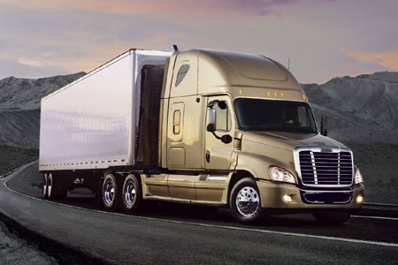
Clean Diesel Engines in Class 8 Trucks Save $3,500/year in Fuel
NOx (g/mi)
Savings to the new clean diesel buyer | Per Year
Average vehicle miles traveled | 125,000
Fuel savings - gallons | 875
Fuel savings - bbl | 21
Fuel cost savings @ $4.00/gal | $3,500
CO₂ savings – metric tonnes | 8.9
NO_{x} savings – metric tonnes | 1.1
Particulate matter savings – kg | 26
95% Reduction
PM (g/mi)
89% Reduction
EPA estimates for in-use distance based output. Phase-in for 2004 and 2007 rulemaking is averaged across 2007-2009 and 2010 and beyond respectively. Pre-2007 estimates are based on an estimate of all vehicles in operation before 2007.

Slide 20
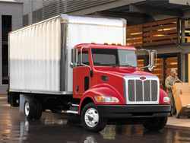
Pick-up and Delivery Vehicles Have Achieved a 20X Reduction in Real World Nox Emissions With Clean Diesel Engines
NOx (g/mi)
Savings to the new clean diesel buyer | Per Year
Average vehicle miles traveled | 35,000
Fuel savings - gallons | 160
Fuel savings - bbl | 4
Fuel cost savings @ $4.00/gal | $640
CO₂ savings – metric tonnes | 1.6
NO_{x} savings – metric tonnes | 0.15
Particulate matter savings – kg | 2
94% Reduction
PM (g/mi)
83% Reduction
EPA estimates for in-use distance based output. Phase-in for 2004 and 2007 rulemaking is averaged across 2007-2009 and 2010 and beyond respectively. Pre-2007 estimates are based on an estimate of all vehicles in operation before 2007.

Slide 21
Future Heavy-Duty Trucks:
Balancing New Fuel Efficiency Standards & Near Zero Emissions
New commercial diesel trucks (2014-2018) will be getting more fuel efficient
  EPA/NHTSA GHG rules for HD trucks require anywhere from 6 % to 23 % reductions in fuel consumption by 2018 (3 classes of vehicles, - pickup trucks/vans, vocational and tractors)
  Combinations of engine and vehicle technologies for phase 1
Phase 2 – 2014-2018 Significant challenges to achieve future fuel economy gains
  Meeting near-zero emissions of NOx with lower CO2 Reductions gets harder– future standards
  Further changes in NOx emissions challenge ability to meet future fuel economy requirements.

Slide 22
Diesel to be # 1 Transport Fuel by 2020
ExxonMobil: Diesel will surpass gasoline as the number one global transportation fuel by 2020. Diesel demand will account for 70% of the growth in demand for all transportation fuels through the forecast period to 2040. Although natural gas will play a greater role as a transportation fuel by 2040, it will remain only a small share of the global transportation fuel mix, at 4 percent by 2040, up from today’s 1 percent, according to ExxonMobil’s forecast.
The World Energy Outlook: Diesel fuel will remain the “dominant” growth fuel between now and 2035, according to the International Energy Agency. Globally, the report suggests the possibility of only a two percent share of natural gas in the heavy-duty transport market by 2035.
The National Petroleum Council in its 2012 report “Advancing Technology for America’s Transportation Future” for the U.S. Department of Energy stated: “Diesel engines will remain the powertrain of choice for HD (heavy-duty) vehicles for decades to come because of their power and efficiency."
Diesel to gasoline production ratio (per bbl of crude oil) difficult to increase
Biodiesel contributes to increasing supply of fuel for diesel market

Slide 23
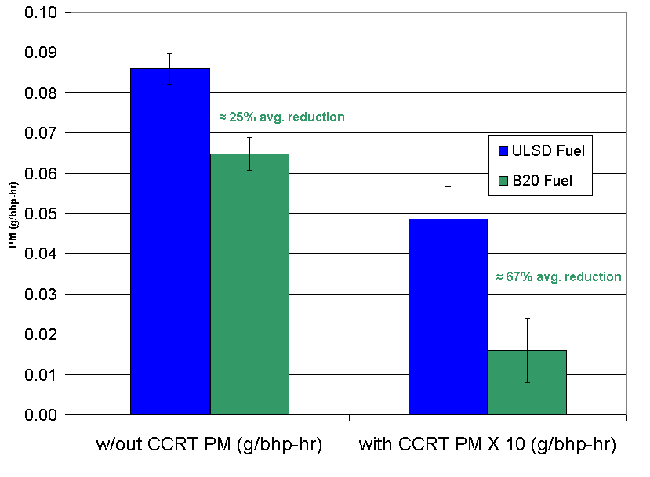
B20 Biodiesel PM Reduction in Clean Diesel Engines
(Particulate Filter Traps)
25% PM reduction w/o DPF 67% reduction w/ DPF
Source: National Renewable Energy Lab

Slide 24
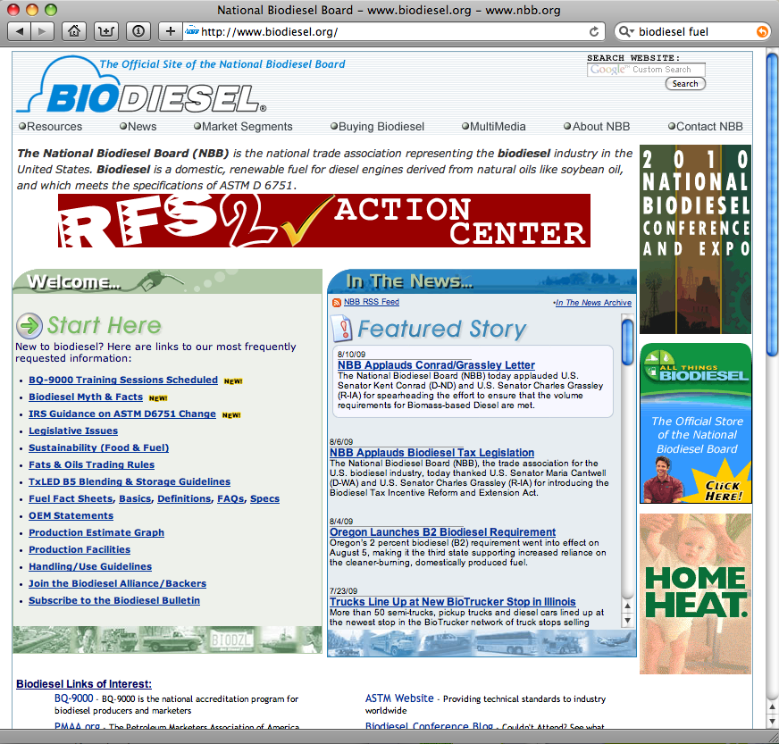


Biodiesel
The future is here now.
Thank You !!!
Notes:
In summary, biodiesel can be a very effective part in making our national and regional use of fuel more sustainable.
Our society is addicted to petroleum. We are already beginning to suffer the effects of a culture dependent of borrowing money from Asia to buy oil from the Middle East. These problems are only going to get worse if we don’t get serious about finding new alternatives.
We need to use our domestic resources to produce fuel in this country. We need to put American’s to work producing fuel that burns cleaner. We need to use our wastes and byproducts for beneficial uses. We can accomplish all of these things in a sustainable manner. We can accomplish all of these things with biodiesel.

