Slide 1
Reducing Air Emissions through Alternative Transportation Strategies
April 8, 2014
Mark Giuffre Vice President, UPS State Govt. Affairs

Slide 2
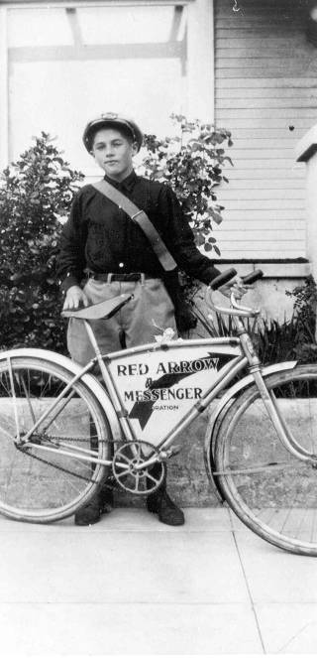
Alternative Fuel Vehicle History
1907: Couriers on foot and bicycles
1913: First truck, a Model T Ford
75 years of growing dependence on oil
35 years: Carefully investigating truck fuels
Domestic, cleaner, cheaper (less price volatility)
1930’s plug-in electric fleet of delivery trucks in NYC
Began testing CNG “package cars” in 1989
1,000 purchased and on the road by 2001
Began testing propane trucks in the 1980s.
In 2002, began testing 11 LNG class 8 trucks in service

Slide 3
UPS’s Vision for the Future of Alternative Fuels
Central fueling and financial incentives are key
In-service use permits perfection of vehicles, fuels
Economics drives the focus to long-haul heavy trucks
UPS is willing to move boldly once the case is made
UPS is fuel neutral, but still will require petroleum for years to come
Required financial incentives to make the business case for alternative fuels

Slide 4
UPS Seeks to Move Its Trucks to “Bridging Fuel of the Future and Off Oil”
Roughly 100,000 trucks worldwide, 17,000 heavy class 8 trucks in U.S.
Ninth largest airline in the world
Fuel price volatility is a major burden
Oil prices driven by international cartel – domestic oil likely priced at or close to world price, even if U.S. is world’s largest producer
Partial decoupling from oil is now thinkable: U.S. has 150 years of natural gas reserves, price appears relatively stable and well below petroleum on energy equivalent basis.
Alternative fuels generally yield less air emissions, including carbon, especially if replacing older trucks.

Slide 5
Current UPS Situation
UPS “Rolling Laboratory”: 3,152 alternative fuel vehicles worldwide
About 1,000 CNG “package cars” (class 6)
249 LNG heavy class 8 tractors
Need for financial incentives:
Prefer not to rely on them, but still need them now
Systematic hub-by-hub search for cheap LNG
Seeking State/federal financial assistance in States, and removal of federal disincentives.
Close to acceptable economics in isolated instances.
Incentives lead to earlier deployment and removal of older, more emitting trucks

Slide 6
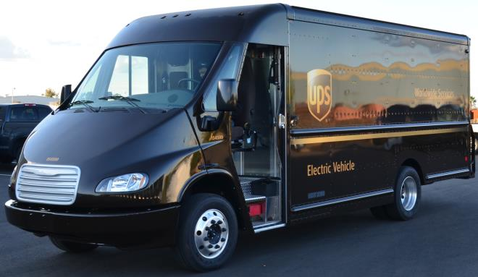
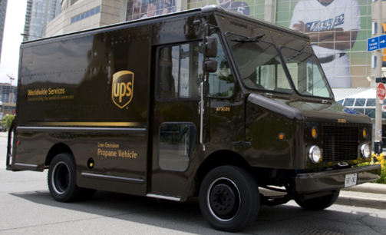
UPS Global Alternative Fuel and Advanced Technology Vehicles
Total Alternative Tech Vehicles Globally: 3,152
(as of Jan. 15, 2014)
U.S. Alternative Tech Fleet: 2,077
Compressed Natural Gas Vehicles: 877
Hybrid Electric Vehicles: 380
Liquid Natural Gas Vehicles: 249
Propane Vehicles: 28
Electric Vehicles: 102
Hydraulic Hybrid Vehicles: 41
Composite Body Diesel: 400
International Alternative Tech Fleet: 1,075
Compressed Natural Gas Vehicles: 88
Hybrid Electric Vehicles: 6
Propane Vehicles: 846
Electric Vehicles: 56
Ethanol Vehicles: 50
Biomethane Vehicles: 29

Slide 7
Liquid Natural Gas (LNG) As A Fuel For Over-the-Road Heavy Trucks (Compression Ignition)
95% reduction in petroleum use
26% reduction in greenhouse gas emissions (tailpipe to wheel) when replacing diesel trucks.
500 - 550-mile range
Much reduced operating costs
Cryogenic tanks
High initial costs
LNG truck – as much as 100% premium over new diesel truck
Fueling station -- $1 million +
UPS: a decade of experience with 11 LNG heavy trucks on the road between CA and NV.

Slide 8
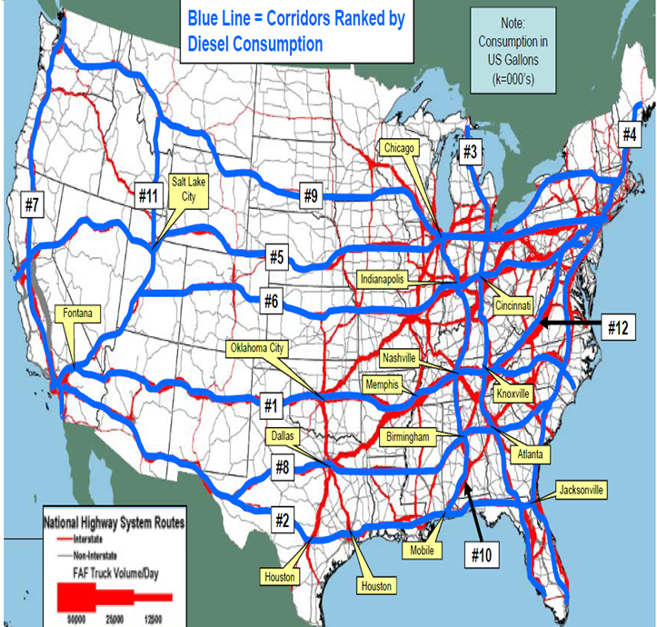
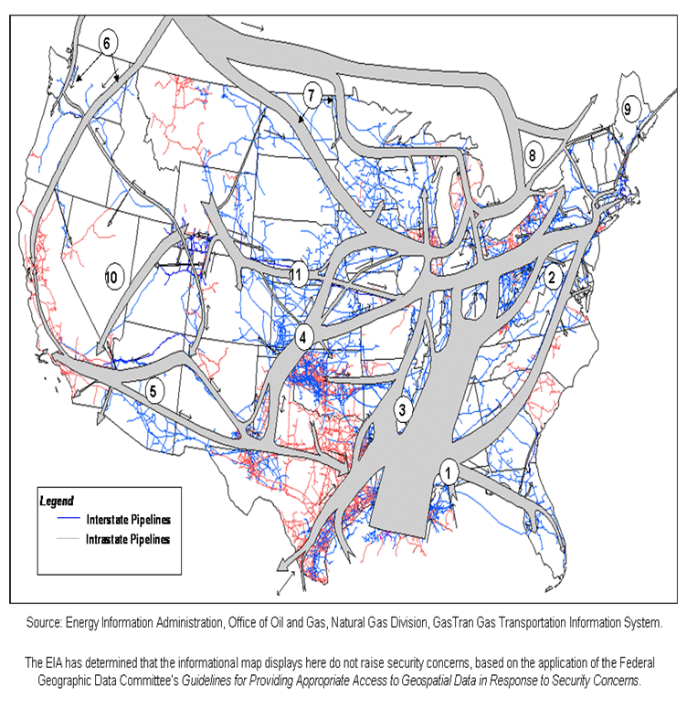
Heavy Truck Corridors Align With NG Pipelines

Slide 9
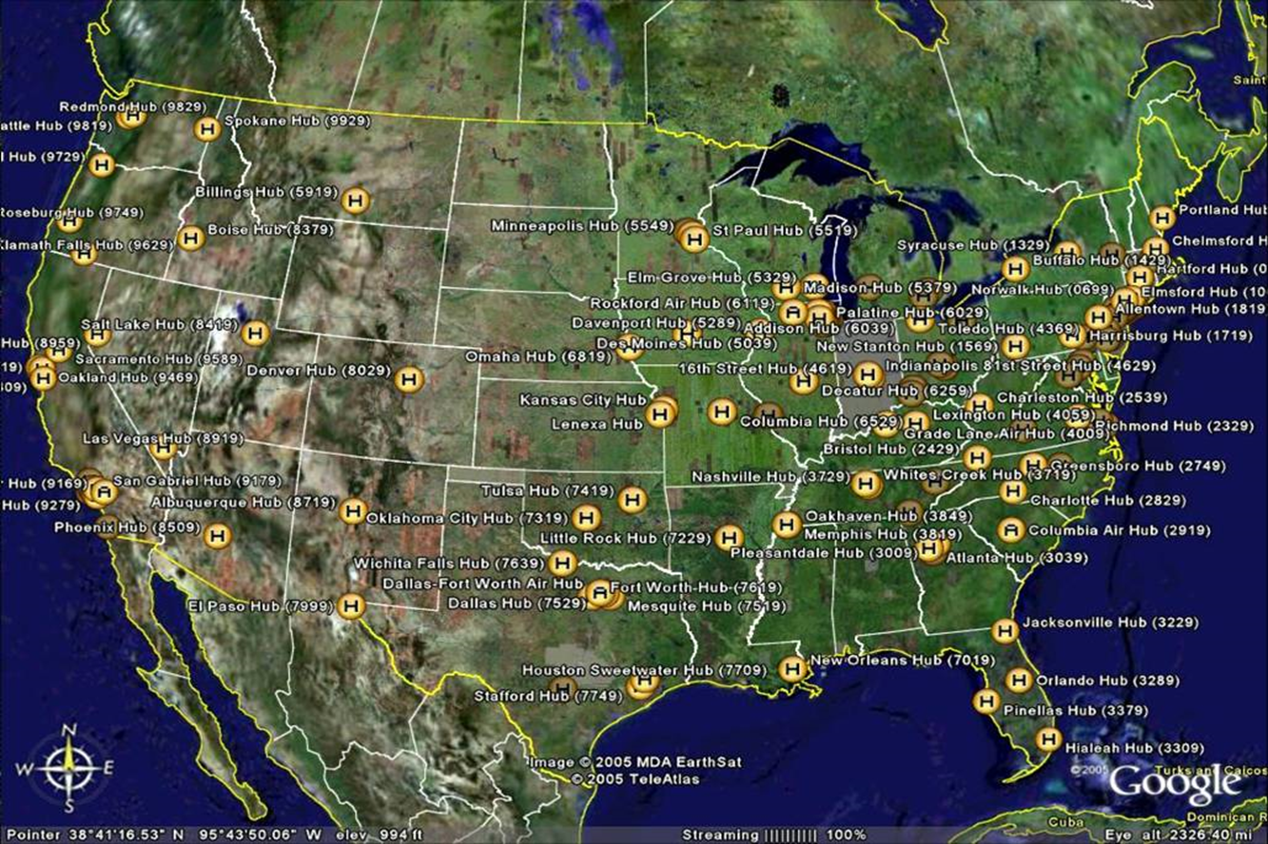
UPS Major Hubs

Slide 10
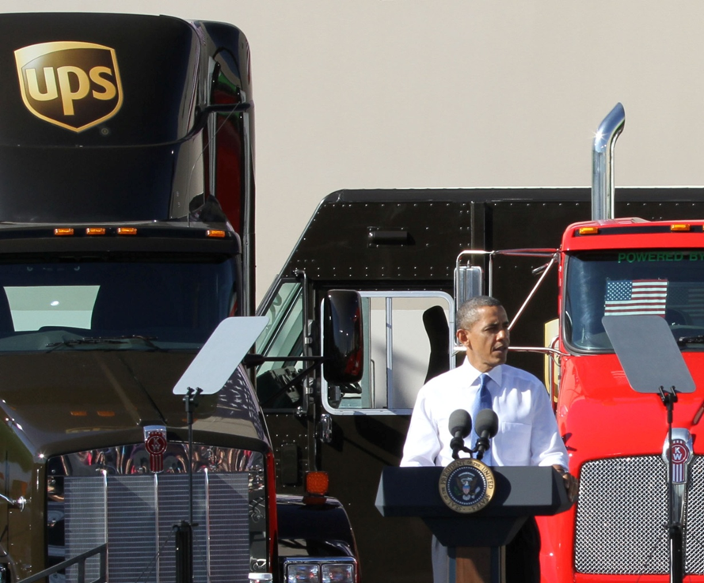
“As the folks here at UPS understand, we’ve got to have an all-out, all-in, all-of-the-above strategy that develops every source of American energy.”
President Obama,
Jan 26, 2012

Slide 11
Outlook for UPS Alternative Fuels Fleet
LNG:
In 2014, the only new class 8 tractors that UPS will buy (for its domestic small package business) will run on natural gas. Will build 9 more LNG fueling stations by the end of 2014 – increasing the total number of stations by 13.
By the end of 2014 UPS will have in excess of 1,000 Class 8 LNG tractors, displacing 24 million gallons annually (19 in the U.K. operating on bio-methane).
Propane:
UPS began using propane-powered vehicles in Canada in the 1980s. Today UPS has nearly 900 there.
In March said we will spend $68 million to buy 1,000 propane-powered trucks for the U.S., including 40 propane-fueling stations, by early next year.
Electric:
UPS has 158 plug-in electric delivery trucks worldwide. UPS engineers are seeking more affordable, longer-range electric delivery trucks to deploy in large numbers in the future.

Slide 12
UPS Game Plan on Natural Gas Alternative Fuel Vehicles
Systematically find cheap LNG for our hubs
Systematically seek State financial incentives, one state at a time.
Florida (5 year tax free holiday on CNG and LNG)
Rebate per vehicle up to 50% of cost differential, but not more than $25,000 per vehicle
Use CNG vehicles at our hubs if natural gas is there
Find less expensive new Class 8 trucks that operate on natural gas
Eliminate disincentives to natural gas trucks
Seek state “green” procurement laws

Slide 13
Overview
U.S. has the domestic energy resources to get UPS trucks off oil gradually
UPS is fuel neutral
Centrally fueled fleets can avoid the chicken and egg problem to pave the way forward
Eliminate disincentives at federal and state level
Seek state and federal incentives, which will attract alternative fuel vehicle deployment earlier and remove older trucks sooner
Replacing older trucks with alternative fuel vehicles reduces air emissions.

