Slide 1


Greening the Fleet in New Jersey
New Jersey Clean Air Council
Public Hearing
April 8, 2014
Julie Becker
Vice President for Environmental Affairs
Alliance of Automobile Manufacturers

Slide 2














Slide 3

Question: What’s New in New Jersey?
Answer: Not the Light-Duty Fleet!
The average car on the road in NJ today is 11.4 years old.
“The Virtuous Cycle”: replacing a road warrior makes a profound difference for the environment and passenger safety.
Environmental improvements are taking place across all powertains.
Notes:
The average car on the road in the U.S. today is 11 years old. That’s just an average; there are a lot of older vehicles still in operation.
This is important because every time a family swaps a new car for their eleven year old road warrior, they are making a profound difference for the environment, they are diminishing our oil dependency and they are significantly reducing the changes that they will be seriously injured in a crash.
What some people don’t realize is that they can make a big difference whether or not they purchase an alternatively fueled vehicle.

Slide 4

The 2013 Model Year Included…
535 Models That Achieve 30 MPG or Higher Highway Fuel Economy
A Wide Range of Powertrains
  60 models of hybrids
  7 models of PHEVs
  10 models of BEVs
  34 models of diesels
2014 Ford Focus Electric
Source: fueleconomy.gov

Slide 5
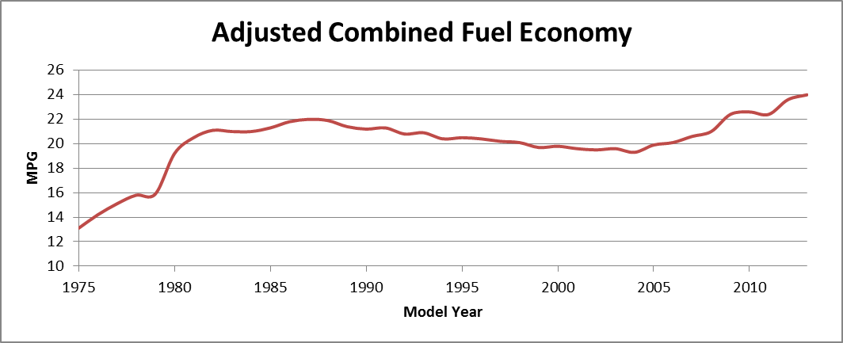
Fuel Economy is Improving
Source: EPA Trends Report

Slide 6





Advances in Conventional Technologies are Driving Fuel Economy/GHG Improvements
Cylinder deactivation
Variable valve timing
Stratified charge combustion
Controlled auto-ignition
Homogeneous charge compression ignition
Low rolling resistance tires
Lean-burn gasoline engines
Clean diesel selective catalytic reduction
Stop-Start
Lightweight materials
Reduced GWP refrigerants, improved A/C efficiency and low-leak A/C systems
7, 8 and 9-speed transmissions
Advanced ceramics for trapping clean diesel emissions
Integrated starter alternator damper
Belt-driven alternator starter
Adaptive cruise control
Advanced aerodynamics
Driver fuel consumption feedback systems
Continuously variable transmissions
Tire pressure monitoring
Downsized turbocharged engines

Slide 7
Auto Sector R&D
Amount Spent Annually on R&D in 2013
99% Comes from the Auto Industry!
$ Billions
$102
Billion
$25.5
Billion

Slide 8
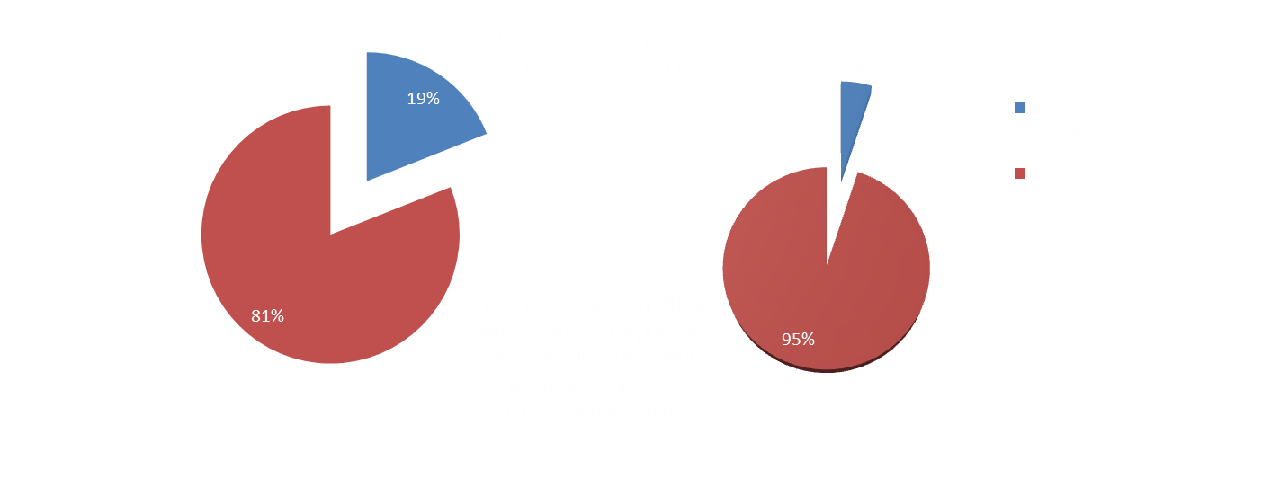
Projected U.S. NOx Emissions Under Tier 2
Source:
U.S. EPA

Slide 9
Alliance Supports EPA’s Final Tier 3 Rule
By 2025, Light-Duty Vehicles Must Have:
80% Lower Nitrogen Oxide (presented as NMOG+NOx) Emissions
70% Lower Particulate Matter (PM) Emissions
150,000 Mile “Useful Life” for Emission Control Systems
By 2017, Gasoline Producers Are Required to Meet an Annual
Average Standard of 10 Parts Per Million (ppm) Sulfur
Immediately Achieves 10% Lower NOx from On-Highway Vehicles
Enables Fuel-Efficient Technologies

Slide 10
2012-2025 GHG Goal Expressed in Miles Per Gallon
The endpoint of 54.5 represents the goal of 163 gpm CO2 emissions from improved fuel economy and credits for other measures that reduce GHG emissions.
MPG

Slide 11
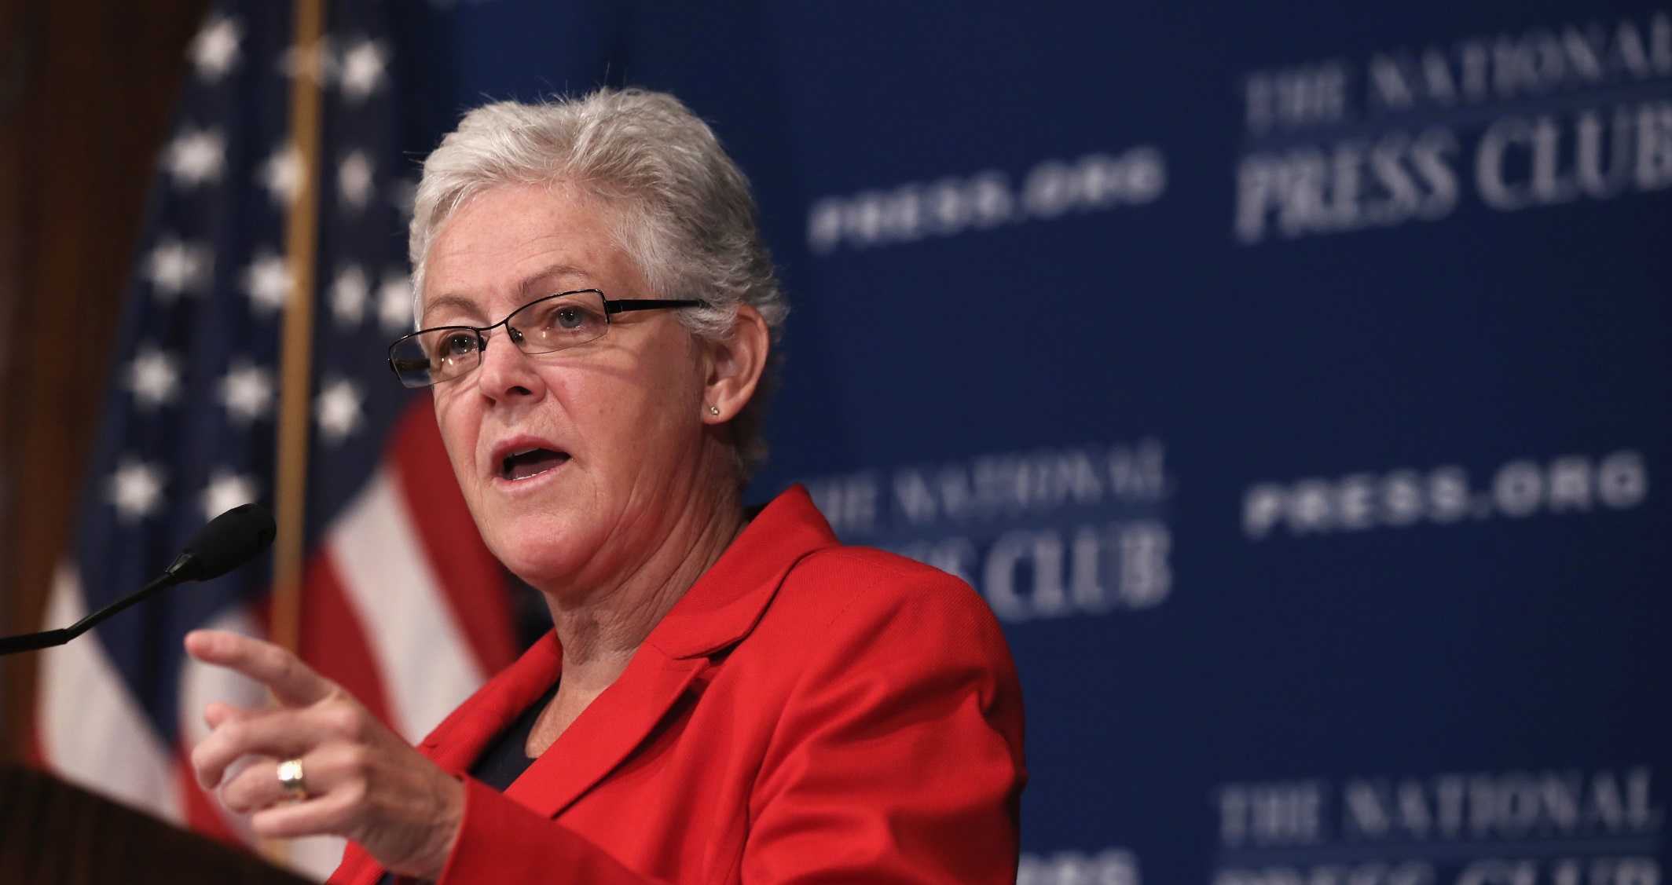

EPA Chief Gives Automakers 'A' for Fuel Economy Effort
"If we don't quite get there … it is
not going to be the fault of those
companies... They are trying
hard. They are working.
They are investing."
Gina McCarthy
EPA Administrator
January 13, 2014

Slide 12
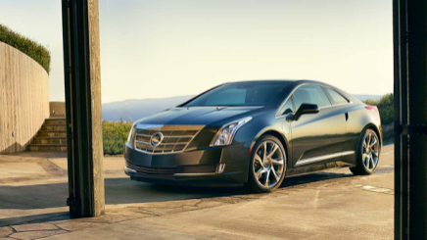
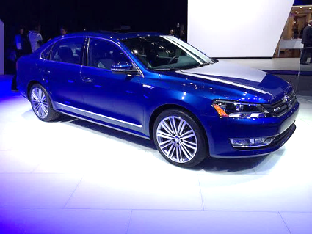
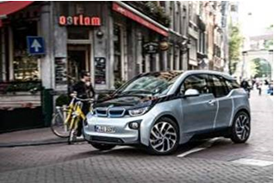
News from the 2014 Auto Shows
Cadillac ELR (Extended Range Electric) with “Regeneration on Demand” puts energy back into your battery while simultaneously slowing you down.
Photo Source: www.cadillac.com
VW Passat BlueMotion Concept Car: 7 speeds, direct injection, turbo, stop-start, cylinder deactivation and more!
Photo source: www.press.bmwgroup.com
Photo source: www.vw.com
Photo source: www.vw.com
The BMW i3 is the world’s first vehicle to use carbon fiber on this scale in large volume production. Its range extender version uses a small gasoline engine to recharge the battery.

Slide 13
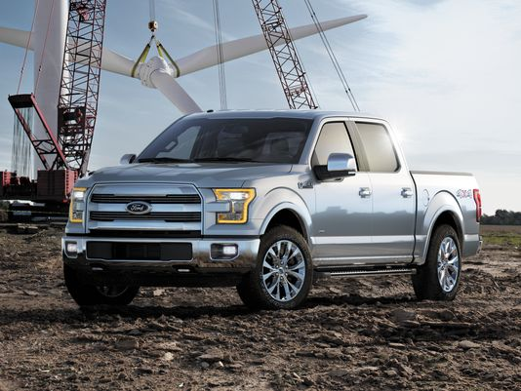
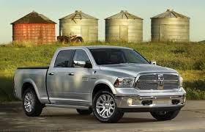
More News from the Auto Shows
2015 F-150 sheds 700 pounds with aluminum body and cargo box
Photo Source: Ford Motor
2014 Dodge Ram 1500 EcoDiesel
Pickup, rated 28 mpg highway, features a 3.0 liter V6 engine
Photo Source: www.newsday.com

Slide 14

Why Is Every Company Doing Something Different?
The GHG/CAFE program is a consumption program, not a production program, and each company’s customer base is unique.

Slide 15
“Looking ahead, about 5% of projected MY 2013 production could meet the MY 2025 CO2 emissions targets. Vehicles meeting the MY 2025 CO2 targets are comprised solely of hybrids, plug-in hybrids, and electric vehicles. Since the MY 2025 standards are over a decade away, there’s considerable time for continued improvements in gasoline vehicle technology.”
EPA Trends Report, Oct. 2013

Slide 16
NJ Versus CA
Issue | CA | NJ
ZEV Incentives | State rebates BEVs: $2,500 rebate PHEVs: $1,500 rebate HOV access (1,400 miles) Local rebates up to $3,000 Local free parking Free charging Utility discounts | Sales & use tax exemption HOV access (<50 miles) Green Pass (10%) Discount on Off-Peak NJ and Garden State Turnpike Fees for SULEV Vehicles with ≥ 45 MPG
Public Fueling Infrastructure (Source: DOE Alt Fuels Data Center, www.afdc.energy.gov, 3/25/14) | EV chargers: 1,651 Hydrogen: 9 stations 18 more funded CNG: 143 stations | EV chargers: 88 Hydrogen: 0 stations CNG: 27 stations

Slide 17
ZEV Sales Need to Meet the Future Mandated Requirements
Vehicle Type | 2013 Sales | <0.5% | 2020 Requirement | 6% | 2025 Requirement | 15.4%
BEV | 843 |  | 26,918 |  | 71,782
PHEV | 1,677 |  | 28,040 |  | 48,068
To meet the 2020 requirements, New Jersey consumers will need to purchase ZEVs at 12 times the present rate.
To meet the 2025 requirements, New Jersey consumers will need to purchase ZEVs at >30 times the present rate.

Slide 18

Getting Green Vehicles from the Showroom to the Driveway Is Complex and Challenging!

Slide 19
THANK YOU!

