Slide 1
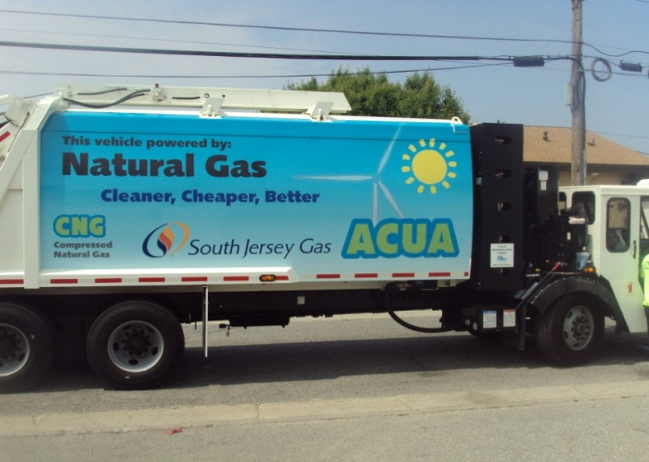
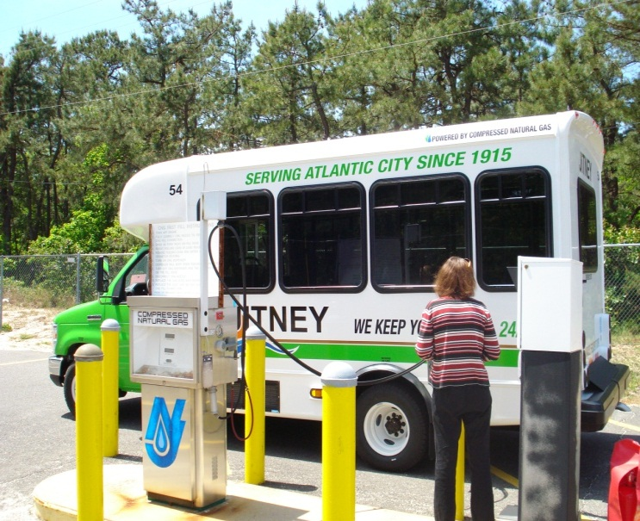
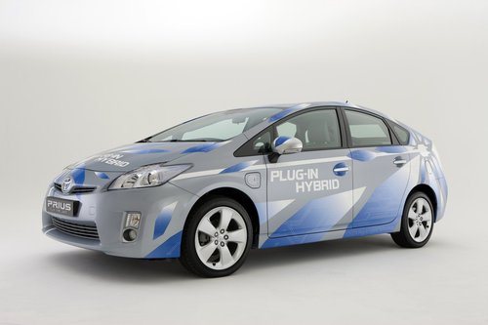
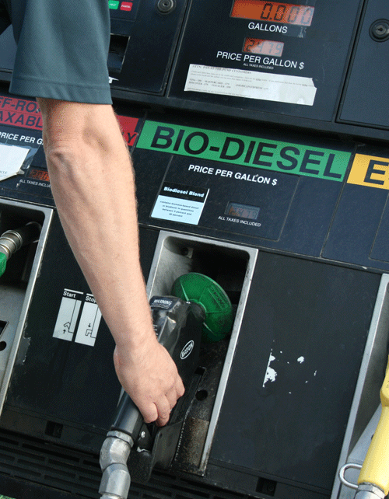
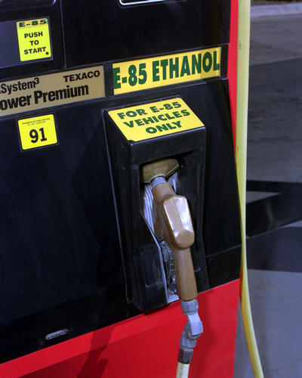


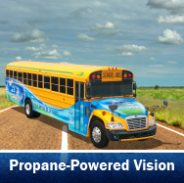
Working to Deploy Alternative Transportation Fuels & Vehicles in New Jersey
New Jersey Clean Air Council – April 8, 2014
Chuck Feinberg, Executive Vice President, Greener by Design
Chairman and Coordinator, NJ Clean Cities Coalition

Slide 2
NJ Clean Cities Coalition
The New Jersey Clean Cities Coalition is a NJ registered IRS 501(c)3 non-profit corporation, and is formally designated by the US Dep’t of Energy as a Clean Cities Coalition.
We are the only state-wide entity dedicated to the establishment of Public/Private Partnerships for the advancement of alternative transportation fuels, advanced vehicle technologies and clean fuels project development.

Slide 3
Clean Cities Mission
The U.S. Department of Energy's Clean Cities program advances the nation's economic, environmental, and energy security by supporting local actions to cut petroleum use.
A national network of nearly 100 Clean Cities coalitions brings together stakeholders in the public and private sectors to deploy:
  Alternative and renewable fuels (biodiesel, electricity, ethanol, hydrogen, natural gas, propane)
  Idle-reduction measures
  Fuel economy improvements
  Emerging transportation technologies.

Slide 4






New Jersey Clean Cities Coalition
DOE designation in 1997, as a BPU program
Incorporated as a NJ Non-Profit and IRS 501(c)3 tax exempt entity in 2009
Stakeholders represent the spectrum of public and private interests
Activities funded by:
  Member dues (various levels)
  Sponsorships
  grants & contracts
Secured more than $17 million in grants for stakeholders in the past 4 years
Outreach to more than 3000 through: LinkedIn Group, Facebook, Twitter, e-newsletter, www.njcleancities.org
Platinum & Gold members 2014

Slide 5

Clean Cities Portfolio of Technologies
Alternative Fuels
Electric Vehicles
Biodiesel
Ethanol
Hydrogen
Propane
Natural Gas
Fuel Economy
More Fuel efficient vehicles, adopting smarter driving and vehicle purchasing habits
Hybrids
Light- and heavy-duty
Electric hybrids
Plug-In hybrids
Hydraulic hybrids
Replace
Reduce
Idle Reduction
Heavy-Duty Trucks
School & Transit Buses
Light-Duty Vehicles
Eliminate
Post Sandy Theme = FUEL DIVERSIFICATION!

Slide 6

Vehicle Fuels – No longer “one size fits all”

Slide 7

NJCCC Public/Private Partnership Projects
CNG Fleet & Infrastructure Program
Regional Electric Vehicle Network Planning, with NYSERDA/TCI
EPA Diesel Emission Reduction Program - Marine Vessel Engine Replacements
DOE Clean Cities Program Support
Notes:
7

Slide 8
CC Program Support Contract
This is the “bread & butter” of the CC Program
Major tasks:
Annual Report of Petroleum Displacement
Quarterly Alternative Fuel Price Reports
Maintain data for Alternative Fuel Station Locator
Stakeholder meetings, fuel-specific workshops, events
Dedicated fleet outreach

Slide 9
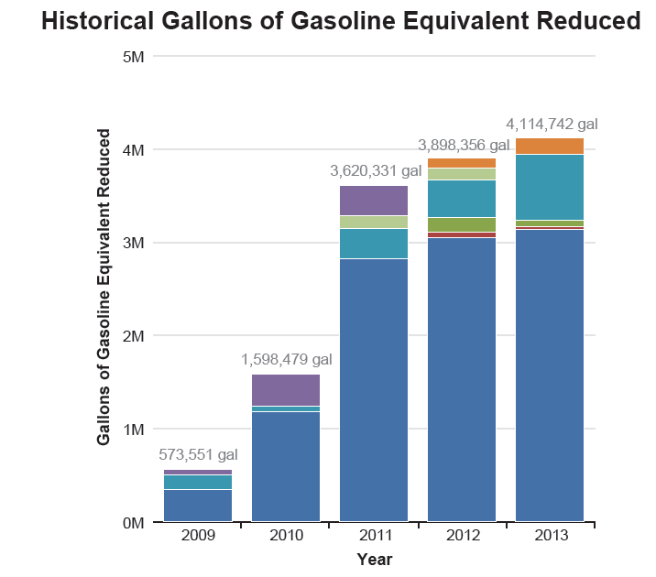
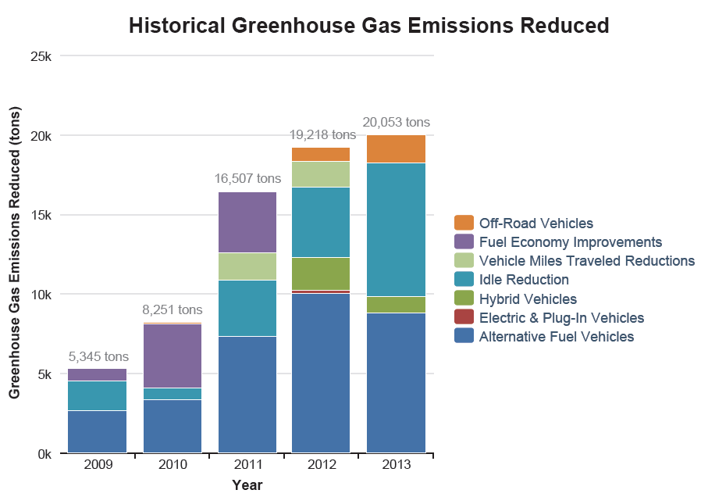
Impact of NJCCC-Stakeholder Activities

Slide 10
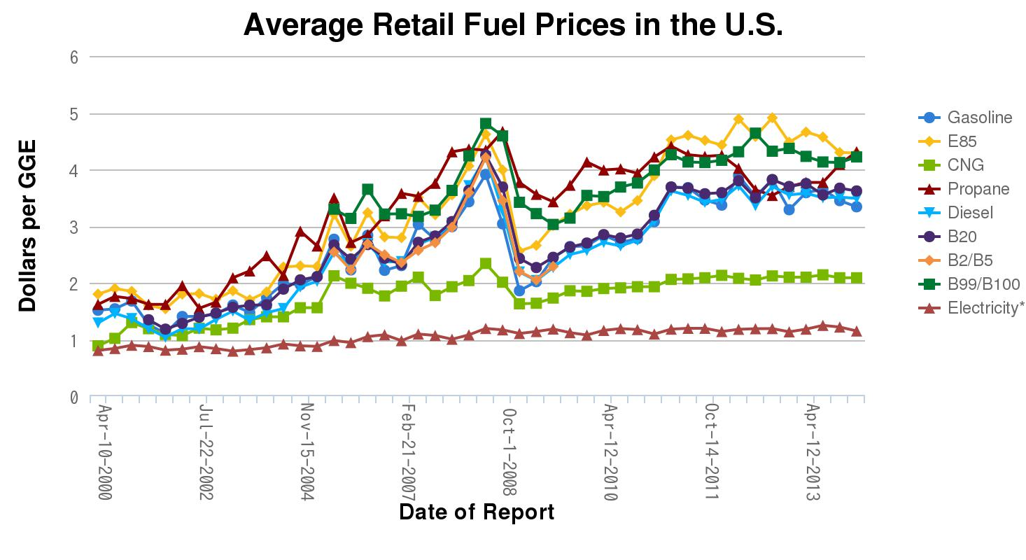
Clean Cities Price Report
National Average Price Between January 1 and January 15, 2014
Fuel | Price
Biodiesel (B20) | $3.97/gallon
Biodiesel - B99+ | $4.28/gallon
Electricity | $0.12/kWh
Ethanol (E85) | $3.04/gallon
CNG | $2.09/GGE
Propane | $2.96/gallon
Gasoline | $3.34/gallon
Diesel | $3.89/gallon

Slide 11
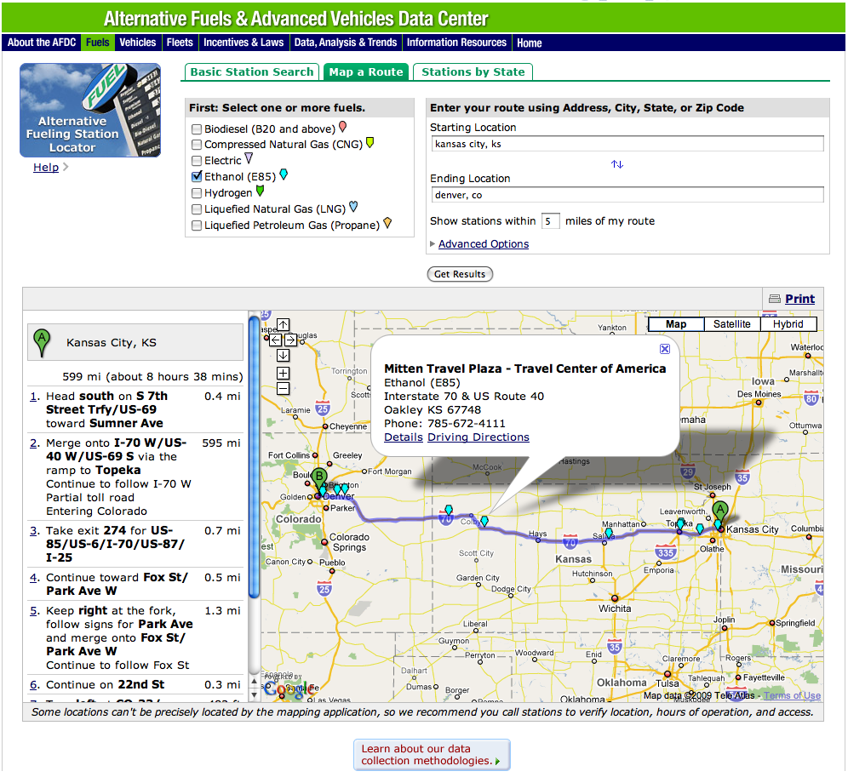
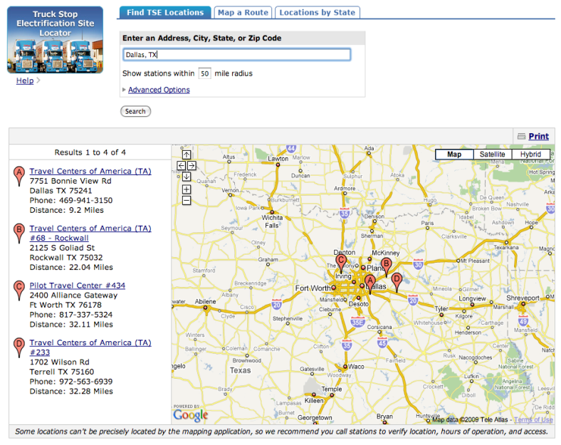
AFDC Alternative Fueling Station Locator
Notes:
The alternative fueling station locator also lets you map a route for longer trips.
The Clean Cities program supports citizens and employees who desire to use alternative fuels for the duration of an extended trip. This option allows you to plan routes most conducive to the use of a specific alternative fuel.
The map a route feature uses the Google® maps mapping and directional features.

Slide 12
NJ CNG Vehicle & Infrastructure Project
NJCCC lead a public/private team to implement the first statewide deployment of AFVs and infrastructure in NJ.
Effectively leveraged federal investment of $15mil with an additional $34 mil of non-federal for $49mil total project cost.
Transitioned 305 highly visible vehicles to CNG from 15 fleets statewide (trash collection trucks and shuttle buses). Installed 6 CNG fueling stations.
“Stimulated” the market for all alternative fuels by providing outreach & education to fleets, regulators and the public.
Base program displaces more than 2,000,000 gallons of petroleum and avoids more than 900,000 pounds of identified criteria pollutants and greenhouse gas emissions per year.

Slide 13



Northeast Electric Vehicle Network
Transportation and Climate Initiative is a collaboration of eleven Northeast and Mid-Atlantic states and the District of Columbia to:
Reduce greenhouse gases in the transportation sector;
Create benefits and funding opportunities for states that are leading the way;
Align with federal government actions, goals and emerging inter-agency approaches;
Along with Clean Cities coalitions, implement a nearly $1 million Electric Vehicle Readiness Grant from DOE to lay the groundwork for the Northeast Electric Vehicle Network

Slide 14
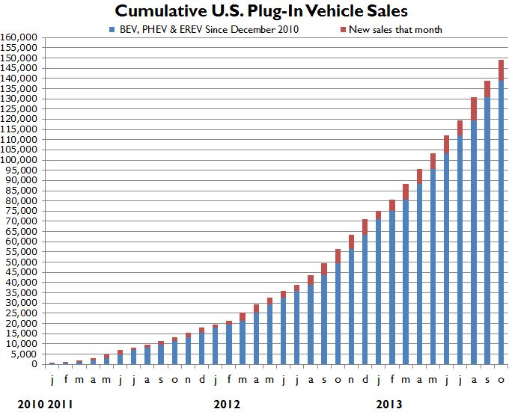
Sales pace is significantly increasing
PEV sales in 2013 were 103% higher than in 2012.
Many new models available, more coming.
First 3 years of sales of PEVs far exceeds pace of first 3 years of hybrids (150,000 vs 25,000). Over 3 million hybrids now.

Slide 15
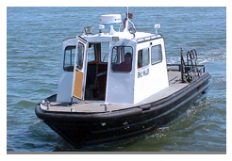
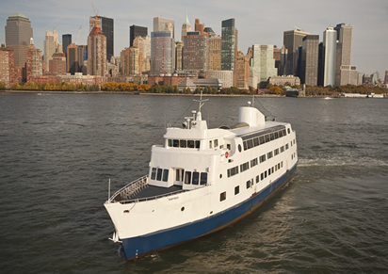
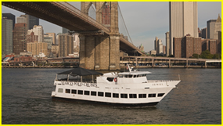
Vessel Engine Replacements
NJCCC lead a public/private team to repower unregulated engines in vessels operating in NY Harbor & Vicinity with new Tier 2 and Tier 3 compliant engines.
Many of the existing engines date back to the 1970’s, with no emission controls.
EPA-assisted project provides significant emission benefits, petroleum reduction through increased efficiency, and public education. Additional funding for more vessels is pending.

Slide 16
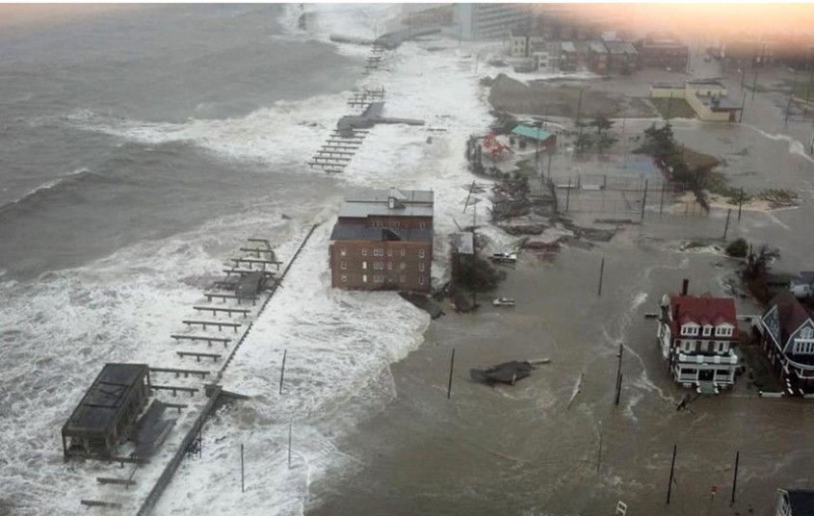
Atlantic City Boardwalk

Slide 17
Importance of alternative fuel vehicles
Hurricane Sandy recovery efforts showed value of alternative fuel vehicles/advanced technology vehicles
  Able to provide critical services when conventional fuel supplies are interrupted
  Alternative fuel supplies remained available post-storm
  Point to need for FUEL DIVERSIFICATION
Important to maintain an inventory of these resources so they can be integrated into contingency planning efforts and energy assurance planning.
Clean Cities Coalitions
  Informed about local alternative fuel landscape
  Connected to key stakeholders

Slide 18
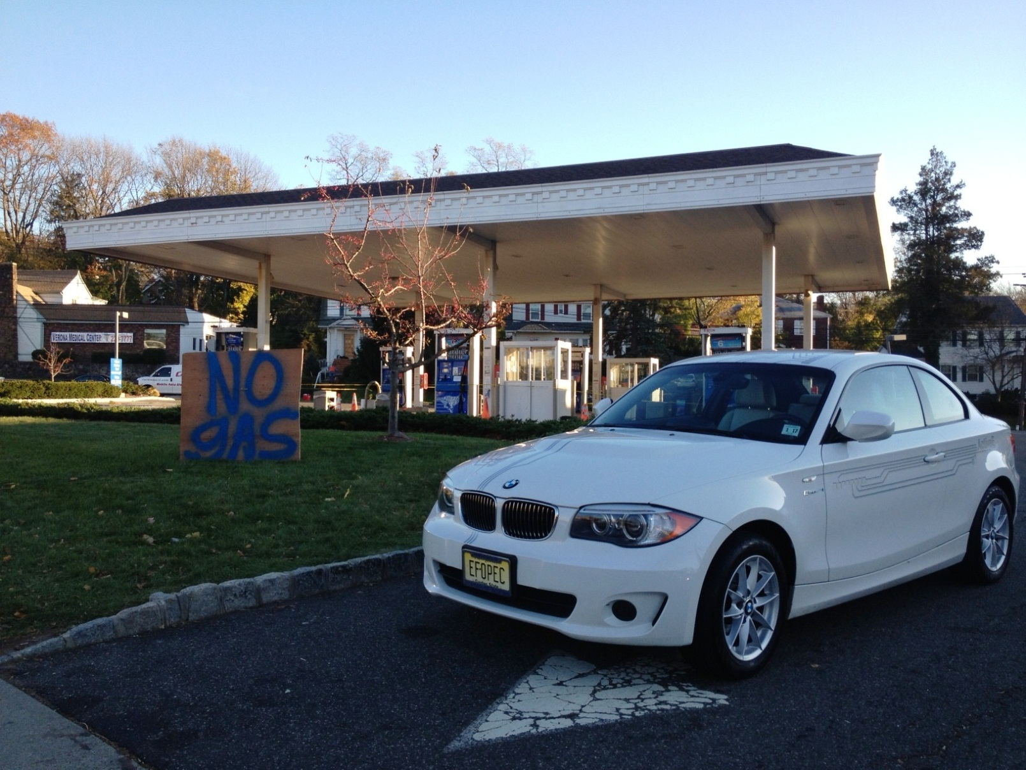
No gas? – No problem!
Note the license plate! (EF-OPEC)

Slide 19
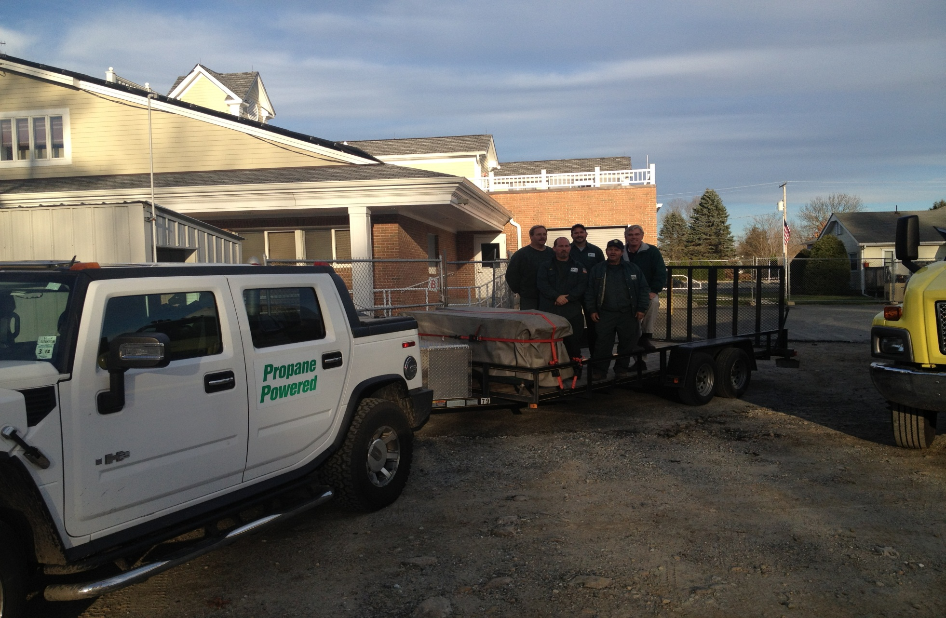
Loading Relief Supplies via Propane-fueled Hummer

Slide 20

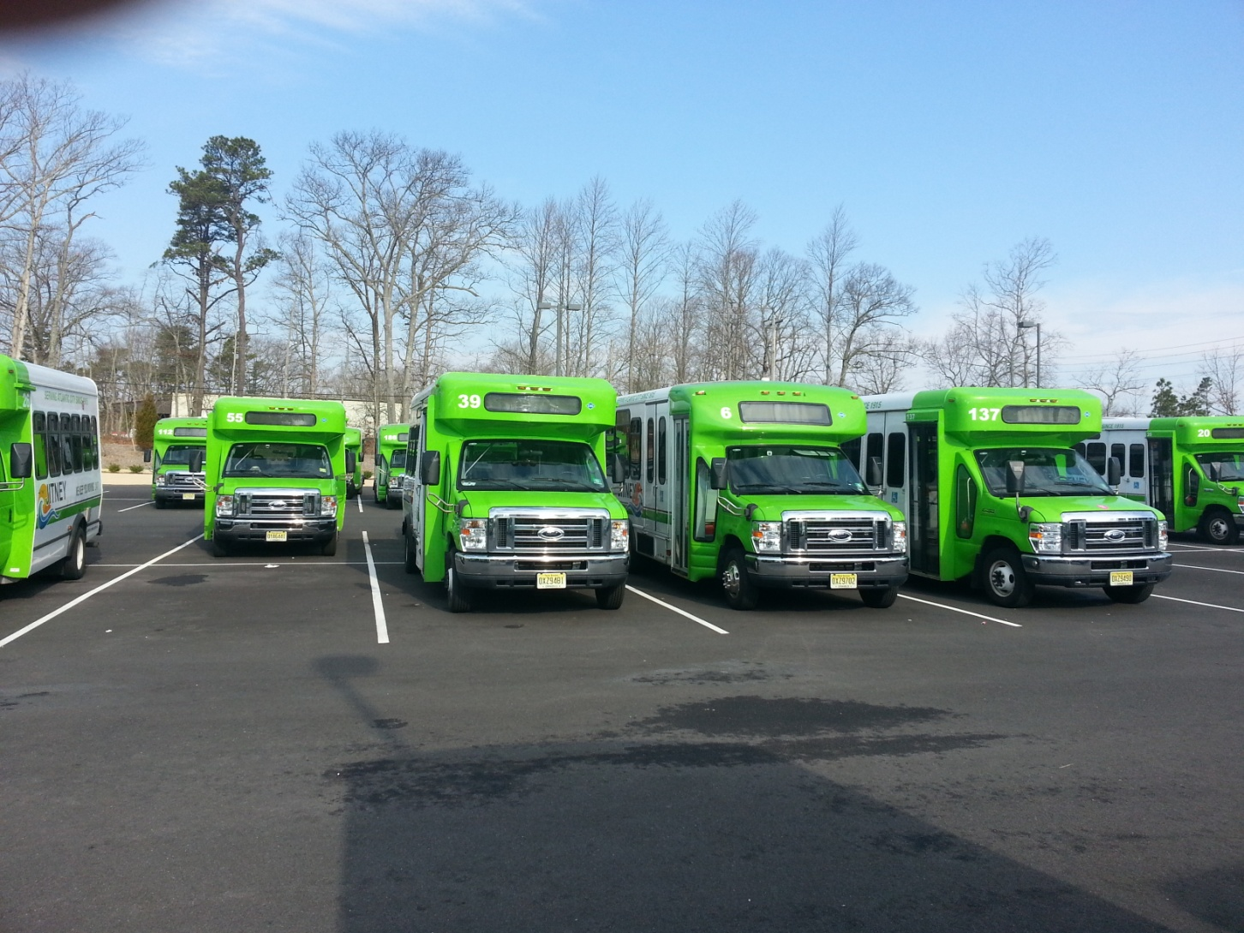
“Natural Gas Minibuses Help NJ Recover From Hurricane Sandy”
PBS show highlights the Atlantic City Jitneys that run on compressed natural gas and were able to assist with assistance and relief efforts prior to and after Hurricane Sandy
Clean Cities TV – YouTube
Alternative Fuels Data Center
Case Studies
http://www.afdc.energy.gov/case/1323

Slide 21
Upcoming Events
April 9-10, 25th Annual Globalcon Conference and Expo at the AC Convention Center, features developments in the energy field, promising new technologies, energy supply options, and innovative project implementation strategies. Alt Fuel Panel on 4/10.
April 26, Rutgers Day Annual Alternative Fuel Vehicle Festival - join the NJCCC for our 4th annual exhibit of alternative fueled vehicles.
May 5 - 8, Alternative Clean Transportation Conference and Expo (ACT 2014), Long Beach, CA. Join more than 3,000 attendees—fleets, technology companies, OEMs, fuel providers, infrastructure developers, and policymakers.

Slide 22

We Need Your Help
Encourage public and private entities to lead by example
  Bid preferences for contractors that use alternative fuel vehicles, further preference for those that make fueling available to the public
  Transition your own fleets to use alternative fuels; “right-size”
  Leverage private capital by encouraging Public/Private Partnerships to build alternative fuel infrastructure, in exchange for long-term fuel purchase agreements.
Respond to Clean Cities data requests
Support your local Clean Cities Coalition (financially & otherwise)!!

Slide 23

Contact Information
Chuck Feinberg
Chairman of the Board of Trustees
New Jersey Clean Cities Coalition
www.njcleancities.org
Twitter: @njcleancities
LinkedIn Group: New Jersey Clean Cities Coalition
Partner and EVP, Greener By Design
www.gbdtoday.com
cfeinberg@gbdtoday.com

