Slide 1
Clean Air Strategies at NJDOT
NJ Clean Air Council Annual Public Hearing
April 8, 2014
Andy Swords, NJDOT

Slide 2
Clean Air Strategies for NJDOT
AFVs in Our Fleet
Traffic Signal Optimization
Construction – Materials, Equipment
Incentives to Reduce Travel

Slide 3
AFVs in NJDOT’s Fleet
NJDOT owns more than 1000 gas powered vehicles
54% of fleet is other than standard IC engine (hybrid, ethanol or CNG)
Roughly 10% of the gas powered fleet is hybrids, but they are the newest portion of the passenger fleet.
NJDOT owns over 2000 diesel engines
All are B5 biodiesel capable, but higher cost and limited budget prevents use

Slide 4
Traffic Signals and Technology
NJDOT is working to optimize systems of traffic signals throughout the state
Reduces idling emissions & delay, improves travel time
NJDOT is also exploring Adaptive Signal Control Technology
Uses sensors to continuously monitor traffic conditions and adjust signal timing to minimize delay and optimize travel time

Slide 5
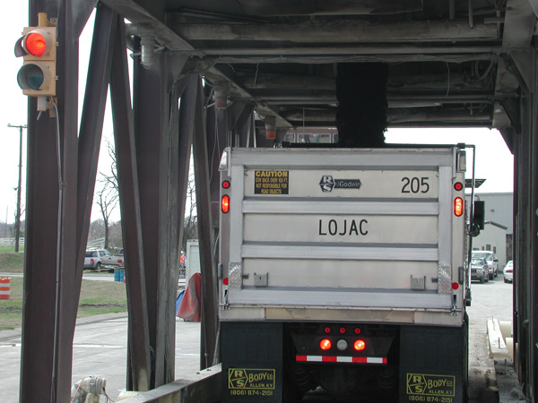
Construction - Materials
NJDOT requires use of WMA additives for asphalt-rubber* HMA
w/o additive – temp of 330⁰
w/additive – temp of 290 – 300⁰
WMA = Warm Mix Asphalt
* - incorporates ground rubber
into HMA

Slide 6
Construction - Retrofit
Governor Christie’s Executive Order 60 requires that 175 pieces of construction equipment be retrofitted
Status (as of end of March)
148 retrofits completed
25 more on order
63 more quoted & approved, not yet ordered
Early results indicate that some work zones can avoid PM2.5 exceedances by using retrofits

Slide 7
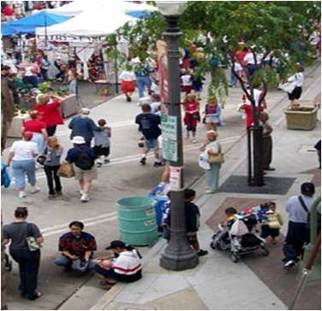
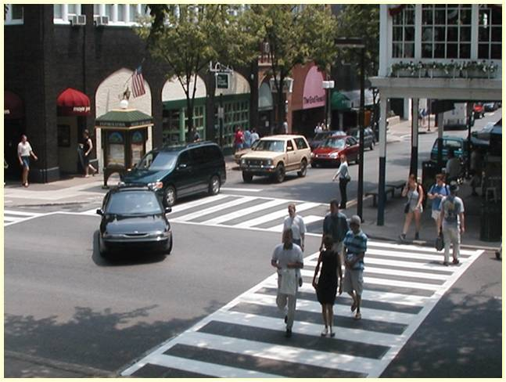
Incentives to reduce miles driven
Encourage Transit-oriented
Development (TOD)
Car Streets ==> Complete Streets
Public Health Partnerships

Slide 8
Transit Village/TOD Successes
Strong real estate market for transit oriented development (TOD)
Strongest: properties w/in ½ mile walk of train station that offers < 1 hour commute to NYC or NJ rail friendly destinations
Number of Designated Transit Villages
2004: 14
2010: 20
2014: 28

Slide 9
Complete Streets Phenomenon
NJDOT: #1 Complete Streets Policy in US
NJ Municipal Complete Streets Policies
a/o Jan 1, 2012: 25
a/o Jan 1, 2013: 62
a/o Jan 1, 2014: 88
+ 2 more so far in 2014 ➔ 90 total
NJ Counties: Camden, Essex, Hudson, Mercer, Middlesex, Monmouth (6)

Slide 10
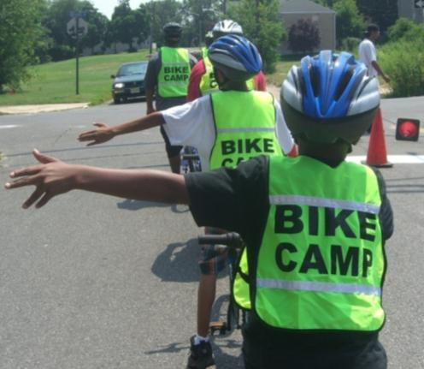
Partnership with health agencies
Health and transportation agencies – growing partnership to
encourage healthy lifestyles
minimize impacts on at risk populations
Safe Routes to School (SRTS)
Reducing hot spots of congestion, emissions near schools

Slide 11
Outlook – Moving Forward
Funding constraints = continued competition between worthy policy goals
Demand for livable communities is continuing
Continue expanding Transit Village, Complete Streets initiatives
Nurture, grow partnerships with low cost targeted technical assistance to municipalities

Slide 12
Questions?
Andy Swords
Director, Division of Statewide Planning
NJDOT
andrew.swords@dot.state.nj.us

