Slide 1
New Jersey electronic RMP eNJRMP
State of New Jersey
Department of Environmental Protection
Toxic Catastrophe Prevention Act (TCPA) Program
February 2016
Notes:
There is no requirement to immediately register and/or submit an RMP. The last RMP you submitted is still valid. You would only submit an RMP if you need to correct or update the information formerly submitted.
However, we urge you to at least go thru the registration process. This can take time since it involves submitting a form via US Mail.
If you haven’t already been made aware, there is an eNJRMP User’s Manual available on-line which will walk you through the process. What I am going to do initially is give an abbreviated version of what is in the eNJRMP manual. The 46 page manual goes into much more detail. Much of this will be how to get into the system. Actually entering data into an RMP is the easy part.

Slide 2
What needs to be done to access enjrmp?
1. Create a User Profile for the NJDEPOnline Portal at www.njdeponline.com and access eNJRMP here also
2. Submit a form via US Mail to designate your FSA (What’s an FSA?) (Where do I get the *&@!?$ form?)
Notes:
1. Some of you may already have a User Profile. If you do not, you must create one. Because this is where you will access eNJRMP submit.
What’s an FSA? Facility Security Administrator.

Slide 3
Types of eNJRMP Accounts
Facility Security Administrator (FSA)
  Only one FSA allowed per facility
  Should be a member of the facility’s management with an understanding of the Risk Management Program
  Authority to grant and revoke access to eNJRMP for other designated personnel
  Able to edit and submit the RMP
  Plays a crucial role in maintaining the security of the RMP
  Granted access by the NJDEP
Notes:
Basically the FSA is the gatekeeper for your RMP submission process. Information contained in the RMP is Homeland Security data so it is essential that the FSA be carefully selected and that he carefully selects other users.
You should note that there are three “paths” after this:
1. An FSA who will only designate others to submit RMPs
2. An FSA who will submit all RMPs himself, and
3. An FSA who will submit RMPs himself and who will have others who can also submit RMPs.

Slide 4
Types of eNJRMP Accounts
Individual with Direct Knowledge (IDK)
  May have multiple per facility
  Can be from outside the company
  Cannot grant access to others
  Able to edit and submit RMP
  Granted access by FSA
Notes:
A non-FSA person who will submit RMPs is referred to by the Department as an “Individual with Direct Knowledge.” You will see this term in the user’s manual which is on-line.
There are a number of reasons why someone other than the FSA will submit RMPs:
a. You may have a consultant whom you have hired to do so;
b. Your FSA may be an upper manager who does not want to submit RMPs;
c. Your company may want more than one person available who can submit an RMP.

Slide 5
Types of eNJRMP Accounts
Changes to Personnel:
FSA - Done through the Department
IDK - Performed by the FSA
Personnel who leave should be removed ASAP
Notes:
If the FSA leaves, it is important that a new FSA be designated ASAP.
It is important to restrict access to your RMP to authorized individuals. If your FSA leaves or you wish to designate a new FSA, you must submit a form to the Department. Consult your user’s manual for details on this.
If an IDK leaves, the FSA should remove his access.
Both the FSA and the IDK can delete themselves from access.

Slide 6
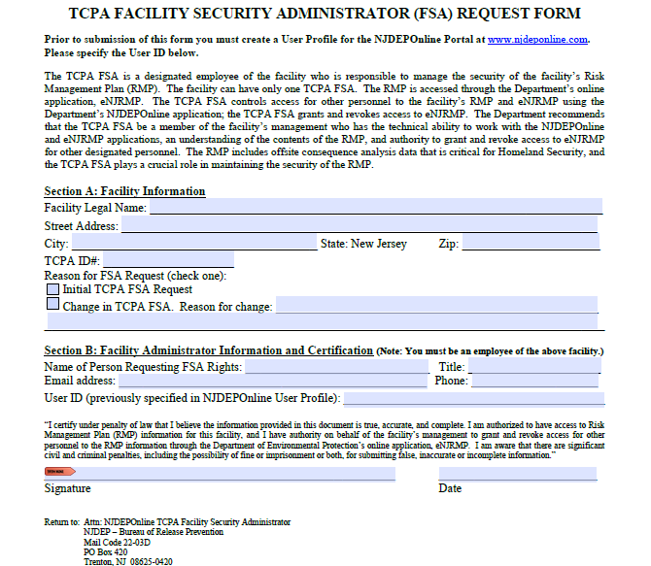
Submit a form to designate an fsa
Notes:
This is the form you need in order to designate your FSA. As indicated, you complete this and mail it to the address indicated. Until you have an FSA, you cannot proceed.
The form is available from Deponline or through the TCPA website.

Slide 7
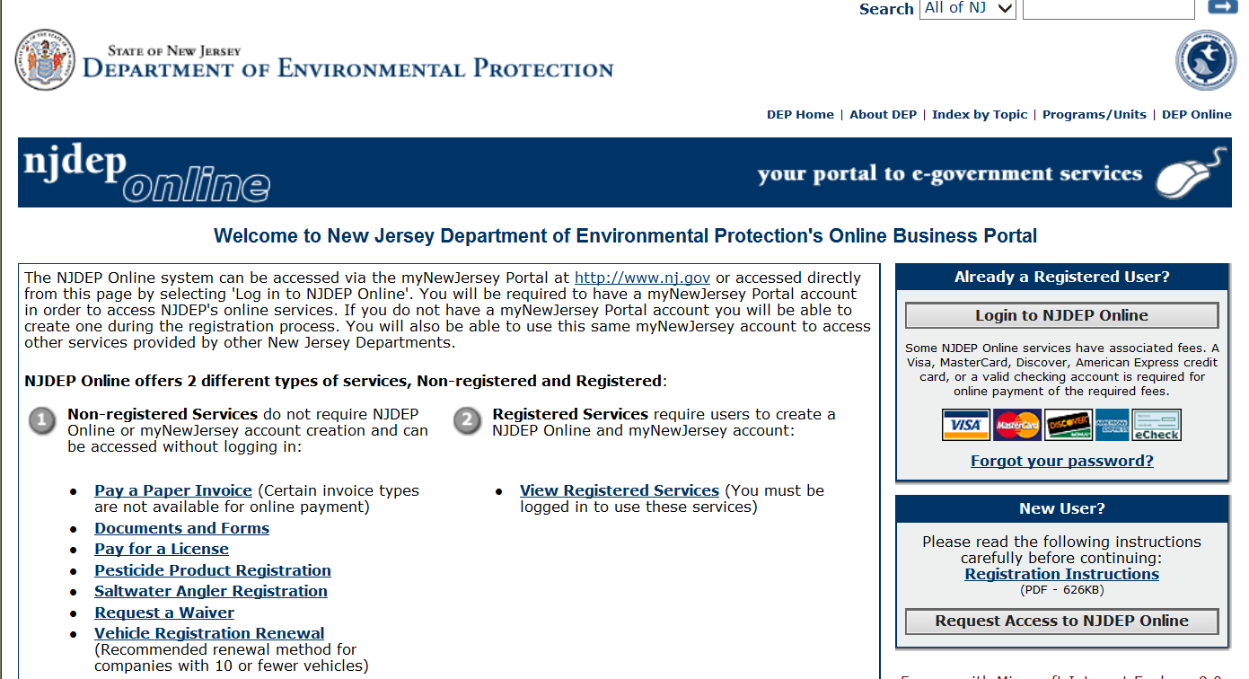
Creating a User Profile
Notes:
This is what you see after you go on-line at www.njdeponline.com. You can see under non-registered services a line which says “Documents and Forms”. Clicking on this will take you a screen where you can select the FSA form. Or you can simply go directly to the TCPA website and obtain the form.
If you already have an account you select the upper box; if you do not, you select the lower and begin to create an account. After you have requested access, you go through several screens much like when you register to shop at Amazon, except that at the end you don’t enter your Visa or Master Card account number. It’s the old “What’s your mother’s maiden name?” or “What was your first car?” type thing. We are not going through each of these since none of us wants a 45 slide PP presentation and it is all detailed in the user’s manual previously mentioned.

Slide 8
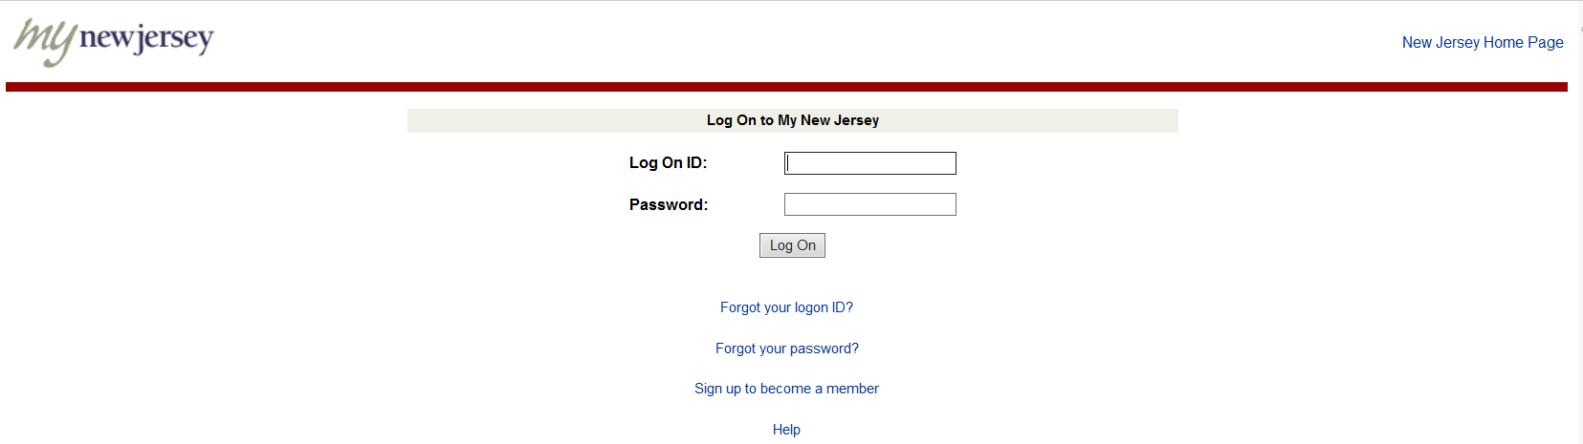
Log on to my new jersey
Notes:
Once you hear back from the Department via an e-mail that you, the FSA, have been granted access, and you intend to submit RMPs, you must configure your services to include eNJRMP. You do this by logging in and [next slide]

Slide 9
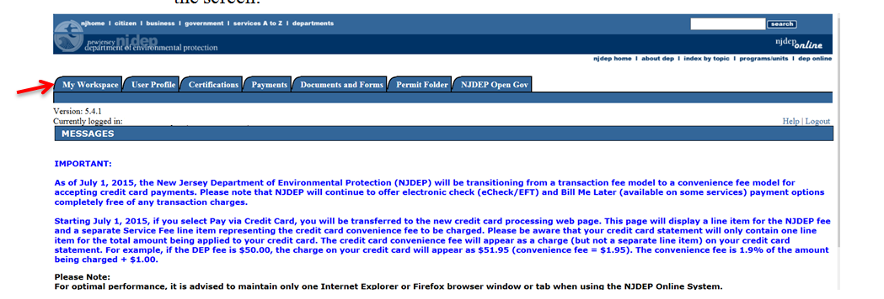
Configure your services to include enjrmp submit
Click My Workspace
Notes:
and clicking on My Workspace.

Slide 10
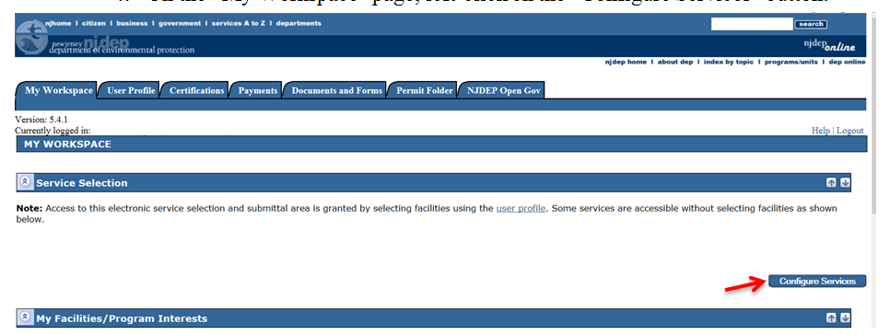
Configure your services to include enjrmp submit
Click Configure Services
Notes:
Under the workspace tab, click Configure Services.

Slide 11
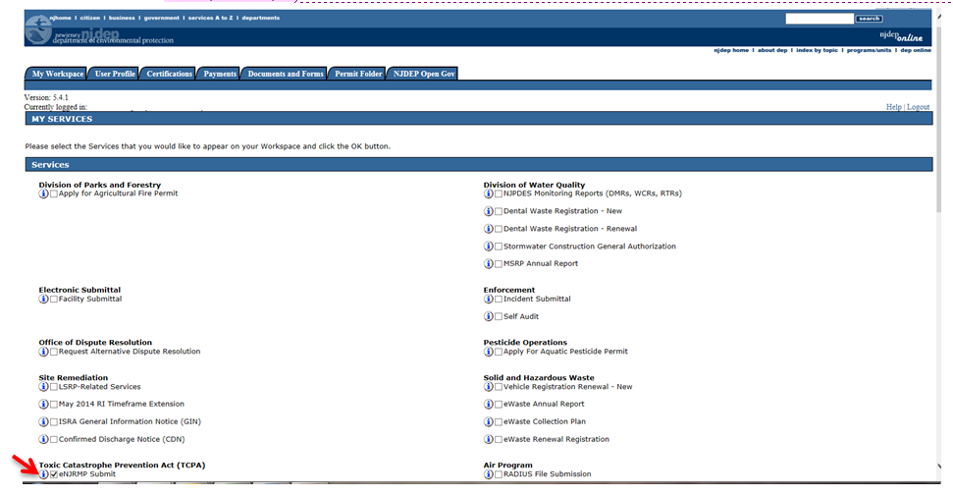
Configure your services to include enjrmp submit
Check eNJRMP Submit and click OK
Notes:
Then check eNJRMP Submit and click OK.
Doing this places the eNJRMP Submit link on My Workspace.

Slide 12
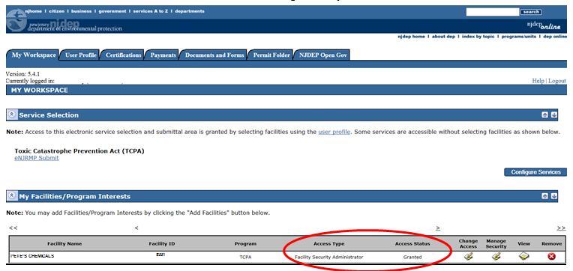
Configure your services to include enjrmp submit
Notes:
Producing this screen.
Note the eNJRMP link. You will use this every time you access enjrmp SUBMIT. The configure services button is used only once.
At this point, an FSA who will be submitting RMPs is ready to do so. But before we get into submitting RMPs, we need to show how to add additional persons, including consultants, to the people who can submit an RMP for your facility.
Individuals who are not FSAs do the following:
a. You create an NJDEP on-line account and log on.
b. [next slide]

Slide 13
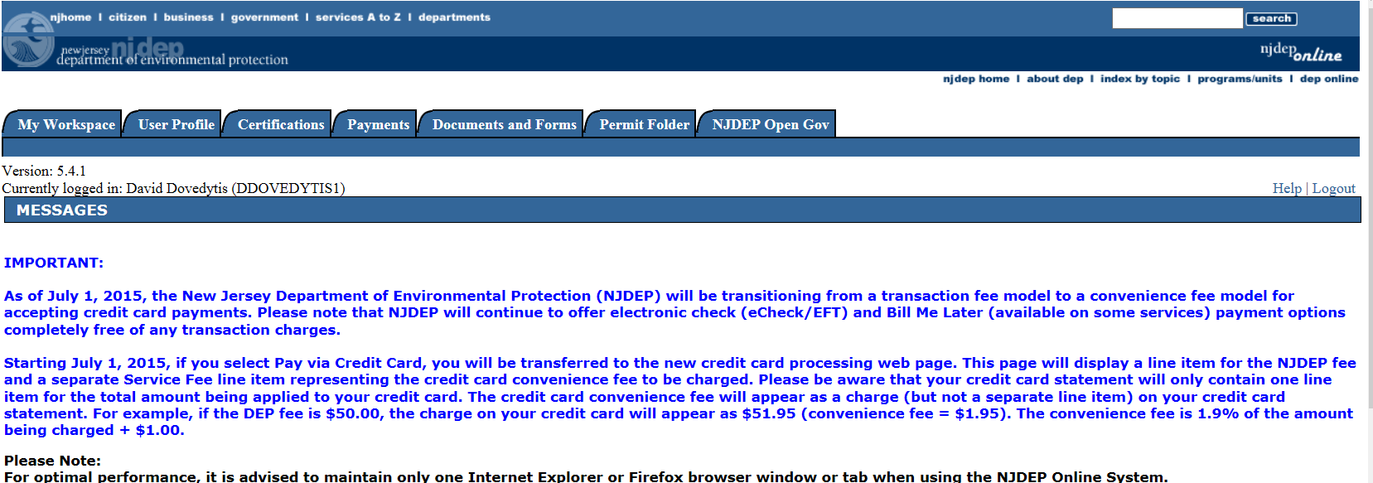
access for other users (IDK)
Log in and then click My Workspace
Notes:
c. And this screen appears
d. We saw this screen earlier when we configured services as an FSA; you now click My Workspace and configure services just as you saw earlier as an FSA.
e. But now, instead of getting this [[next slide].

Slide 14
Notes:
This screen will not be seen by the IDK.

Slide 15
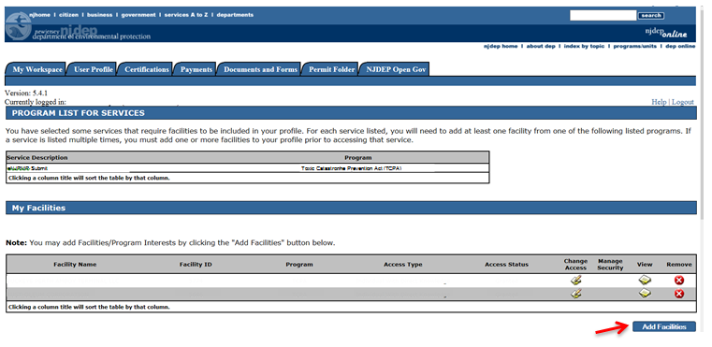
access for other users (IDK)
Click Add Facilities
Notes:
You get this. This is the screen seen by the IDK.
No facilities are shown so you click Add Facilities.

Slide 16
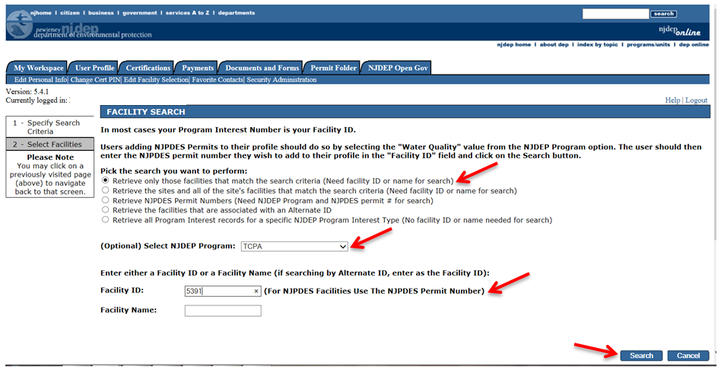
access for other users (IDK)
Notes:
We select the first item, then select TCPA, and then type in the TCPA ID number and click Search.

Slide 17
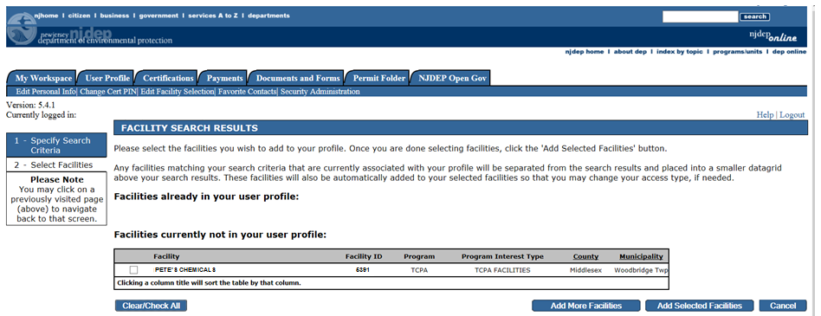
access for other users (IDK)
Notes:
We then get where we check the box next to the facility (even if there is only one facility) and then click Add Selected Facilities.
At this point, the system automatically sends out an e-mail to the FSA requesting access for you to the facility.
You should note that you need to check your spam folder if you are waiting for a system e-mail. When we were testing the program we discovered that our spam filter was routing some of the system-generated e-mails to the spam folder.

Slide 18
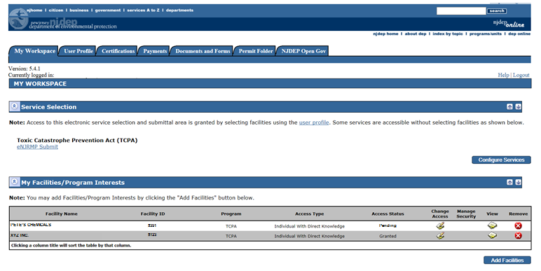
access for other users (IDK)
Clicking eNJRMP Submit would take you to the RMP submission process
Notes:
And we get this. This particular slide shows what a consultant might see, i.e. more than one facility. For most others, this will not be true.
Note that for the facility in question, the status is shown as pending. This means that you do not yet have access to that facility. The status will change from pending to granted when the FSA approves you. And this could take a while if the FSA is doesn’t read e-mails, is on vacation, or otherwise doesn’t approve you right away.
So you, an “Individual with Direct Knowledge” are done until you receive an e-mail from the system which says you have been granted access. When that happens the “Pending” changes to “Granted” and you are ready to submit RMPs.

Slide 19
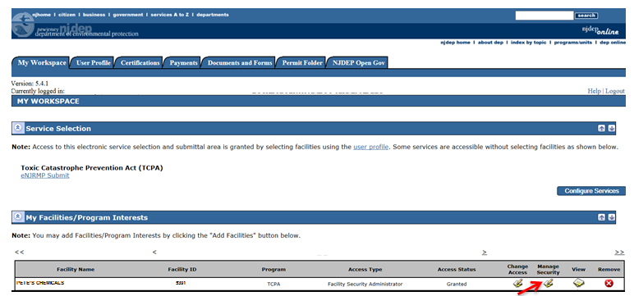
granting access to other users (FSA)
Click the icon beneath Manage Security
Notes:
The FSA, after receiving notification of an RMP access request, must login to NJDEPOnline and navigate to the “My Workspace” tab/page.
The FSA then clicks on the icon (which looks like a notepad and pencil) in the Manage Security column

Slide 20
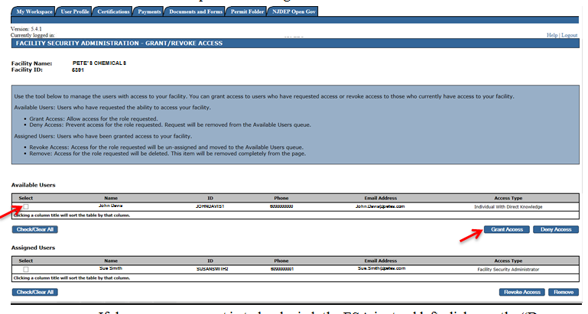
granting access to other users (FSA)
Check the Select box and click Grant Access
Notes:
Which brings us to this screen.
Click Select, click Grant Access, and the individual in question, in this case John Davis1, moves from Available users to Assigned Users, and the FSA is done and logs out. The system automatically sends an e-mail to the Individual with Direct Knowledge and we are complete and ready to submit an RMP!

Slide 21
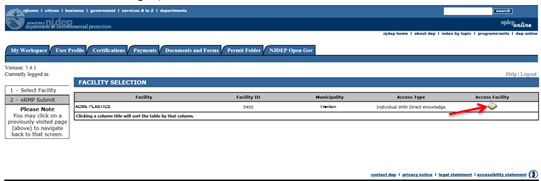
eNJRMP Submission
Click the icon beneath Access Facility
Notes:
We are now ready to begin working on an actual RMP.
To begin, you log onto NJDEP on-line and navigate to the My Workspace as we did earlier. Only now, you click on eNJRMP Submit
Clicking on eNJRMP Submit brings you here. You then click Access Facility as indicated. Note that consultants may have more than one facility but only one is shown here.

Slide 22
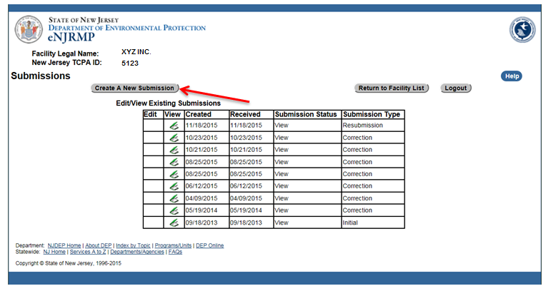
eNJRMP Submission
Click Create a New Submission
Notes:
Doing that brings you to here.
You will see that a number of RMPs are already listed. The Department has loaded all the existing RMP data into the new system. You can review any of them but you will not be able to edit them. You can only edit an RMP which you have saved but not yet submitted. Once it is submitted, it can no longer be edited.
At this point I should point out that facilities which are federally registered will have an advantage over facilities which are registered only in NJ. The NJ system was largely adapted from the EPA’s RMP submit system so Federal users should be somewhat familiar with it.
Click Create a New Submission

Slide 23
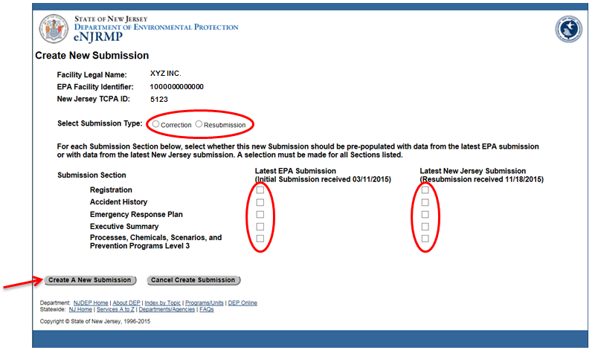
eNJRMP Submission
… and Click Create a New Submission
Notes:
And we arrive here.
You must then select correction or resubmission. Remember that a correction is used when changing one or two specific items. A resubmission is a complete update of the entire RMP. There are a number of criteria which determine which you should select. I am not going to go into that here. The user’s manual has two pages which discuss the issue. If you are not sure which to select, please consult the manual. Suffice it to say, If you are submitting a correction, there are some things you cannot change; if you are submitting a resubmission, there are some things you must change.
Note that when you submit an RMP to the EPA, that submission is downloaded to the New Jersey RMP database. You can tell here what the last Federal RMP received by NJ is. You then select whether you want to load the data from your last Federal or NJ RMP. Mention caveats.
And finally we click Create a New Submission and we enter the world of eNJRMP.

Slide 24
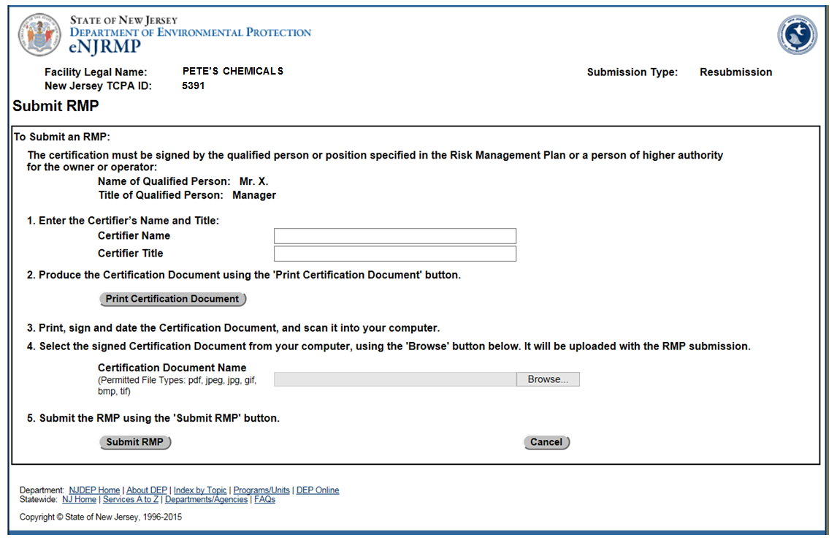
eNJRMP Certification
Notes:
At this point we are going to jump ahead to the very last thing you do in eNJRMP submission. Actual RMP data entry should be familiar to many of you but this last step will not be.
And that is the Certification step. When you have completed data entry in the RMP screens, you click on submit. This does not submit the RMP but rather produces the screen shown. You must now do the steps indicated:
You type in the certifier’s name and title.
You print the form and get the certifier to sign it.
You take the signed form and scan it into your computer. Be sure to note where it goes; you will need this in the next step.
You click on browse and find the scanned cert. page and upload it.

Slide 25
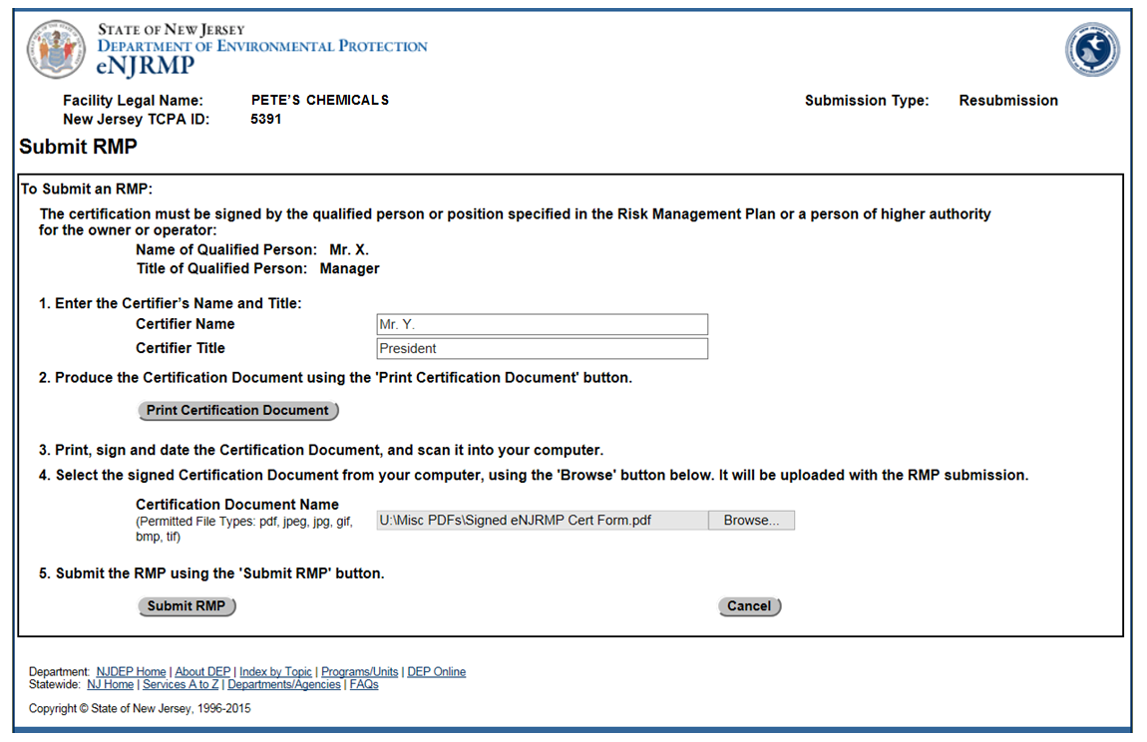
eNJRMP Certification
Notes:
This is what your screen should now look like.
At this point you click the RMP Submit button and you are finished. You may log out and get on with your business.

Slide 26
NJ Peculiar items
1.17d Inventory Basis and Chemical Uses
1.19a FEIN
1.19b Area Surrounding Facility
1.21 NJ RMP Developer
Notes:
These are the items which used to be in the Word Document which we used to refer to as the “NJ RMP”.
None of our Registrants have this data entered electronically, so the first time you submit an RMP to the Department with the new system, these items must be completed.

Slide 27

Who Ya Gonna Call?
1. Your Assigned CSE
2. Sanjeev Sharma – 609-633-1137
3. Paul Komosinsky – 609-984-3642
4. Dave Dovedytis – 609-633-1140
5. TCPA Website: http://www.nj.gov/dep/enforcement/tcpa.html
Notes:
Dave is the author of the user’s manual which is available on the TCPA website
Note also that we have produced two brief video presentations which are also available on the website.
If anyone would like to see this presentation, it is also on the TCPA website.

Slide 28

Questions?
Notes:
I want to remind you that there is a user’s manual, there are two videos, and this presentation on the TCPA website.

