Slide 1
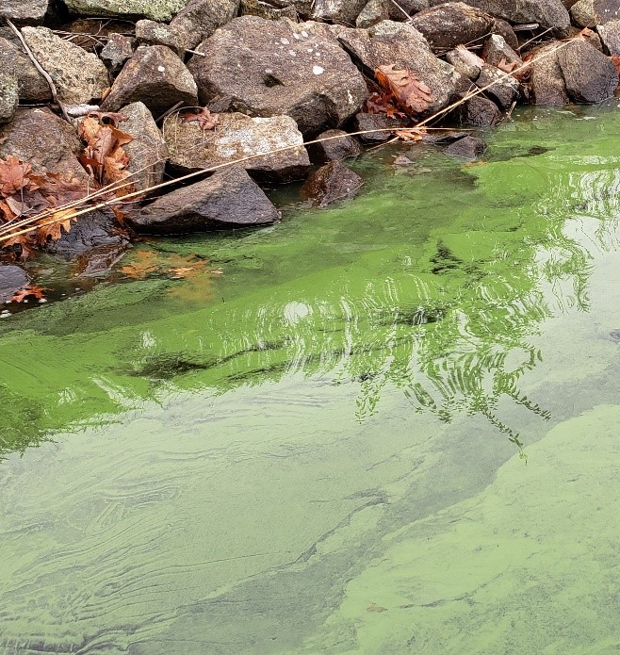
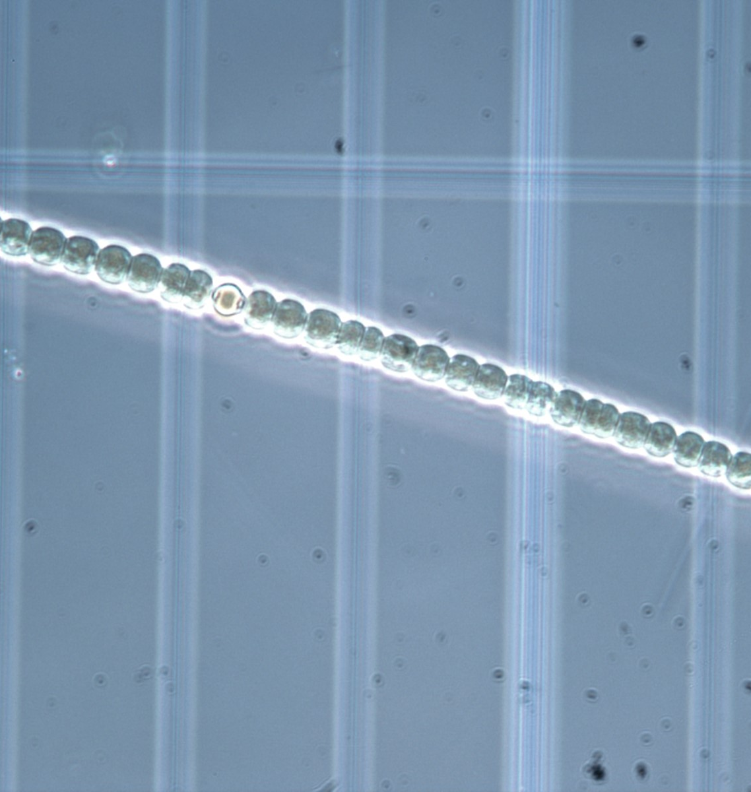
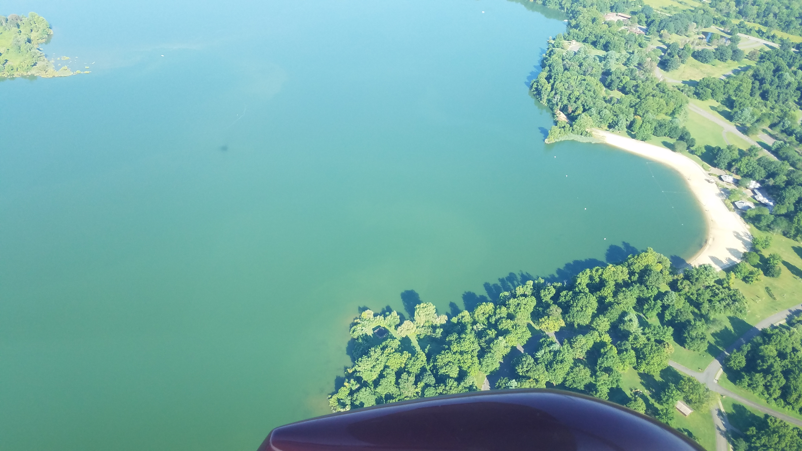

Proposed 2020 HABs Strategy
Overview and Discussion
Teams Meeting
May 21, 2020

Slide 2

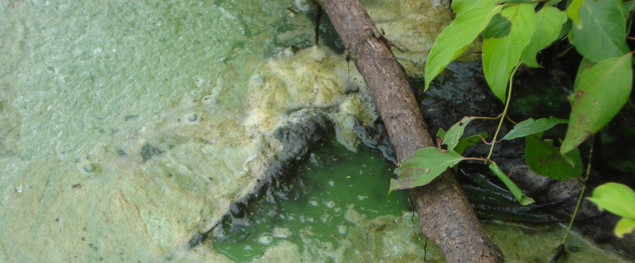
Introduction and Ground Rules
Kerry Kirk Pflugh
Manager, Local Government Assistance, DEP

Slide 3
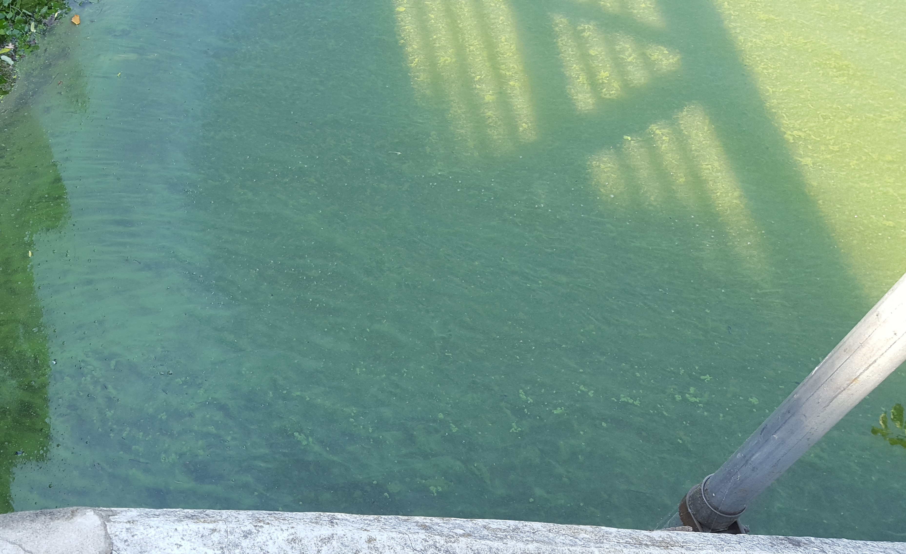
AGENDA
Introduction/Ground Rules – Kerry Kirk Pflugh
Meeting Objectives and Governor’s HABs Initiative –
Kati Angarone, DEP Associate Commissioner, Science & Policy
Proposed 2020 HAB Recreational Response Strategy –
Leslie McGeorge, DEP Administrator, Bureau of Freshwater & Biological Monitoring
Questions and Answers - All

Slide 4
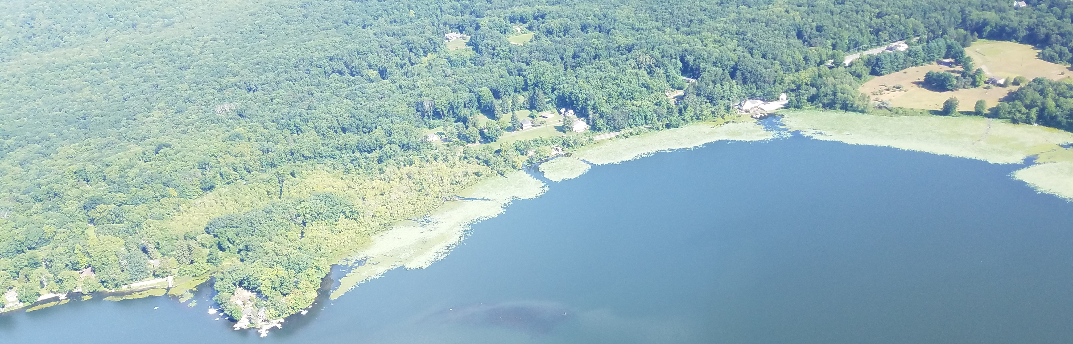
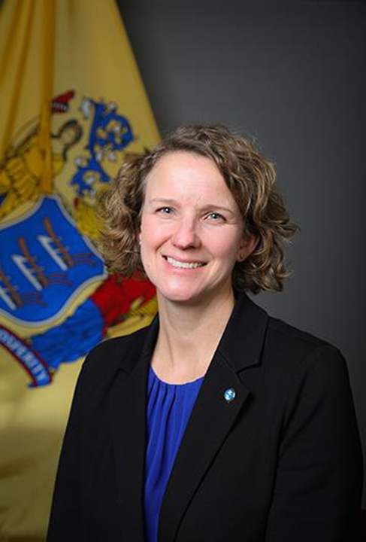
Meeting Objectives and Governor’s HAB Initiative
Kati Angarone, DEP Associate Commissioner, Science & Policy

Slide 5
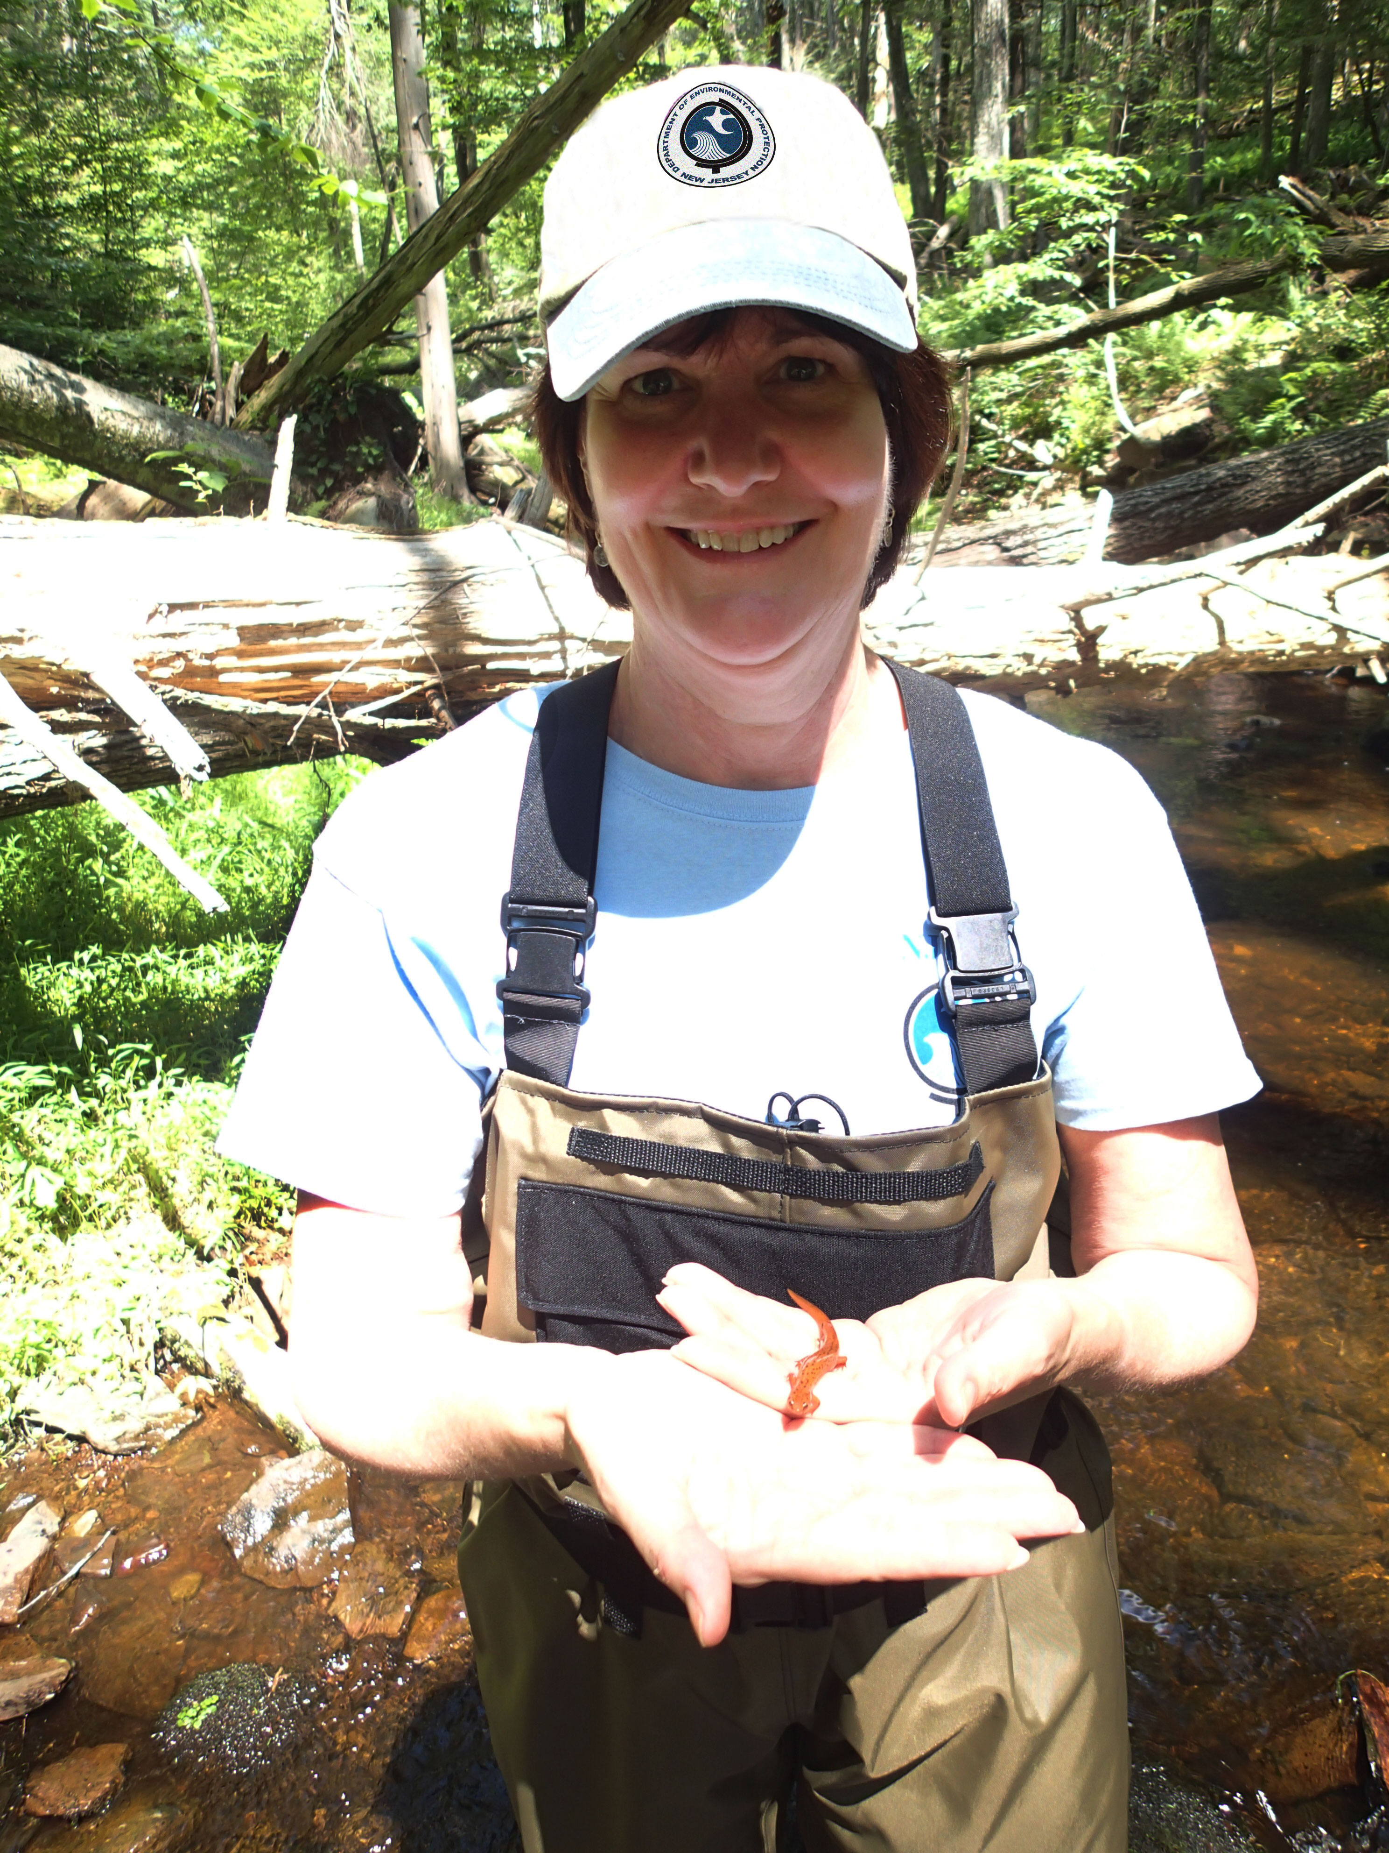
Proposed 2020 HAB Recreational Response Strategy
Leslie McGeorge, Administrator
Bureau of Freshwater & Biological Monitoring (BFBM)
Presented at:
HAB Strategy Overview and Discussion
May 21, 2020
Photo: Spruce Run (8/9/19)

Slide 6
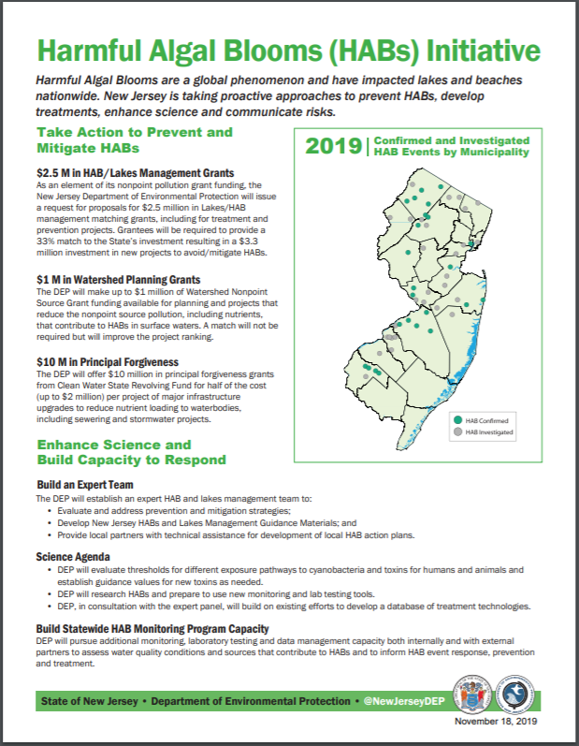
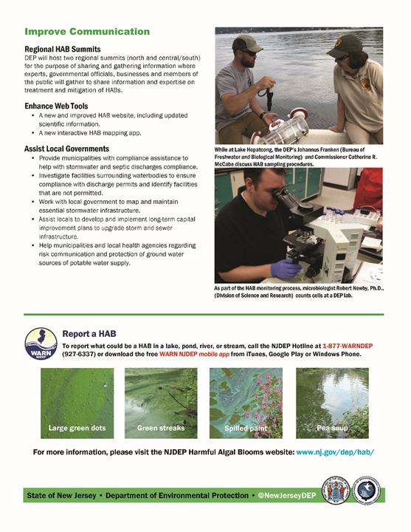
Governor's November 2019 HABs Initiative
Enhance Science & Build Capacity to Respond
Evaluate thresholds and guidance values – cyanobacteria & toxins
New monitoring and testing tools
Build DEP & external capacity – monitoring, lab testing & data management
Improve Communication
Improve HAB website
Build interactive HAB reporting tool

Slide 7
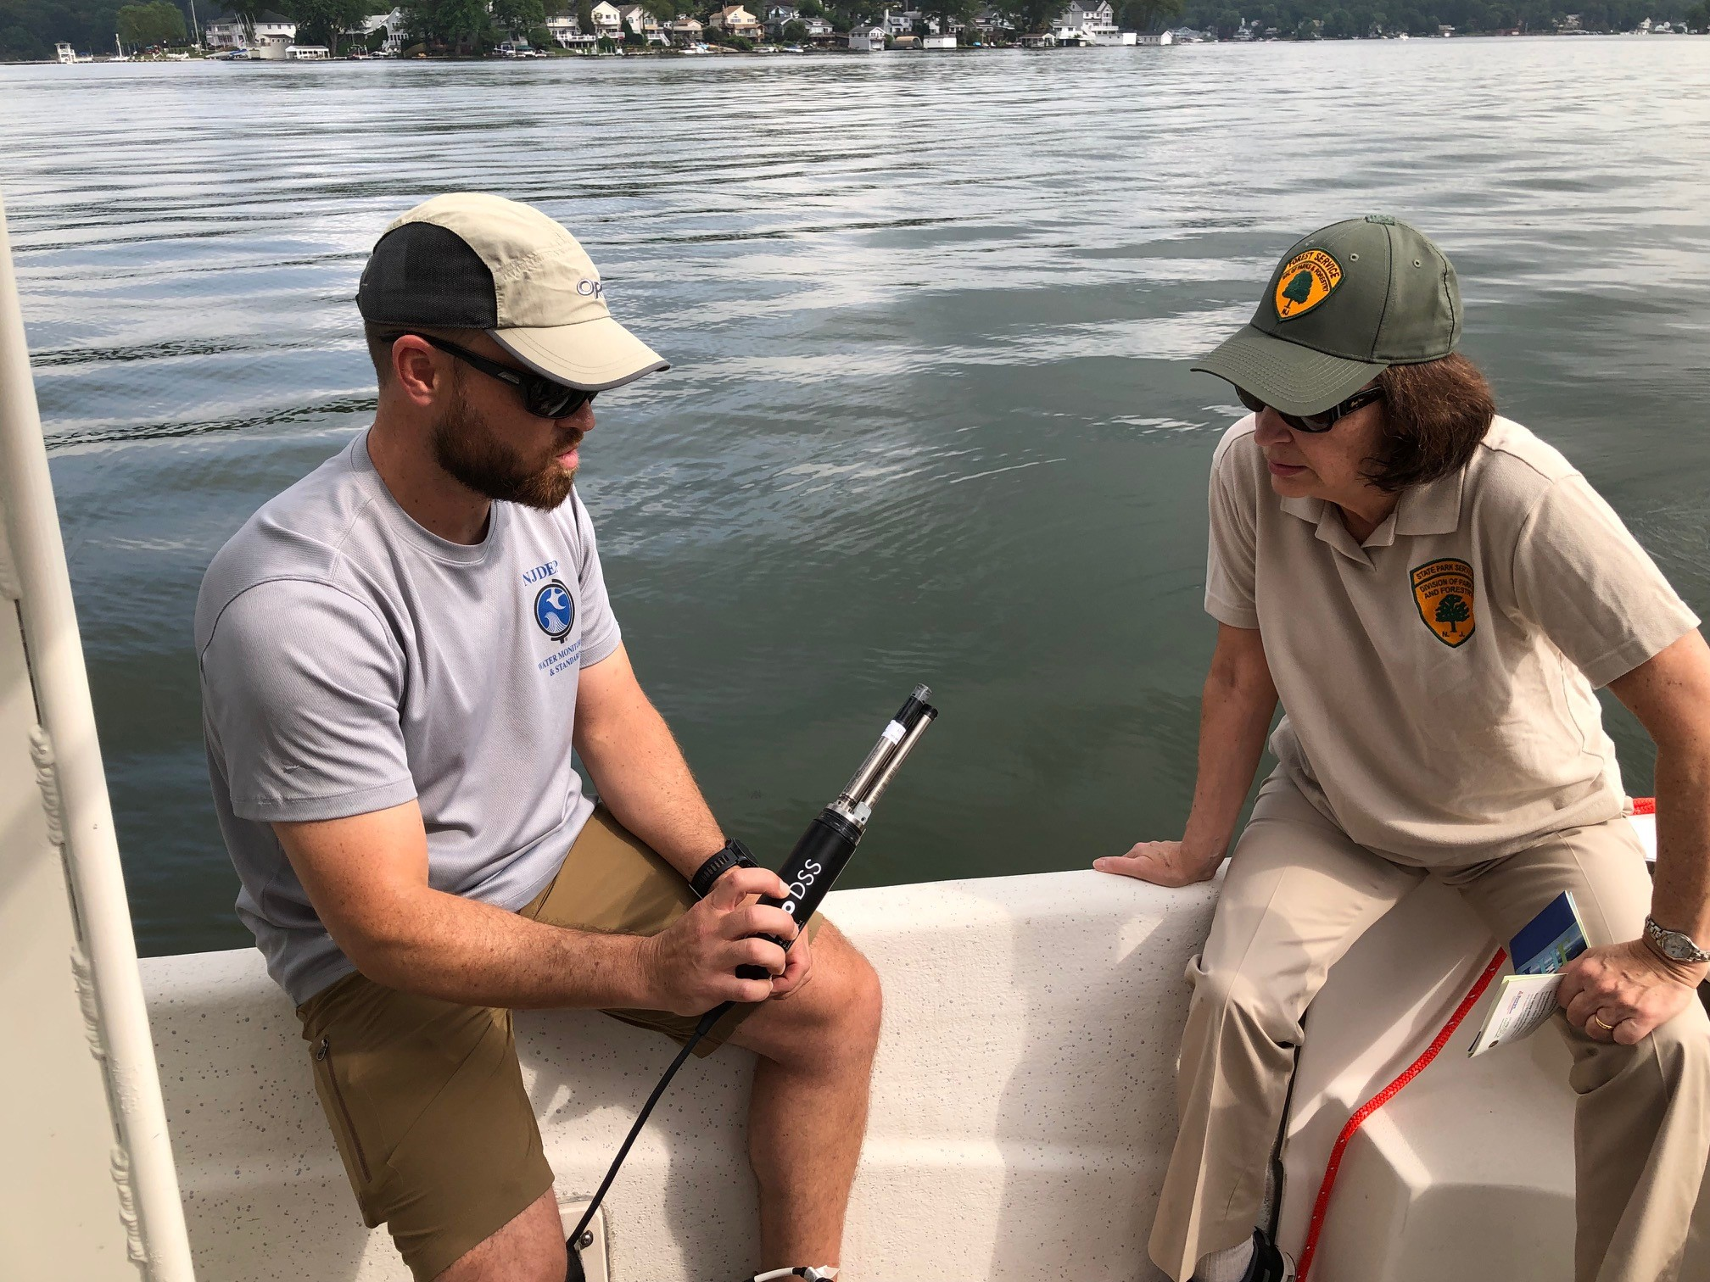
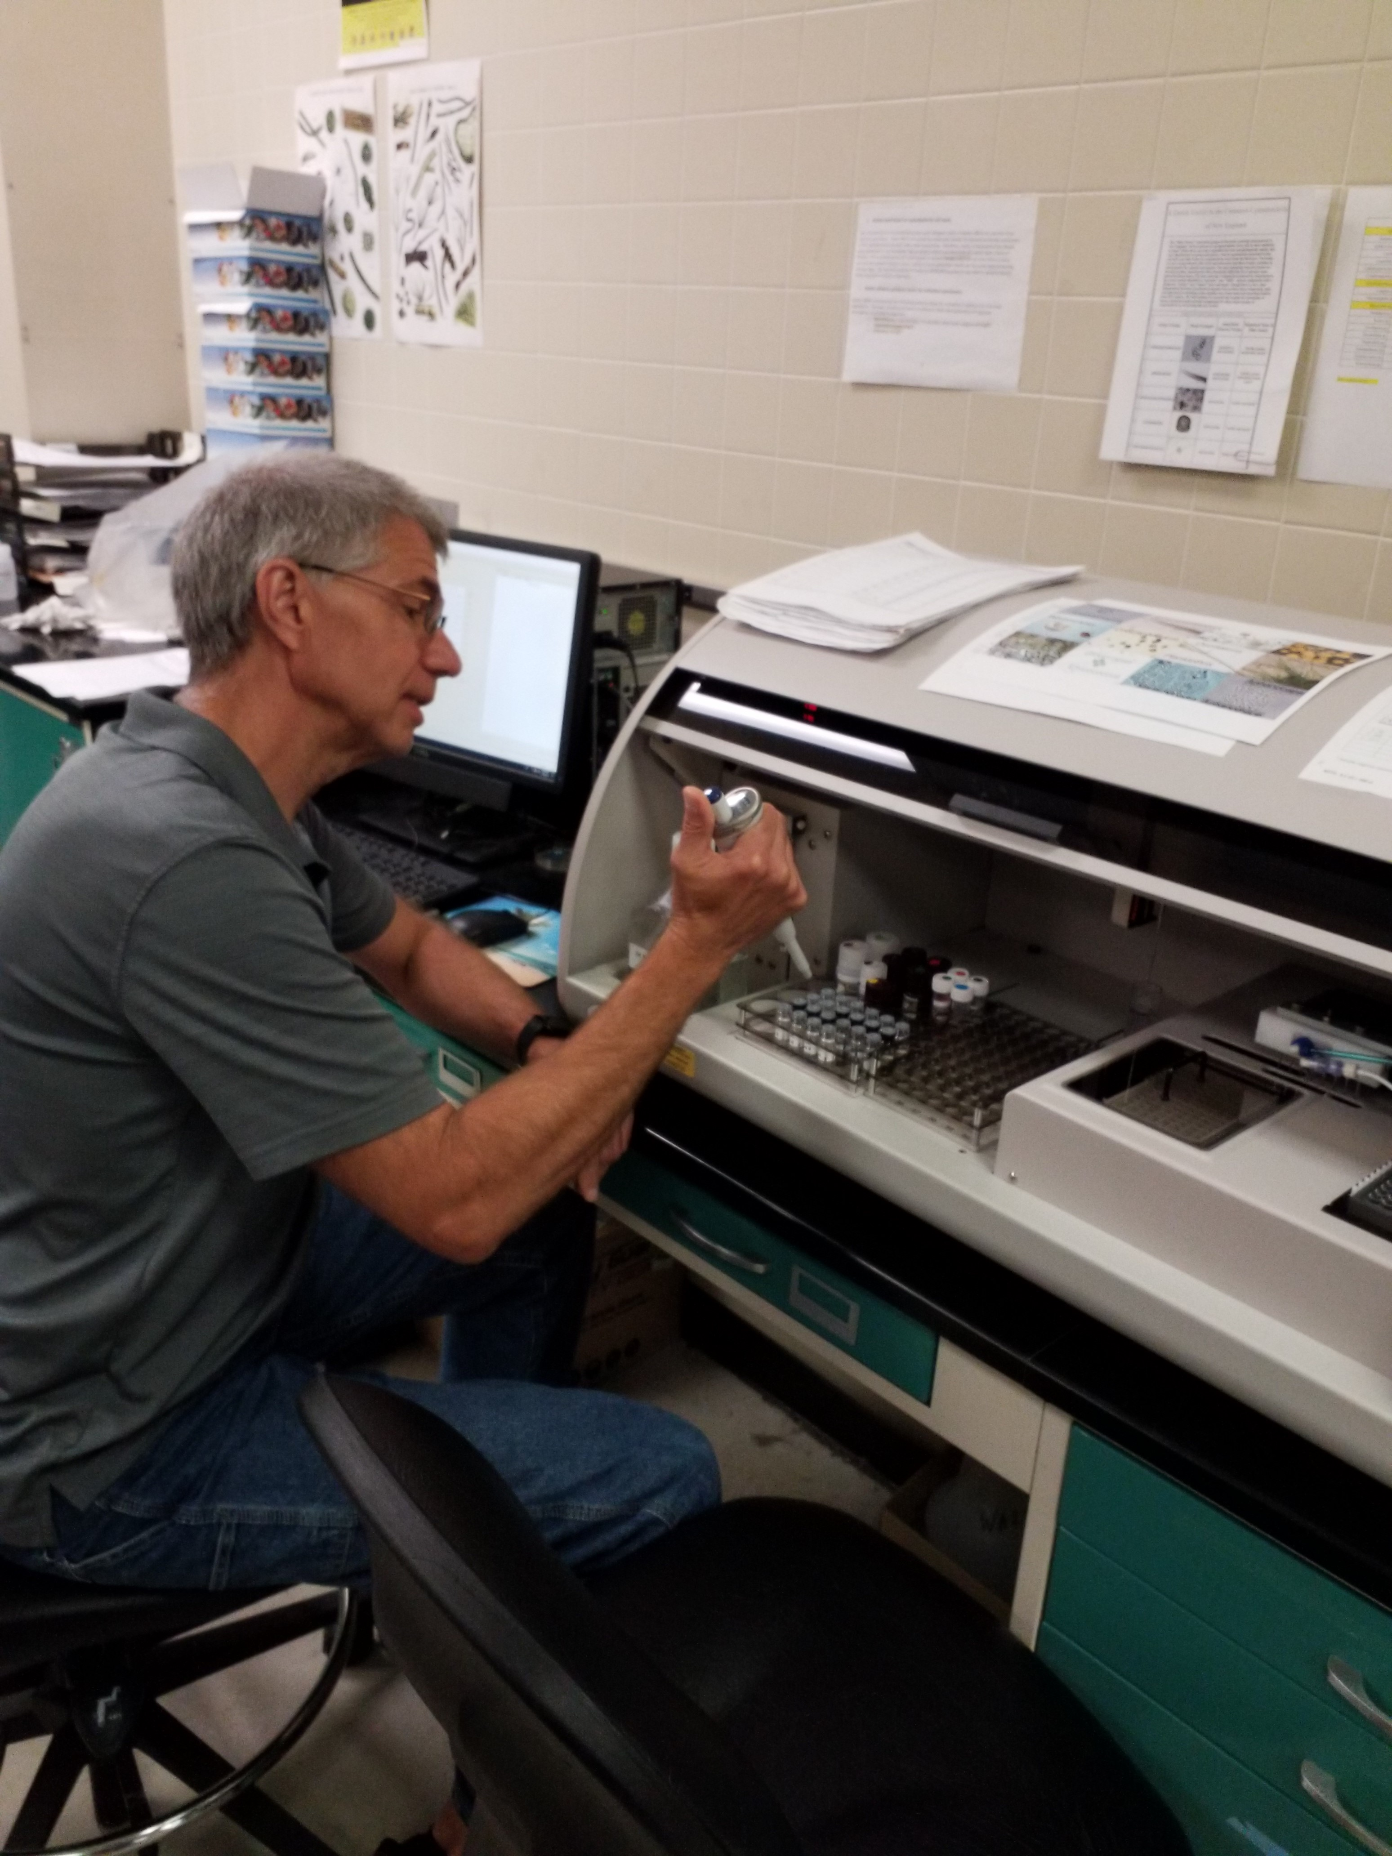



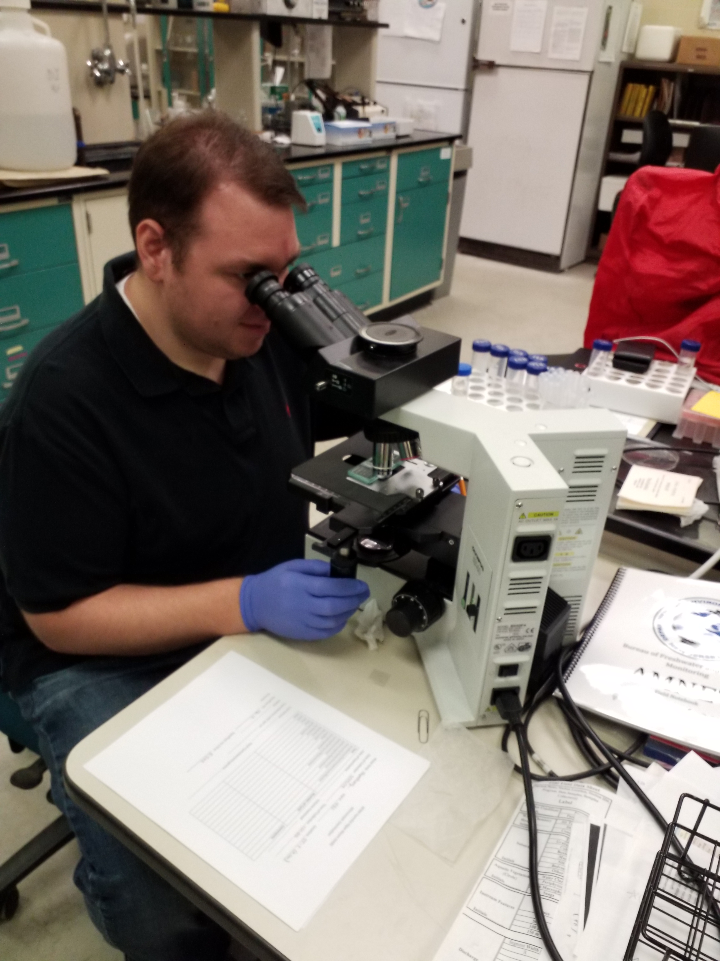
HAB Strategy Development and 2020 Revisions
Interagency Workgroup - initiated Strategy development in 2016, released in 2017, reviewed and enhanced through 2020
2020 Proposed Strategy revised by Interagency Workgroup and DEP HAB Task Force
Workgroup
  7 DEP Programs
  2 DOH Programs
  1 NJDOA Program
  4 Committees
    Health Effects, Monitoring/Testing, Research and Communications

Slide 8
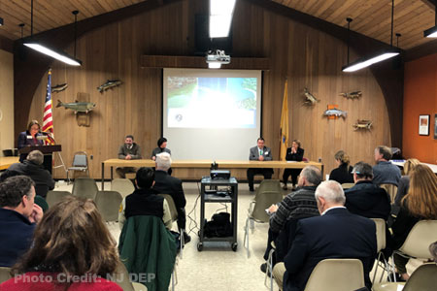
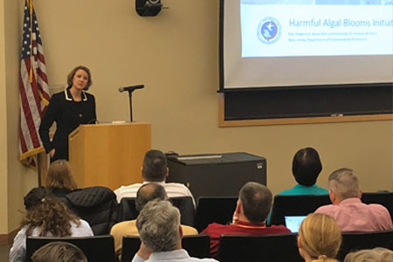
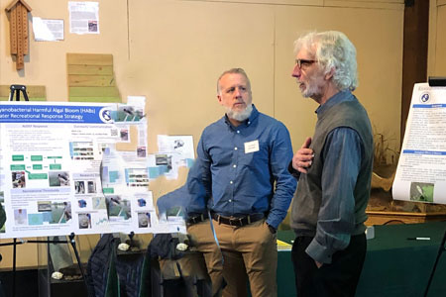
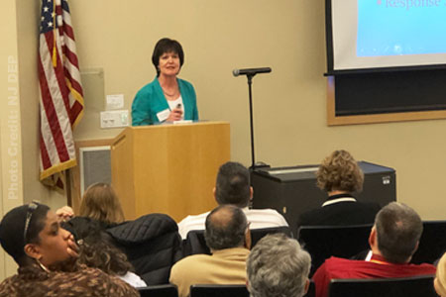
2020 HAB Strategy Development
- External Input
Greenwood Lake and Lake Hopatcong Commission Meetings (2)
2 HAB Summits – Pequest Natural Resource Education Center & Rutgers EcoComplex
2 NJ Water Monitoring Council HAB Technical Meetings

Slide 9
Gov's HABs Initiative Strategy Needs | 2018/19 Strategy | 2020 Proposed Strategy
Evaluate existing Advisory Guidance Levels – Cells count and 3 Toxins New Toxins | Cell count – 1 threshold >20,000 cells/mL 3 Toxins >3µg/L Microcystins >8 ug/l Cylindrospermopsin >27 ug/l Anatoxin | Cell Count – 3 thresholds >20,000, >40,000 (monitoring) and >80,000 cells/mL Toxins – Advisory toxin thresholds for toxins remain the same New Toxin in progress - Saxitoxin
Evaluate notification/ advisory tiers Enhance alignment of advisory tiers w/expected adverse health responses Use new 2017-2019 NJ HAB Database | 2 tiers – Warning ( Suspected) Danger ( Confirmed) | 5 tiers - Watch – Suspected and Confirmed- Cell Count, toxins Alert – Cell Count (beach monitoring) Advisory – Cell Count, toxins Warning - microcystins Danger - microcystins
Enhance communication Develop interactive mapping & reporting system | Division/Bureau HAB website: Monitoring, Testing, Strategy, Advisory Signs, Outreach factsheets HAB event reporting- Table by municipality usually w/o data | Comprehensive DEP HAB website - Expanded web presence -e.g. links to drinking water, prevention. New advisory signs. HAB event reporting - Interactive mapping tool by site or waterbody w/data
Advance monitoring, lab testing, research & data management Enhance capacities - all areas | Limited advanced monitoring tools No DEP lab certification for Toxins No HAB database Capacities limited –internal & external | Advanced monitoring tools included DEP certification available for microcystins HAB database developed ( 2017-2019) Internal capacity enhancement? External Capacities – NJ Water Monitoring Council (NJWMC), CEHA, Watershed Assoc's
STRATEGY CHANGES RELATED TO GOV’S HABS INITIATIVE

Slide 10
Gov's HABs Initiative Strategy Needs | 2018/19 Strategy | 2020 Proposed Strategy
Evaluate existing Advisory Guidance Levels – Cells count and 3 Toxins New Toxins | Cell count – 1 threshold >20,000 cells/mL 3 Toxins >3µg/L Microcystins >8 ug/l Cylindrospermopsin >27 ug/l Anatoxin | Cell Count – 3 thresholds >20,000, >40,000 (monitoring) and >80,000 cells/mL Toxins – Advisory toxin thresholds for toxins remain the same New Toxin in progress - Saxitoxin
Evaluate notification/ advisory tiers Enhance alignment of advisory tiers w/expected adverse health responses Use new 2017-2019 NJ HAB Database | 2 tiers – Warning ( Suspected) Danger ( Confirmed) | 5 tiers - Watch – Suspected and Confirmed- Cell Count, toxins Alert – Cell Count (beach monitoring) Advisory – Cell Count, toxins Warning - microcystins Danger - microcystins
Enhance communication Develop interactive mapping & reporting system | Division/Bureau HAB website: Monitoring, Testing, Strategy, Advisory Signs, Outreach factsheets HAB event reporting- Table by municipality usually w/o data | Comprehensive DEP HAB website - Expanded web presence -e.g. links to drinking water, prevention. New advisory signs. HAB event reporting - Interactive mapping tool by site or waterbody w/data
Advance monitoring, lab testing, research & data management Enhance capacities - all areas | Limited advanced monitoring tools No DEP lab certification for Toxins No HAB database Capacities limited –internal & external | Advanced monitoring tools included DEP certification available for microcystins HAB database developed ( 2017-2019) Internal capacity enhancement? External Capacities – NJ Water Monitoring Council (NJWMC), CEHA, Watershed Assoc's
ADVISORY GUIDANCE LEVELS

Slide 11
Reminder: Why Cyanobacterial Cell ID's & Densities Are Important
Harmful algal bloom definition – generally ≥ 20,000 cyanobacterial cells per milliliter (ml)
Blooms are variable – can begin producing toxins when not previously & dominant HAB species can change
Individuals may have different sensitivities to exposures to cells
Exposure to cells (without toxins) can cause skin rashes, eye and ear irritation, mouth ulcers, vomiting and diarrhea, and fever
Such symptoms can be of concern, particularly when they occur in children.

Slide 12
Cyanobacterial Cell Counts
Cell Count (cells/ml) | Observation | Citation
> 5,000 | Increased risk of mild irritative and allergenic effects. | Pilotto et al., 1997; cited by WHO (2003)
> 20,000 | Defined as a bloom. WHO guideline for irritative and allergenic effects. | USGS/Loftin et al. (2008) WHO (2003)
> 80,000 | Increased probability of microcystin concentration > 3 µg/L (NJDEP guidance level) | BFBM and DSR analyses of NJ data
Division of Science & Research (DSR)

Slide 13
Review of Basis of Cyanotoxin Reference Doses
Division of Science and Research
    Newer studies provide additional support for the microcystin and cylindrospermopsin Reference Doses. No new studies for anatoxin-a.
    No revision to current DEP Reference Doses or Recreational Advisories
Cyanotoxin | NJDEP Reference Dose (µg/kg/day) | NJDEP Criterion (µg/L)
Microcystin-LR | 0.01 | 3
Cylindrospermopsin | 0.03 | 8
Anatoxin-a | 0.1 | 27
Saxitoxin | underway | underway
Division of Science & Research (DSR)

Slide 14
Tiered Microcystin Threshold Values
 | Recreational Threshold Values
Advisory | 3 µg/L
Warning (new) | 20 µg/L (new) California and Ohio “Danger” level; New York – “Confirmed with High Toxins Bloom” WHO states that adult dose could be close to WHO TDI, and child dose could be 10-times WHO TDI. USEPA (based on WHO) – “high relative probability of acute health effects.”
Danger (new) | 2,000 µg/L Kansas and Utah “Danger” level. Child dose would be ~750 times the NJ Reference Dose and only ~5 times < dose causing toxicity in animal studies. USEPA (based on WHO) – “very high relative probability of acute health effects.” Based on USEPA screening analysis – Daily inhalation dose near a lake with 2,000 µg/L estimated as several-fold higher than NJDEP Reference Dose.

Slide 15
Gov's HABs Initiative Strategy Needs | 2018/19 Strategy | 2020 Proposed Strategy
Evaluate existing Advisory Guidance Levels – Cells count and 3 Toxins New Toxins | Cell count – 1 threshold >20,000 cells/mL 3 Toxins >3µg/L Microcystins >8 ug/l Cylindrospermopsin >27 ug/l Anatoxin | Cell Count – 3 thresholds >20,000, >40,000 (monitoring) and >80,000 cells/mL Toxins – Advisory toxin thresholds for toxins remain the same New Toxin in progress - Saxitoxin
Evaluate notification/ advisory tiers Enhance alignment of advisory tiers w/expected adverse health responses Use new 2017-2019 NJ HAB Database | 2 tiers – Warning ( Suspected) Danger ( Confirmed) | 5 tiers - Watch – Suspected and Confirmed- Cell Count, toxins Alert – Cell Count (beach monitoring) Advisory – Cell Count, toxins Warning - microcystins Danger - microcystins
Enhance communication Develop interactive mapping & reporting system | Division/Bureau HAB website: Monitoring, Testing, Strategy, Advisory Signs, Outreach factsheets HAB event reporting- Table by municipality usually w/o data | Comprehensive DEP HAB website - Expanded web presence -e.g. links to drinking water, prevention. New advisory signs. HAB event reporting - Interactive mapping tool by site or waterbody w/data
Advance monitoring, lab testing, research & data management Enhance capacities - all areas | Limited advanced monitoring tools No DEP lab certification for Toxins No HAB database Capacities limited –internal & external | Advanced monitoring tools included DEP certification available for microcystins HAB database developed ( 2017-2019) Internal capacity enhancement? External Capacities – NJ Water Monitoring Council (NJWMC), CEHA, Watershed Assoc's
NOTIFICATIONS/ ADISORY TIERS

Slide 16
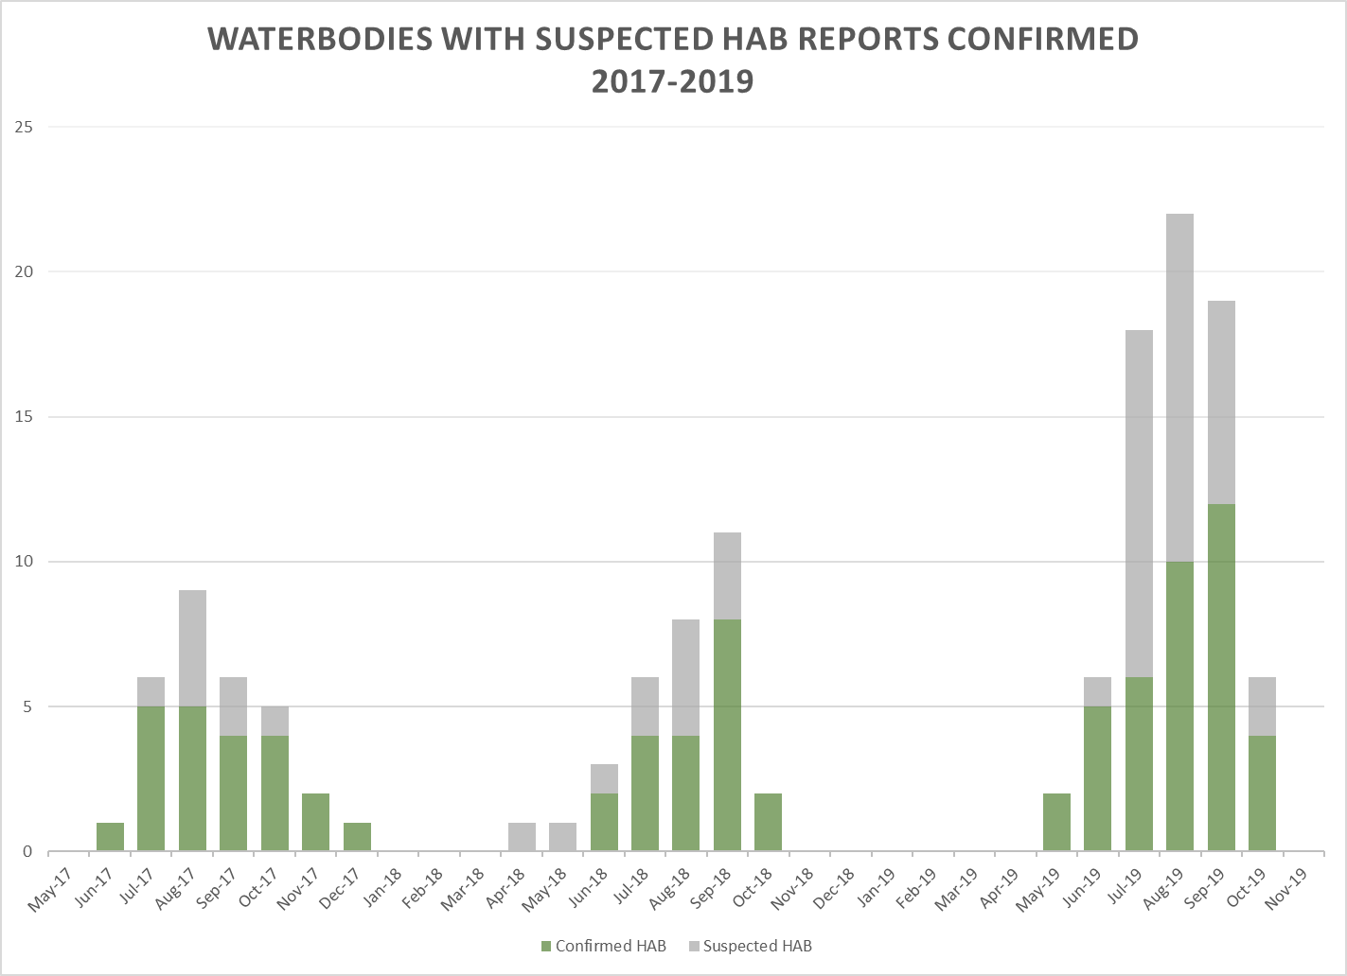
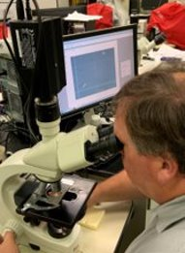
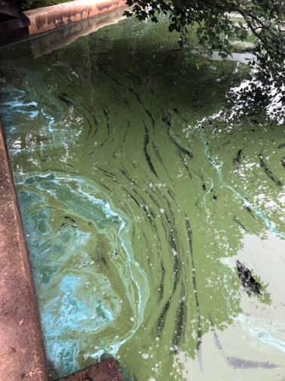
Sample totals = 935
2019
74 Reported
Waterbodies 35 Confirmed
2018
32 Reported
Waterbodies 19 Confirmed
2017
30 Reported Waterbodies 20 Confirmed

Slide 17
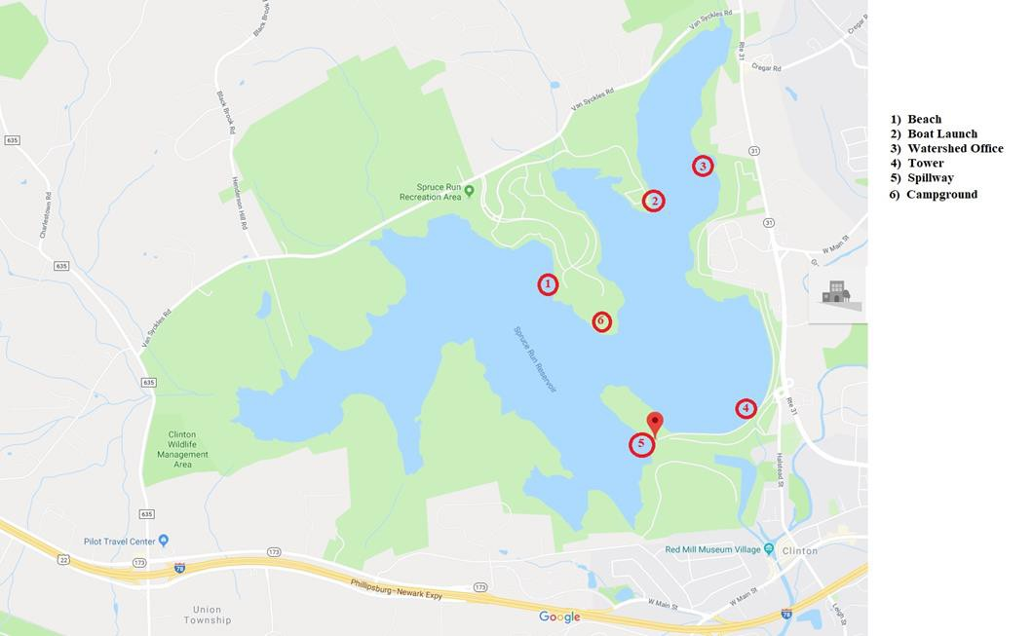
HAB Event Summary - 2019
35 Waterbodies with confirmed HABs/ 74 responses to suspected HAB reports
25 Bathing Beaches (in season) at 6 waterbodies
  18 at Lake Hopatcong
  3 at Greenwood Lake
  4 other lakes
  17% of waterbodies w/
confirmed HABs
4 Drinking Water Sources
  11% of waterbodies w/ confirmed HABs
  Spruce Run, Canistear, Manasquan and Monksville
Spruce Run

Slide 18
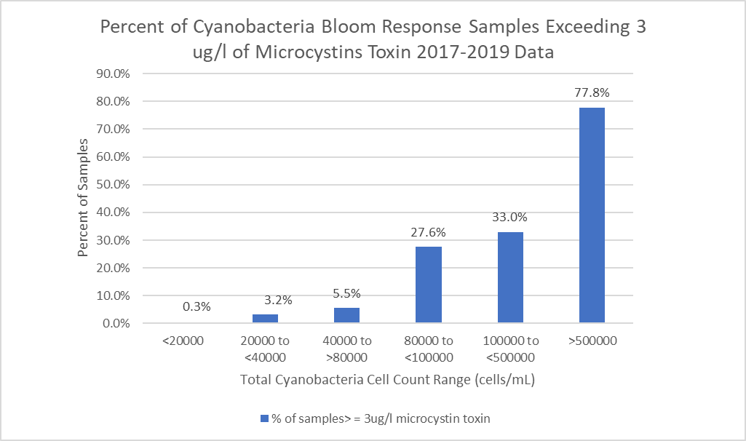
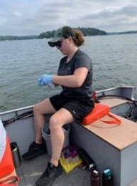
3
Sample # = 935

Slide 19
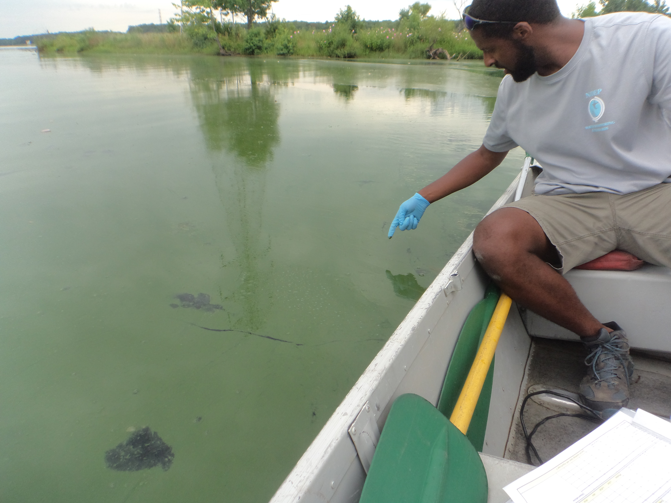
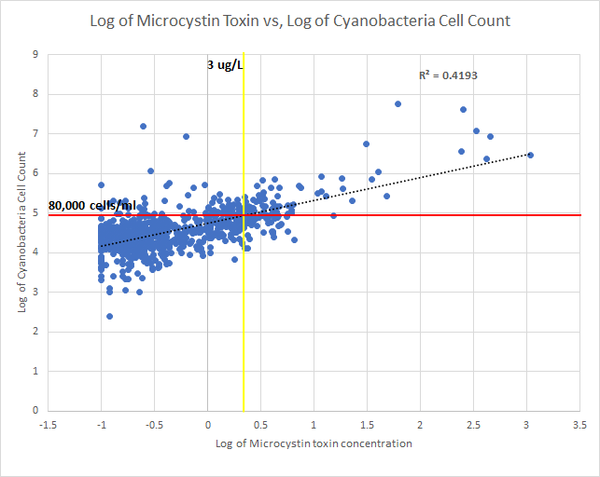
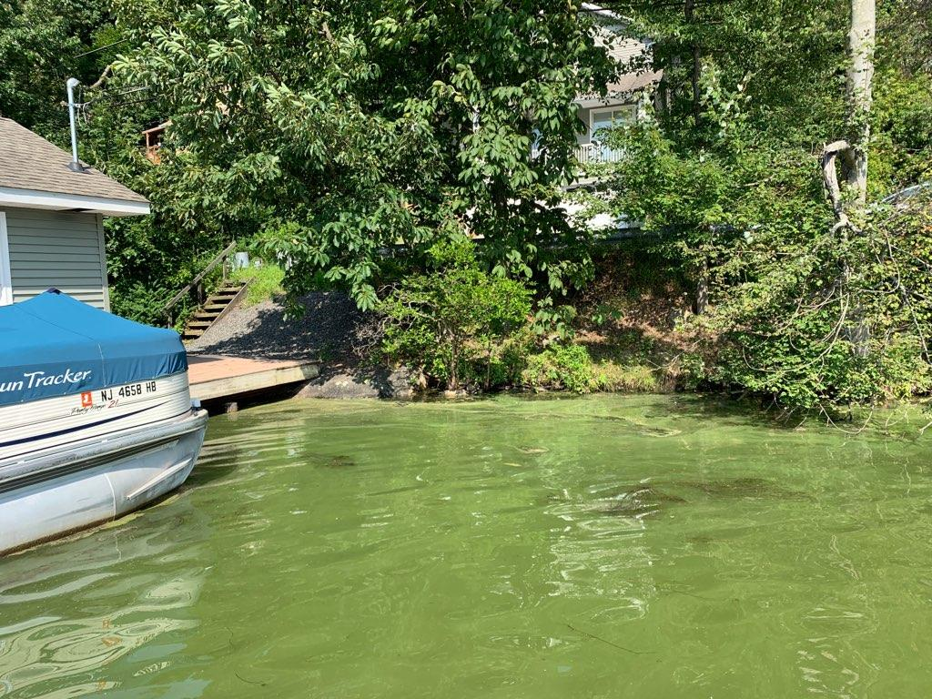
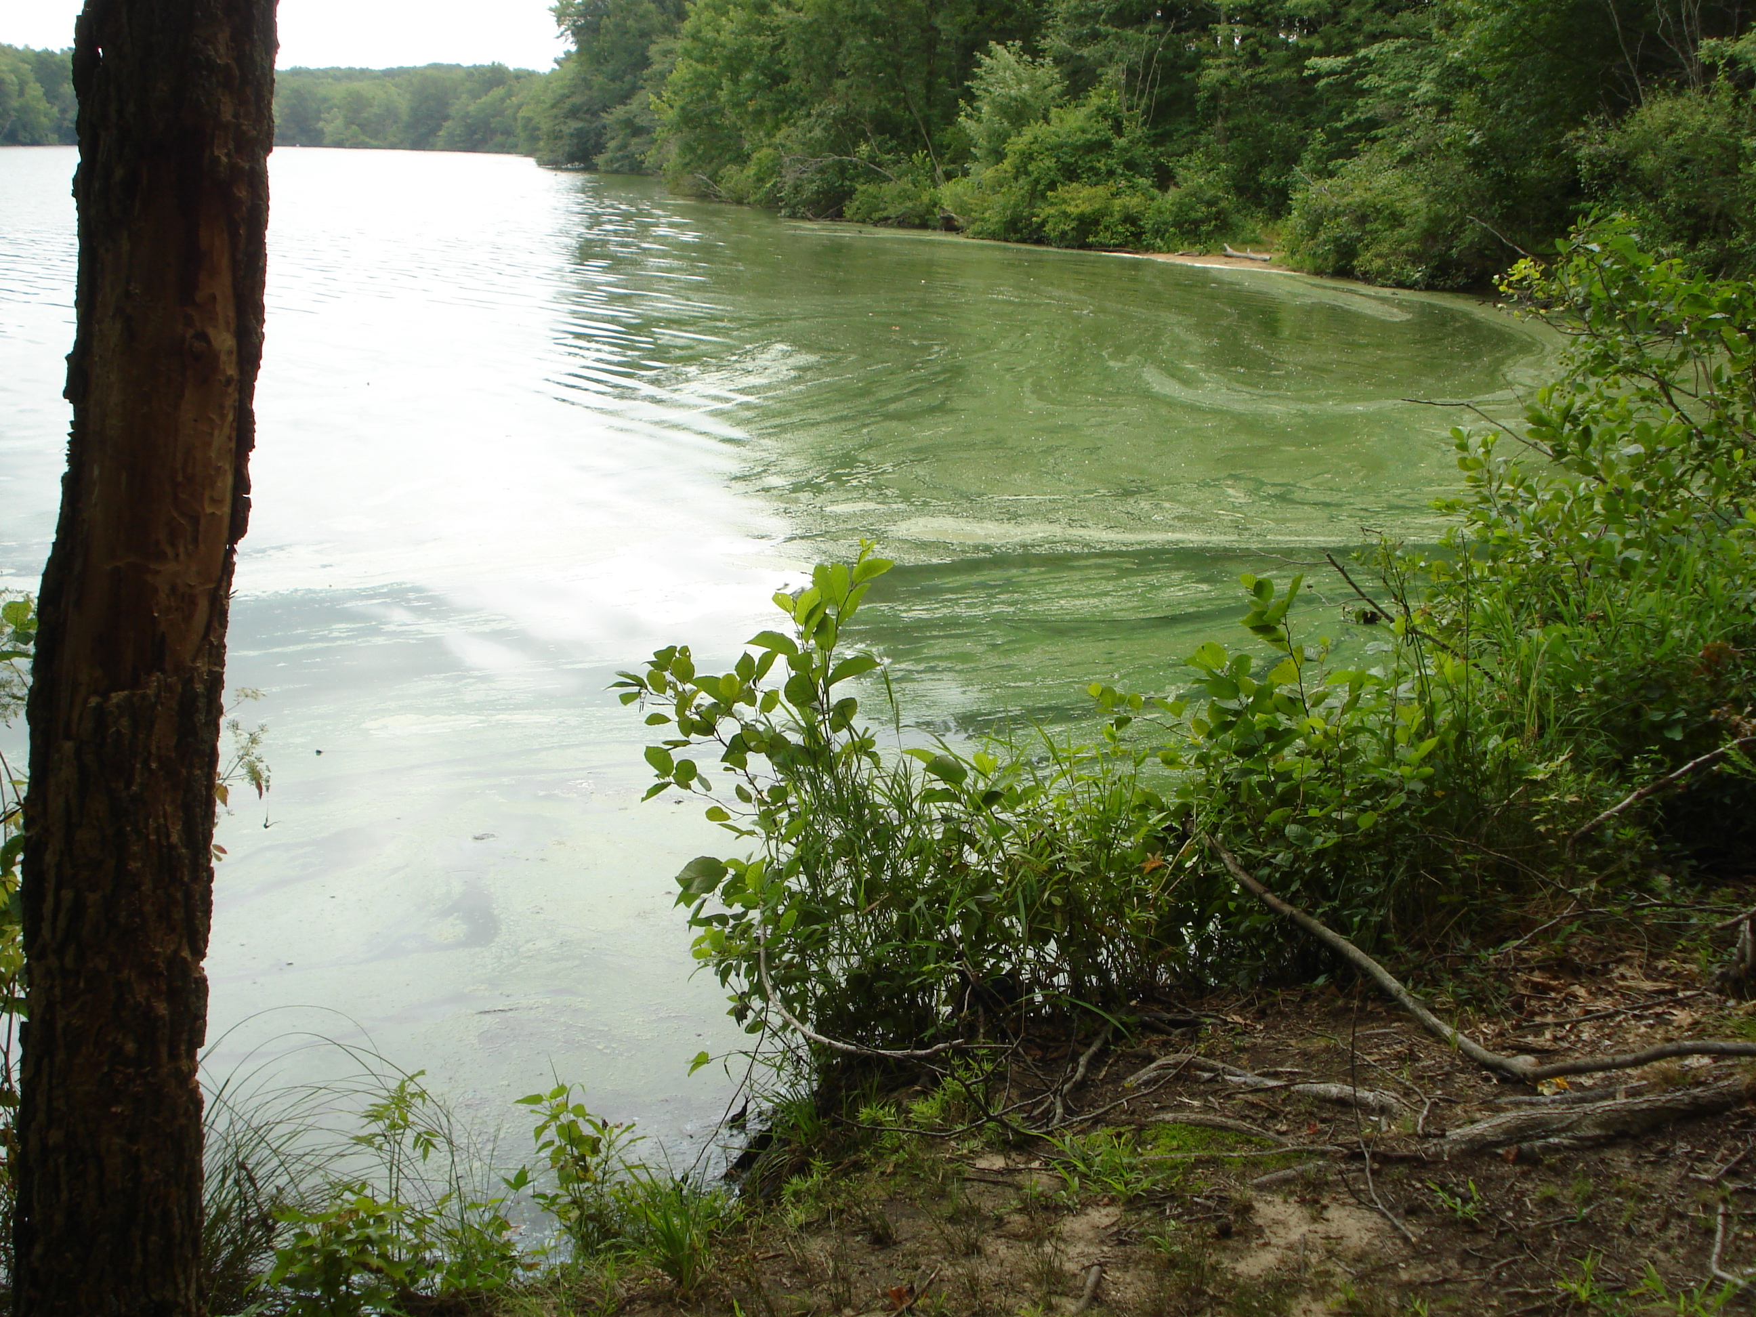
Relationship of Cell Counts to Microcystins
Robert Schuster, BMWM

Slide 20
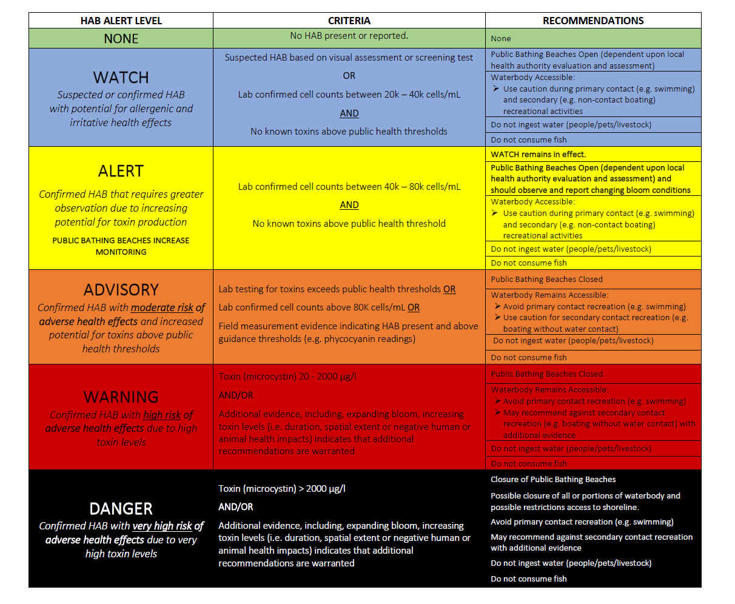
Beach monitoring tier
2020 HAB ALERT TIERS

Slide 21
WATCH
HAB Alert Level | Criteria | Recommendations
WATCH Suspected or confirmed HAB with potential for allergenic or irritative health effects | Suspected HAB based on visual assessment or screening test OR Lab confirmed cell counts between 20K-40K cells/mL AND No known toxins above public health thresholds | Public Bathing Beaches open (dependent upon local health authority evaluation and assessment) ______________________________ Waterbody Accessible: Use caution during primary contact (e.g., swimming) and secondary (e.g., no contact boating) recreational activities ______________________________ Do not ingest water (people/pets/livestock) ______________________________ Do not consume fish

Slide 22
ALERT (Beach Monitoring Tier)
HAB Alert Level | Criteria | Recommendations
ALERT Confirmed HAB that requires greater observation due to increasing potential for toxin production PUBLIC BATHING BEACHES- INCREASE MONITORING | Lab confirmed cell counts between 40K-80K cells/mL AND No known toxins above public health threshold | WATCH remains in effect ______________________________ Public Bathing Beaches open (dependent upon local health authority evaluation and assessment) and should observe and report changing bloom conditions ______________________________ Waterbody Accessible: Use caution during primary contact (e.g., swimming) and secondary (e.g., no contact boating) recreational activities ______________________________ Do not ingest water (people/pets/livestock) ______________________________ Do not consume fish

Slide 23
ADVISORY
HAB Alert Level | Criteria | Recommendations
ADVISORY Confirmed HAB with moderate risk of adverse health effects and increased potential for toxins above public health thresholds | Lab testing for toxins exceeds public health thresholds OR Lab confirmed cell counts above 80K cells/mL OR Field measurement evidence indicating HAB present and above guidance thresholds (e.g., phycocyanin readings) | Public Bathing Beaches closed ______________________________ Waterbody Remains Accessible: Avoid primary contact (e.g., swimming) Use caution for secondary contact recreation (e.g., boating without water contact) ______________________________ Do not ingest water (people/pets/livestock) ______________________________ Do not consume fish

Slide 24
WARNING
HAB Alert Level | Criteria | Recommendations
WARNING Confirmed HAB with high risk of adverse health effects due to high toxin levels | Toxin (microcystin) 20-2000 µg/L AND/OR Additional evidence including expanding bloom, increasing toxin levels (i.e., duration, spatial extent or negative human or animal health impacts) indicates that additional recommendations are warranted | Public Bathing Beaches closed ______________________________ Waterbody Remains Accessible: Avoid primary contact (e.g., swimming) May recommend against secondary contact recreation (e.g., boating without water contact) with additional evidence ______________________________ Do not ingest water (people/pets/livestock) ______________________________ Do not consume fish

Slide 25
DANGER
HAB Alert Level | Criteria | Recommendations
DANGER Confirmed HAB with very high risk of adverse health effects due to very high toxin levels | Toxin (microcystin) >2000 µg/L AND/OR Additional evidence including expanding bloom, increasing toxin levels (i.e., duration, spatial extent or negative human or animal health impacts) indicates that additional recommendations are warranted | Closure of Public Bathing Beaches ______________________________ Possible closure of all or portions of waterbody and possible restrictions of access to shoreline ______________________________ Avoid primary contact recreation (e.g., swimming) ______________________________ May recommend against secondary contact recreation with additional evidence ______________________________ Do not ingest water (people/pets/livestock) ______________________________ Do not consume fish

Slide 26
General Impacts of New Tiers with Previous HAB Data
Beaches – all but 1 waterbody would have had beach closure(s)
Non-beach Waters
  Advice provided for all waterbodies
  Most - Watch or Advisory tiers
  Small number – Warning tier

Slide 27
Gov's HABs Initiative Strategy Needs | 2018/19 Strategy | 2020 Proposed Strategy
Evaluate existing Advisory Guidance Levels – Cells count and 3 Toxins New Toxins | Cell count – 1 threshold >20,000 cells/mL 3 Toxins >3µg/L Microcystins >8 ug/l Cylindrospermopsin >27 ug/l Anatoxin | Cell Count – 3 thresholds >20,000, >40,000 (monitoring) and >80,000 cells/mL Toxins – Advisory toxin thresholds for toxins remain the same New Toxin in progress - Saxitoxin
Evaluate notification/ advisory tiers Enhance alignment of advisory tiers w/expected adverse health responses Use new 2017-2019 NJ HAB Database | 2 tiers – Warning ( Suspected) Danger ( Confirmed) | 5 tiers - Watch – Suspected and Confirmed- Cell Count, toxins Alert – Cell Count (beach monitoring) Advisory – Cell Count, toxins Warning - microcystins Danger - microcystins
Enhance communication Develop interactive mapping & reporting system | Division/Bureau HAB website: Monitoring, Testing, Strategy, Advisory Signs, Outreach factsheets HAB event reporting- Table by municipality usually w/o data | Comprehensive DEP HAB website - Expanded web presence -e.g. links to drinking water, prevention. New advisory signs. HAB event reporting - Interactive mapping tool by site or waterbody w/data
Advance monitoring, lab testing, research & data management Enhance capacities - all areas | Limited advanced monitoring tools No DEP lab certification for Toxins No HAB database Capacities limited –internal & external | Advanced monitoring tools included DEP certification available for microcystins HAB database developed ( 2017-2019) Internal capacity enhancement? External Capacities – NJ Water Monitoring Council (NJWMC), CEHA, Watershed Assoc's
ENHANCE COMMUNICATION

Slide 28
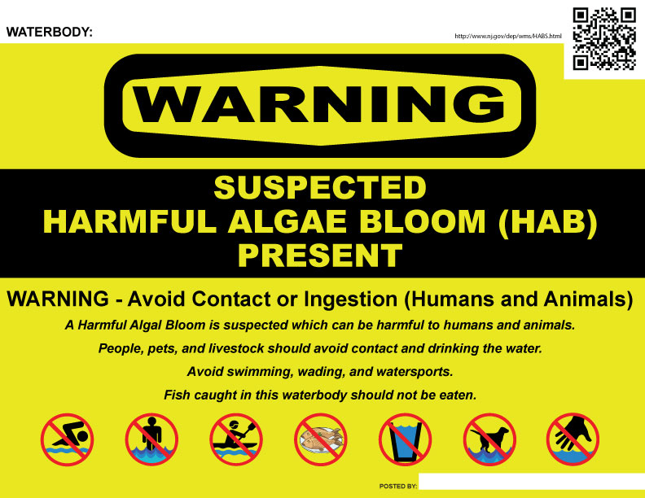
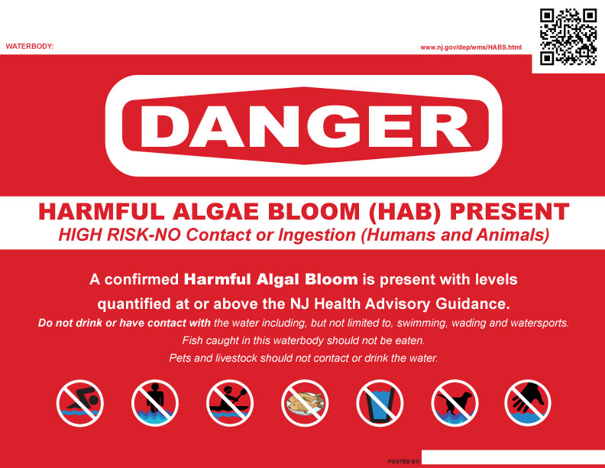
2018/2019 Advisory Signs
Suspected HAB
Greater that 20,000 cells/mL or 3 µg/L

Slide 29
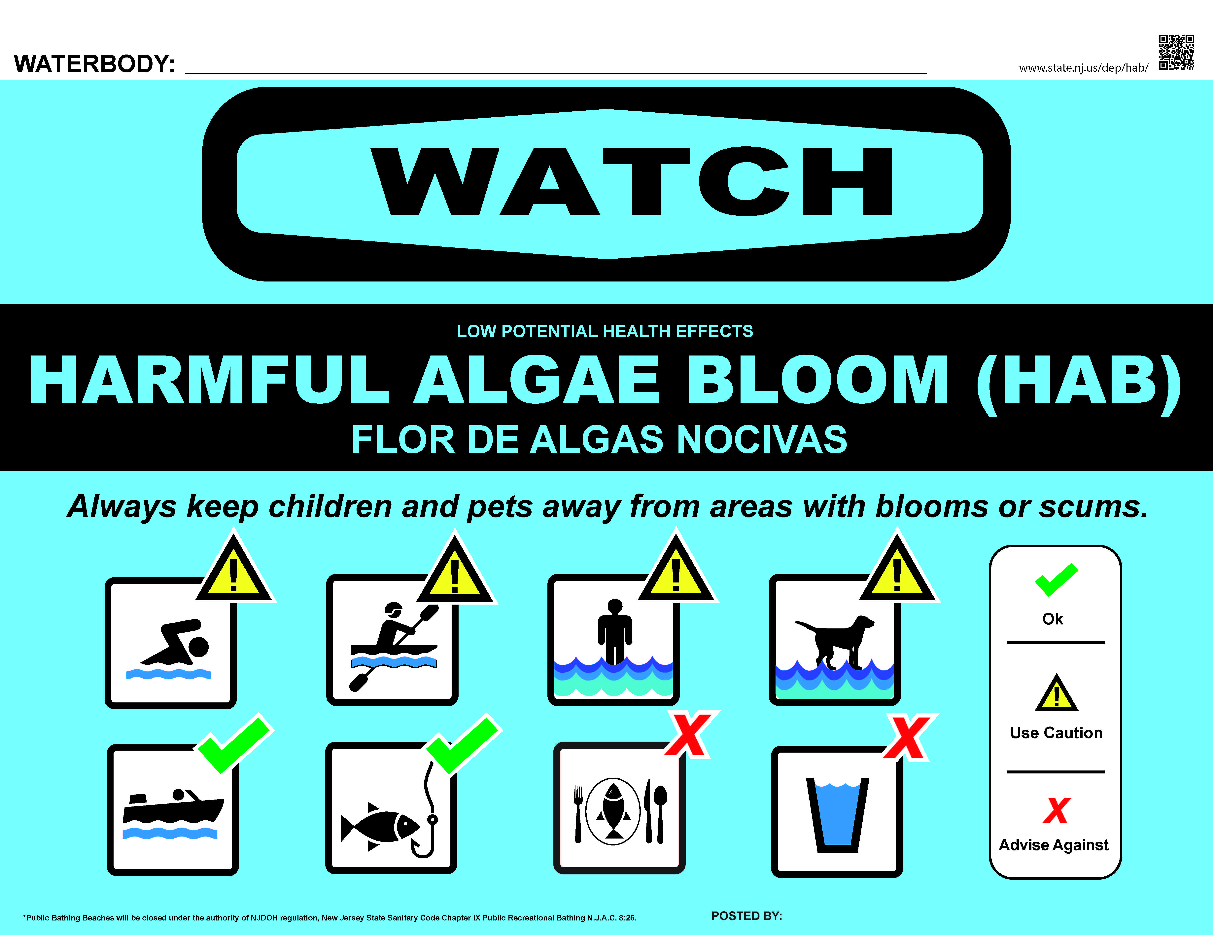
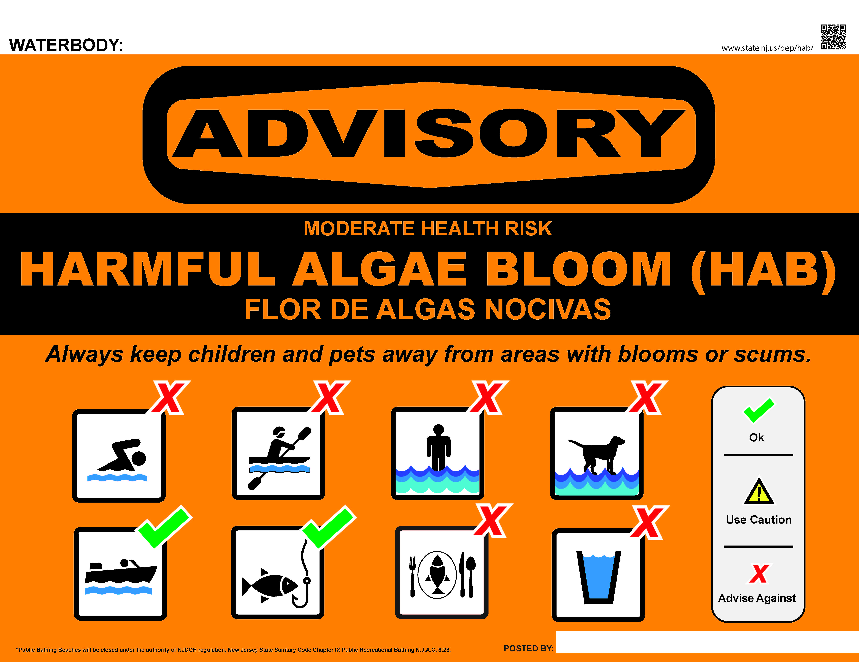
Proposed 2020 Advisory Signs*
>20,000-80,000 cells/ml AND
Toxins below thresholds
Beaches open ( dependent upon Local Health Authority)
>80,000 cells/ml OR
>3 µg/L (microcystins)
>8 µg/L (cylindrospermopsins)
>27 µg/L (anatoxin-a)
Beaches closed
Advice on primary recreation ( e.g., Swimming, kayaking)
* Beach Closure sign will also be provided

Slide 30
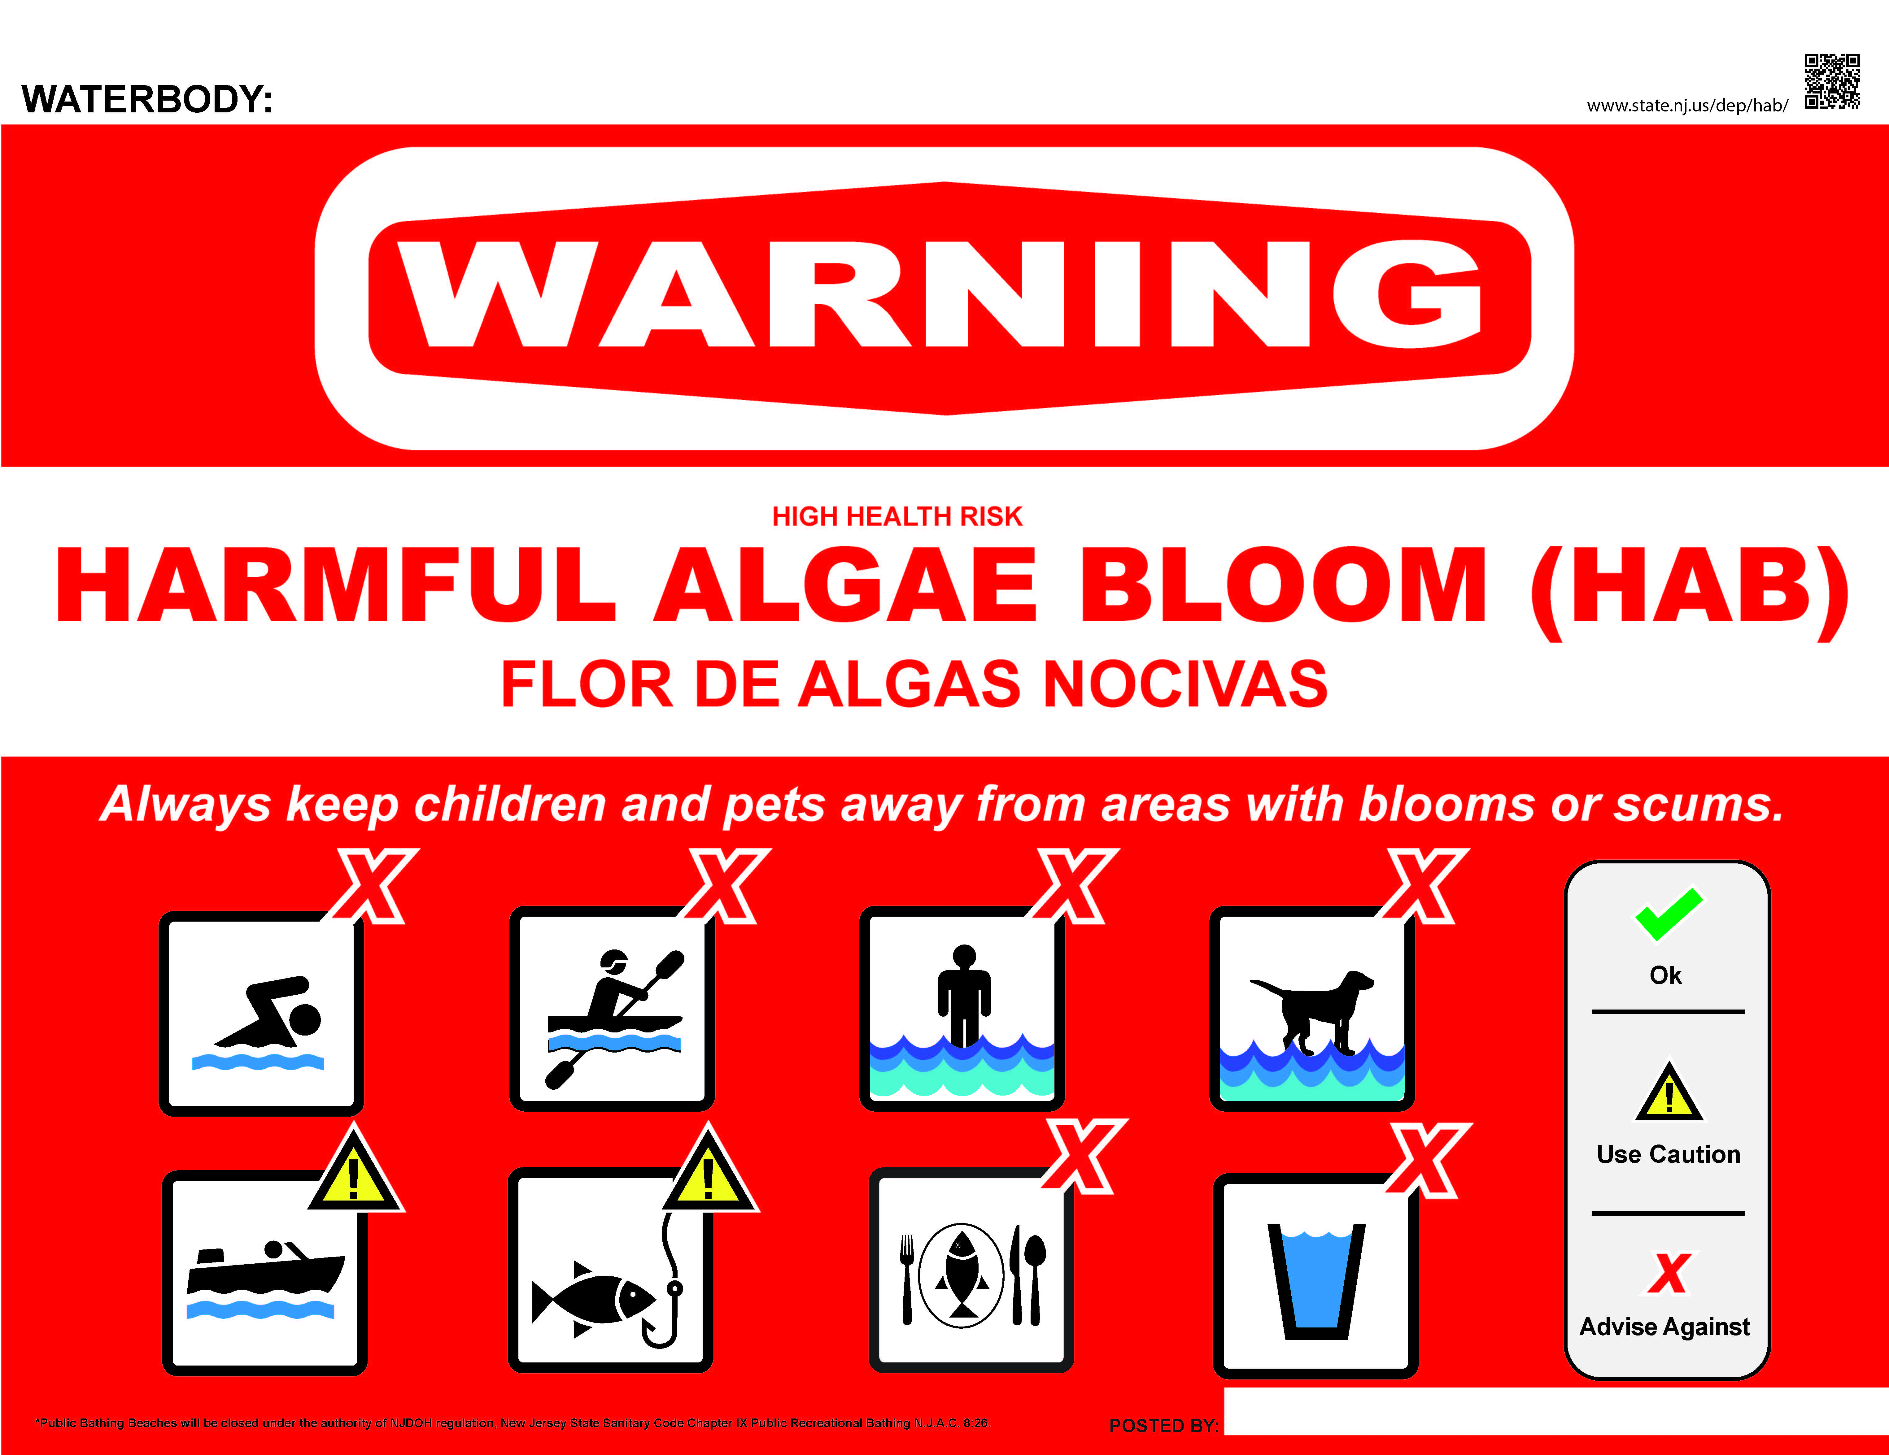
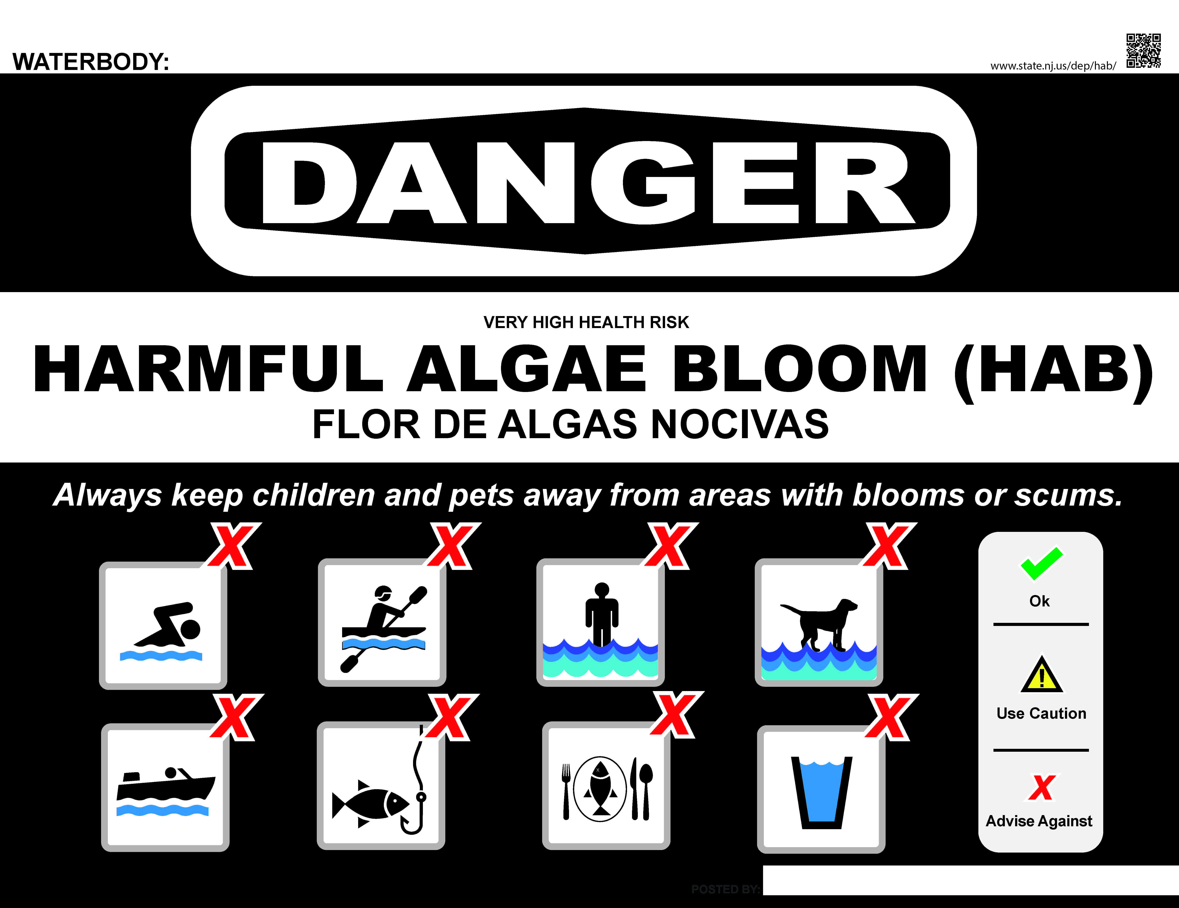
Proposed 2020 Advisory Signs (cont)
20-2000 µg/L (microcystins)
Beaches closed
May include advice on secondary recreation - boating/fishing
>2000 µg/L (microcystins)
Beaches closed
Access to portions of or entire waterbody may be prohibited

Slide 31
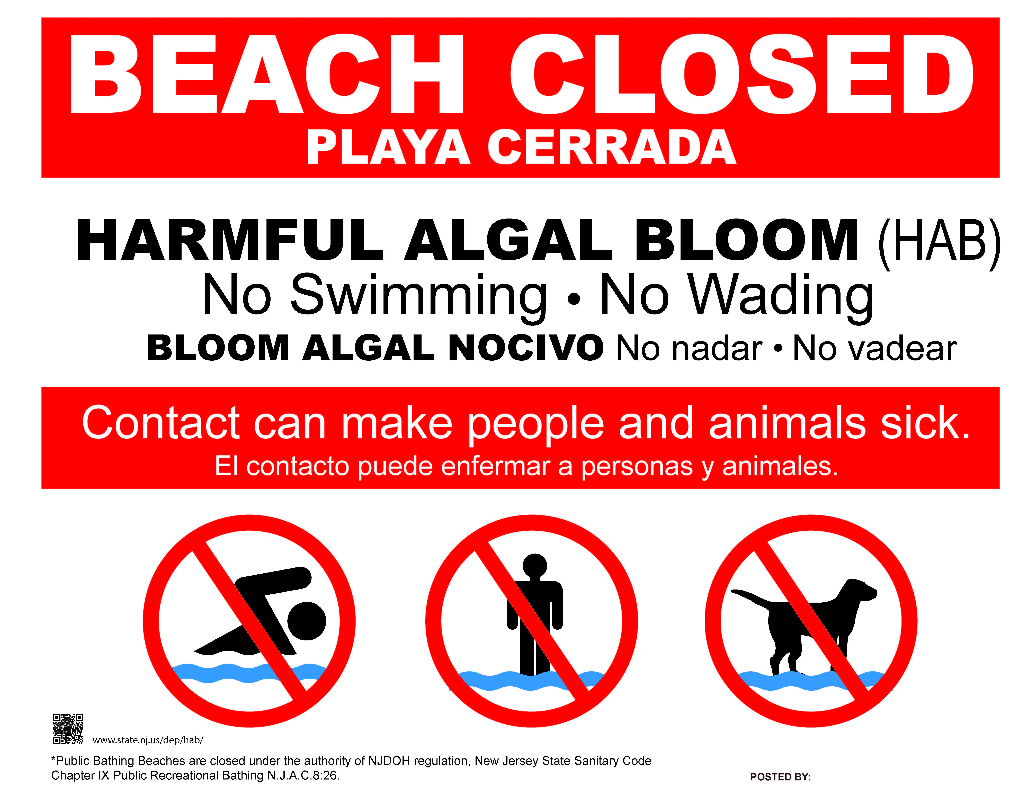

Slide 32
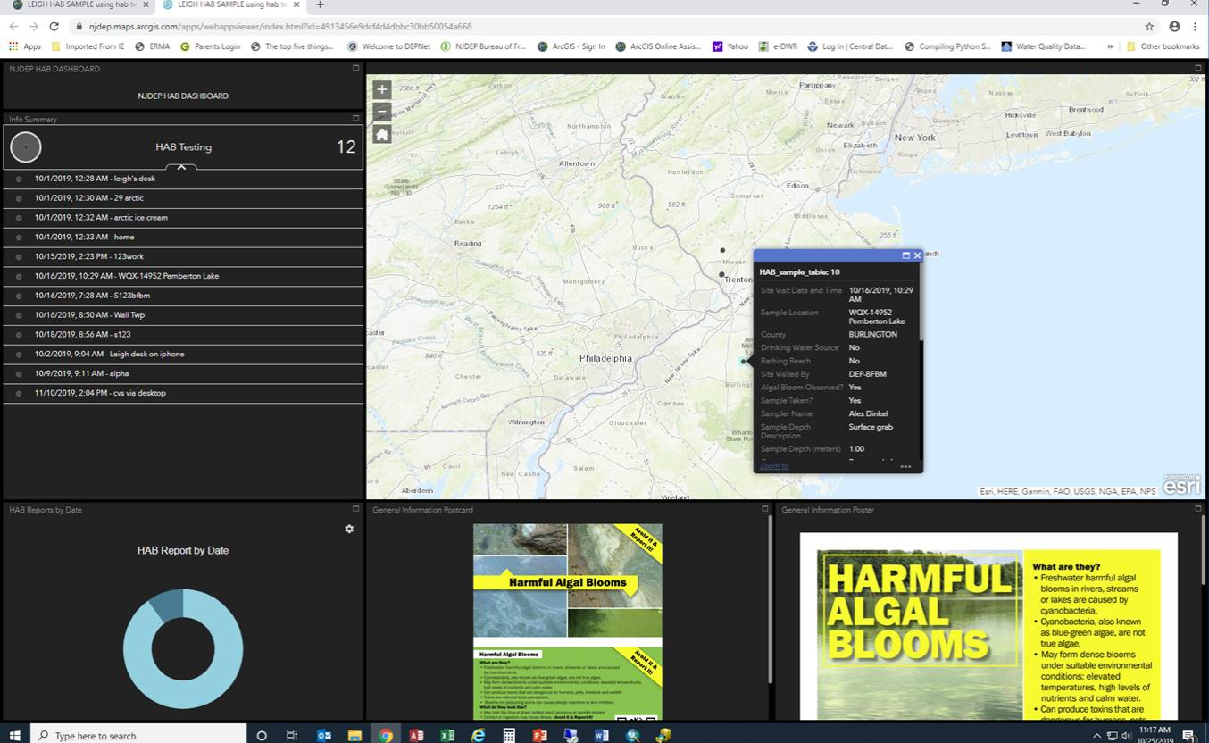
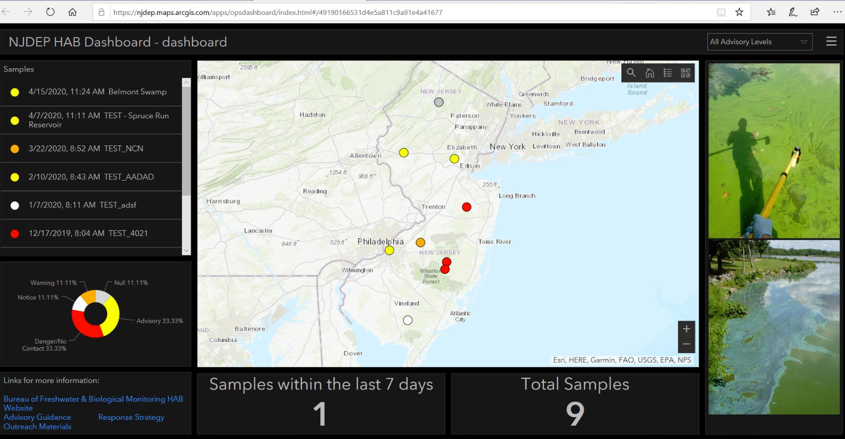
HAB Interactive Mapping and Communication System
(reporting system, searchable map, data, alerts…)
DRAFT

Slide 33
Gov's HABs Initiative Strategy Needs | 2018/19 Strategy | 2020 Proposed Strategy
Evaluate existing Advisory Guidance Levels – Cells count and 3 Toxins New Toxins | Cell count – 1 threshold >20,000 cells/mL 3 Toxins >3µg/L Microcystins >8 ug/l Cylindrospermopsin >27 ug/l Anatoxin | Cell Count – 3 thresholds >20,000, >40,000 (monitoring) and >80,000 cells/mL Toxins – Advisory toxin thresholds for toxins remain the same New Toxin in progress - Saxitoxin
Evaluate notification/ advisory tiers Enhance alignment of advisory tiers w/expected adverse health responses Use new 2017-2019 NJ HAB Database | 2 tiers – Warning ( Suspected) Danger ( Confirmed) | 5 tiers - Watch – Suspected and Confirmed- Cell Count, toxins Alert – Cell Count (beach monitoring) Advisory – Cell Count, toxins Warning - microcystins Danger - microcystins
Enhance communication Develop interactive mapping & reporting system | Division/Bureau HAB website: Monitoring, Testing, Strategy, Advisory Signs, Outreach factsheets HAB event reporting- Table by municipality usually w/o data | Comprehensive DEP HAB website - Expanded web presence -e.g. links to drinking water, prevention. New advisory signs. HAB event reporting - Interactive mapping tool by site or waterbody w/data
Advance monitoring, lab testing, research & data management Enhance capacities - all areas | Limited advanced monitoring tools No DEP lab certification for Toxins No HAB database Capacities limited –internal & external | Advanced monitoring tools included DEP certification available for microcystins HAB database developed ( 2017-2019) Internal capacity enhancement? External Capacities – NJ Water Monitoring Council (NJWMC), CEHA, Watershed Assoc's
MONITORING, LAB & RESEARCH

Slide 34
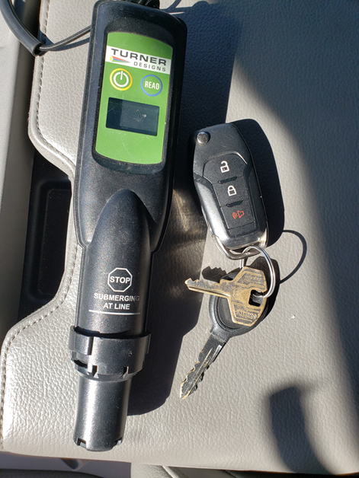
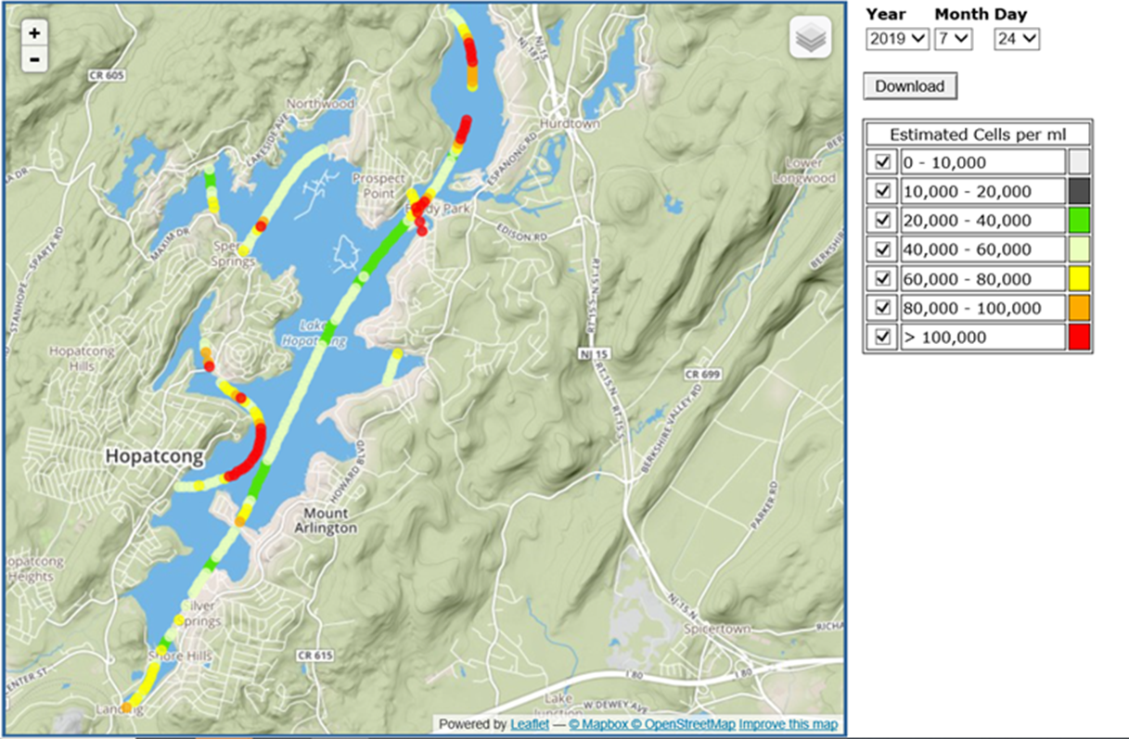
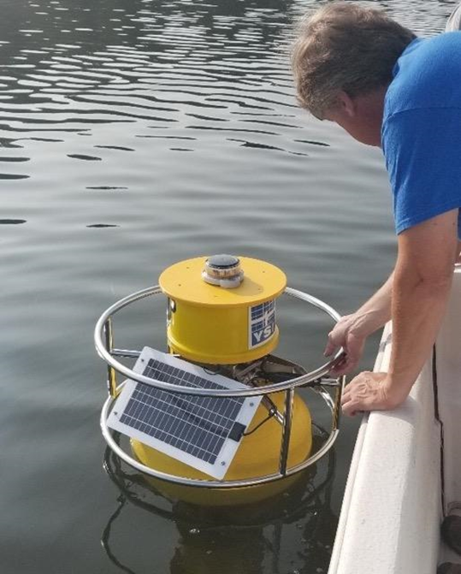
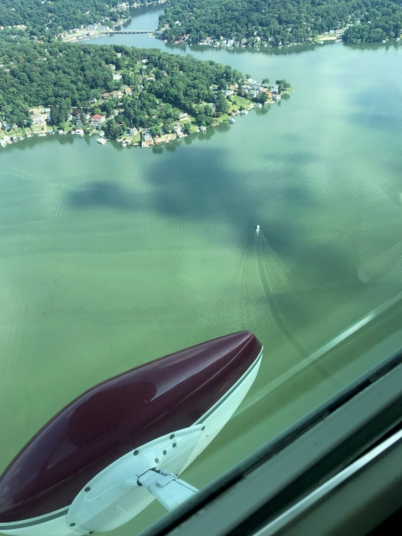

DEP Use of Advanced Technology for HABs Monitoring & Testing
Hand-held phycocyanin meters
Aircraft remote sensing
qPCR – molecular testing for toxin production potential
Continuous monitoring buoys
Notes:
Hand held used as screening for relative Phyco levels. Unique pigment
Because of intensive surveys we have data to relate meter readings to cell counts for more reliable field screenings.
Will be a good tool for partners to screening suspected HABs and prioritize sampling.
Air craft – phyco measurements based on an algorithm using hyper spectral sensors.
Marine water monitoring are experts and have used for years on ocean flight recon

Slide 35
Summary of Key 2020 Proposed Strategy Revisions
Data and science-driven enhancements with interested party and public input
Five alert tiers (one monitoring tier) vs two tiers
Better alignment between advisory tiers and potential adverse health risks, including increased focus on toxins
Improved communication through:
  Clearer signs, including activities that are ok to do (e.g., boating)
  Interactive mapping tool
Enhanced application of advanced monitoring tools

Slide 36
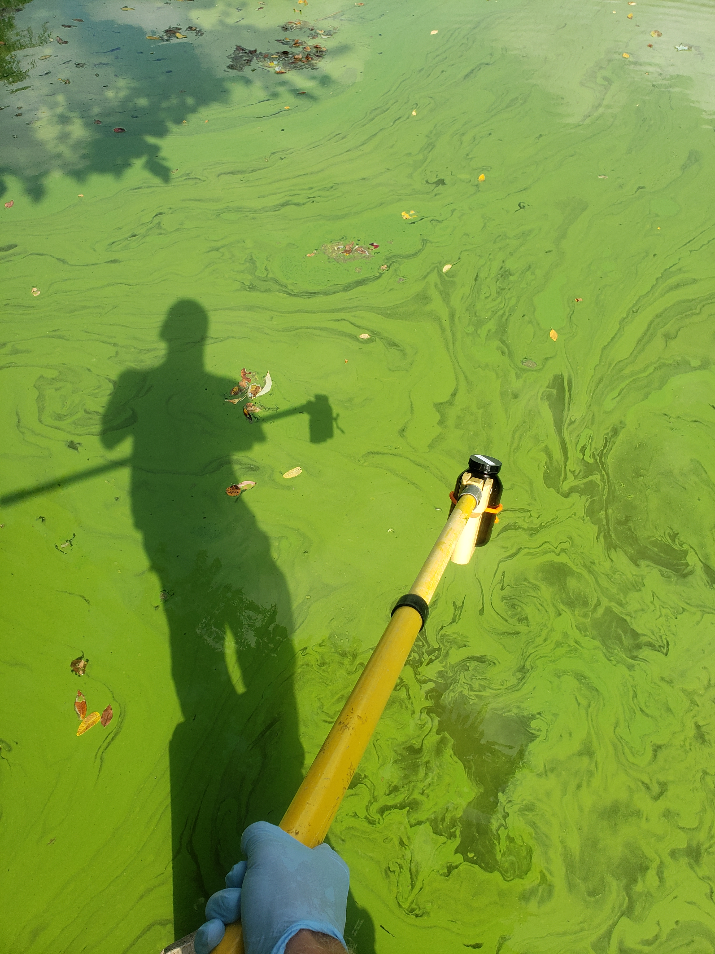
QUESTIONS AND ANSWERS
Kerry Kirk Pflugh, Kati Angarone, Leslie McGeorge, Loel Muetter (DOH), Rob Newby, Bruce Friedman, Vic Poretti and Alena Baldwin-Brown
QUESTIONS?

