Slide 1
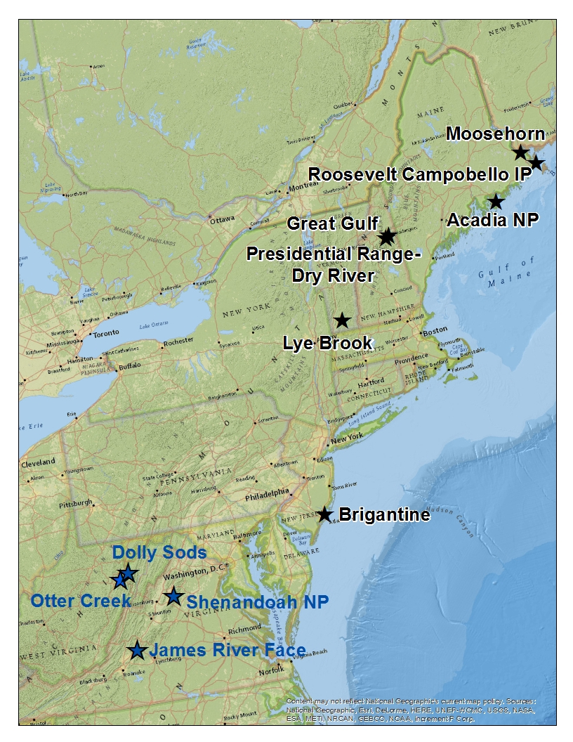
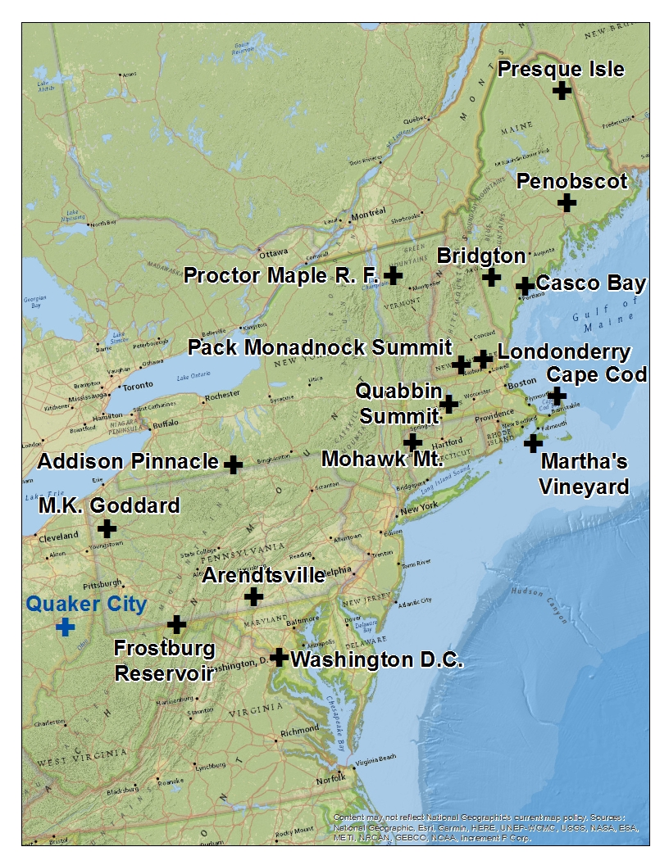

Slide 2
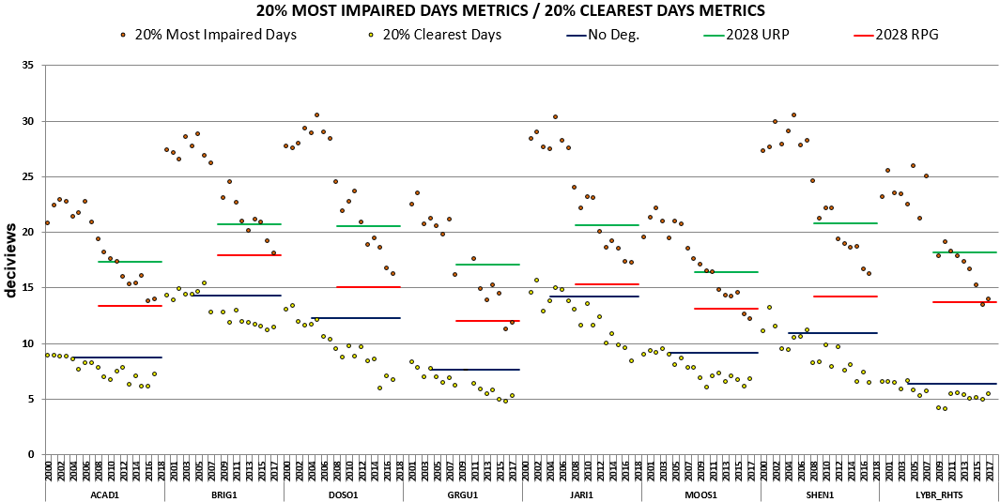

Slide 3
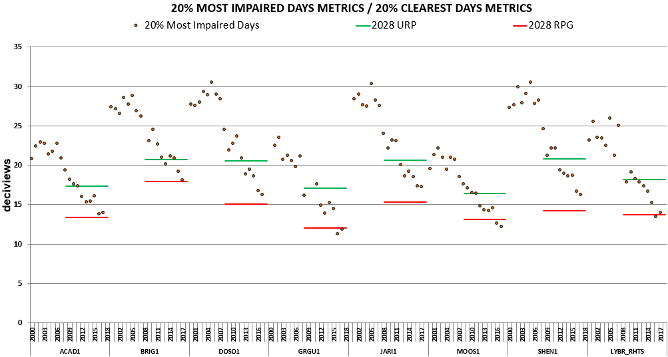

Slide 4
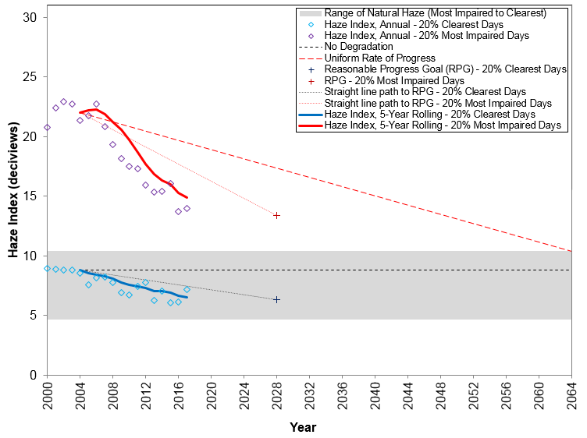
Acadia NP
Size – 7.4
Horiz – 2.0
Vert – 0.1

Slide 5
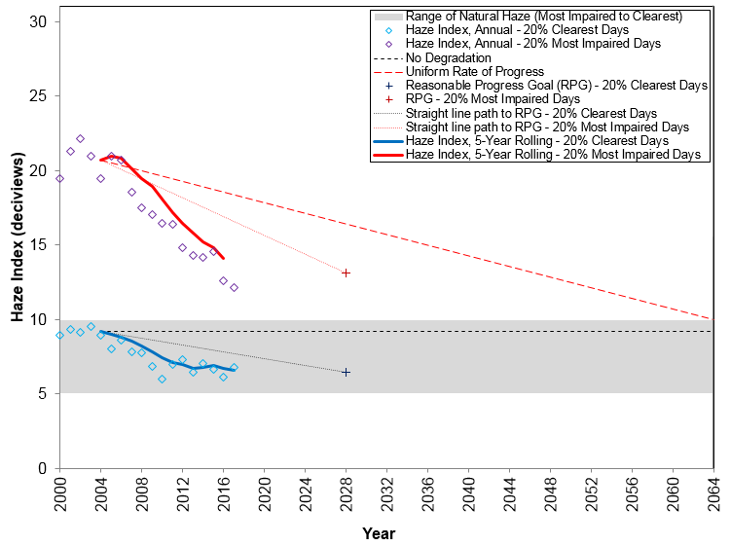
Moosehorn
Size – 7.4
Horiz – 2.0
Vert – 0.1

Slide 6
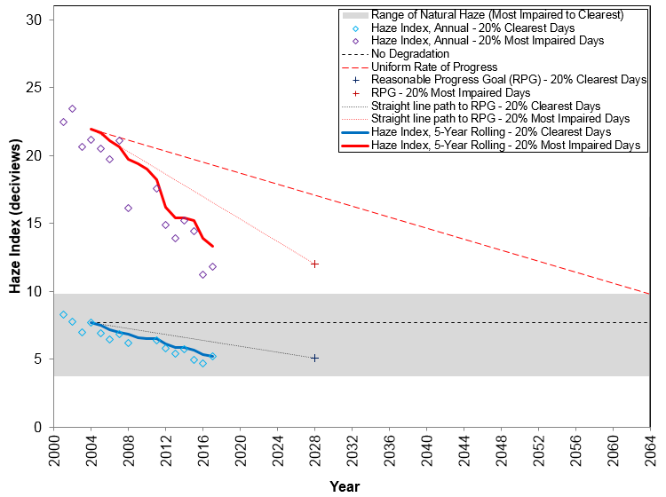
Great Gulf
Size – 7.4
Horiz – 2.0
Vert – 0.1

Slide 7
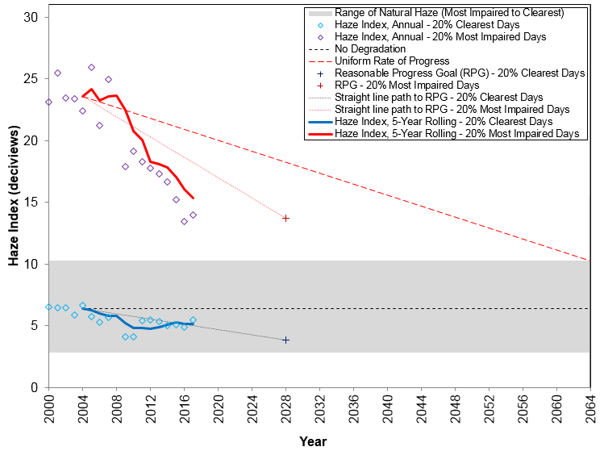
Lye Brook
Size – 7.4
Horiz – 2.0
Vert – 0.1

Slide 8
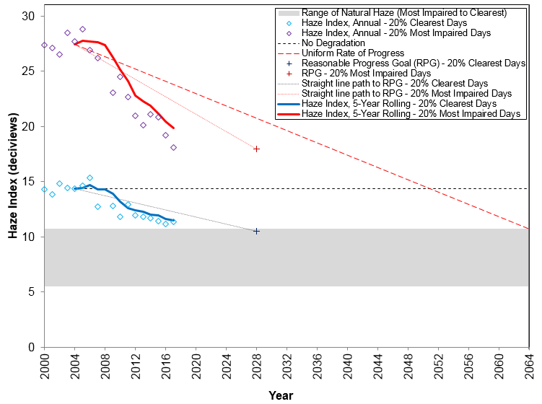
Brigantine
Size – 7.4
Horiz – 2.0
Vert – 0.1

Slide 9
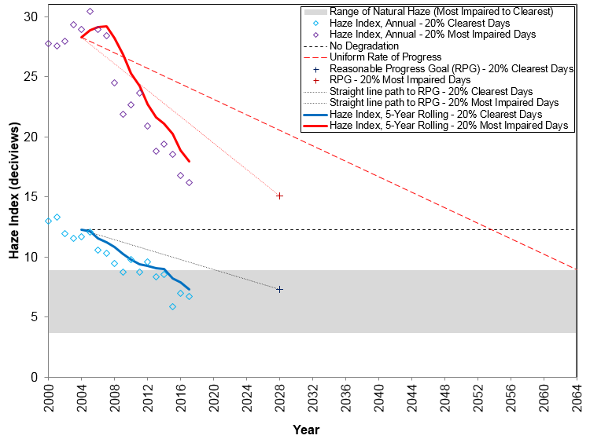
Dolly Sods
Size – 7.4
Horiz – 2.0
Vert – 0.1

Slide 10
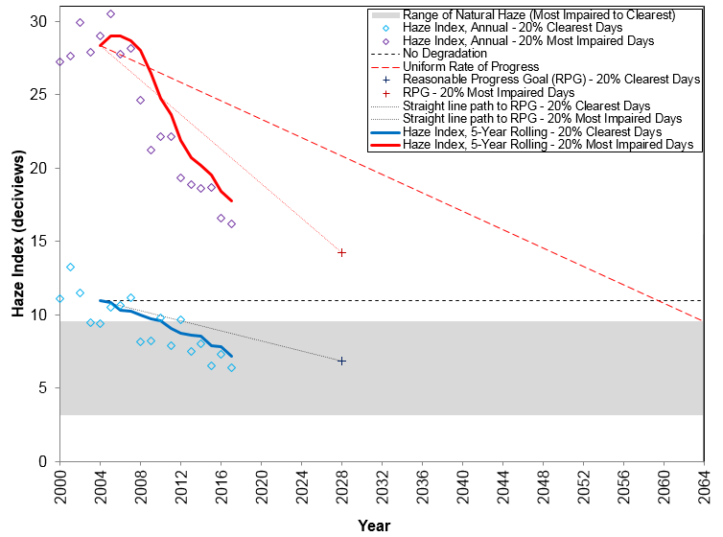
Shenandoah NP
Size – 7.4
Horiz – 2.0
Vert – 0.1

Slide 11
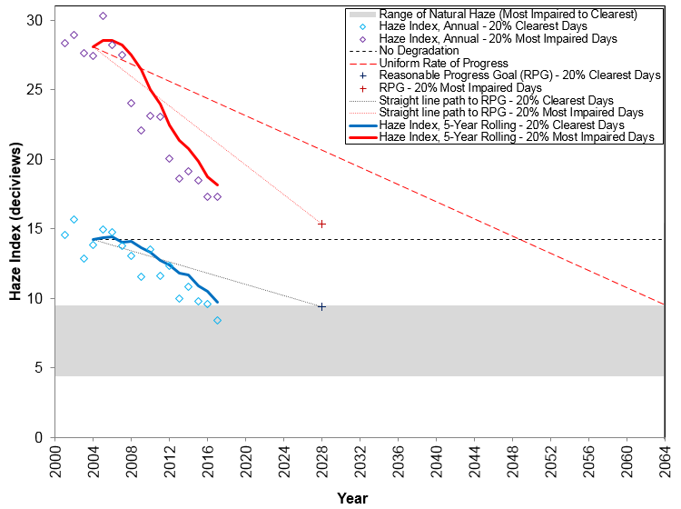
James River Face
Size – 7.4
Horiz – 2.0
Vert – 0.1

Slide 12
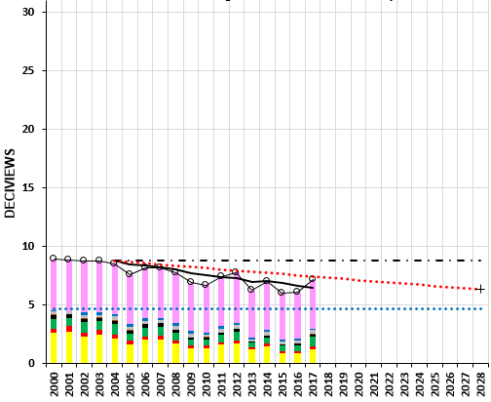
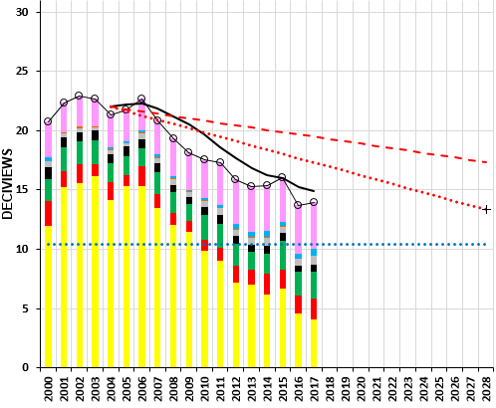
(a) 20% Clearest Days
(b) 20% Most Impaired Days
SIZE – 5.1
Position – 0.1 / 6.40 Horizontal
- 0.1 / 0.1 Vertical
ACADIA NP

Slide 13
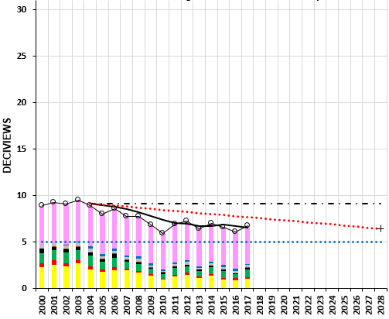
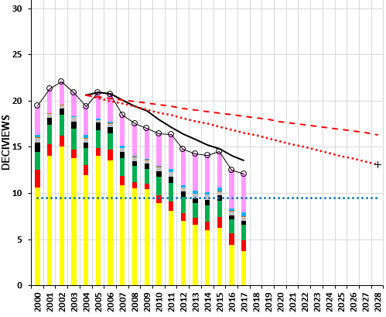
(a) 20% Clearest Days
(b) 20% Most Impaired Days
SIZE – 5.1
Position – 0.1 / 6.40 Horizontal
- 0.1 / 0.1 Vertical
MOOSEHORN

Slide 14
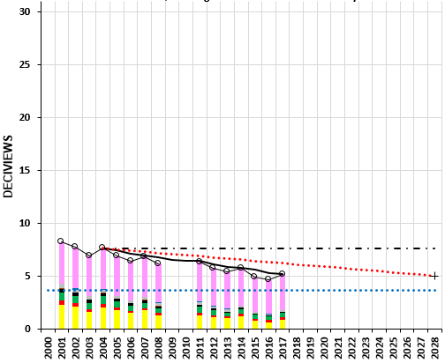
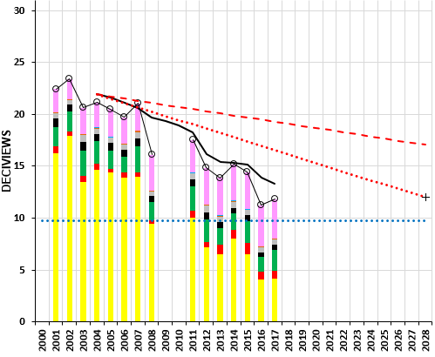
(a) 20% Clearest Days
(b) 20% Most Impaired Days
SIZE – 5.1
Position – 0.1 / 6.40 Horizontal
- 0.1 / 0.1 Vertical
GREAT GULF

Slide 15
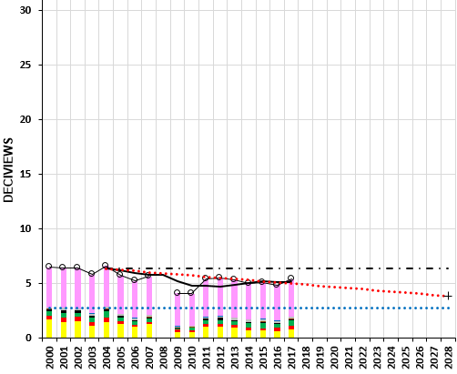
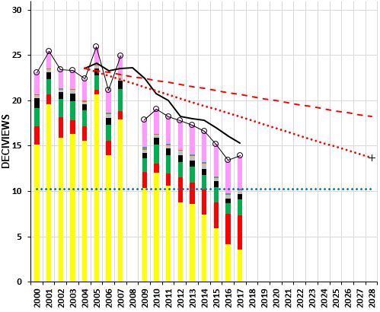
(a) 20% Clearest Days
(b) 20% Most Impaired Days
SIZE – 5.1
Position – 0.1 / 6.40 Horizontal
- 0.1 / 0.1 Vertical
LYE BROOK

Slide 16
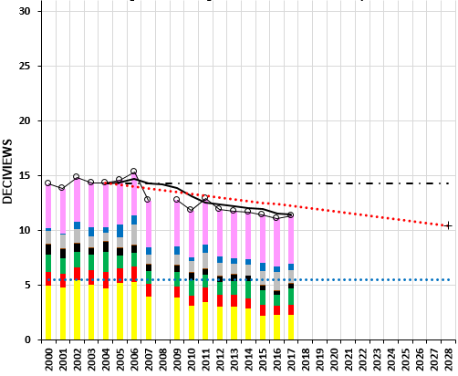
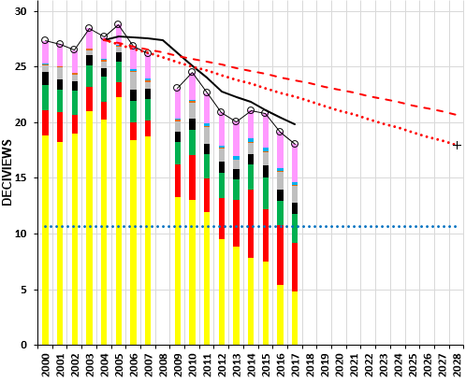
(a) 20% Clearest Days
(b) 20% Most Impaired Days
SIZE – 5.1
Position – 0.1 / 6.40 Horizontal
- 0.1 / 0.1 Vertical
BRIGANTINE

Slide 17
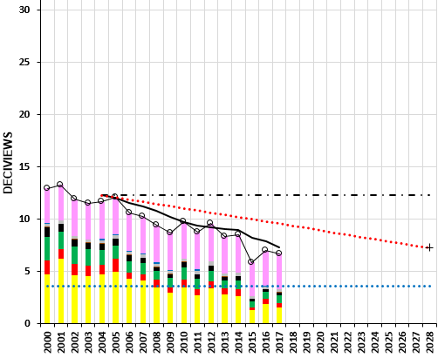
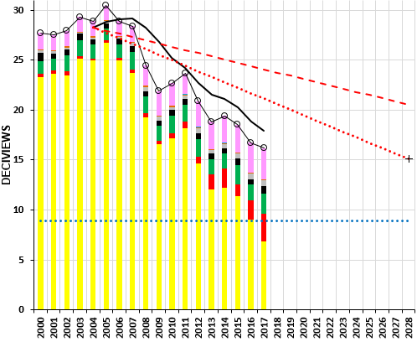
(a) 20% Clearest Days
(b) 20% Most Impaired Days
SIZE – 5.1
Position – 0.1 / 6.40 Horizontal
- 0.1 / 0.1 Vertical
DOLLY SODS

Slide 18
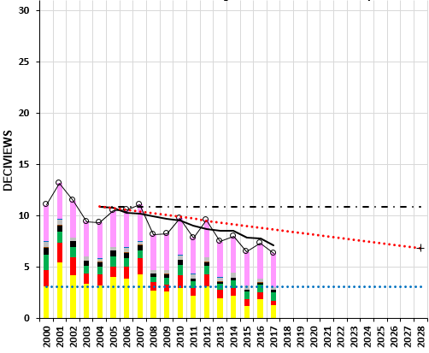
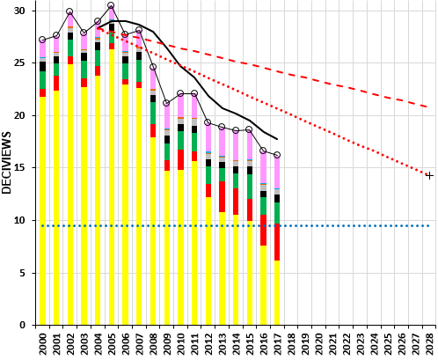
(a) 20% Clearest Days
(b) 20% Most Impaired Days
SIZE – 5.1
Position – 0.1 / 6.40 Horizontal
- 0.1 / 0.1 Vertical
SHENANDOAH

Slide 19
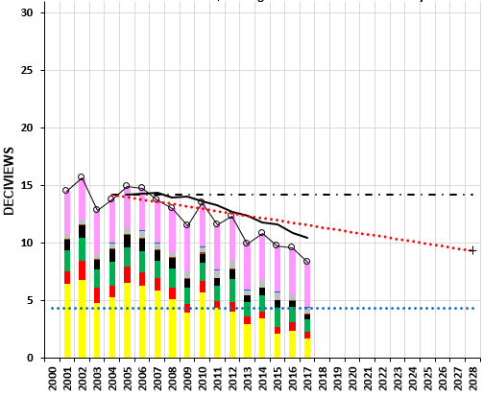
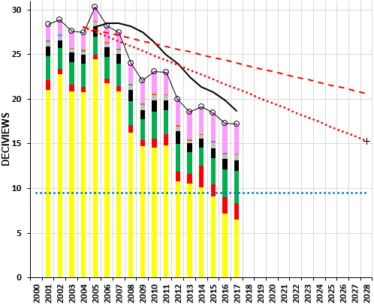
(a) 20% Clearest Days
(b) 20% Most Impaired Days
SIZE – 5.1
Position – 0.1 / 6.40 Horizontal
- 0.1 / 0.1 Vertical
JAMES RIVER

Slide 20
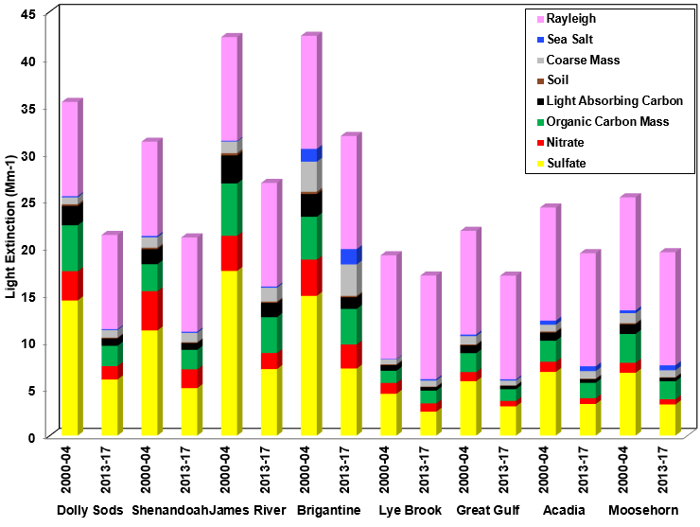
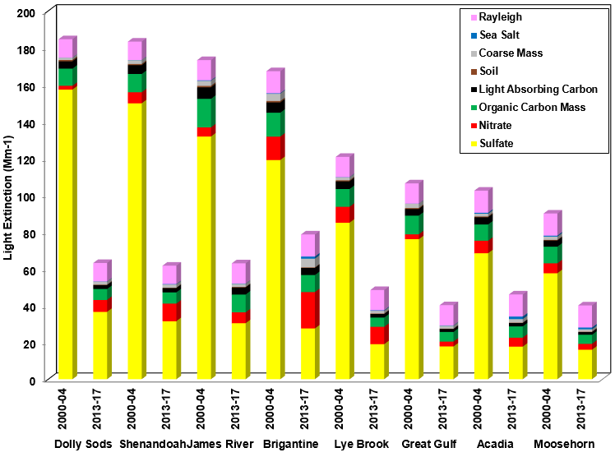
a) 20% Clearest Visibility Days
b) 20% Most Impaired Visibility Days
Size 4.96

Slide 21
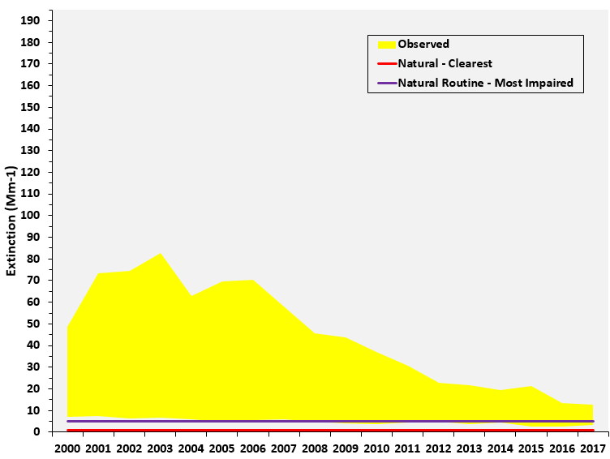
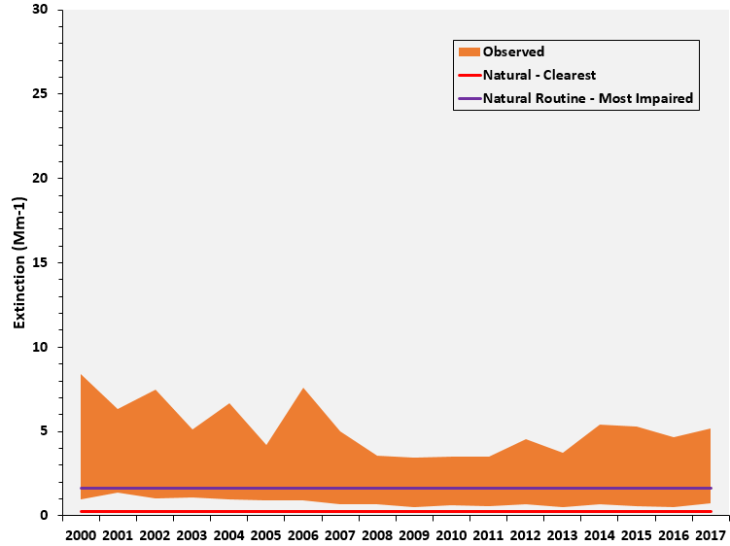
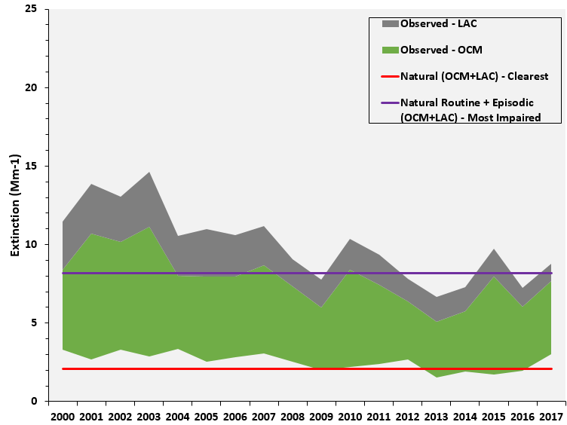
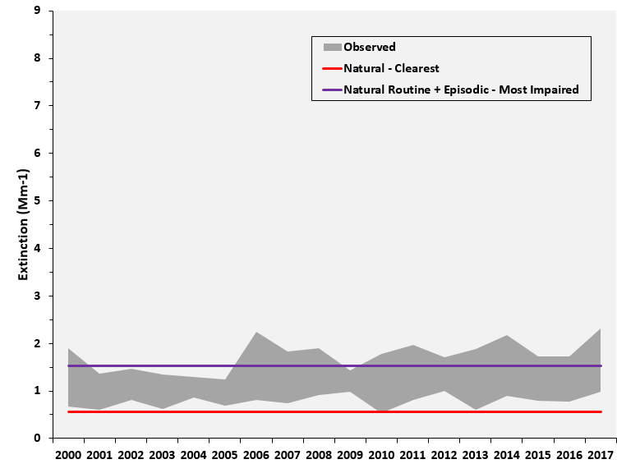
(a) Sulfate
(b) Nitrate
Acadia National Park
(c) Carbonaceous
Matter
(d) Coarse Mass
SIZE
3.7
POSITIONS
0.1 - 0.05
5.31 - 0.05
0.1 - 3.75
5.31 - 3.75

Slide 22
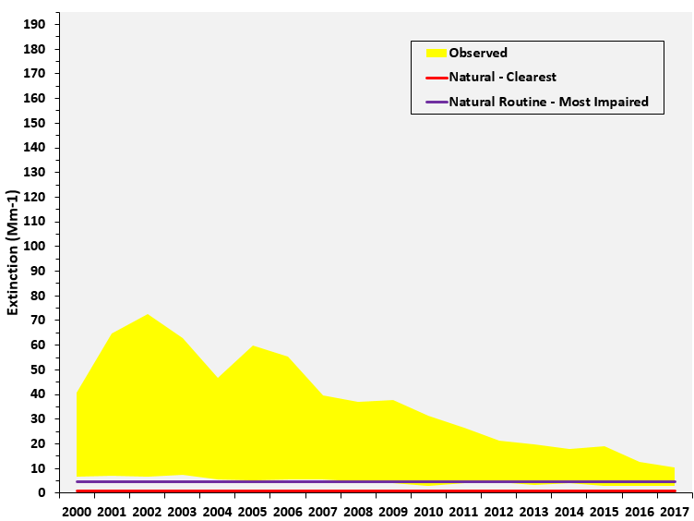
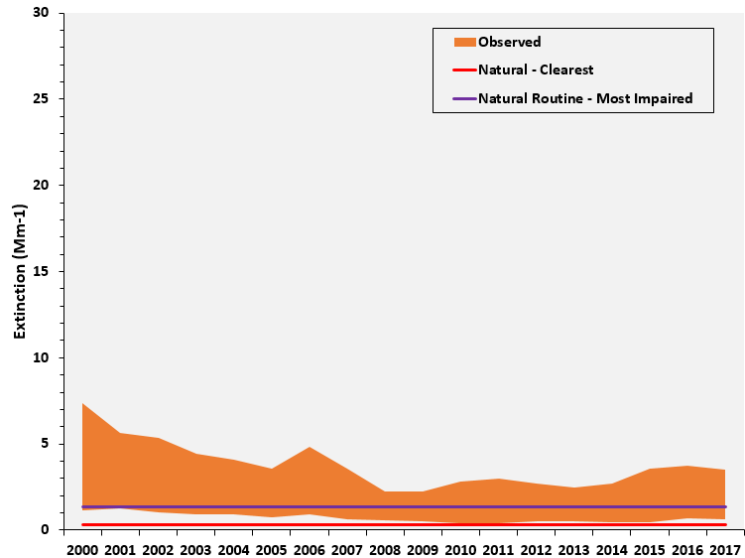
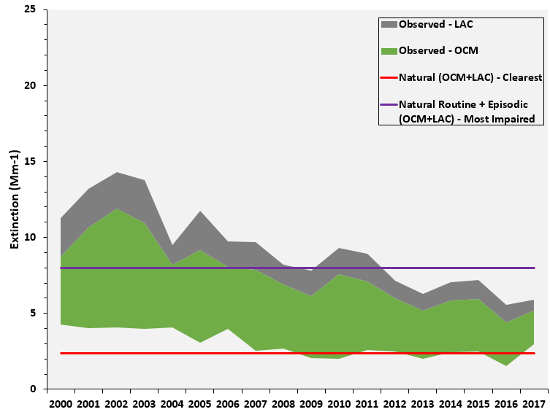
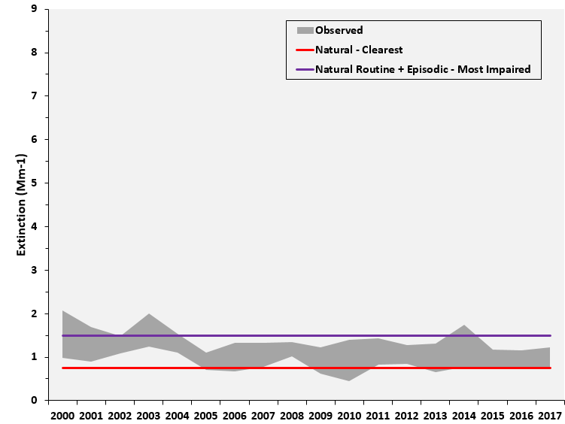
(a) Sulfate
(b) Nitrate
Moosehorn
(c) Carbonaceous
Matter
(d) Coarse Mass
SIZE
3.7
POSITIONS
0.1 - 0.05
5.31 - 0.05
0.1 - 3.75
5.31 - 3.75

Slide 23
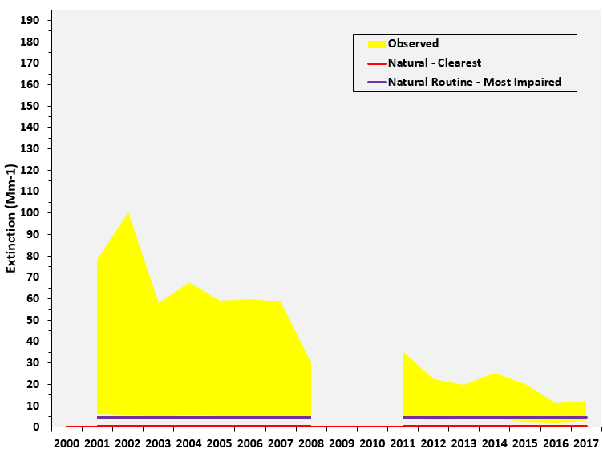
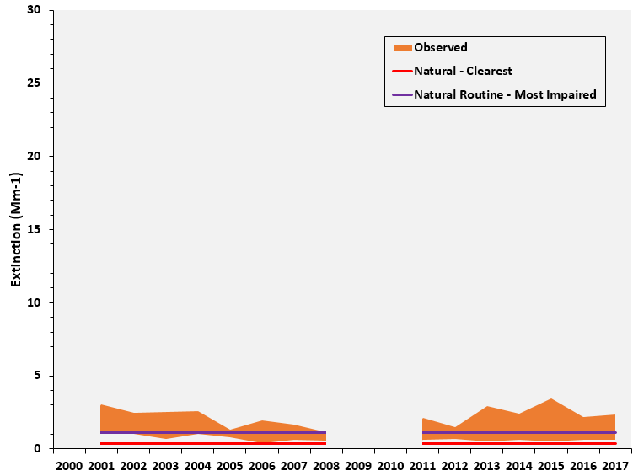
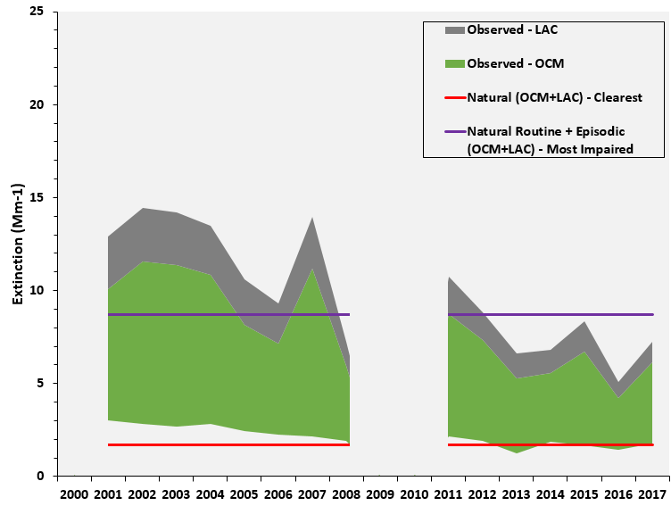
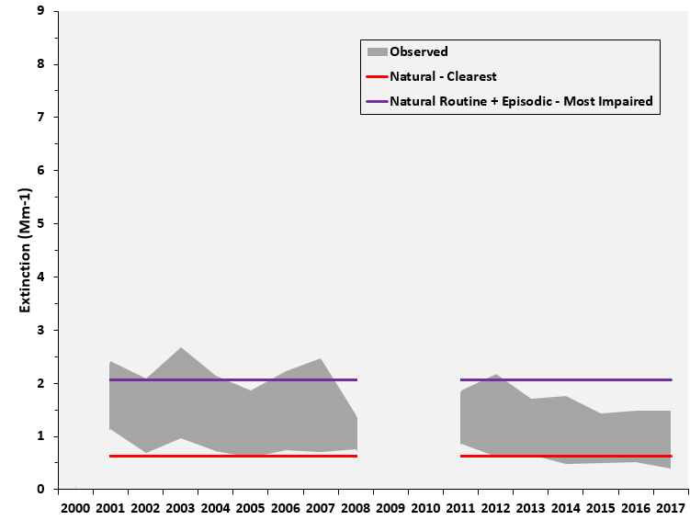
(a) Sulfate
(b) Nitrate
Great Gulf
(c) Carbonaceous
Matter
(d) Coarse Mass
SIZE
3.7
POSITIONS
0.1 - 0.05
5.31 - 0.05
0.1 - 3.75
5.31 - 3.75

Slide 24
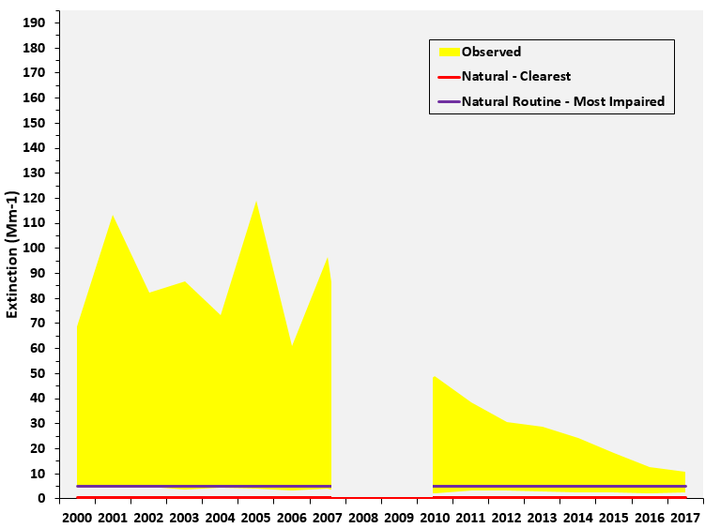
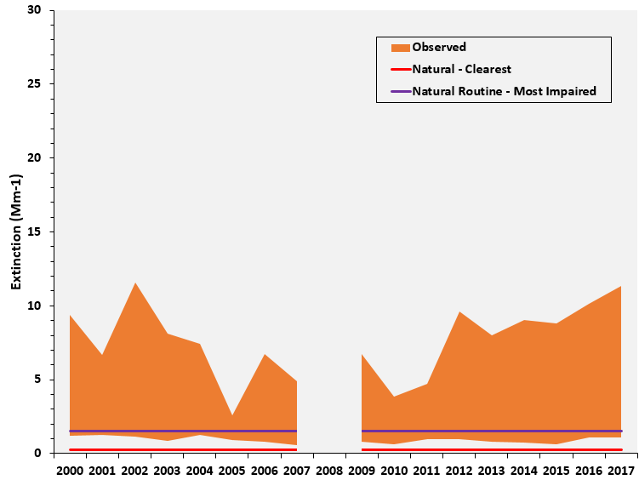
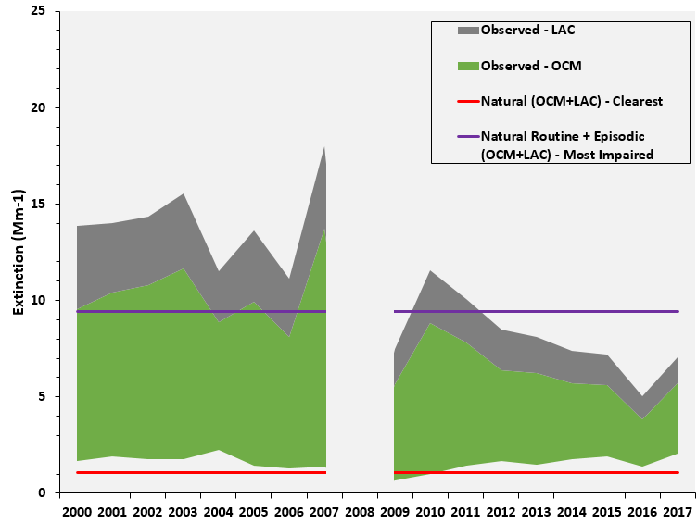
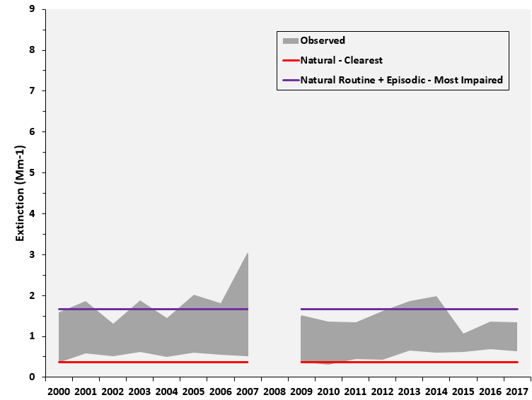
(a) Sulfate
(b) Nitrate
Lye Brook
(c) Carbonaceous
Matter
(d) Coarse Mass
SIZE
3.7
POSITIONS
0.1 - 0.05
5.31 - 0.05
0.1 - 3.75
5.31 - 3.75

Slide 25
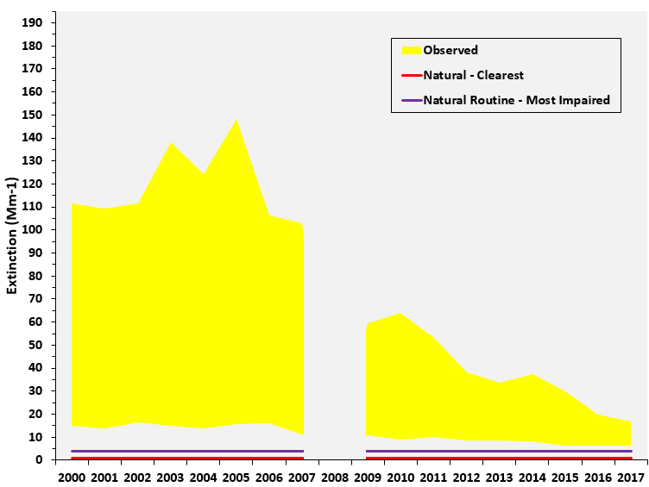
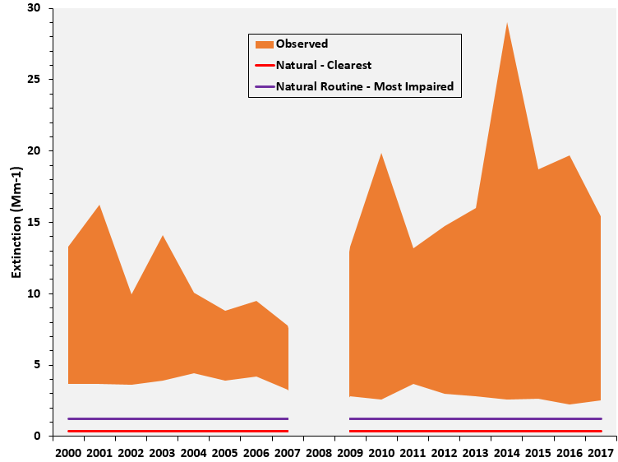
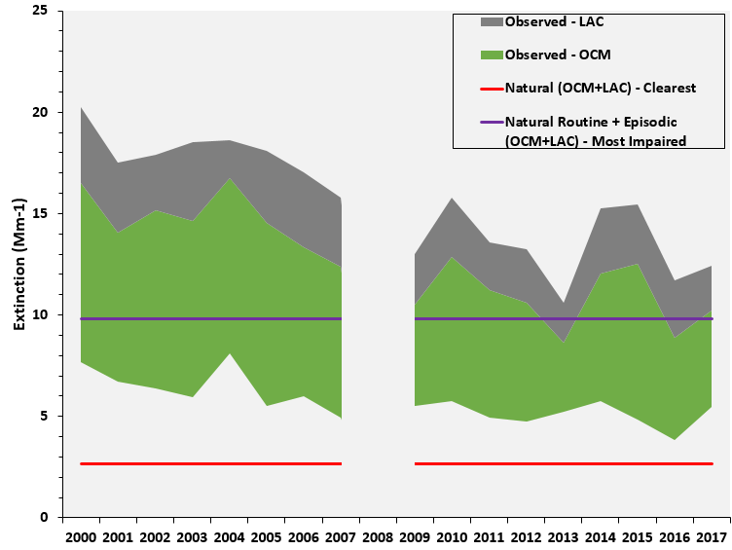
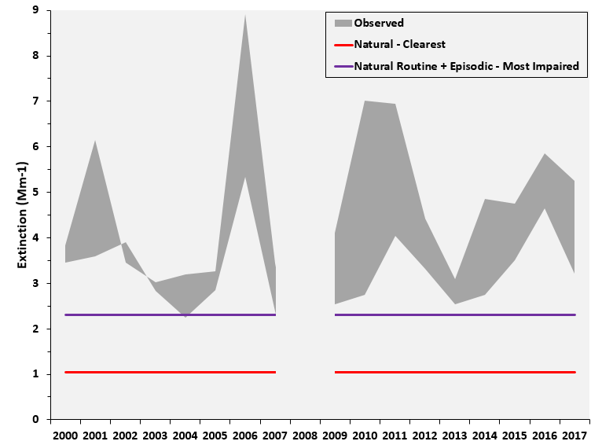
(a) Sulfate
(b) Nitrate
Brigantine
(c) Carbonaceous
Matter
(d) Coarse
Mass
SIZE
3.7
POSITIONS
0.1 - 0.05
5.31 - 0.05
0.1 - 3.75
5.31 - 3.75

Slide 26
(a) Sulfate
(b) Nitrate
Shenandoah NP
(c) Carbonaceous
Matter
(d) Coarse Mass
SIZE
3.7
POSITIONS
0.1 - 0.05
5.31 - 0.05
0.1 - 3.75
5.31 - 3.75

Slide 27
(a) Sulfate
(b) Nitrate
Dolly Sods
(c) Carbonaceous
Matter
(d) Coarse Mass
SIZE
3.7
POSITIONS
0.1 - 0.05
5.31 - 0.05
0.1 - 3.75
5.31 - 3.75

Slide 28
(a) Sulfate
(b) Nitrate
James River Face
(c) Carbonaceous Matter
(d) Coarse Mass
SIZE
3.7
POSITIONS
0.1 - 0.05
5.31 - 0.05
0.1 - 3.75
5.31 - 3.75

Slide 29
(a) 2000-04 20% Clearest Days
(b) 2013-17 20% Clearest Days
Acadia
(c) 2000-04 20% Most Impaired Days
(d) 2013-17 20% Most Impaired Days
SIZE
3.7
POSITIONS
0.1 - 0.05
6.7 - 0.05
0.1 - 3.8
6.7 - 3.8

Slide 30
(a) 2000-04 20% Clearest Days
(b) 2013-17 20% Clearest Days
Moosehorn
(c) 2000-04 20% Most Impaired Days
(d) 2013-17 20% Most Impaired Days
SIZE
3.7
POSITIONS
0.1 - 0.05
6.7 - 0.05
0.1 - 3.8
6.7 - 3.8

Slide 31
(a) 2001-04 20% Clearest Days
(b) 2013-17 20% Clearest Days
Great Gulf
(c) 2001-04 20% Most Impaired Days
(d) 2013-1720% Most Impaired Days
SIZE
3.7
POSITIONS
0.1 - 0.05
6.7 - 0.05
0.1 - 3.8
6.7 - 3.8

Slide 32
(a) 2000-04 20% Clearest Days
(b) 2013-17 20% Clearest Days
Lye Brook
(c) 2000-04 20% Most Impaired Days
(d) 2013-17 20% Most Impaired Days
SIZE
3.7
POSITIONS
0.1 - 0.05
6.7 - 0.05
0.1 - 3.8
6.7 - 3.8

Slide 33
(a) 2000-04 20% Clearest Days
(b) 2013-17 20% Clearest Days
Brigantine
(c) 2000-04 20% Most Impaired Days
(d) 2013-17 20% Most Impaired Days
SIZE
3.7
POSITIONS
0.1 - 0.05
6.7 - 0.05
0.1 - 3.8
6.7 - 3.8

Slide 34
(a) 2000-04 20% Clearest Days
(b) 2013-17 20% Clearest Days
Dolly Sods
(c) 2000-04 20% Most Impaired Days
(d) 2013-17 20% Most Impaired Days
SIZE
3.7
POSITIONS
0.1 - 0.05
6.7 - 0.05
0.1 - 3.8
6.7 - 3.8

Slide 35
(a) 2000-04 20% Clearest Days
(b) 2013-17 20% Clearest Days
Shenandoah
(c) 2000-04 20% Most Impaired Days
(d) 2013-17 20% Most Impaired Days
SIZE
3.7
POSITIONS
0.1 - 0.05
6.7 - 0.05
0.1 - 3.8
6.7 - 3.8

Slide 36
(a) 2001-04 20% Clearest Days
(b) 2013-17 20% Clearest Days
James River
(c) 2001-04 20% Most Impaired Days
(d) 2013-17 20% Most Impaired Days
SIZE
3.7
POSITIONS
0.1 - 0.05
6.7 - 0.05
0.1 - 3.8
6.7 - 3.8

Slide 37
a)
b)
c)
d)

Slide 38
a)
b)
c)
d)

