Slide 1
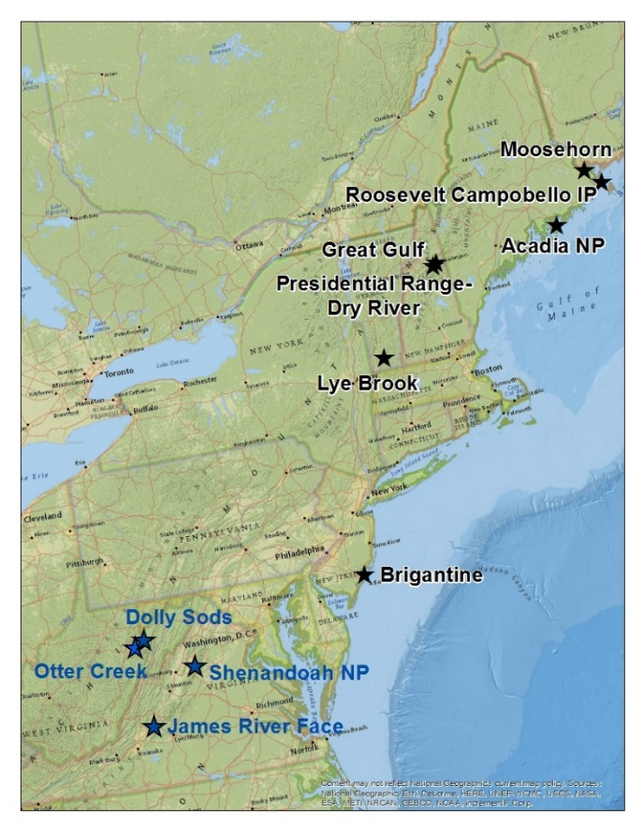
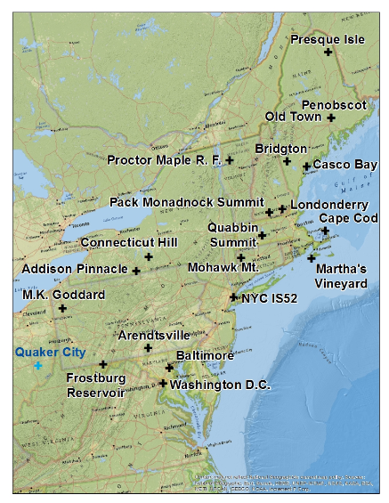

Slide 2
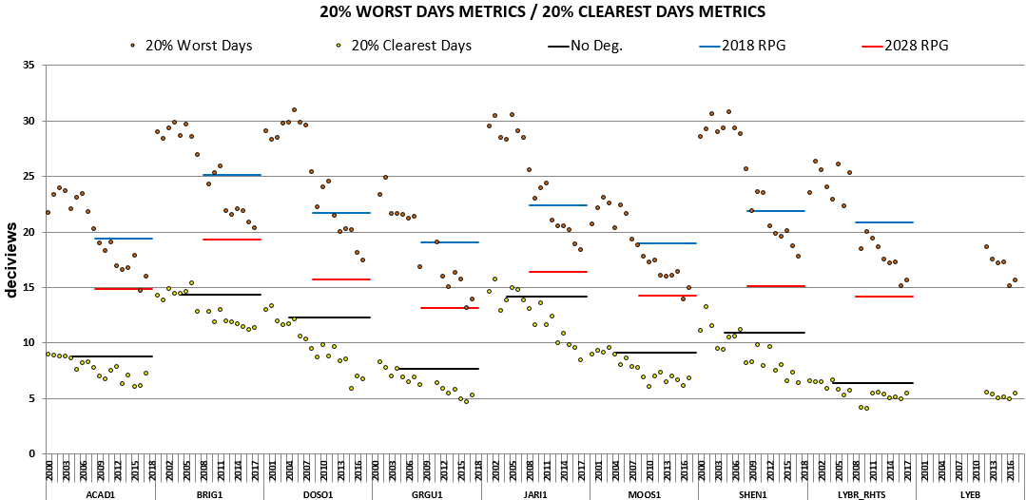

Slide 3
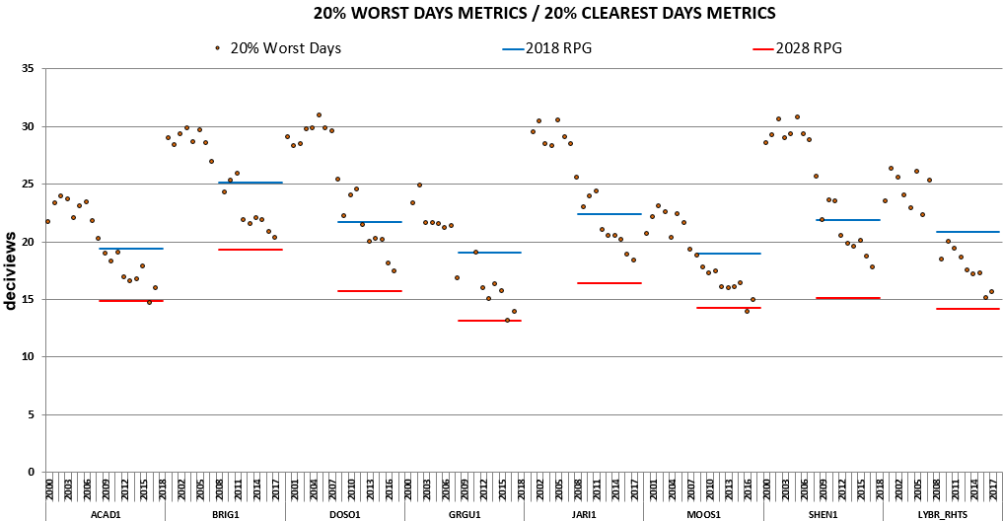

Slide 4
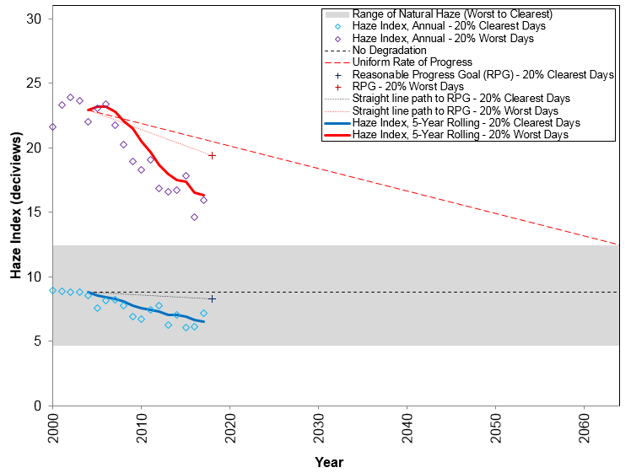
Acadia NP
Size – 7.4
Horiz – 2.0
Vert – 0.1

Slide 5
Moosehorn
Size – 7.4
Horiz – 2.0
Vert – 0.1

Slide 6
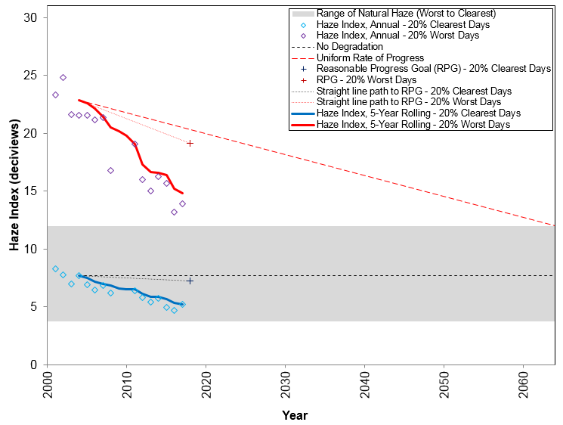
Great Gulf
Size – 7.4
Horiz – 2.0
Vert – 0.1

Slide 7
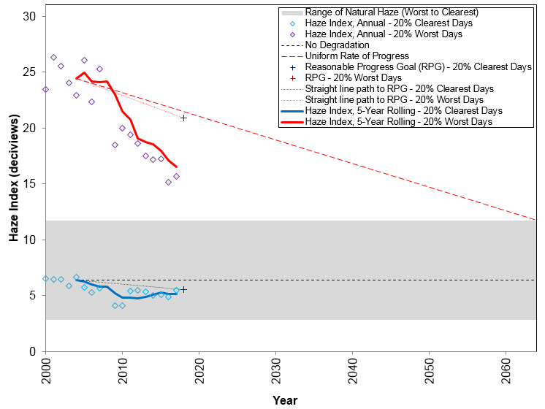
Lye Brook
Size – 7.4
Horiz – 2.0
Vert – 0.1

Slide 8
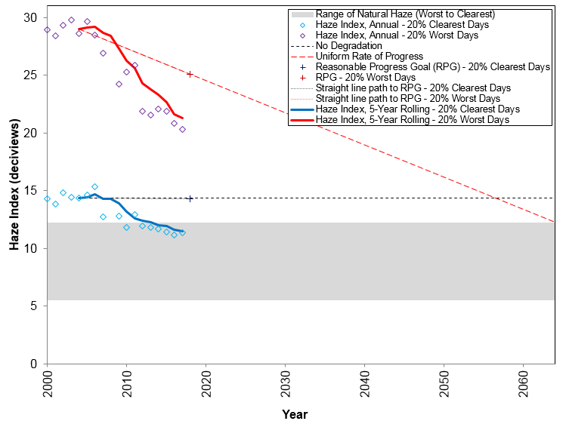
Brigantine
Size – 7.4
Horiz – 2.0
Vert – 0.1

Slide 9
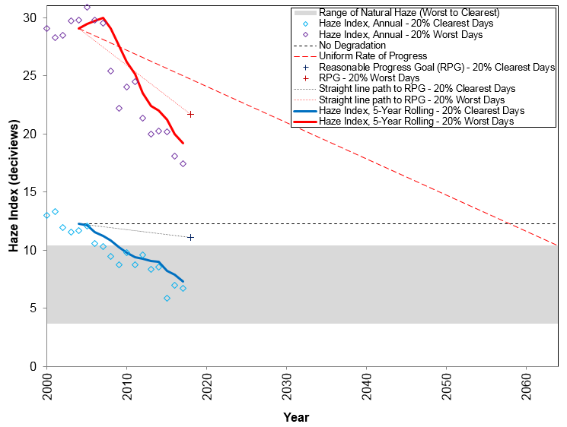
Dolly Sods
Size – 7.4
Horiz – 2.0
Vert – 0.1

Slide 10
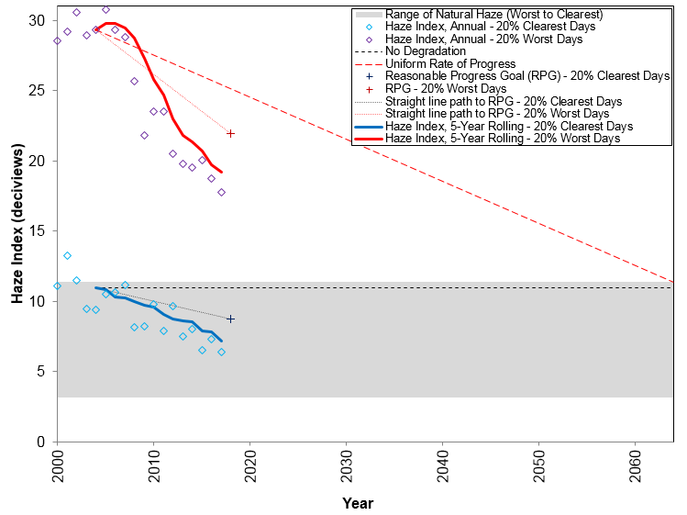
Shenandoah
Size – 7.4
Horiz – 2.0
Vert – 0.1

Slide 11
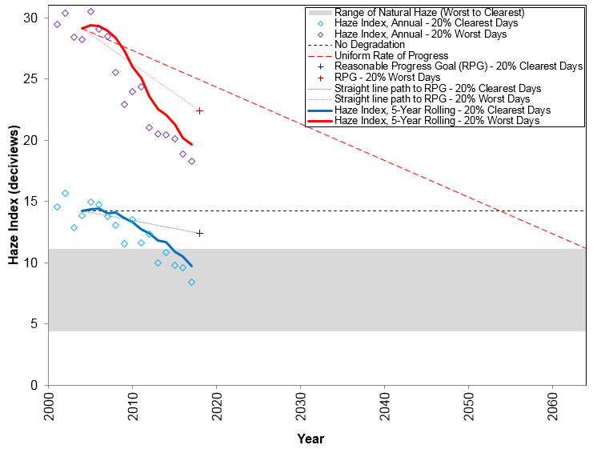
James River
Size – 7.4
Horiz – 2.0
Vert – 0.1

Slide 12
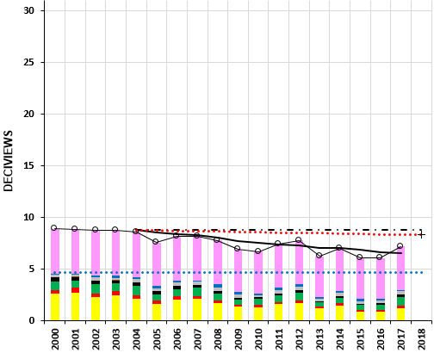
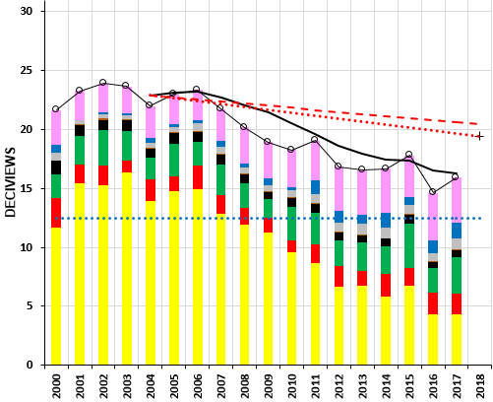
(a) 20% Clearest Days
(b) 20% Worst Days
SIZE – 5.1
Position – 0.1 / 6.40 Horizontal
- 0.1 / 0.1 Vertical
Acadia NP

Slide 13
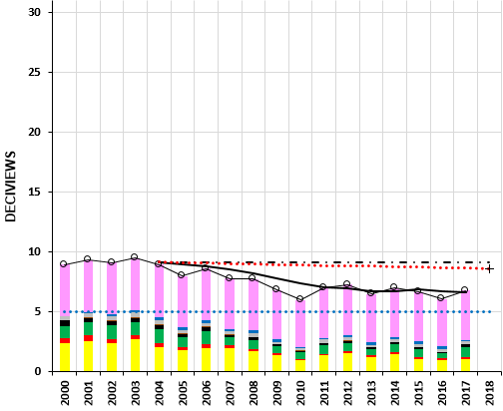
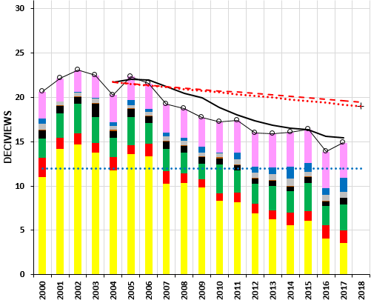
(a) 20% Clearest Days
(b) 20% Worst Days
SIZE – 5.1
Position – 0.1 / 6.40 Horizontal
- 0.1 / 0.1 Vertical
Moosehorn

Slide 14
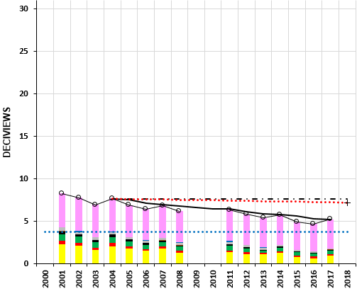
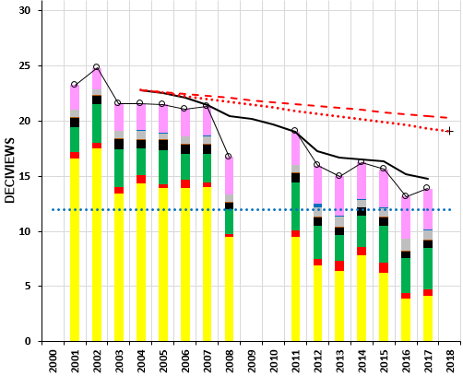
(a) 20% Clearest Days
(b) 20% Worst Days
SIZE – 5.1
Position – 0.1 / 6.40 Horizontal
- 0.1 / 0.1 Vertical
Great Gulf

Slide 15
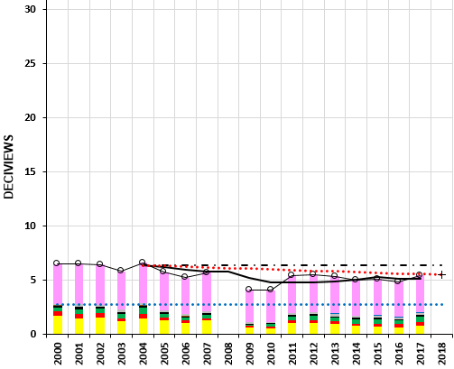
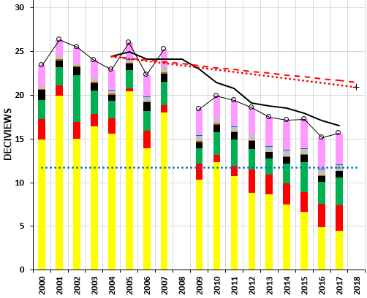
(a) 20% Clearest Days
(b) 20% Worst Days
SIZE – 5.1
Position – 0.1 / 6.40 Horizontal
- 0.1 / 0.1 Vertical
Lye Brook

Slide 16
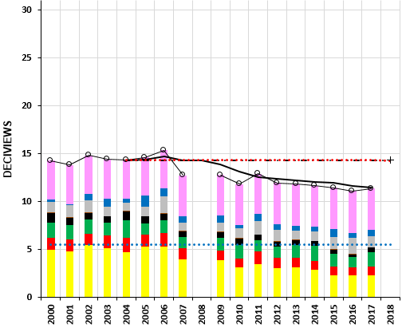
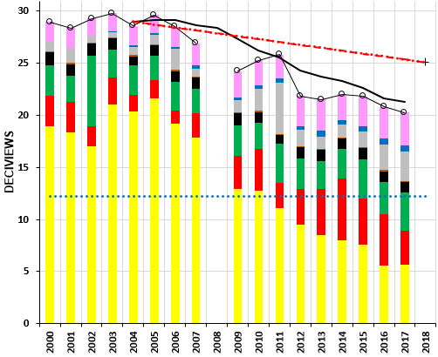
(a) 20% Clearest Days
(b) 20% Worst Days
SIZE – 5.1
Position – 0.1 / 6.40 Horizontal
- 0.1 / 0.1 Vertical
Brigantine

Slide 17
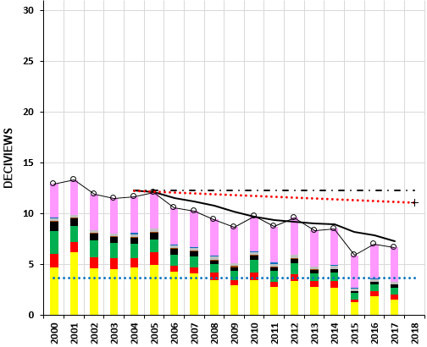
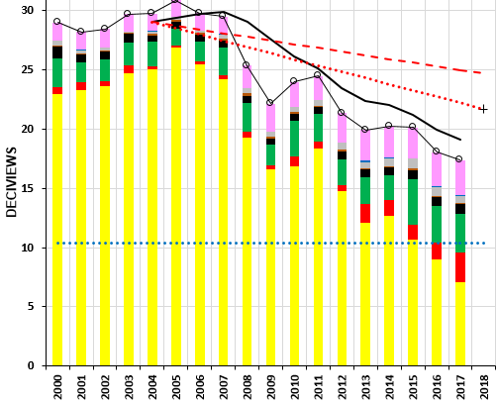
(a) 20% Clearest Days
(b) 20% Worst Days
SIZE – 5.1
Position – 0.1 / 6.40 Horizontal
- 0.1 / 0.1 Vertical
Dolly Sods

Slide 18
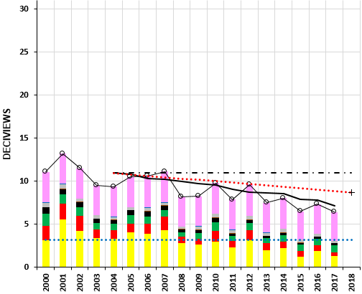
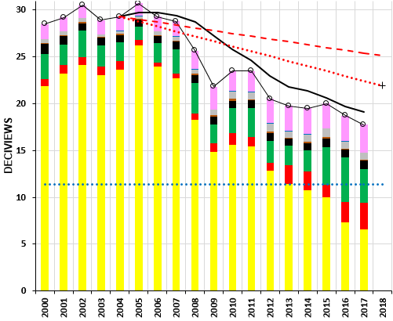
(a) 20% Clearest Days
(b) 20% Worst Days
SIZE – 5.1
Position – 0.1 / 6.40 Horizontal
- 0.1 / 0.1 Vertical
Shenandoah NP

Slide 19
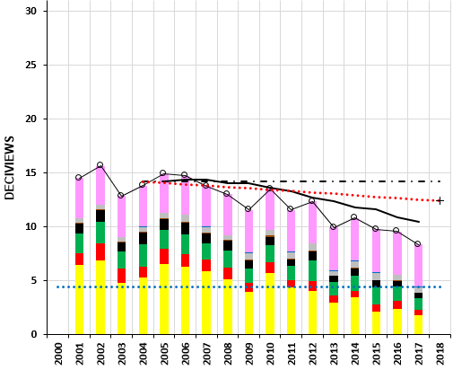
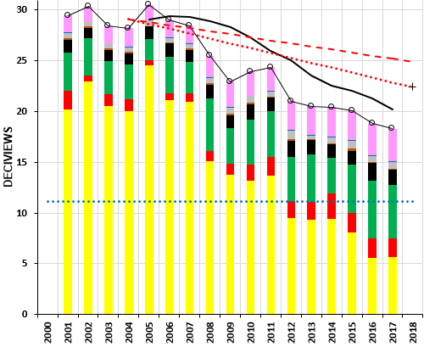
(a) 20% Clearest Days
(b) 20% Worst Days
SIZE – 5.1
Position – 0.1 / 6.40 Horizontal
- 0.1 / 0.1 Vertical
James River Face

Slide 20
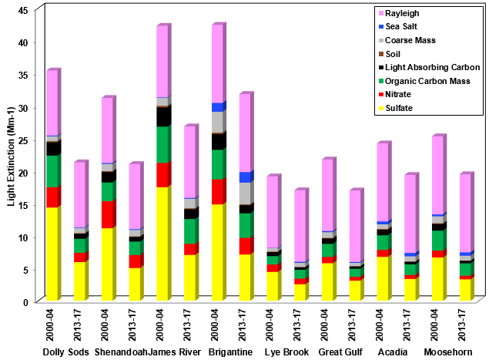
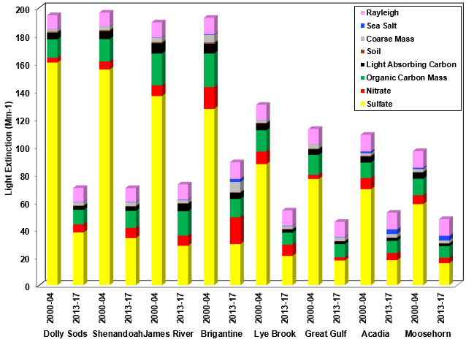
a) 20% Best Visibility Days
b) 20% Worst Visibility Days
SIZE – 4.85
Position – 0.09 / 6.65 Horizontal
- 1.15 / 1.15 Vertical

Slide 21
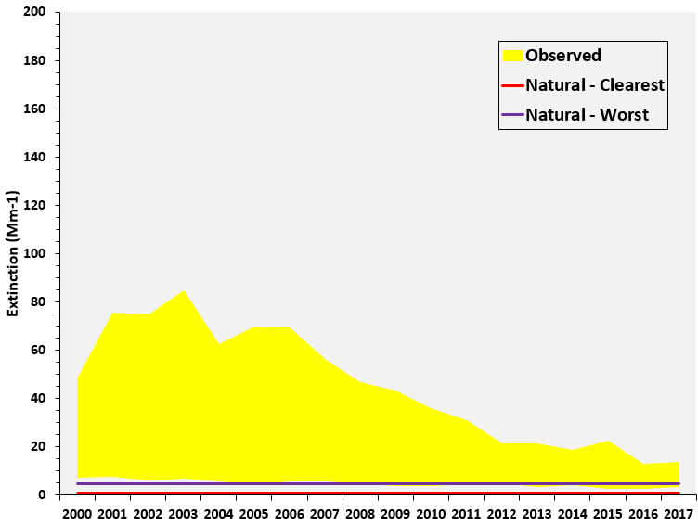
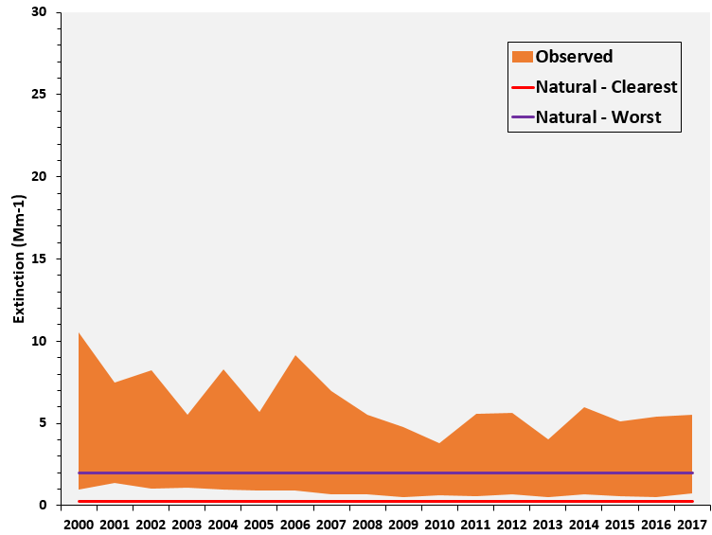
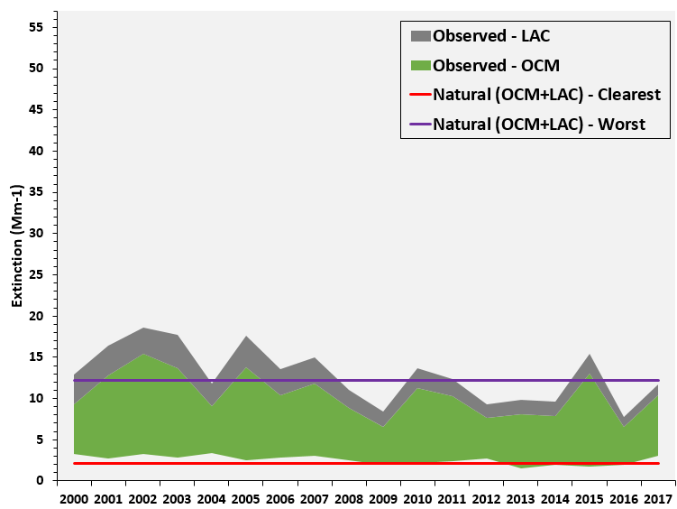
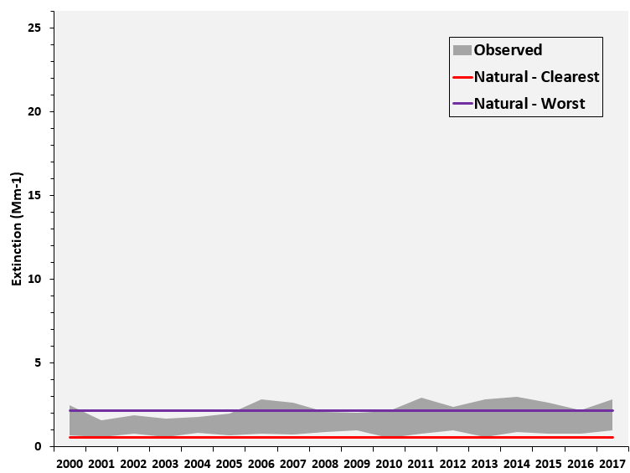
(a) Sulfate
(b) Nitrate
Acadia National Park
(c) Carbonaceous
Matter
(d) Coarse Mass
SIZE
3.7
POSITIONS
0.1 - 0.05
5.31 - 0.05
0.1 - 3.75
5.31 - 3.75

Slide 22
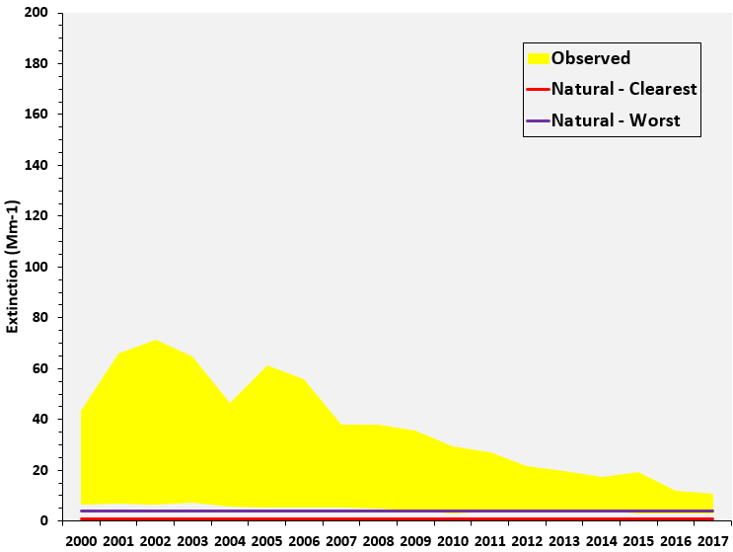
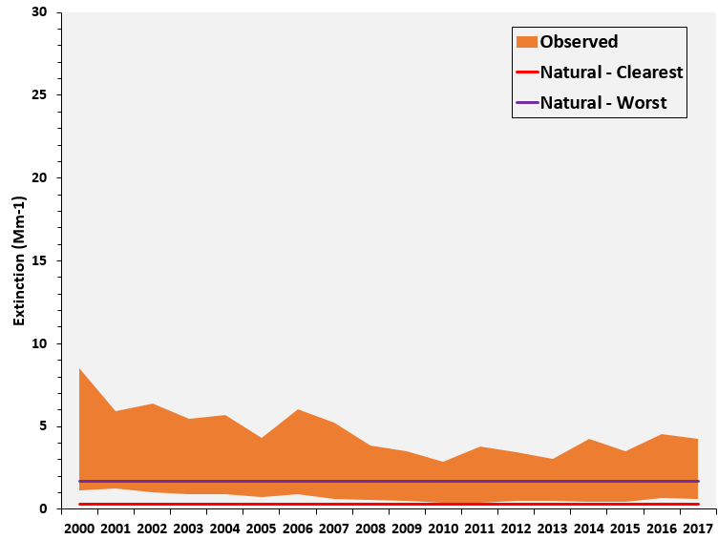
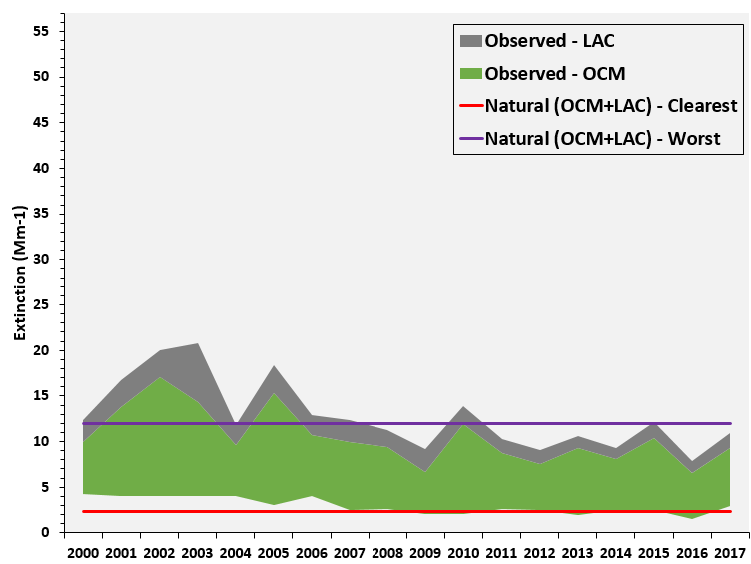
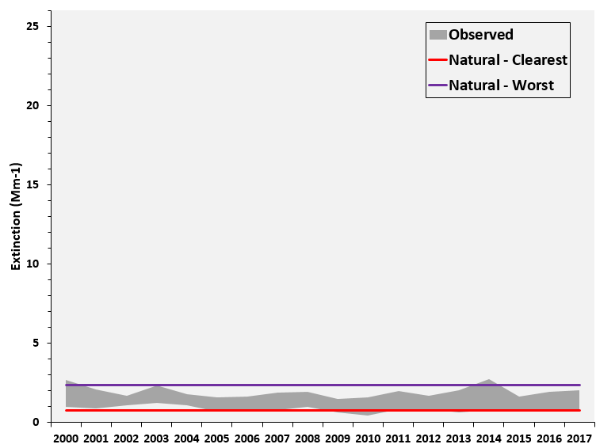
(a) Sulfate
(b) Nitrate
Moosehorn
(c) Carbonaceous
Matter
(d) Coarse Mass
SIZE
3.7
POSITIONS
0.1 - 0.05
5.31 - 0.05
0.1 - 3.75
5.31 - 3.75

Slide 23
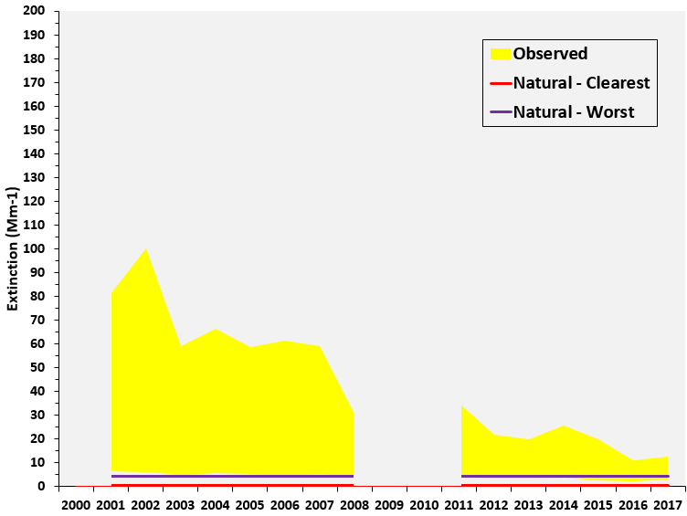
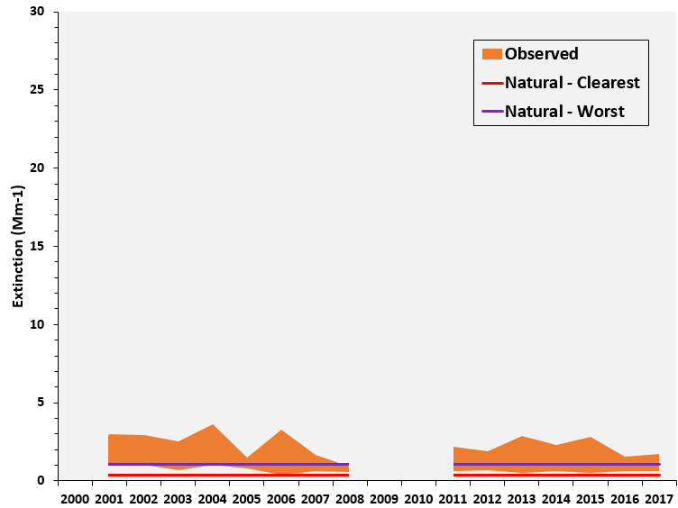
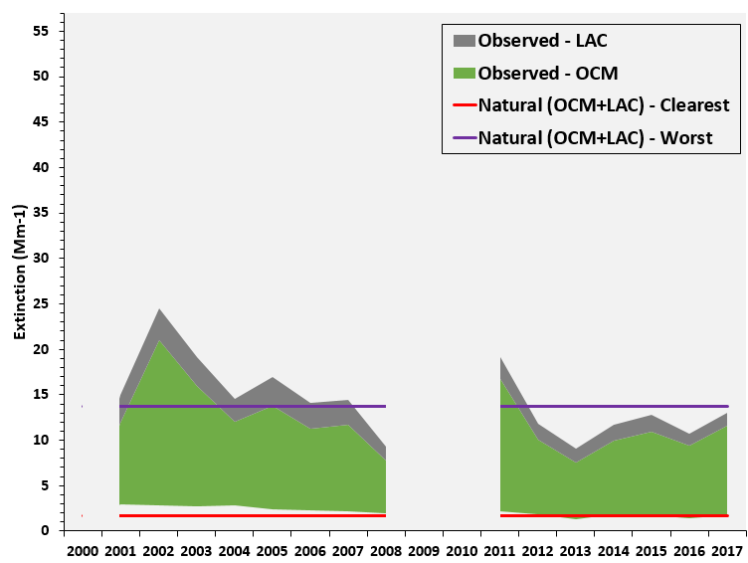
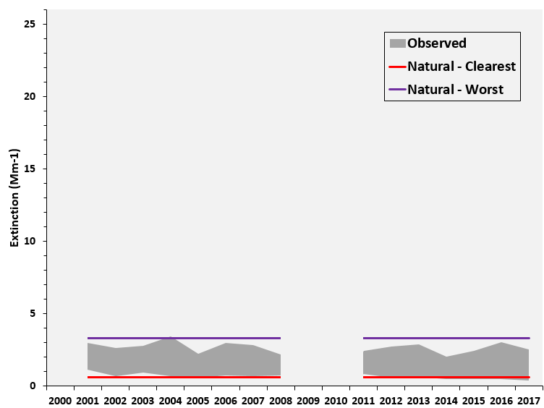
(a) Sulfate
(b) Nitrate
Great Gulf
(c) Carbonaceous
Matter
(d) Coarse Mass
SIZE
3.7
POSITIONS
0.1 - 0.05
5.31 - 0.05
0.1 - 3.75
5.31 - 3.75

Slide 24
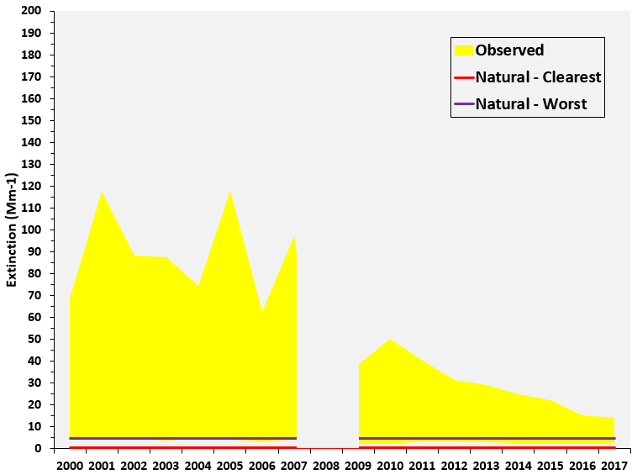
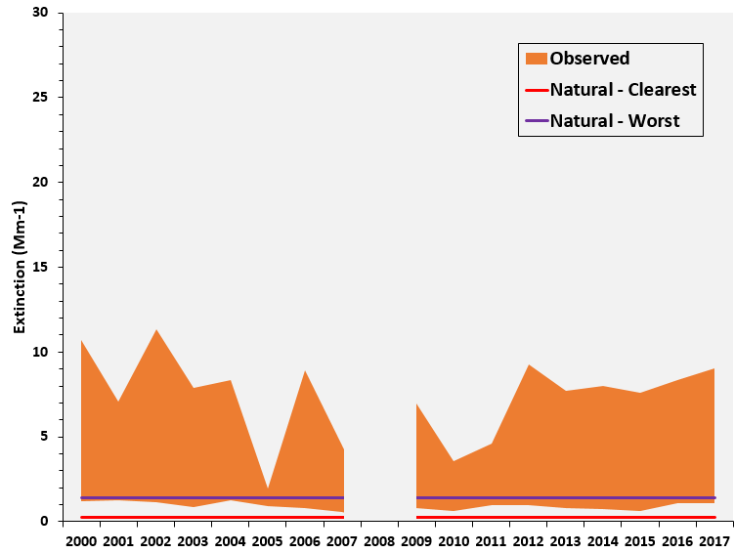
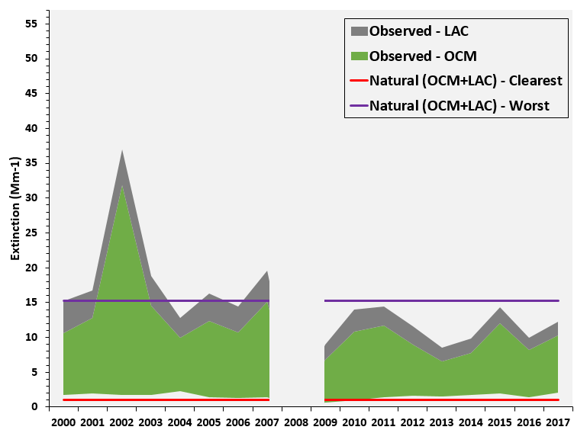
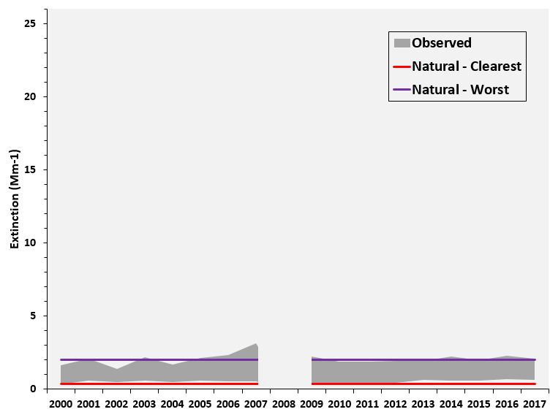
(a) Sulfate
(b) Nitrate
Lye Brook
(c) Carbonaceous
Matter
(d) Coarse Mass
SIZE
3.7
POSITIONS
0.1 - 0.05
5.31 - 0.05
0.1 - 3.75
5.31 - 3.75

Slide 25
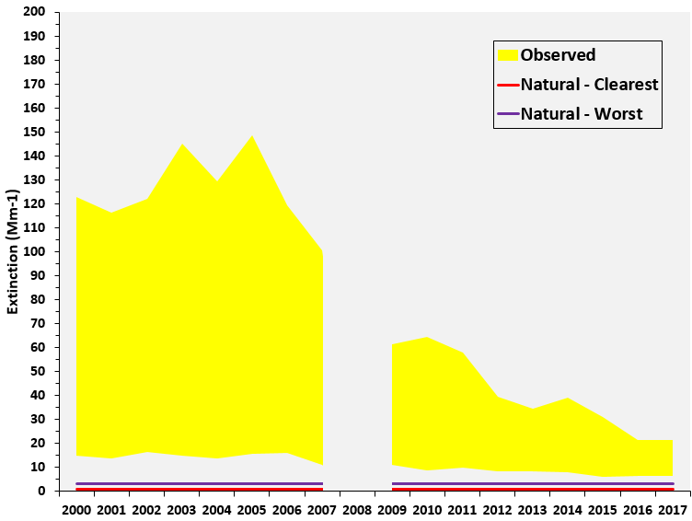
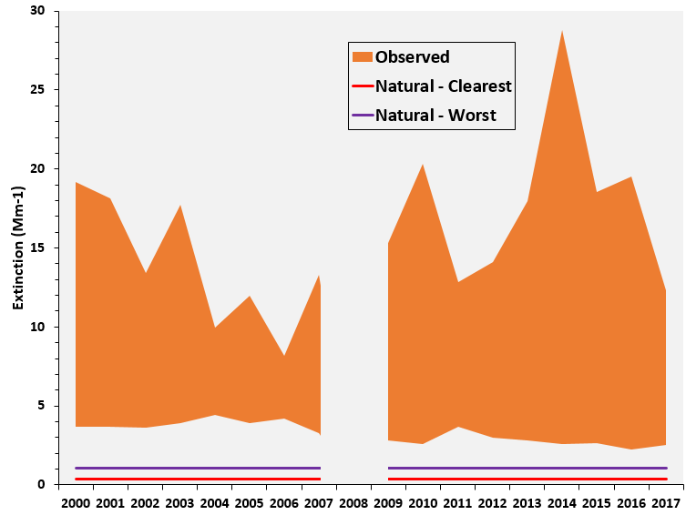
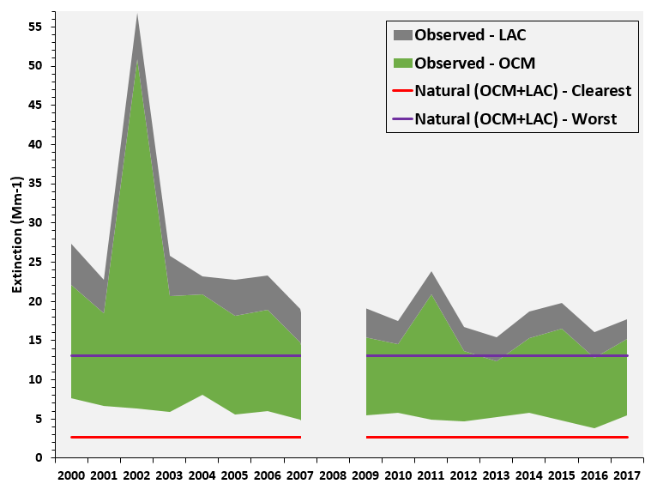
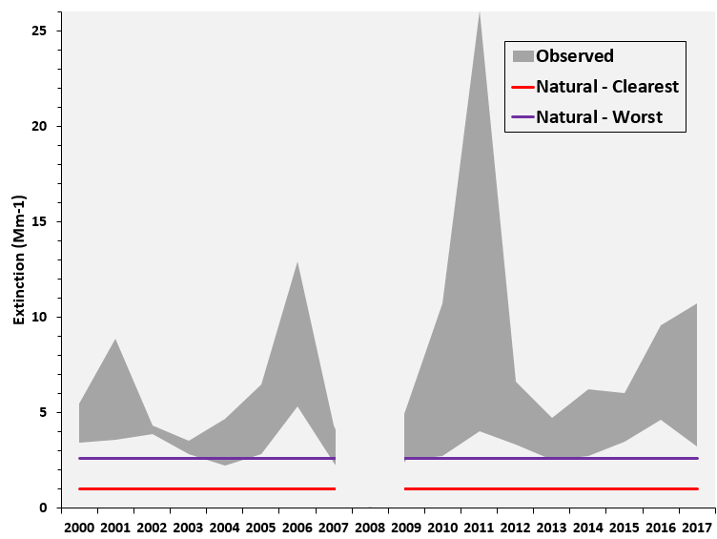
(a) Sulfate
(b) Nitrate
Brigantine
(c) Carbonaceous
Matter
(d) Coarse Mass
SIZE
3.7
POSITIONS
0.1 - 0.05
5.31 - 0.05
0.1 - 3.75
5.31 - 3.75

Slide 26
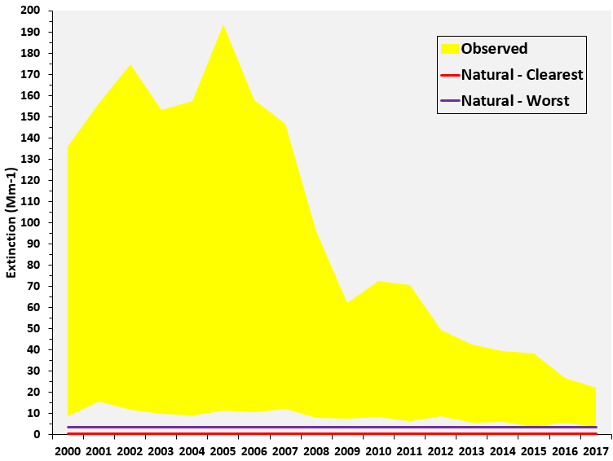
(a) Sulfate
(b) Nitrate
Shenandoah NP
(c) Carbonaceous
Matter
(d) Coarse Mass
SIZE
3.7
POSITIONS
0.1 - 0.05
5.31 - 0.05
0.1 - 3.75
5.31 - 3.75

Slide 27
(a) Sulfate
(b) Nitrate
Dolly Sods
(c) Carbonaceous
Matter
(d) Coarse Mass
SIZE
3.7
POSITIONS
0.1 - 0.05
5.31 - 0.05
0.1 - 3.75
5.31 - 3.75

Slide 28
(a) Sulfate
(b) Nitrate
James River Face
(c) Carbonaceous
Matter
(d) Coarse Mass
SIZE
3.7
POSITIONS
0.1 - 0.05
5.31 - 0.05
0.1 - 3.75
5.31 - 3.75

